Slide 1
Robin Mack
Director, Telework Technical Assistance
October 21, 2015

Slide 2
Telework!VA
Technical Assistance Program
Technical Assistance Program through VDOT & DRPT partnership
Available to Northern Virginia employers
Provides FREE technical assistance to implement or expand a telework program
Helps manage traffic congestion and reduce transportation emissions

Slide 3
Technical Assistance
Help businesses understand telework as a business management/operations model
Develop Telework Policies and Agreements
Incorporate with Continuity of Operations (COOP) plan
Implement disciplined/proven approach including identifying positions suited for telework
Train Managers and Employees
Develop Budgets
Assist with a Technology Plan

Slide 4
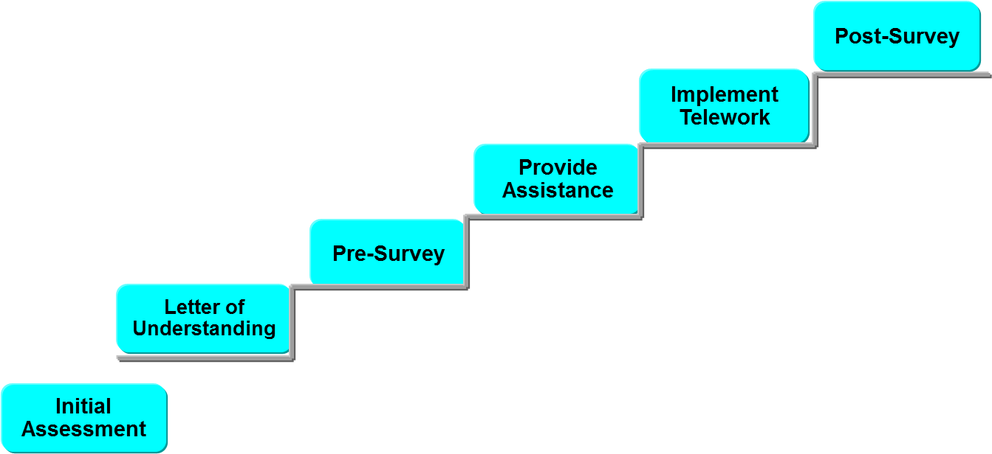
Technical Assistance

Slide 5
Telework Tax Credit
Up to $50,000 credit per employer per calendar year
Up to $20,000 for a telework assessment
Up to $1,200 per employee for telework expenses
(credit issued to company)
Home Based Businesses and non-profits are not eligible

Slide 6
Telework Tax Credit
Critical Deadlines
Form TEL-1 must be filed between September 1 and October 31.
Tentative approval from the Virginia Department of Taxation by December 31.
A signed Telework Agreement must be on file for employee on or after July 1, 2012 but before January 1, 2017.
Form TEL-2 must be submitted by April 1 of the year following the calendar year that the eligible expenses were incurred.

Slide 7
Telework Benefits
Business Continuity
Recruit and Retain Highly-Skilled Employees
Increased Productivity
Work-life Balance
Reduced Absenteeism
Reduced Overhead Costs
Environmental Impacts

Slide 8
Contact Us
Robin Mack
Director, Telework Technical Assistance
rmack@teleworkva.org
P: 571.418.8135
Ext 700
http://www.teleworkva.org/nova/
Sarah McGowan
Manager, Business/Community Outreach
smcgowan@teleworkva.org
P: 571.418.8135
Ext 701

