Slide 1
Presentation to DATA on VTrans 2040 / HB2
October 21, 2015

Slide 2
Life Cycle of a Candidate Project
How it’s planned.
How it’s scored.
How it’s funded.
Notes:
We are facing many changes with how projects get built. We are here to assist local governments, staff, and the public in understanding the different pieces of new policy and legislation which will guide transportation project planning, scoring, selection, and funding in the Commonwealth beginning with the Six-Year Improvement Program on July 1, 2016.
The vision document, planning, and project scoring outreach which is currently underway, will not only influence, but will determine how projects ultimately make their way from an idea, to an actual funded transportation project.

Slide 3
How it’s planned. VTrans2040
VTRANS 2040 serves two functions, and produces two independent, but connected documents.
The VTRANS 2040 Vision Document.
The VTRANS 2040 Multimodal Transportation Plan (VMTP)
The VMTP will identify future needs for all modes of travel across the Commonwealth (used to screen candidate HB2 projects)
The policy and recommendations of the plan will focus on corridors of statewide significance, identified regional networks, local designated growth areas and safety.
Notes:
The Virginia Office of Intermodal Planning and Investment (OIPI) has recently released the draft Vision document for public comment and will be developing the VMTP over the next 12 months, incorporating both locality and public outreach sessions.

Slide 4
Corridors of Statewide Significance
(CoSS)
Approved by the CTB
Demonstrate the following characteristics:
Multiple modes and/or an extended freight corridor
Connection among regions, states and/or major activity centers
High volume of travel
Unique statewide function and/or fulfillment of statewide goal
Includes parallel/connecting facilities, rail lines, ports, airports, etc (not just the Interstates)

Slide 5
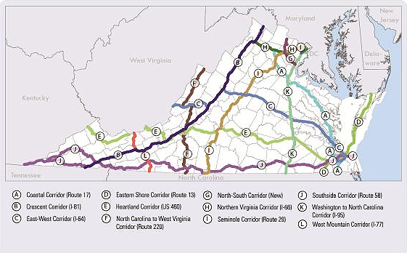
Virginia CoSSs

Slide 6
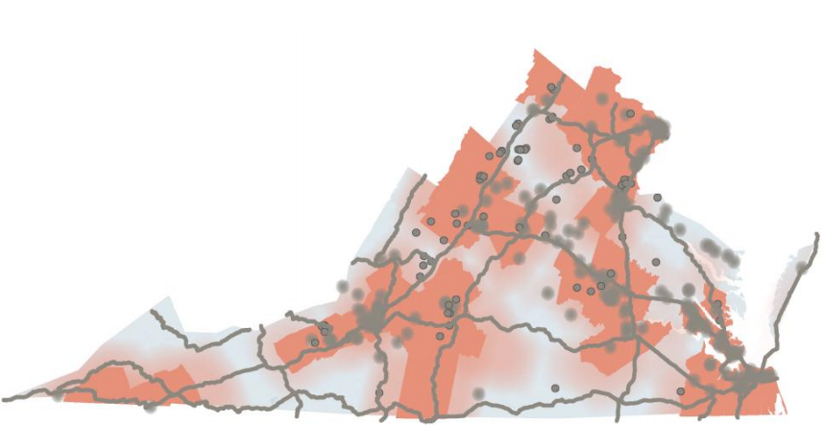
Regional Networks
Defined as:
Jurisdictions that are included either in whole or in part within MPO Planning Area Boundaries
Any additional element of the transportation system that is connected to the MPO area and deemed critical to the MPO

Slide 7
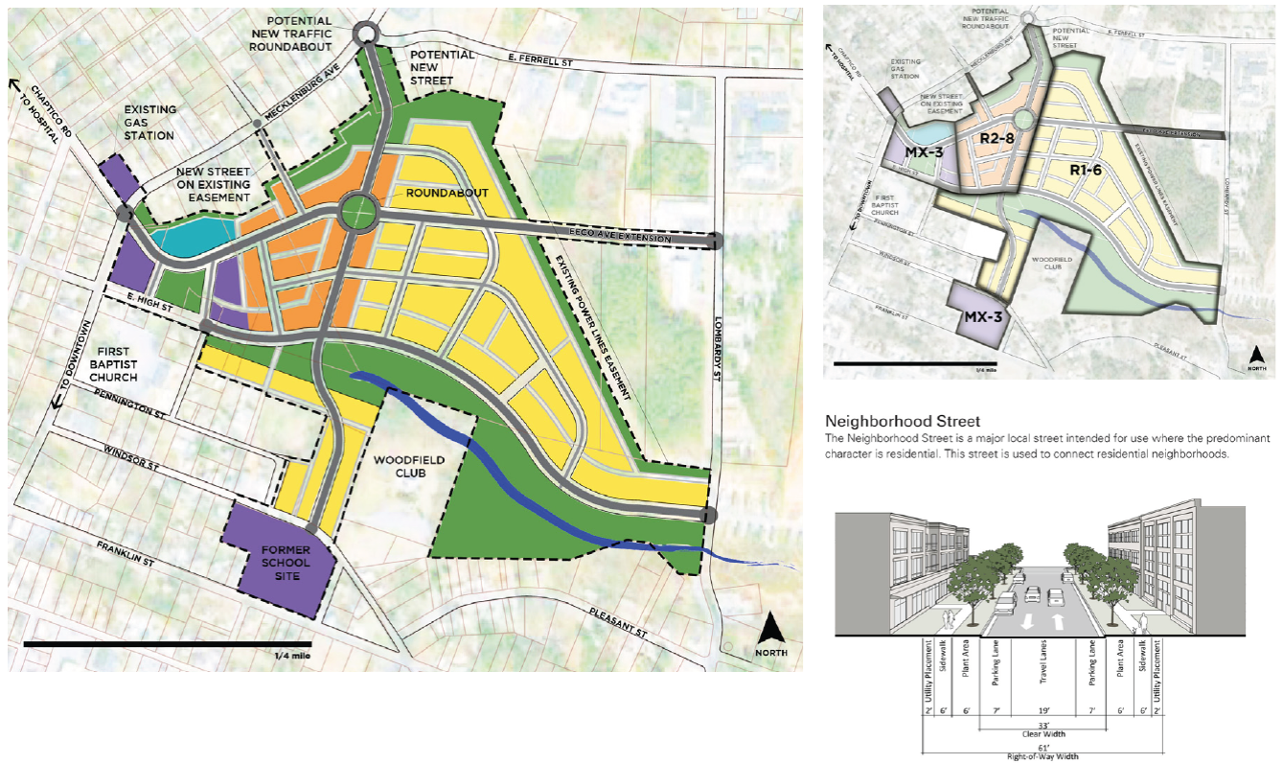
Urban Development Areas
UDAs
Areas voluntarily designated by local governments as prime areas for future economic growth pursuant to 15.2-2223.1
Must reflect transportation- efficient land use principles including
Mixed-use land use
Interconnected streets
Moderately compact growth

Slide 8
How it’s scored. HB 2
House Bill 2 (HB 2) is a new state law that requires the implementation of a process for prioritizing projects
Some types of projects and funding are exempt from HB 2
Congestion Mitigation and Air Quality
Highway Safety Improvement Program
Transportation Alternatives
Revenue Sharing
Secondary/Urban Formula Funds
Regional funds for NOVA, Hampton Roads
Projects not exempt will follow prescribed process to determine eligibility for funding and ultimate rating as compared to other projects submitted.
HB2 process currently under development
Notes:
HB2 requires us to score certain projects. The law requires us to use 5 Factor areas for scoring – land use is also required for areas over 200k in population. VDOT and DRPT are continuing efforts to develop the process for prioritizing projects. We have hosted multiple outreach sessions to obtain feedback on the measures and the process. Last month, the Deputy Secretary gave an overview of the HB2 process at the March CTB meeting and draft Policy Guide was issued for public comment. We are now hosting public hearings across the state providing opportunities for you to comment on both the draft SYIP and the draft Policy Guide. I hope we will hear from you tonight. Based on feedback received from these meetings and on-line feedback revisions to the draft Policy Guide will be presented to the CTB at their May meeting with final approval by the CTB at the June meeting.

Slide 9
Screening
All projects submitted for the HB2 process must pass through an initital screening
VTrans 2040 assesses the State’s transportation needs on these scales:
Corridors of Statewide Significance (COSS) – interregional travel market
Regional Networks – intraregional travel market
Urban Development Areas (UDAs) – local activity center market
Safety
Consistent with VTrans 2040, projects will be screened according to criteria established for each scale
Notes:
Urban Development Areas (UDAs) are a statewide designation for compact areas where jurisdictions intend to concentrate future population growth and development.
Regional Networks – potentially to primary arterials.

Slide 10
Entities Eligible to Submit Projects
Project Type | Regional Entity (MPOs/PDCs) | Locality (Counties/Cities/Towns) | Public Transit Agencies
Corridor of Statewide Significance | Yes | Yes, with a resolution of support from relevant regional entity | Yes, with a resolution of support from relevant regional entity
Regional Network | Yes | Yes | Yes, with a resolution of support from relevant entity
Urban Development Area | No | Yes | No

Slide 11
Scoring: HB2 Factor Areas
The process of scoring includes 5 factor areas:
Congestion Mitigation
Economic Development
Accessibility
Safety
Environmental Quality
A Land Use factor is required for areas over 200k in population
Within each factor area, measures were identified with the goal that they:
Analyze what matters to people and have meaningful impact
Ensure fair and accurate benefit-cost analyses
Are both transparent and understandable
Work for both urban and rural areas
Work for all modes of transportation
Minimize overlap between measures

Slide 12
Scoring: HB2 Measures
Safety Factor
50% of score – reduction in the number of fatalities and severe injuries
50% of score – reduction in the rate of fatalities and severe injuries per 100 million vehicle miles traveled
Congestion Factor
50% of score – decrease in the person hours of delay in the corridor
50% of score – increase in the peak-period person throughput in the corridor

Slide 13
Measures (continued)
Accessibility Factor
60% of score – increase in the cumulative access to jobs accessible within 45 minutes in a region (60 minutes for transit)
20% of score – increase in the cumulative job accessibility for disadvantaged populations within 45 minutes (60 minutes for transit)
20% of score – increase in the access to travel options in a corridor
Environmental Factor
50% of score – degree to which a project is likely to improve air quality and reduce greenhouse gas emissions
50% of score – potential of project to minimize impact on natural and cultural resources.

Slide 14
Measures (continued)
Economic Development Factor
60% of score – project consistency with regional and local economic development plans and policies
20% of score – project potential to enhance access to critical intermodal locations, interregional freight movement and/or freight intensive industries
20% of score – improvement in travel time reliability
Land Use Coordination Factor
100% of score – degree to which project will support mixed use development, in-fill development and corridor access management policies

Slide 15
Weighting
Score will be based one of several weighting frameworks depending on location in Commonwealth – NOVA is in category A

Slide 16
Sample Project Scoring
Project "A" - located in Typology A | Congestion |  | Safety |  | Accessibility |  |  | Environ. |  | Econ. Dev. |  |  | Land Use
 | Throughput | Delay | F &SI Crashes | F &SI Crash Rate | Access to Jobs | Access to Jobs (Dis. Pop.) | Multimodal Choices | Air Quality | Natural & Cult. Resources | Economic Development | Goods Movement | Travel Tim Reliability | Trans. Efficient Land Use
Measure Score | 62 | 48 | 20 | 32 | 10 | 20 | 10 | 38 | 28 | 30 | 20 | 20 | 17
Measure Weight | 50% | 50% | 50% | 50% | 60% | 20% | 20% | 50% | 50% | 60% | 20% | 20% | 100%
Weighted Measure Score | 31 | 24 | 10 | 16 | 6 | 4 | 2 | 19 | 14 | 18 | 4 | 4 | 17
Raw Factor Score | 55 |  | 26 |  | 12 |  |  | 33.0 |  | 26.0 |  |  | 17
Factor Weighting (Typ. A) | 45% |  | 5% |  | 15% |  |  | 10% |  | 5% |  |  | 20%
Weighted Factor Score | 24.8 |  | 1.3 |  | 1.8 |  |  | 3.3 |  | 1.3 |  |  | 3.4
Project Score | 35.9
Total Project Cost | $20,000,000
Score Divided by Total Cost | 18.0
HB2 Cost | $10,000,000
Score Divided by HB2 Cost | 35.9

Slide 17
Status and Next Steps
Application period closed September 30, 2015 at 11:59pm
All 9 VDOT Districts are currently reviewing applications as part of “Validation” process.- expected to conclude this month.
All applications will be screened by the Office of Intermodal Planning and Investment against VTrans 2040 Needs
Scoring of projects will follow and continue through December.
Results will be presented to CTB for consideration in January 2016, and ultimately projects selected will be incorporated into SYIP
Notes:
319 applications received statewide
46 applications received in NOVA: 5 transit, 41 highway and/or bicycle and pedestrian projects

