Slide 1
Fairfax Connector
Riders Advisory Committee
(RAC)
Board Transportation Committee
March 17, 2015
Stuart Boggs
Fairfax County Department of Transportation

Slide 2
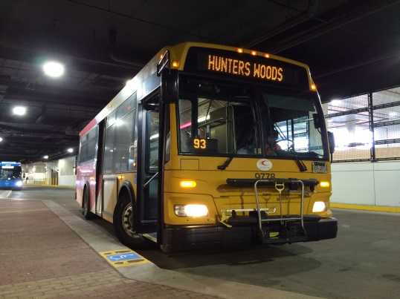
Issue
At the June 4, 2013, Board of Supervisors Meeting, during the approval for Fairfax Connector’s Silver Line bus service plan, Supervisor Hudgins asked that the Board refer the issue (of community outreach) to the Transportation Committee meeting to explore the establishment of a Transit Riders Advisory Group to provide input on transit issues

Slide 3

Research
Staff researched various transit riders advisory groups including:
  WMATA: Riders Advisory Council (RAC)
  Arlington County (ART): Transit Advisory Committee (TAC)
  Charlotte, NC (CATS): Transit Services Advisory Committee (TSAC)
Reviewed other Fairfax advisory committees
Reviewed by-laws, guidelines, resolutions, procedures, roles, responsibilities, membership composition, and meeting frequency

Slide 4
Research
Reviewed other Fairfax County advisory Committees
  Transportation Advisory Commission (TAC)
  Disability Services Board (DSB)
Attended meetings, conducted interviews
  WMATA RAC
    Met with WMATA RAC coordinator to seek insights into the operation of the committee
  Fairfax County Transportation Advisory Committee (TAC)
    Attended meetings of the TAC to discuss RAC concept and solicit the group’s input

Slide 5
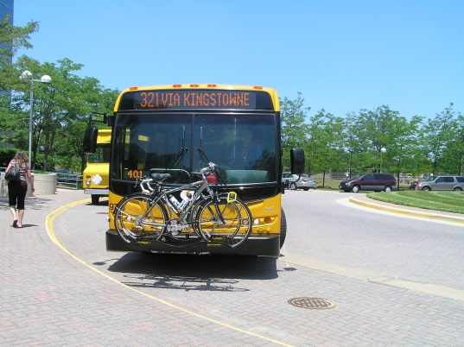
Research
Typical Purpose: A committee that can advise the governing body on transit service from the riders perspective
  Service plans
  Communications and outreach
  Transit policies and procedures
  Performance standards
  Emerging issues in public transportation
  Feedback on Connector service

Slide 6
Research
Typical Composition: Varies
  Depends on governance
  One member for each district/jurisdiction that is on the transit board
  Members are typically transit riders of their local system
  Body’s size can range from 13 to 21 members
  Bodies usually include a representative from the disabled community
  Other representatives can include at-large or area specific, such as north and south county

Slide 7
Transportation Advisory Commission
Consultation
The Board directed staff to seek input from the Transportation Advisory Commission (TAC)
At the May 5, 2014, meeting of the TAC, staff presented a series of questions regarding the nature and role of the RAC to the Commission and asked for input
Staff subsequently met with the TAC on August 19, 2014, and September 16, 2014, to review and discuss the Commission’s response to the questions

Slide 8
Transportation Advisory Commission
Consultation
Summary of commissioners response to first question: Is there a role for the RAC?
  Name of proposed RAC should reflect service type (i.e. Fairfax Connector) that will be the focus of the group. This reflects the fact that WMATA currently maintains a riders advisory council (RAC) for Metrorail and Metrobus services
  Differing Connector service levels and availability across the county may make it challenging to identify a qualified representative from each magisterial district

Slide 9
Transportation Advisory Commission
Consultation
Summary of commissioners response to second question: How would the RAC’s purpose differ from the TAC’s purpose?
  Narrowly define RAC’s role to operational matters affecting Fairfax Connector to avoid overlap with TAC’s role
    TAC is more broadly focused on all transportation issues affecting the county
    RAC would be focused on assessing and improving current bus services from the viewpoint of the rider

Slide 10
Transportation Advisory Commission
Consultation
Summary of commissioners response to third question: How would the RAC and TAC interact?
  Initial TAC suggestion of folding this role into the existing TAC, but subsequent discussion argued for a separate bus riders group that would focus on service issues
  Open invitation to TAC and RAC representatives to attend each other’s meetings as needed to share information
  RAC input/recommendations could be forwarded to TAC for their consideration as part the overall county transportation scheme

Slide 11
Proposal
If the Board believes a Riders Advisory Committee would be a valuable tool to provide advice on Fairfax Connector service, staff recommends the following:
Name: Fairfax Connector Rider’s Advisory Committee (RAC)
Mission: Provide input on customer service and operational issues that affect Fairfax Connector bus service
Purpose: Represent consumers and residents perspective and improve bus operations and customer service

Slide 12
Proposal
13 members
  Ten, one from each magisterial district plus one at-large citizen representative appointed by Board Chairman
  One nominated by Disabilities Service Board
  One Non-rider nominated by Fairfax Federation of Citizens Association
  One Non-rider nominated by Fairfax County Chamber of Commerce
Recruitment coordinated by FCDOT Transit Services staff
  Membership should be representative of the demographics of Fairfax County and reflective of Title VI requirements [MINORITY REPRESENTATION ON PLANNING AND ADVISORY BODIES. Title 49 CFR Section 21.5(b)(1)(vii)]

Slide 13
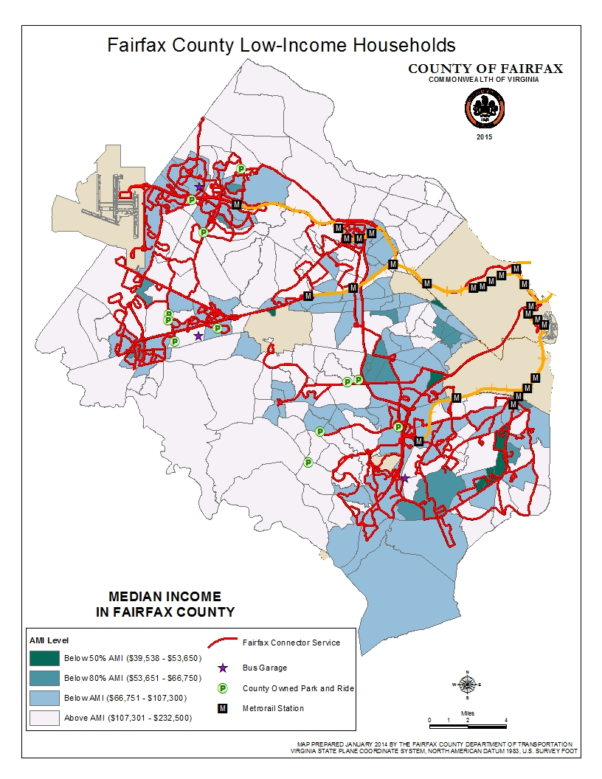
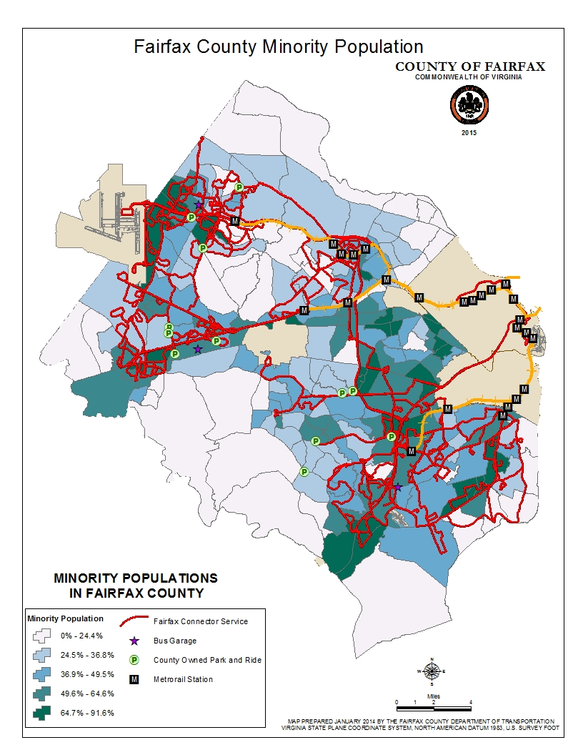
Demographics

Slide 14
RAC Appointments
On-line application process
  On-line form (www.fairfaxconnector.com) would identify applicants by magisterial district
  Ask Supervisors to encourage potential candidates to apply for available slots on the RAC
  FCDOT Transit Services staff would vet the applications received
  Eligible applicants from each magisterial district would be forwarded to the respective Supervisor for their review
  Supervisor would recommend their candidate nomination to the Board
  At-large member of RAC to be selected by Board Chairman

Slide 15
RAC Appointments
Disabilities Service Board, Fairfax Federation of Citizens Association, and Fairfax County Chamber of Commerce – will each nominate a candidate
  Candidates vetted by FCDOT Transit Services staff and ratified by the Board of Supervisors

Slide 16
RAC Appointments
RAC members will be appointed to staggered two year terms.
  Initial appointments will take this into account by appointing seven members to two year terms, and six members to three year terms
RAC officers will include a chairperson and vice-chairperson.
  Officers will be nominated and elected by the RAC

Slide 17
Recommended Action
Staff believes a RAC can provide valuable input that will lead to improved Fairfax Connector service and recommends the Board consider, at a subsequent regular meeting, adoption of a resolution for the establishment of a 13 member Fairfax Connector Riders Advisory Committee. The committee will be governed by proposed by-laws to be included in the Board meeting item

Slide 18
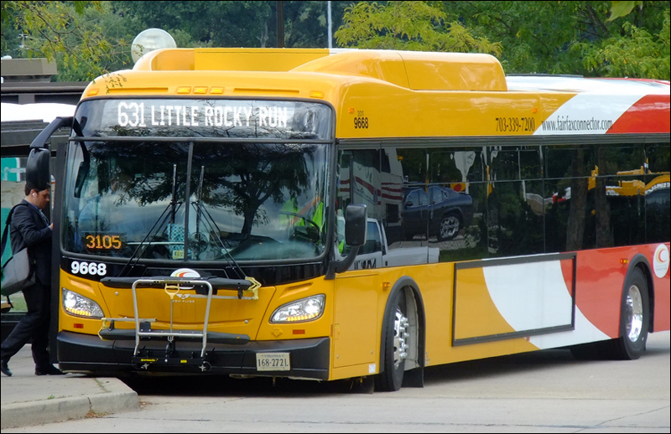
Questions/Comments

