Slide 1
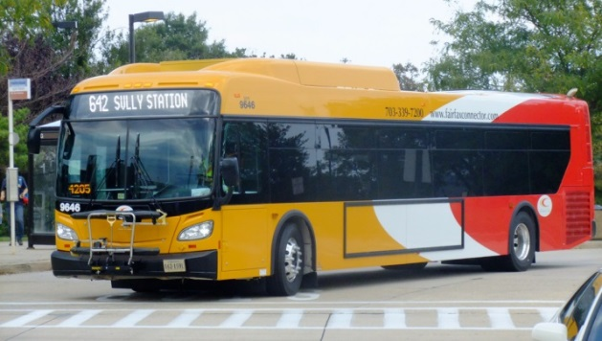
Intelligent Transportation System (ITS) Project Update TAC - July 21, 2015 Nick Perfili, FCDOT

Slide 2
Fairfax Connector ITS
Key goals:
Improve passenger & employee safety
Increase ridership
Improve communications & information
Enhance the rider experience
Improve service reliability & on-time performance
Notes:
Key goals of Fairfax Connector ITS:
Improve Safety
ITS enhances the safety of passengers and employees with improved emergency features such as remote vehicle monitoring and GPS technology and eventually will integrate on board video technology
Increase Ridership
System will employ technologies that ensure ADA compliance thereby increasing access to persons with disabilities
Attract Millennials and other tech savvy persons connected to the world via smartphones expect to receive information electronically
Improved Communications
Customer will have full access to real time information
Customers may receive updates on service disruptions or activities that may impact their trip plans
Rider experience
Data will be open for 3rd party developers to create user friendly customized apps
It is envisioned the system will provide overall better customer service to our patrons
Improve reliability
System reliability and connectivity will be improved thru the use of system data for planning and operations

Slide 3
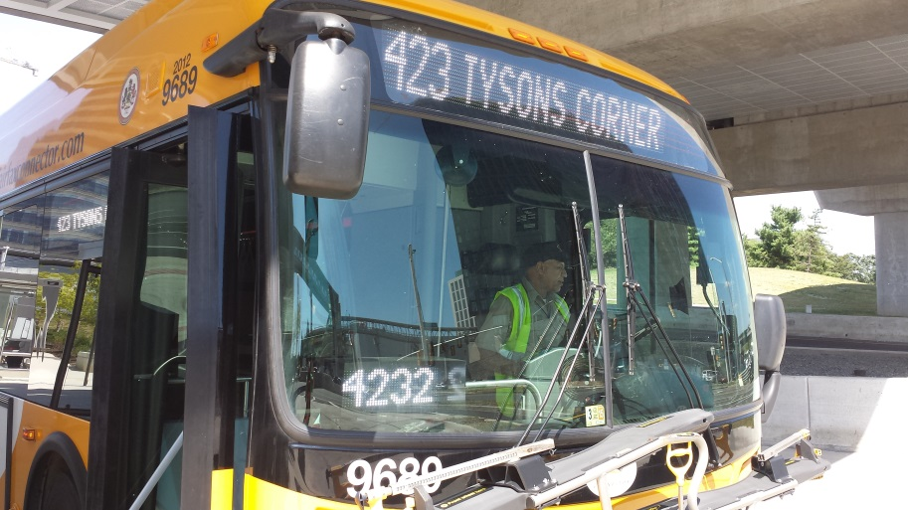
Fairfax Connector ITS
Two-phase implementation:
Phase 1: Computer-aided dispatch & Automatic Vehicle Location (CAD/AVL) and real-time passenger information
Phase 2: (Future) Options for interior cameras and remote fleet component monitoring
Notes:
Our approach to implementing ITS is two-phase.

Slide 4
Fairfax Connector ITS (cont.)
Phase 1 Technology:
Computer-aided Dispatch & Automatic Vehicle Location (CAD-AVL)
Automatic Passenger Counters (APC)
Digital Message Signs (DMS)
Interactive Voice Response (IVR)
Real-time bus information for passengers
Data warehousing/reporting systems
Notes:
Fairfax Connector ITS:
CAD-AVL technology- automates traditional dispatching and provides new functionality to more efficiently manage resources. The technology allows for monitoring of all vehicles in real time adding to efficiency and security of operations.
APC will replace fareboxes as the method of recording ridership
DMS signage will be installed at key transit facilities inc: F-S, WRE, RTC, with options for phase 2 rail stations
IVR system will be layered on the front end of call center software. Technology allows riders to get predictions via the call center without talking to an agent. *point of info 8500 monthly calls
Real time information for passengers in the form of web applications, call center software, on board annunciation
Reporting systems-
In conjunction with this project, the Connector is reviewing all legacy reports.
Custom reports and dashboards will be developed which focus on key metrics in order to better manage the system

Slide 5
Fairfax Connector ITS (cont.)
Phase 2 Technology:
Vehicle Component monitoring
Video system technology
Yard management software
Notes:
Fairfax Connector ITS:
Phase 2 solutions include options for:
Vehicle component monitoring software is Advanced fleet technology that helps reduce maintenance costs and improves fleet reliability
Video technology- Many transit providers are using camera technology today and most report the systems pay for themselves in terms of risk management
Yard management software is useful for managing vehicle locations and assignments on bus yards

Slide 6
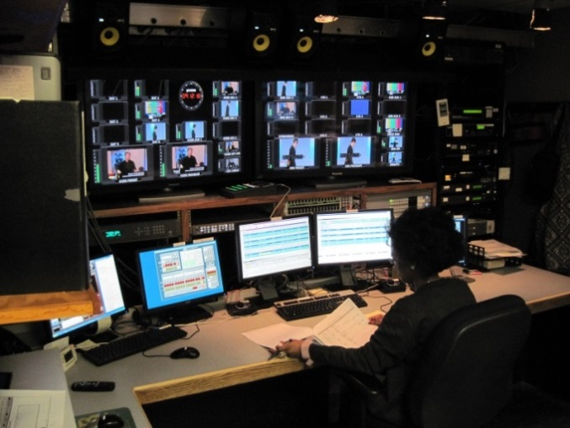
Bus Monitoring & Management
Establish Bus Operations Control Center (BOCC)
Control center staff actively manage service
Vehicle location and status is continuously monitored
Communication is better managed between controllers and operators
Notes:
Management of bus service
The Connector is establishing a Bus Operations Control Center (BOCC) which will centralize all communications and system management throughout the entire County. The BOCC will be set up similar to police 911 centers or emergency operations centers such as at PSTOC
Control center supervisors will use real time information to actively manage service
Communication is controlled and prioritized among various work groups and channeled as voice to voice or data in the form of text messaging to on board computer

Slide 7
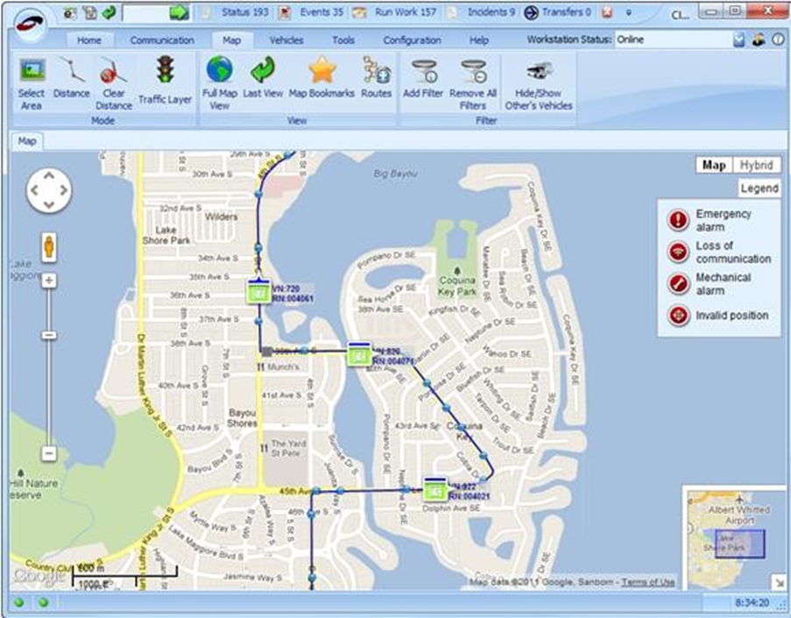
Bus Monitoring & Management (cont.)
CAD/AVL:
Bus location
Schedule adherence
Interior/exterior announcements
Next stop display
Destination sign display
Passenger counts
Farebox settings
Notes:
(continued) Bus Monitoring & Management
This Slide lists some of the information controllers will use to ensure the system is operating efficiently:
Information about the bus operator
When an operator logs “on” or “off” a bus
Bus location
Schedule status – is the bus on time; is the bus late?
Passenger counts
Route status – are buses on-route or on detour?
Whether or not the vehicle is correctly communicating with the ITS system

Slide 8
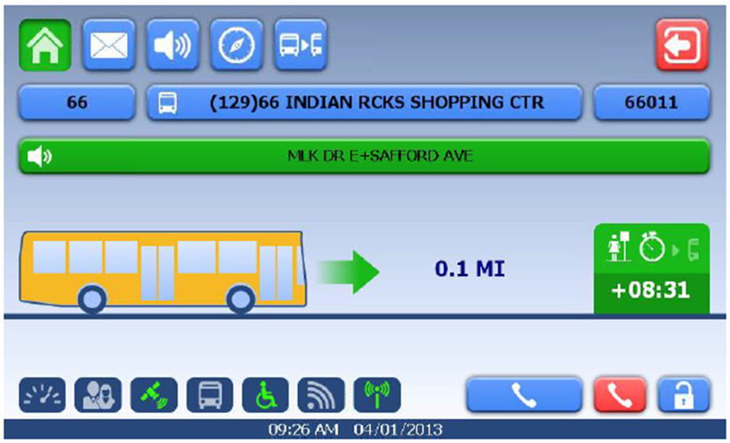
Bus Monitoring & Management (cont.)
Operations support:
Timepoint and schedule adherence indications
Control center communication
Incident reporting
Security/emergency response
Operator information display
Notes:
Bus Operators will have new technology on the vehicle and better communication tools so they can focus more attention on bus operation and passenger service-
Operators will receive their work assignment electronically
Monitor on-time performance electronically
May request other buses hold for transfers within defined parameters
During emergencies, Bus drivers can trigger alarms opening channels of communication between the bus and control center

Slide 9
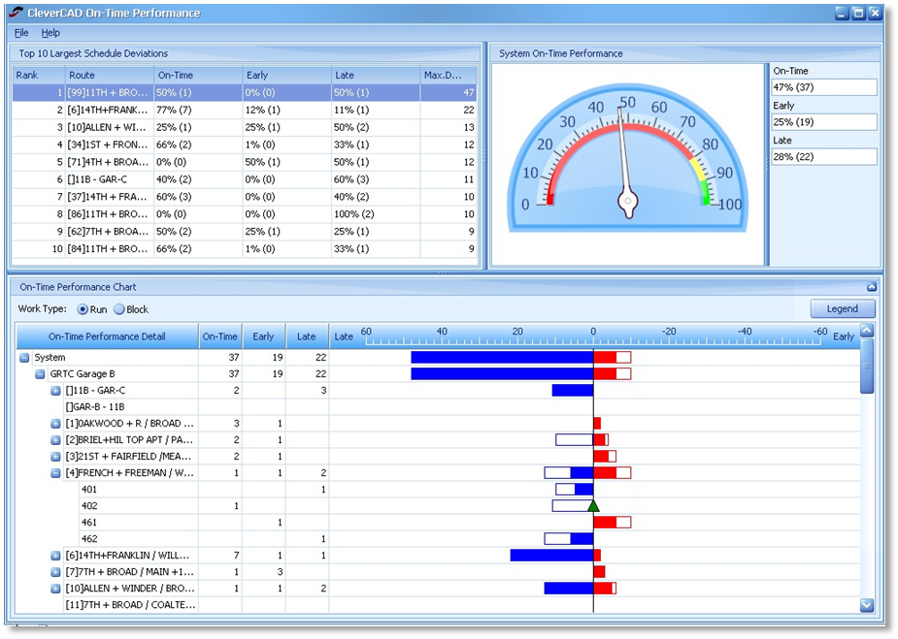
Bus Monitoring & Management (cont.)
Planning support:
Improved schedules & service planning
Historical travel time data at the trip level
Will track bus stop utilization, allowing for better allocation of resources to stops with higher rider usage
Notes:
The system will provide benefits in addition to the technology that will be used in operations and the BOCC and will be useful for planning staff:
Planning staff will use data generated by the system to improve scheduling and connections.
Data mining will allow for improved service allocation based on system capacity, actual running and dwell times
APC systems will be certified for NTD reporting and will provide more reliable and detailed ridership information at the route and stop level

Slide 10
Real-Time Bus Information
Bus arrival predictions for every stop
Offers riders an opportunity to reduce time waiting for buses
Accessed online (mobile device or computer) or through the Fairfax Connector call center
Provides onboard travel information, including bus stop announcements
Helps increase ridership and convenience of using the Fairfax Connector system
Notes:
Fairfax Connector passengers will see new benefits from ITS! Most visible to passengers will be the availability of real-time bus arrival information and on-board next stop announcements.
Since the re-launch of Metro’s “NextBus” predictions in late 2009/early 2010, Fairfax Connector passengers have been requesting real-time bus arrival predictions.
Fairfax Connector’s website and call center menu will be updated to reflect bus tracking capabilities.
Passengers will reduce time spent waiting for a bus –

Slide 11
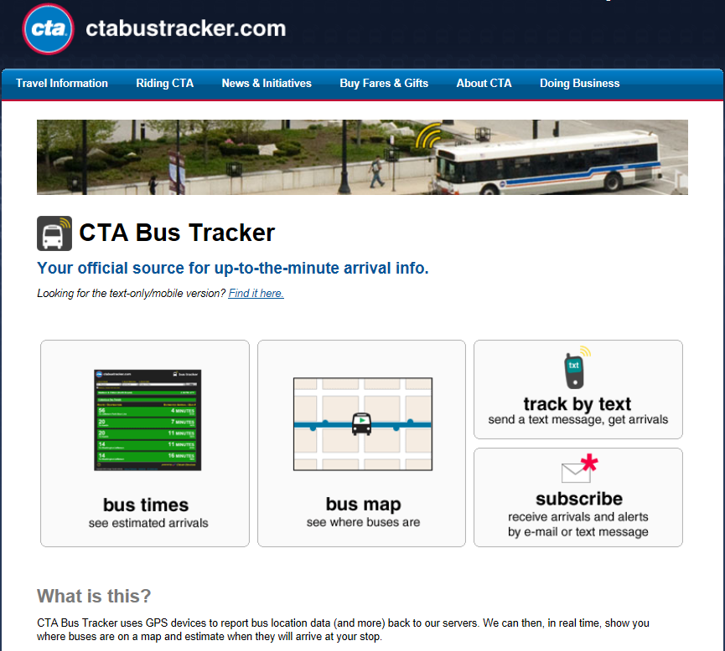
Real-Time Bus Information (cont.)
Public-facing information will be formatted similar to the Chicago Transit Authority system (also a Clever Devices’ system)
Notes:
Fairfax Connector’s real-time bus tracking website will be similar to what is in place now at the Chicago Transit Authority (CTA). (one of the largest in the US)

Slide 12
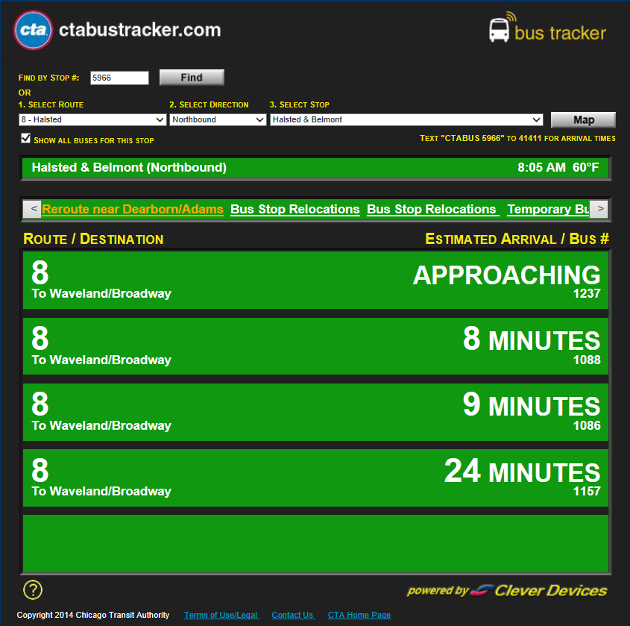
Real-Time Bus Information (cont.)
Riders will have access to bus arrival predictions by stop and will be able to view bus locations on a map
Notes:
The Connector will add bus stop ID #’s to all stops as part of ITS (+2000)
Fairfax Connector riders will have access to predicted arrival times by bus stop
View web link and talk to information

Slide 13
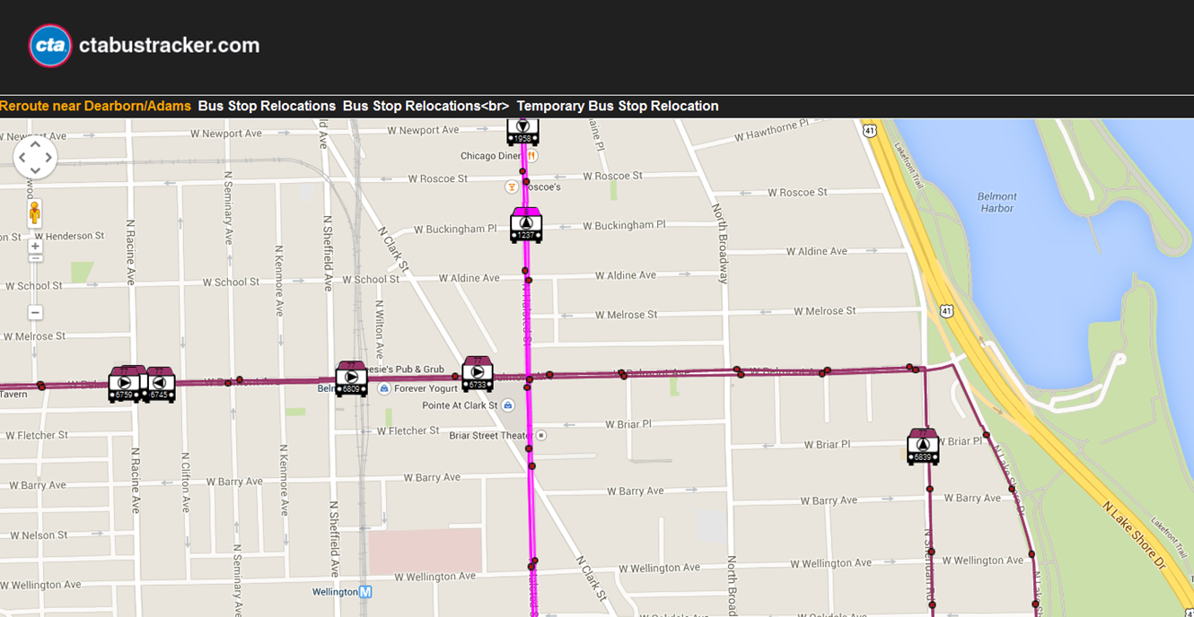
Real-Time Bus Information (cont.)
Bus location map (CTA Bus Routes 8 - Halsted and 77 - Belmont)
Notes:
(FROM PRIOR SLIDE)
Option to also view bus locations on a map.

Slide 14
Project History
Began exploring ITS solutions in 2004
Included ITS in the FY-2013 budget
Procurement initiated: FY-2013
Contract award to Clever Devices: February 2014
Project design initiated: July 2014
Notes:
To provide some background, Fairfax Connector started exploring APTS in 2004. Although we have been slow to implement the good news is
Project design team includes members of Transit Services, MV Transportation, DIT, and Transystems who is serving as technical consultant on the project

Slide 15
Project Milestones & Schedule
February 2015: Three project design phases complete
June 2015: Database testing (Factory Acceptance Testing)
Late summer 2015: Pilot testing (Mini-fleet)
Fall 2015: System-wide testing
Spring 2016: System-wide deployment
Notes:
Review of current project schedule
System engineering and three project design phases: were completed in February 2015
Targeting Database testing (Factory Acceptance Testing): June 2015
Project pilot testing (“Mini-fleet”): Late summer 2015
Full vehicle installations and training for approx.: 700 contract employees
System-wide testing: Fall 2015
Deployment: Early spring 2016

Slide 16
ITS Project Update
Questions ?
Notes:
In closing

