Slide 1
2015 Taxicab Rate Review: Staff Recommendation Transportation Advisory Commission August 18, 2015
Susan Hafeli Department of Cable and Consumer Services

Slide 2
Staff Recommendation
Staff recommends no change in rates in 2015
Keep initial charge (drop fee) at $3.50
Keep per-mile charge at $2.16 ($0.36 per 1/6th mile)
2

Slide 3
Taxicab Industry in Fairfax County
Industry provides both on-demand and contract transportation services
Current fleet information:
Five authorized operators (companies)
654 taxicab certificates
45 wheelchair-accessible certificates
Code requirement of 4% WAC taxis (= 26 cabs)
Over 770 licensed drivers
3

Slide 4
Taxicab Rates
DCCS conducts annual rate reviews
Fairfax County Code governs taxi rate changes
Code allows for rate change petitions – but none filed in 2015
A rate change requires public hearings before both Consumer Protection Commission and Board of Supervisors
Code standard for assessing whether a rate change is warranted: change in taxicab price index since last adoption of rates, plus or minus two percent
4

Slide 5
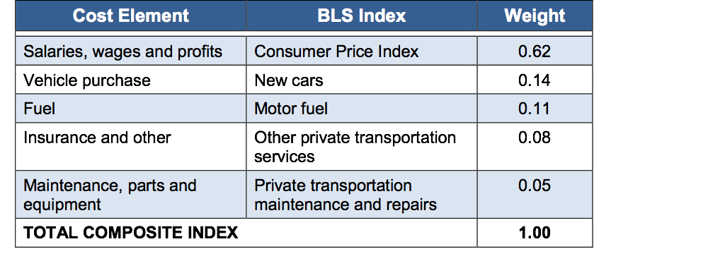
Fairfax County Taxicab Price Index Section 84.1-6-2(d)
5

Slide 6
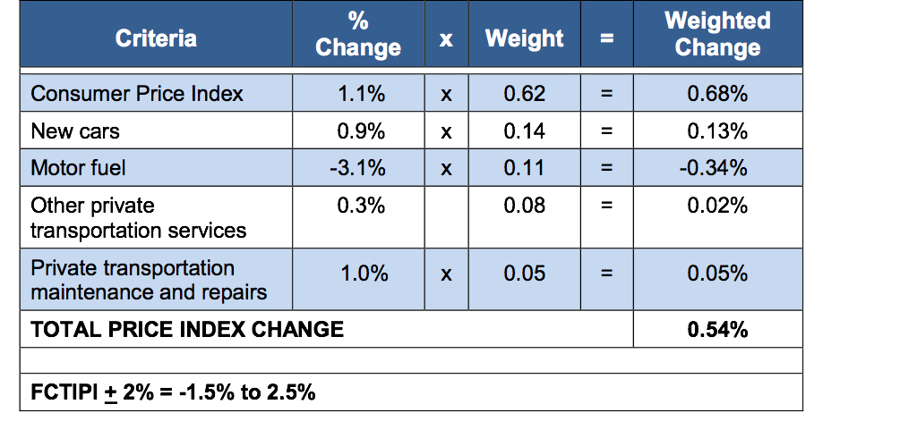
FCTIPI Weighted Change November 2014 – June 2015
6

Slide 7
Evaluation Factors
County Code: change in FCTIPI since rates last adopted, plus or minus 2%
FCTIPI result = 0.5%
Adjustment of + 2% = range of -1.5% to 2.5%
Other factors considered
Trends in gasoline prices
Driver licensing rates
Regional taxicab rate comparison
Competition from TNCs
7

Slide 8
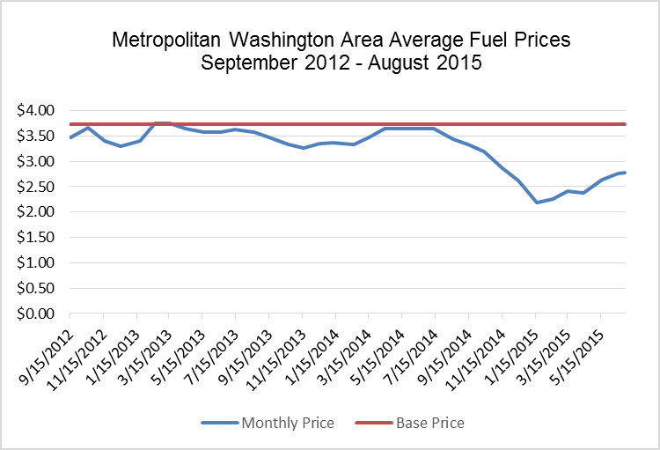
Gasoline Price Trends: 2012-2015
8

Slide 9
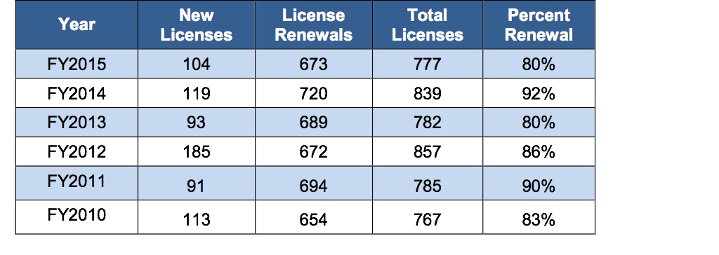
Driver Licensing Rates
Continuing interest in taxi driver (hack) licenses, despite FY2015 decline in both new licenses and renewals
9

Slide 10
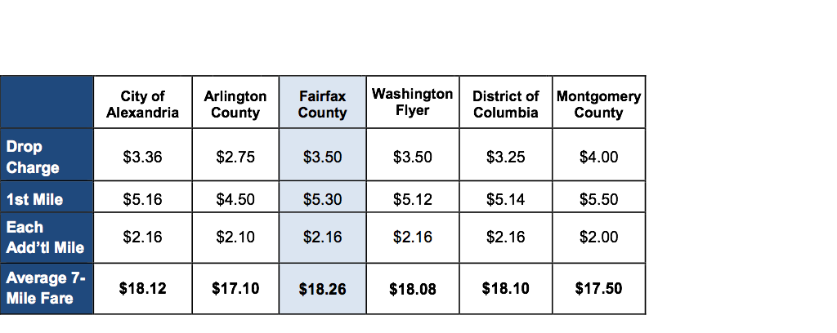
Regional Regulated Rate Comparison
10

Slide 11
Competition from TNCs
Virginia established regulatory framework for TNCs in 2015
No local oversight of TNCs
TNCs enjoy pricing flexibility that regulated companies do not
“Surge pricing” helps balance supply and demand
Data regarding TNC impact on regulated taxi companies not available
11

Slide 12
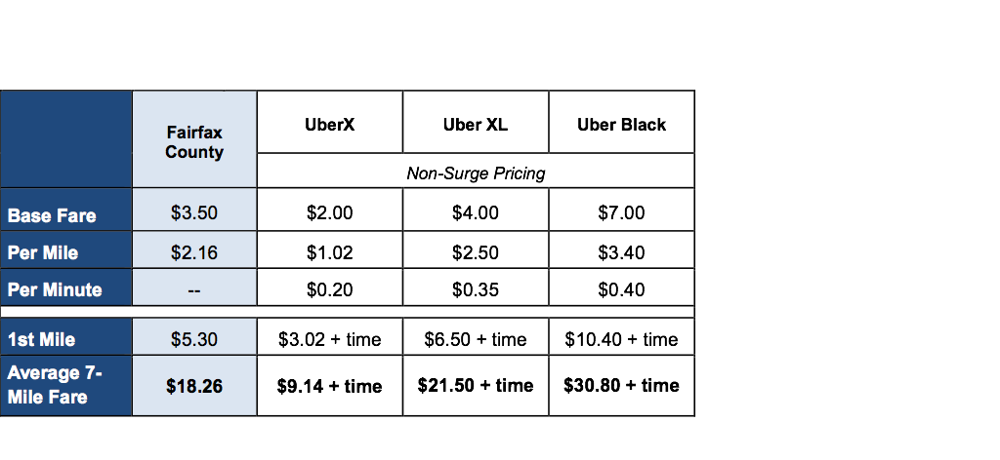
Comparison: Taxi vs. Uber Options
Notes about Fairfax County regulated fares:
Base fare, or drop charge, includes first 1/6th of a mile.
When traffic is traveling less than 10 miles per hour, driver may charge either the mileage
fee or a waiting charge of $0.36 per 61 seconds.
12

Slide 13
Staff Recommendation
Rates have increased 8.2% since 2012
3.5% (2014) + 4.7% (2012) = 8.2%
Staff recommends no change in rates in 2015
Keep initial charge (drop fee) at $3.50
Keep per-mile charge at $2.16 ($0.36 per 1/6th mile)
13

Slide 14
QUESTIONS?

