Slide 1
Tapping Transit to Transform a Thoroughfare
Presented to: Fairfax County Transportation Advisory Committee
Tuesday, September 15, 2015
Presented by: Northern Virginia Transportation Commission
Page 1

Slide 2
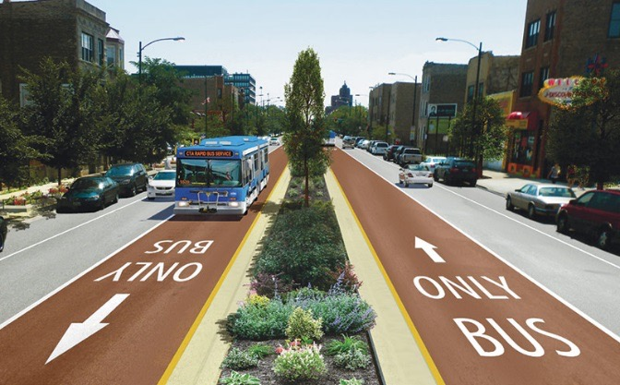
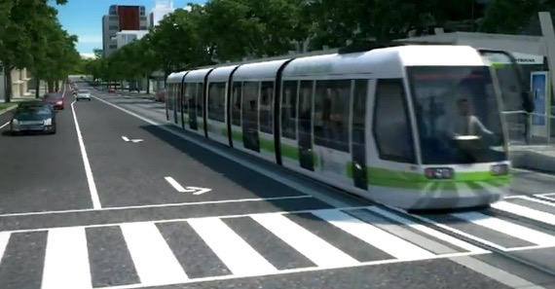
Envision Route 7 Transit
Envision a transit option that:
Connects people and businesses to economic opportunity
Moves more people
Provides a faster trip
Offers higher quality service
Page 2

Slide 3
34 Percent Population Growth
By 2040
Existing
Page 3

Slide 4
36 Percent Job Growth
By 2040
Existing
Page 4

Slide 5
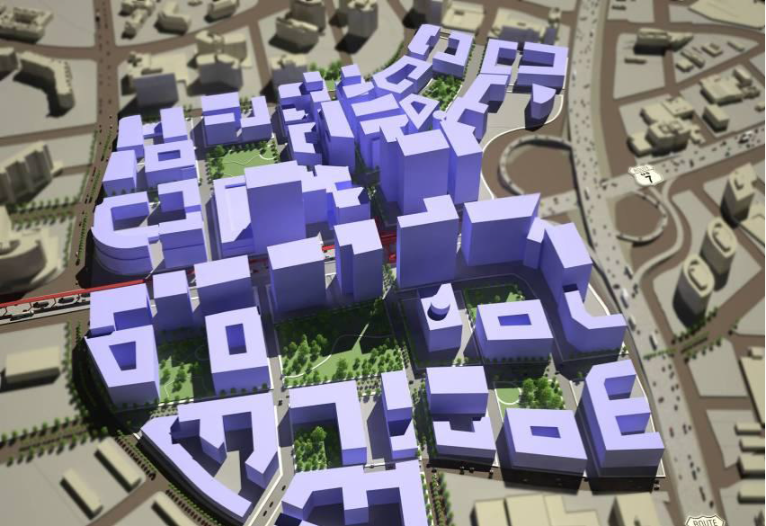
Tyson’s Employment = Miami CBD
By 2040
Existing
Page 5

Slide 6
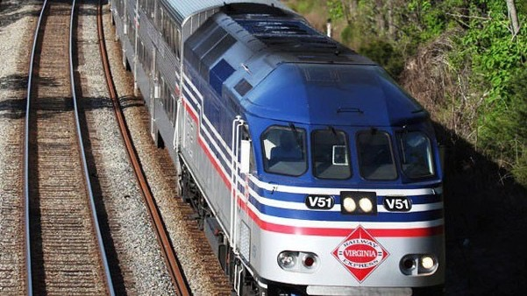
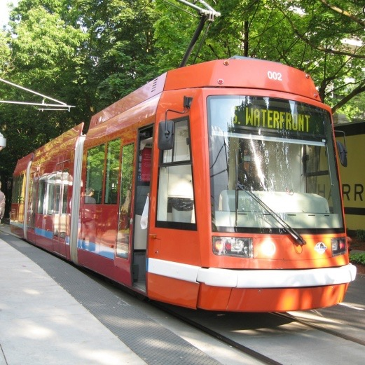
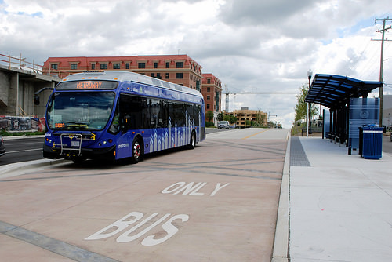
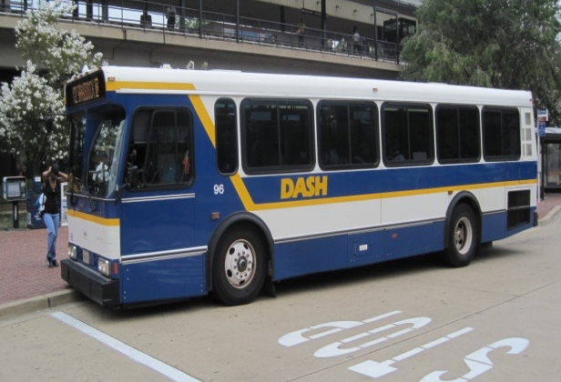
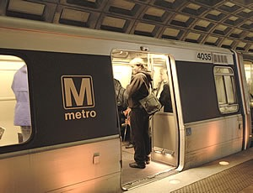
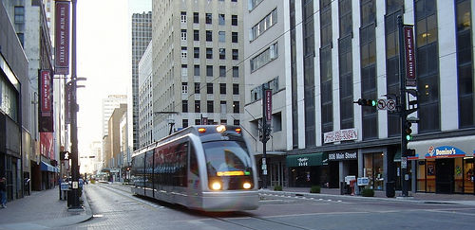
How We Got Here
Types of transit considered in Phase I
Page 6

Slide 7
Remaining Modes for Consideration
Light Rail Transit (LRT)
Bus Rapid Transit (BRT)
Enhanced Bus
Operates in mixed traffic or separate from traffic
Uses overhead electric wires for power
Stations typically include platforms, shelters and ticket vending machines
200 persons per vehicle
Limited station stops
Operates in mixed traffic or
separate from traffic
Uses modern bus technology
Sleek vehicles with low floor,
multi-door boarding
Dual side boarding
120 persons per vehicle
Limited station stops
Operates in mixed traffic
Uses standard bus
technology
Includes normal and
articulated buses
60-80 persons per vehicle
Frequent stops
Page 7

Slide 8
Route Options
Page 8

Slide 9
Lane Configurations

Slide 10
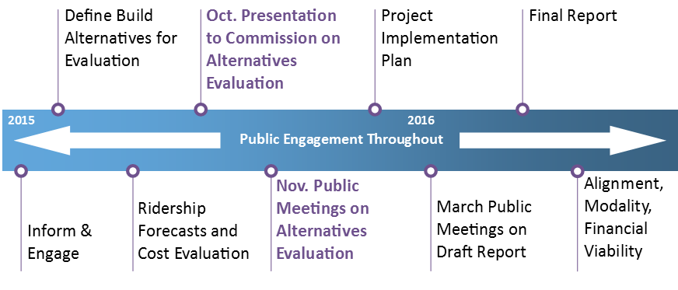
The Road Ahead
Page 9

Slide 11
Upcoming Public Meetings
Wed., Nov. 4, 7-9 p.m.
Alexandria Health Department Building
4480 King St.
5th Fl. Conference Room
Alexandria, VA 22302
Tues., Nov. 10, 7-9 p.m.
Mary Ellen Henderson Middle School
7130 Leesburg Pike Auditorium
Falls Church, VA 22043
Wed., Nov. 18, 7-9 p.m.
Glen Forest
Elementary School
Cafeteria
5829 Glen Forest Dr.
Falls Church, VA 22041
To learn more…
Follow us!
Visit our website at
EnvisionRoute7.com
‘Envision Route 7’
@EnvisionRoute7
@EnvisionRoute7
Page 10

