Slide 1
Bi-County Parkway
Evaluation of Impacts on Fairfax County Roads
Dan Stevens and Leonard Wolfenstein
Board Transportation Committee
October 13, 2015
Department of Transportation

Slide 2
Overview
Board Request
Background
Purpose and Need
Evolution of Tri-County to Bi-County Parkway
Bi-County Parkway Alignment
Bi-County Parkway 2040 Forecasts
Impacts on Fairfax County Roads
Department of Transportation
2

Slide 3
Supervisor’s Frey Board Matter
Requested staff to evaluate Bi-County Parkway and impacts, both of building or not building the Bi-County Parkway on Fairfax County
Present Results at a Board Transportation Committee
Department of Transportation
3

Slide 4
Background
Tri-County Parkway EIS conducted 2002-2005
Alternative West Two (in Prince William and Loudoun Counties only) selected as preferred alternative and approved by CTB in 2005, despite objections from the Fairfax County Board of Supervisors
Tri-County Parkway remains on Fairfax County’s Transportation Plan
Department of Transportation
4

Slide 5
Need for the Project
Current lack of north-south linkages that connect Manassas, I-66, Dulles Airport, Dulles Toll Road and Dulles Greenway
East of US 15, the only north-south principal urban arterials are Routes 28, the Fairfax County Parkway, Route 123 and the Beltway
Congestion on these facilities is expected to increase in the future
Allows closure of Route 234 and Route 29 through Manassas National Battlefield Park, along with construction of Manassas National Battlefield Bypass
Source: Tri-County Parkway Location Study (2005)
Department of Transportation
5

Slide 6
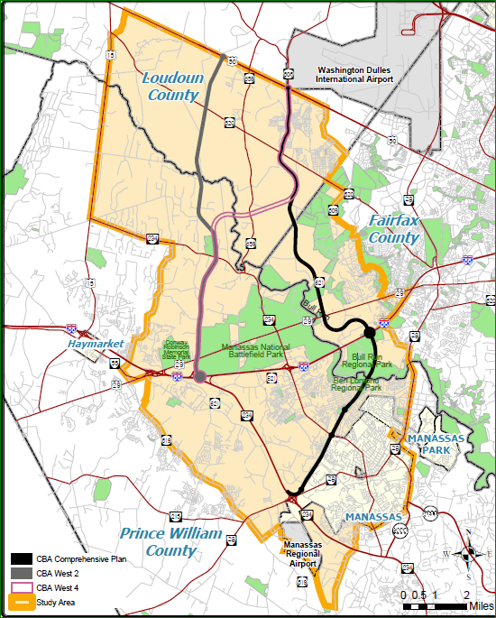
Tri-County Parkway EIS
Study Area located in Prince William, Loudoun and Fairfax Counties
Extended from VA 28 & VA 234 to US 50
Candidate Build Alternatives
Comprehensive Plan
West Two (Highlighted)
West Four
Department of Transportation
6

Slide 7
Evolution of Tri-County to Bi-County Parkway
North-South connection considered for years by Prince William, Fairfax, and Loudoun Counties
Different names have been used for such a road:
Route 28 Bypass
Loudoun County Parkway
Tri-County Parkway
Tri-County Connector
Alternative West Two (Only in Prince William and Loudoun Counties) approved by the CTB in 2005. Now called Bi-County Parkway
Prince William County is currently evaluating whether or not to remove Bi-County Parkway from Comprehensive Plan
Department of Transportation
7

Slide 8
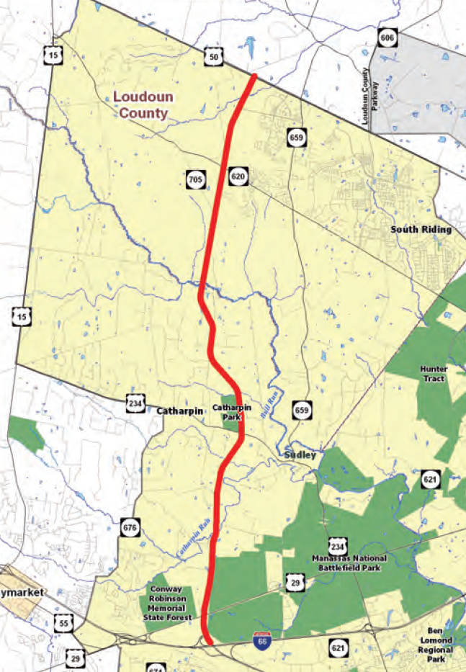
Bi-County Parkway alignment
Located within Loudoun and Prince William Counties
Connects I-66 to US 50
Connects to Route 234 in the south
Connects to North Star Boulevard, and to possible Dulles Air Cargo, Passenger and Metro Access Highway (DACPMAH) in the north
Department of Transportation
8

Slide 9
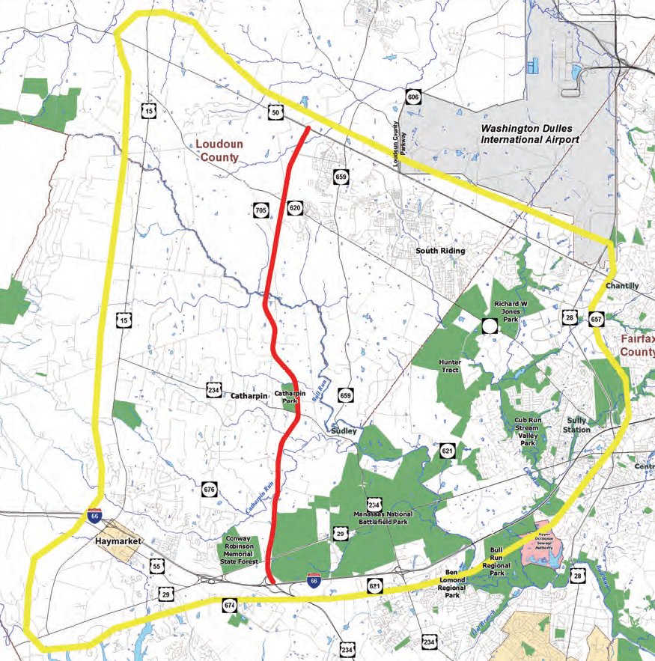
VDOT Bi-County Parkway 2013 FEIS
Updates findings of 2005 DEIS
2013 FEIS study area bounded by US 15, US 50, Route 28, and I-66
Developed forecasts for the year 2040
County supplemental analysis went as far east as the Capital Beltway
Department of Transportation
9

Slide 10
VDOT Bi-County Parkway 2013 FEIS Forecasts
Route 28 daily forecasted volumes drop by less than 5,000 vehicles from 180,000 (3%)
Pleasant Valley Road daily forecasted volumes drop by less than 1,000 vehicles from 15,000 (7%)
Most of the diversions happen on Gum Springs Road (in Loudoun and Prince William Counties) with 13,000 out of 25,000 vehicles being diverted daily (52%)
Projected daily volumes for Bi-County Parkway are from 45,000 to 60,000
Department of Transportation
10

Slide 11
Impact of Bi-County Parkway on Traffic Volumes (Daily Traffic 2030 Conditions)
Red = Increase in traffic
Green = Reduction in traffic
Capital Beltway traffic is reduced by around 5,000 to 10,000 vehicles from around 220,000 vehicles (2% to 5%)
53,000
Bi-County Pkwy
Gum Spring Rd
Pleasant Valley Rd
3,000
6,000
18,000
2,000
36,000
Sudley Rd
7,000
Traffic volume impacts from Fairfax County DOT travel demand model
Department of Transportation
11

Slide 12
Conclusions
Bi-County Parkway does attract traffic away from other parallel roads, primarily Gum Springs Road and Route 15
Bi-County Parkway has a minor benefit for parallel roads in Fairfax County (Route 28, Pleasant Valley Road and the Capital Beltway)
Total projected traffic volume on the Bi-County Parkway is greater than the reductions on other parallel roadways; constructing the Bi-County Parkway appears to result in additional trips
Department of Transportation
12

Slide 13
Questions
Department of Transportation
13

