Slide 1
I-66 Inside the Beltway Initial Traffic Analysis and Framework Agreement
Board Transportation Committee
October 13, 2015
Tom Biesiadny and Bob Kuhns
Fairfax County Department of Transportation

Slide 2
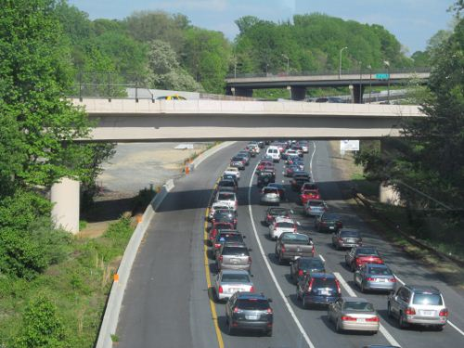
Project Basics
Congestion on I-66 Inside the Beltway is a significant problem.
Roadway congestion also affects the reliability of bus service
Metrorail’s Orange and Silver Lines are experiencing overcrowding.
Secretary of Transportation Aubrey Layne proposed tolling I-66 Inside the Beltway in both directions in the a.m. and p.m. peak periods.
These tolls would generate about $5-10 million per year in revenues (after operations and maintenance) to support multimodal improvements in the corridor.
Department of Transportation
2

Slide 3
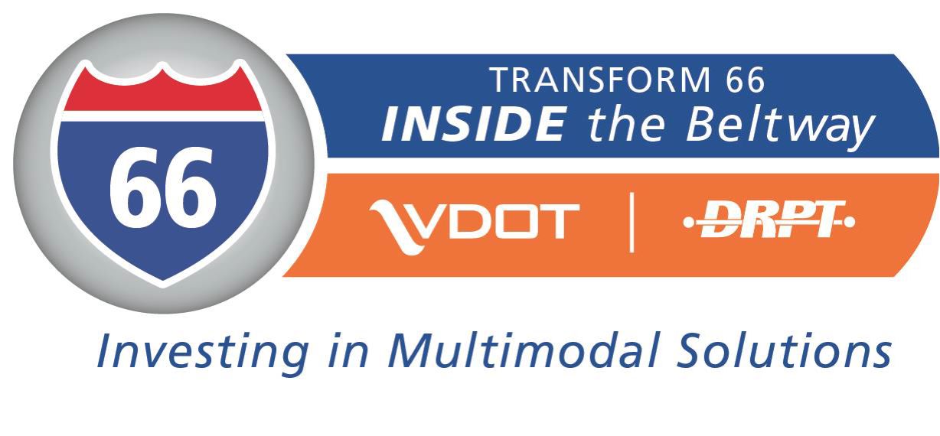
Purpose and Need
The purpose of the I-66 Multimodal Project Inside the Beltway is to move more people and enhance connectivity in the corridor by improving transit service, reducing roadway congestion, and increasing travel options.
Department of Transportation
3

Slide 4
Multimodal Improvements
Multimodal Package Includes:
Improved transit service
Improved bicyclist and pedestrian access
Transportation demand management strategies
Integrated Corridor Management
Tolling non-HOV 2+ vehicles during peak periods initially. This would increase to non-HOV 3+ vehicles during the peak periods in 2020.
Peak periods expanded from 2.5 to 4 hours in both peaks
Travel outside of the peak periods will remain free for all vehicles
Consideration of future widening
Department of Transportation
4

Slide 5
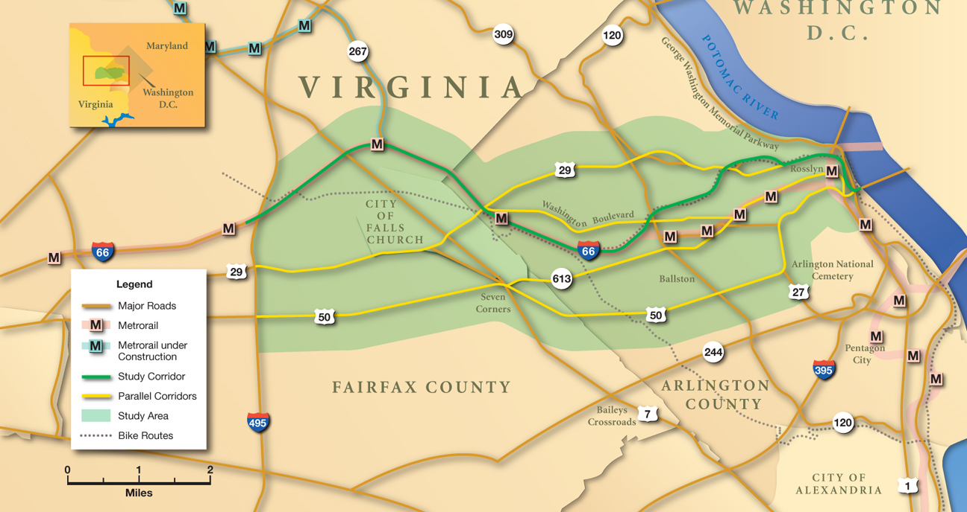
Project Corridor
* The Corridor is defined as I-66 from I-495 to US 29 in Rosslyn and the parallel facilities: Arlington Blvd., Lee Hwy, Wilson Blvd., Washington Blvd., portions of Route 7, and the Metrorail Orange Line.

Slide 6
Recent Activity
Board briefed on the Framework Agreement for the project on July 14.
Board received a comprehensive project briefing on September 11.
Board approved comments on the project on September 22. Comments were subsequently submitted to Sec. Layne.
Local staffs began receiving traffic data associated with the project in mid September 2015.
County staff received the Commonwealth’s version of the Framework Agreement on September 28, 2015.
Jurisdictional staffs are working with VDOT to identify the first set of multimodal projects that should be considered for funding, potentially in advance of the opening of the new toll facility.
It appears that FHWA will allow tolls to be used for transit operating expenses.
Department of Transportation
6

Slide 7
Review of Initial Traffic Data
To review the traffic and revenue data associated with the project, Fairfax County, Arlington and Falls Church established an inter-jurisdictional technical working group.
The group is reviewing the traffic data provided by VDOT to determine where potential problem areas are.
So far, the working group has received traffic information for 2017 and 2021.
A Preliminary Future Conditions Technical Memorandum Report has recently been released which summarizes some of the initial findings. The report has been posted on the Transform66 website
Department of Transportation
7

Slide 8
Review of Initial Traffic Data
Based on the review of the data received so far, County staff has reached the following conclusions:
In 2017, implementing tolls on I-66 and allowing HOV-2+ vehicles to use the facility for free reduces traffic on parallel roadways in the peak direction.
However, tolling in the counter flow direction, increases traffic on the parallel roadways in Fairfax County:
In the AM by up to 40% on US50, 50% on US 29 and 35% on VA7
In the PM by up to 25% on US50, 13.5% on US29 and 9% on VA7
Increases in traffic in the counter flow direction can be accommodated within the available capacity of the roadway
Department of Transportation
8

Slide 9
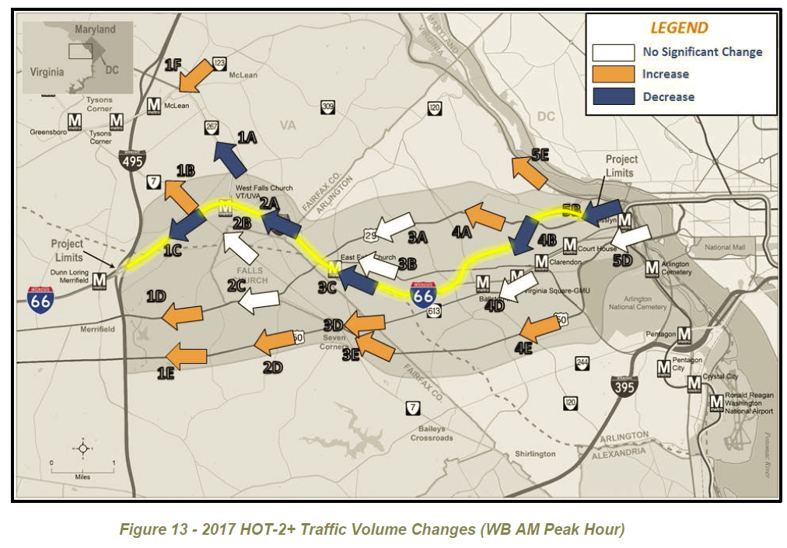
Review of Initial Traffic Data (AM Counter Flow)
Department of Transportation
9

Slide 10
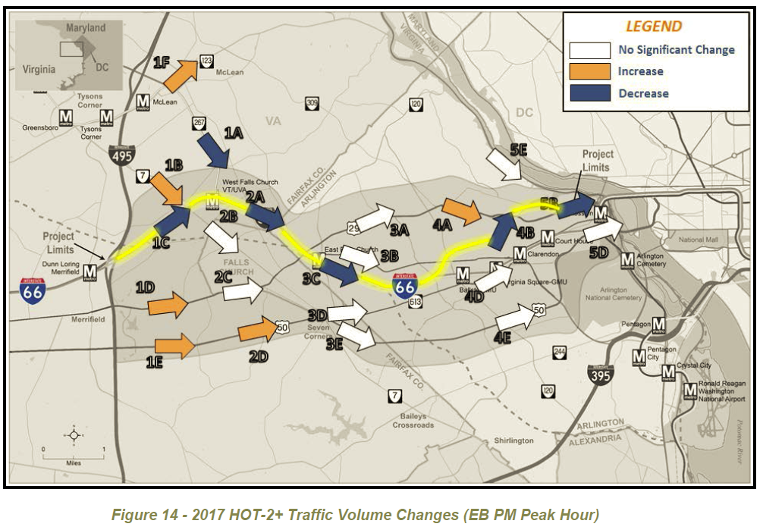
Review of Initial Traffic Data (PM Counter Flow)
Department of Transportation
10

Slide 11
Review of Initial Traffic Data
Based on the review of the 2021 data received so far, County staff has reached the following conclusions:
The conversion from HOV-2+ to HOV-3+ vehicles being free in 2020, results in some increases in volumes on parallel roadways, particularly along US50 in Fairfax County
County staff is continuing to work with the inter-jurisdictional technical working group and the VDOT consultant team to identify the ability of the existing infrastructure to handle the increases upon conversion to HOV-3+
Additional analyses will be conducted on 2040 traffic data
Department of Transportation
11

Slide 12
Framework Agreement: Background
In February 2015, Secretary Layne asked Arlington, Fairfax County and Falls Church to identify a regional partner for the I-66 Inside the Beltway Project
On March 3, 2015, the Board considered this request and recommended that the Northern Virginia Transportation Commission be designated as the regional partner
Similar action taken by the Arlington Board and the Falls Church City Council
On March 10, 2015, the three jurisdictions transmitted their request to Secretary Layne.
On March 25, 2015, Secretary Layne responded and concurred with the jurisdictions’ recommendation.

Slide 13
Framework Agreement
Staff from Arlington, Fairfax and Falls Church drafted an initial Framework Agreement in June 2015.
This Agreement was reviewed with NVTC on July 9, 2015.
The Commission offered comments and concerns
The Agreement was revised and submitted to the Commonwealth on August 19, 2015.
The Agreement outlined proposed roles for VDOT, CTB, NVTC and the local jurisdictions.

Slide 14
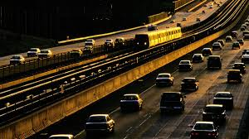
Framework Agreement: Roles
VDOT: collect revenue, operate and maintain facility, and distribute remaining funding.
CTB: includes NVTC recommended projects in Six Year Program
NVTC:
Serves as fiduciary in receiving, managing, and segregating all remaining toll revenues
Develops a project application through the MAC
Facilitates project selection process through the MAC
Approves use of funds for multimodal projects
Ensures lawful use of revenues and report on use
Arlington, Fairfax, and Falls Church (“Jurisdictions”): In consultation with VDOT and NVTC, apply selection criteria and recommend projects for funding

Slide 15
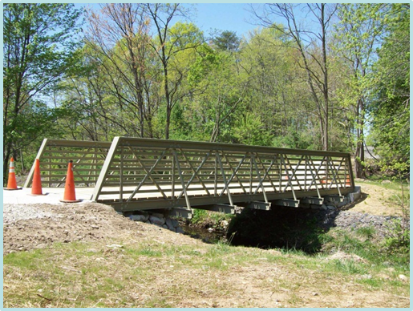
Framework Agreement: Proposed Project Selection
NVTC calls for project from eligible submitters including
Planning District 8 jurisdictions, transit agencies, VDOT, DRPT
NVTC conducts preliminary screening of projects
Is the project in the 2012 Multimodal Study and referenced documentation*?
Is the project located in or does it provide service to the Corridor?
Does the project align with the legal and VDOT requirements?
NVTC provides list of candidate projects to MAC
* The 2012 I-66 Multimodal Study Inside the Beltway incorporates the 2013 Supplemental Report and the CLRP+ baseline (2011 CLRP and the transit/TDM improvements from the 2009 DRPT I-66Transit/TDM Study)

Slide 16
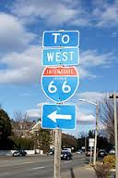
Framework Agreement: Proposed Project Selection (continued)
MAC applies selection criteria
Jurisdictions, VDOT/DRPT, and NVTC screen list and develop draft list of projects
MAC recommendations draft list of projects
NVTC holds public hearing to review draft list of projects
Jurisdictions, VDOT/DRPT, and NVTC finalize list of projects based on feedback
If there is disagreement, staff will meet and confer. CAOs are final arbiters
NVTC forwards finalized list to jurisdictions for approval
NVTC approves use of funding for recommended projects
If no concurrence, NVTC remands list to jurisdictions for further refinement

Slide 17
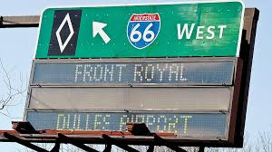
Framework Agreement: Project Funding
NVTC will:
Develop a project agreement for use by NVTC to distribute funding to project sponsors
Provide funding to project sponsors as outlined in agreement
Monitor project implementation to ensure compliance
Conduct periodic reviews of projects
Report on the use of funding in consultation with project sponsors and to the public
Project sponsors will:
implement projects and services
provide documentation of expenses and information regarding project status

Slide 18
Commonwealth’s Draft
County staff received the Commonwealth’s draft of the Framework Agreement on September 28
Very different from jurisdictions’ draft
More specific language defining the project
Expands language regarding VDOT’s and CTB’s roles
Establishes priorities for use of toll revenues
Establishes conditions for widening EB from Dulles Connector Road to Fairfax Drive
Later Date: 5 years from commencement of tolling (2022?) or 2 years after the increase from HOV-2 to HOV-3 (2022-2023?): evaluation of operating speeds
If average operating speed falls below __ mph more than 10% of the time, design of widening to begin
Department of Transportation
18

Slide 19
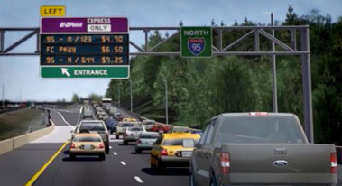
Commonwealth’s Draft
Includes language regarding conditions for suspending tolls
Includes language regarding eligible projects for toll funds and sets time limits for obligating and spending toll revenues
Limited language about the project selection process
Requires that information on projects be provided to the public
Includes language that would make if difficult for NVTC to bond revenues
Local jurisdictions are not parties to the agreement
Department of Transportation
19

Slide 20
Next Steps
Traffic and Revenue Study Review
Complete review of 2021 and 2040 traffic data when available
Identify problems areas and potential solutions
Review revenue data when available
Framework Agreement
Jurisdictions and NVTC meeting on October 16 to discuss
Negotiations with Commonwealth to develop final document
Initial Projects
Identification of initial candidate projects and services
Development of selection criteria
Project selection
Department of Transportation
20

Slide 21
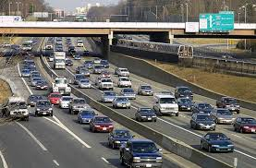
Timeline
November 5: NVTC briefing on project and framework agreement
November 17: Board to consider framework agreement
November TBD: Arlington Board and Falls Church Council to consider
framework agreement
December 2: CTB to consider framework agreement and project
approval
December 3: NVTC to consider framework agreement
Department of Transportation
21

Slide 22
Questions?
Department of Transportation
22

