Slide 1
Silver Line
Board Transportation Committee
October 13, 2015
Mark Canale
Fairfax County Department of Transportation
Department of Transportation

Slide 2
October 13, 2015
Status
Phase 1
VDOT, WMATA, Fairfax Punchlist – Ongoing
Fairfax County – 38 open items
VDOT with majority of remaining punchlist items
Project Closeout anticipated at the end of 2015
Fairfax County completed clean up of kiss and ride lots and Route 7 median stormwater (MWAA to reimburse the County) – County to maintain Route 7 SWM
County Maintaining Mclean, Spring Hill K/R lots
Art in Transit Task Order issued
Phase 1 close out - $2.982B
Phase 2
Total Project Status (all bid packages)
Overall Project – 24%
Design – 93%
Construction – 8%
Highlights
Tower crane at Innovation Center Station
All Stations in Fairfax County have construction and/or utility work ongoing
Loudoun County Stations in design
Aerial Guideway at Dulles Airport under construction
Rail Yard at Dulles Airport in design
Centreville Road Girders Placement ongoing
Upcoming Public Meeting on Innovation Center Station (north side) – Oct 13 at Herndon Middle School
Budget - $2.775B
Total Contingency - $551.4M (Remaining $502M)
Contract extension costs under negotiations between MWAA and CRC
County Activities – Past 60 Days
Centreville Road Construction Public Meeting Sept. 24
Girders at Centreville Road for rail track – Installation Completed
SE for Pavilion at Innovation Center Station (south) PC
Approved Oct 1
BOS scheduled Oct 20
Phase 2 Design Reviews
County Coordination
Project Partners (MWAA, VDOT, DRPT, WMATA, Loudoun County, Town of Herndon, Landowners)
Completed Phase 1 Kiss and Ride and RT 7 SWM Clean up
Herndon and Innovation Center Stations Garages – Ongoing design work
Closed on the Sprint Property – Land needed for Herndon Garage
Herndon Station – Coordinated maintenance of traffic with MWAA, CRC, and Fairfax Connector for utility work

Slide 3
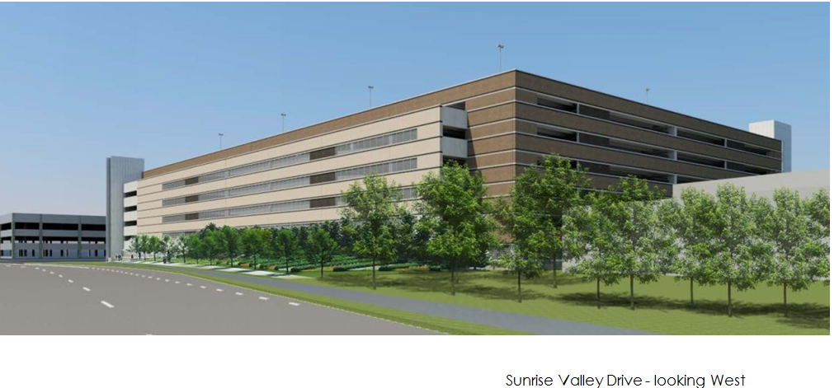
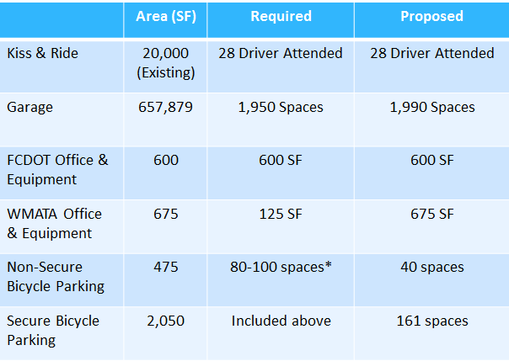
October 13, 2015
Herndon Station Garage

Slide 4
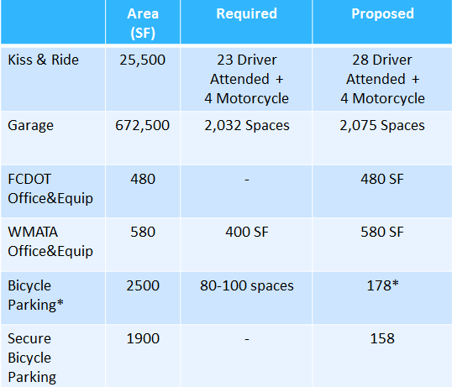
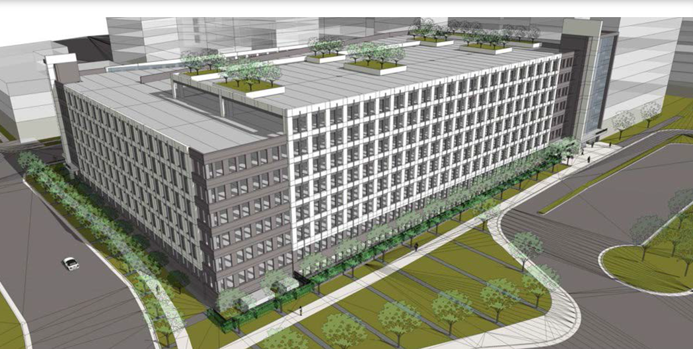
October 13, 2015
Innovation Center Station Garage

