Slide 1
Update on Route 1 Efforts Transportation Advisory Committee October 20, 2015 Leonard Wolfenstein, FCDOT Jane Rosenbaum, FCDOT Doug Miller, FCDOT
Department of Transportation

Slide 2
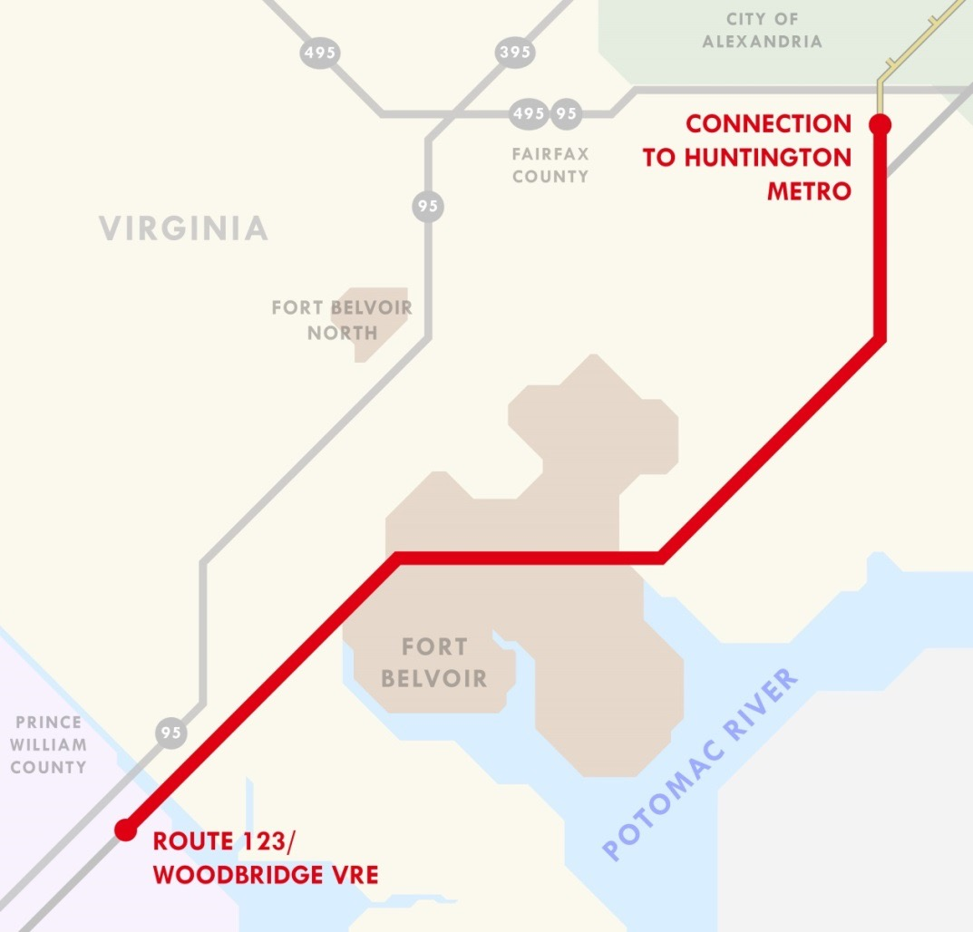
Route 1 Corridor
16- mile section of Route 1
Extends from I-95/I-495 Beltway area, through Fairfax County, to Route 123 at Woodbridge in Prince William County
Department of Transportation
2

Slide 3
Multiple Projects
Route 1 Widening (VDOT)
Telegraph Rd. to Route 235 - BRAC project – Under Construction
Route 235 to Napper Road – Next project
Environmental Analysis
Design
Comprehensive Plan Update (Fairfax County)
Planning for BRT (Fairfax County)
Program Management Consultant
Environmental Analysis
Department of Transportation
3

Slide 4
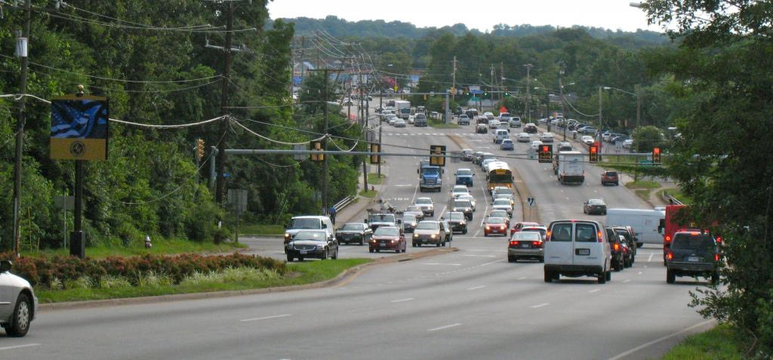
CURRENT CONDITION
4 LANES IN SOUTHERN SECTION
4 LANES IN MIDDLE SECTION
6 LANES IN NORTHERN SECTION
DISCONTINUOUS SIDEWALKS
DESIRED CONDITION
6 LANES (3 NB; 3 SB)
BRT IN MEDIAN
CONTINUOUS PED/BIKE FACILITY

Slide 5
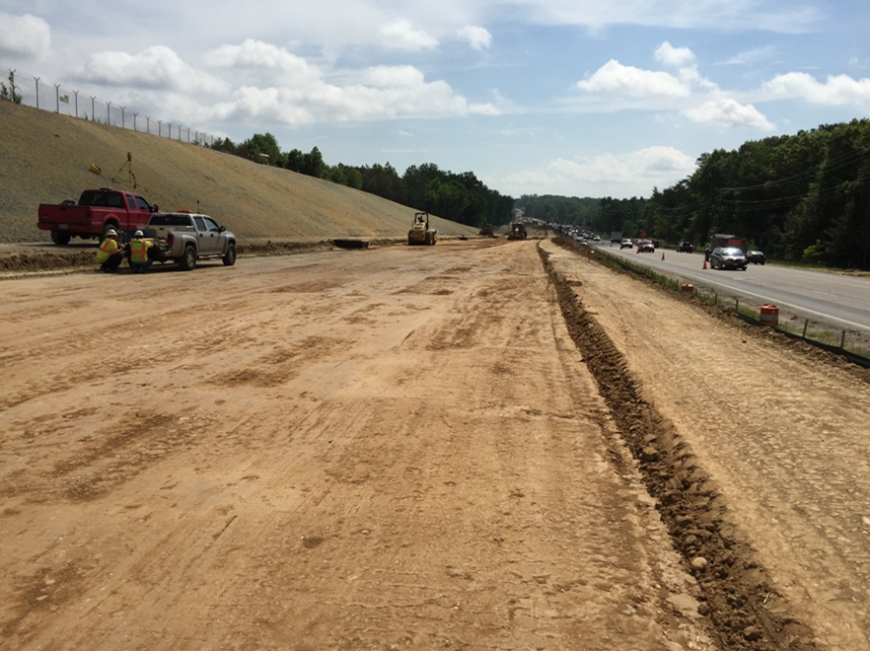
Widening – Fort Belvoir Section
BRAC Project
3.7 Miles
$180 million
Completion Summer 2016
Includes Median for BRT
Department of Transportation
5

Slide 6
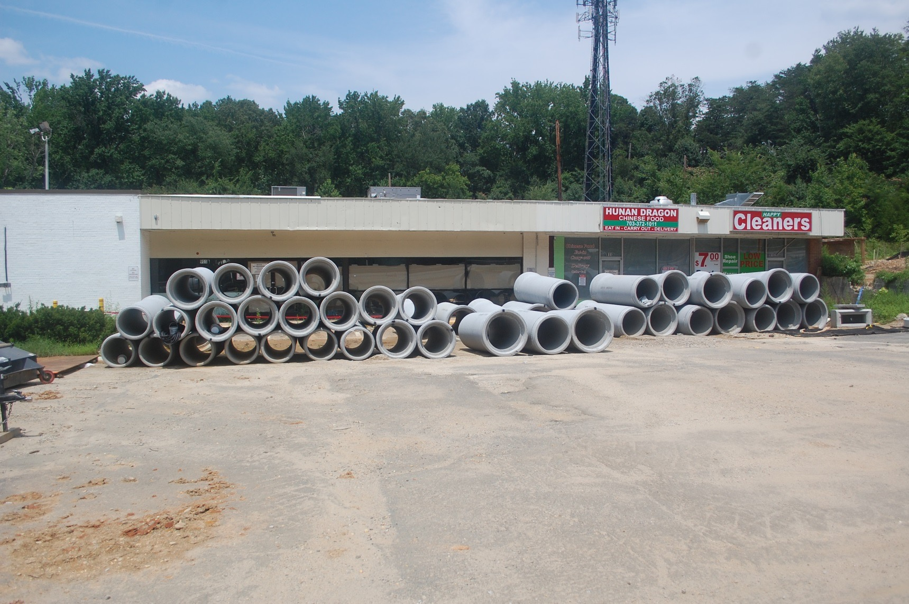
Department of Transportation
6

Slide 7
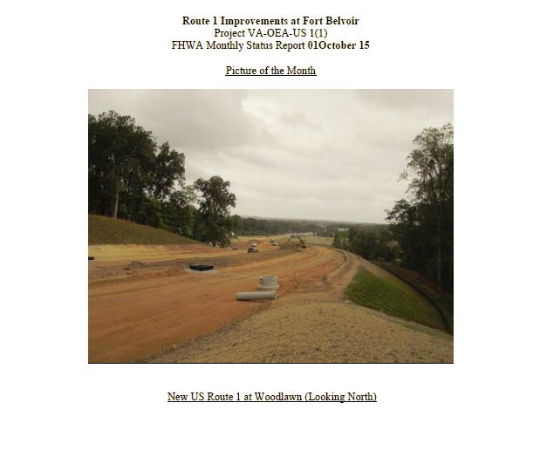
Department of Transportation
7

Slide 8
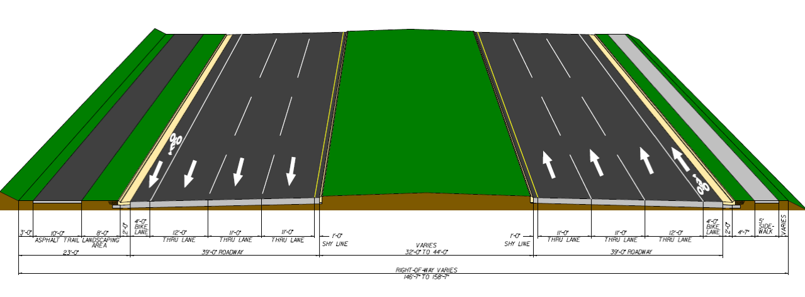
Route 1 – Fort Belvoir Cross Section
Department of Transportation
8

Slide 9
Route 1 Widening – Route 235 to Napper
Addresses a bottleneck (future) between the 6-lane section in the northern portion of the corridor, the 4-lane section in the middle portion of the corridor and 6-lane Fort Belvoir section currently under construction
Preserves right-of-way for future median running BRT
VDOT is lead agency – in collaboration with County
Environmental Analysis – Starting early 2016
Preliminary Design – Starting early 2016
Significant Right-of-Way Challenges Anticipated
Department of Transportation
9

Slide 10
Comprehensive Plan
Key Issues:
Metrorail/BRT Policy guidance
Land use levels at stations
Refining Location of BRT Stations
Station Templates
Cross Section/ROW Impacts
Process:
Advisory Group
Public Outreach
Timeline:
4 Year Timeline Anticipated (Started July 2015)
Department of Transportation
10

Slide 11
Comprehensive Plan Update
Refine BRT stop locations
Refine Land-use, infrastructure, design, etc.
Transportation assessment and modeling
Will identify additional roadway connections and station area street grids
Develop complete street cross-sections and corridor design standards
Will address all transportation modes including walking, biking, taking transit and driving.
Department of Transportation
11

Slide 12
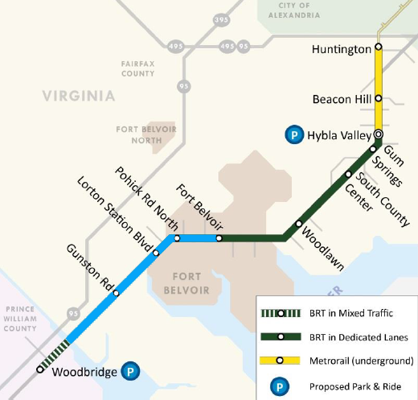
Comprehensive Plan Update
Incorporate Route 1 Multimodal Alternatives Analysis recommendations
DRPT recommendations include:
Phase I: BRT from Huntington to Hybla Valley;
Phase II: BRT to Fort Belvoir;
Phase III: BRT to Route 123 in Woodbridge;
Median running Bus Rapid Transit (BRT) from Huntington along North Kings Highway and Richmond Highway/Route 1 to the Fairfax County boundary;
Route 1 roadway widening from 4 to 6 lanes and additional roadways, where necessary;
Continuous pedestrian and bicycle facilities along corridor; and,
Future Metrorail extension from Huntington to Hybla Valley.
Phase IV: Metrorail extension from Huntington to Hybla Valley
Department of Transportation
12

Slide 13
Comprehensive Plan Update
Public Outreach
EMBARK Advisory Group
SFDC and other stakeholders
Advisory role to provide feedback on
Study direction
Community Outreach
Station locations
Urban Design
Series of open houses for public input
Online Input Opportunity
Department of Transportation
13

Slide 14
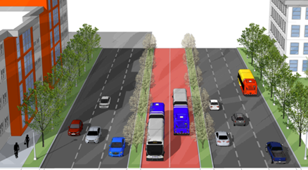
Phasing and Implementation Approach
Huntington
Phase I:
Huntington to Hybla Valley
($306 M)
Hybla Valley
3.1 mi
Fort Belvoir
Napper Rd
Route 1 Widening
(four to six lanes, with reserved median)
Mount Vernon Memorial Highway
Woodbridge

Slide 15
Phasing and Implementation Approach
Huntington
Phase II:
Hybla Valley to Fort Belvoir
($224 M)
Hybla Valley
7.3 mi
Fort Belvoir
Woodbridge

Slide 16
Phasing and Implementation Approach
Huntington
Phase III:
Fort Belvoir to Woodbridge
($472 M)
Hybla Valley
4.6 mi
Fort Belvoir
Woodbridge

Slide 17
Phasing and Implementation Approach
Phase IV:
Metrorail Yellow Line Extension to Hybla Valley*
($1.46 B)
Huntington
Hybla Valley
3.1 mi
*Contingent upon future land use
Fort Belvoir
Woodbridge

Slide 18
Planning for BRT
Program Management Consultant (PMC).
Intended to guide the County through multiple phases of planning and implementation work associated with BRT on the Route 1 corridor. General tasks include the following:
Program Implementation Plan and Timeline
Develop Best Practice Policy Guidance Document
Develop Design Criteria
Aid with Quality Assurance/Quality Control Procedures and Oversight
Assistance RFQ development and scope preparation for Environmental, Final Design and Construction
Initial Environmental Review and Recommendation of level NEPA Documents
Right of Way Acquisition Assistance (Appraisals/Fee)
Develop Project Risk Management Areas
Project Delivery Strategy and Contracting Plan
Public Outreach Plan
3rd Party Coordination
Identify Range of Vehicle, System Infrastructure and Vehicle Acquisition Support including technology
Federal Transit Administration Coordination/Submissions
Financial Analysis including Grant writing support and coordination with FTA submittals
Department of Transportation
18

Slide 19
Thank You Questions/Comments?
Department of Transportation
19

