Slide 1
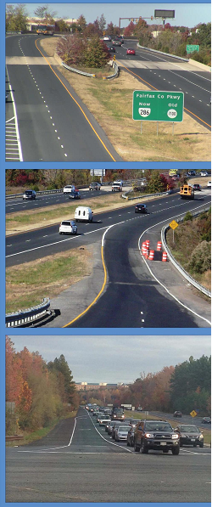
Fairfax County Parkway Corridor Study
Board of Supervisors
Transportation Committee
December 1, 2015
Neil Freschman
Fairfax County Department of Transportation

Slide 2
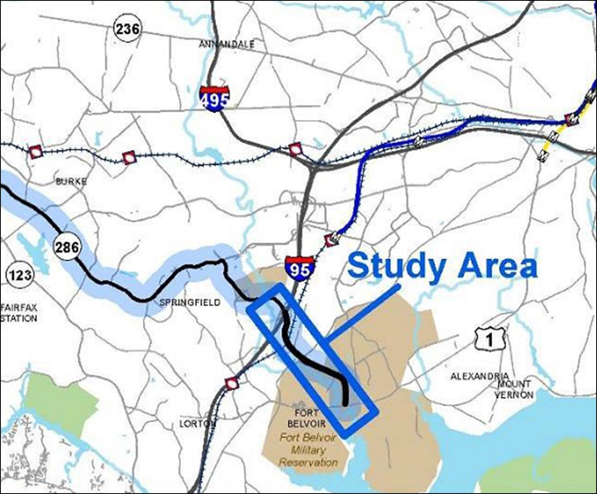
Study Purpose and Scope
Initiated in response to concerns regarding recurring congestion during weekday AM and PM commuter peak periods
Evaluate existing conditions, project traffic growth to 2023, and identify limitations of the current transportation network.
Develop short-term improvements for congestion relief and operational improvements for the study area.
Identify projects that can be scoped, designed, and implemented within the next 5 years, as funding becomes available.
Notes:
Study Limits: FCP between I-95 and Route 1
Short-term improvements include signal timing updates, lane configuration changes, and other minor infrastructure modifications, not to include more substantial infrastructure improvements such as interchanges or major roadway widening.

Slide 3
Recommended Improvements
Improvement B2: Loisdale Road – Add Southbound Left-, Westbound Left-, and Northbound Right-Turn Lanes
Improvement C: Terminal Road - Add Left-Turn Lane along Eastbound Approach
Improvement D: Backlick Road Connector - Realign Backlick Road Northbound approach
Improvement E1: Southbound FCP Ramp to Telegraph Road Intersection - Modify SB Right-Turn Lane to Provide Free-Flow Operation
Improvement F1: John J. Kingman Road - Extend Southbound Left-Turn Lane Storage
Improvement F2: John J. Kingman Road - Widen Westbound Approach and Modify Lane Configurations
Improvement F3: John J. Kingman Road - Add Third Southbound Left-Turn Lane and Extend Southbound Left-Turn Lane Storage
Improvement F4: Southbound Fairfax County Parkway - Add an Auxiliary Lane along Southbound FCP from John J. Kingman Road to US Route 1

Slide 4
Improvement Prioritization
Staff selected the priority improvements that are being considered for funding based on:
Benefit cost analysis
Minimize right-of-way impacts
Overall operational benefit to the corridor

Slide 5
Priority Improvements
Notes:
Study Limits: FCP between I-95 and Route 1
Short-term improvements include signal timing updates, lane configuration changes, and other minor infrastructure modifications, not to include more substantial infrastructure improvements such as interchanges or major roadway widening.

Slide 6
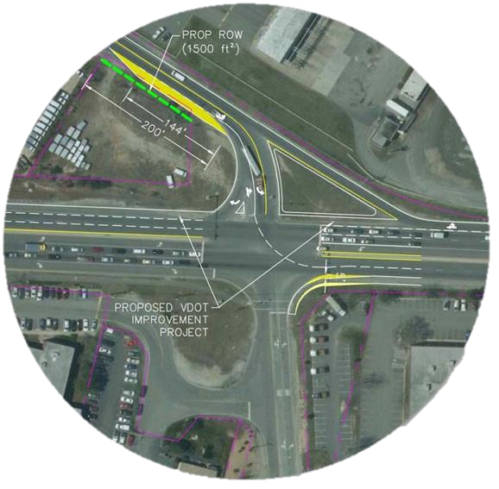
Improvement C: Terminal Road - Add Left-Turn Lane along Eastbound Approach
Improvement Summary:
Add left-turn lane to EB Terminal Road and extend storage length
Design Considerations:
Utilities in SW quadrant will need to be relocated
15-ft receiving lanes on NB FCP are suggested to accommodate heavy truck volumes.
Shared-use path on the east side of FCP would need to be moved 5 ft to the east to accommodate the two 15-ft receiving lanes from Terminal Road.
Project Benefits:
Improves intersection LOS from F to D in the PM peak
Reduces the eastbound left queue length by approximately 200 feet in the AM and PM peak compared to 2023 No Build conditions
Benefit Cost Ratio = 0.9
Planning level cost estimate = $1,485,000
TERMINAL ROAD
FAIRFAX COUNTY PARKWAY
Notes:
[Existing Conditions:] Terminal Road:
2-lane undivided local road, posted 25 mph speed limit west of FCP
EB Terminal has a shared thru-left lane and a channelized right-turn lane at the intersection with FCP.
The EB and WB approaches currently operate with poor Levels of Service (LOS E or F) during the peak hours (Significant EB queuing observed during the PM peak hour)
[Improvement Summary:] In conjunction with a planned VDOT project, a new southbound Route 286 thru/right lane is also considered as part of this intersection improvement. The eastbound improvements could be implemented independent of the VDOT project
[Design Considerations:] Signal modifications will be required for the additional left-turn lane. Short taper along Terminal Road will require a VDOT design waiver.

Slide 7
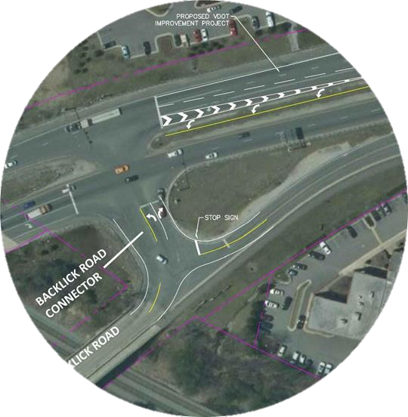
Improvement D: Backlick Road Connector - Realign Backlick Road Northbound approach
Improvement Summary:
Realign the south approach of Backlick Road to re-orient the T-intersection and increase storage length
Design Considerations:
Realignment of the south approach can be tested as an interim design with pavement markings and temporary devices (flex posts and/or rubber curb)
Appropriate turning radius must be provided to accommodate buses and large vehicles.
Project Benefits:
Improves circulation for traffic coming to/traveling from the south leg of Backlick Road. This roadway serves a Fairfax County bus facility and will be the main access for a future WMATA bus facility.
Improves access and line of sight/visibility of the right-turn lane on the Backlick Road Connector
Benefit Cost Ratio N/A
Planning level cost estimate = $96,000
FAIRFAX COUNTY PARKWAY
BACKLICK ROAD
Notes:
[Existing Conditions:] The Backlick Road Connector is a two-lane undivided local road with a posted 25 mph speed limit.
The Backlick Road Connector forms a T-intersection with Route 286 with storage for about 1 to 2 left-turning vehicles. During field observations, this limited storage length in combination with the presence of heavy vehicles was observed to cause vehicle queue spill back along the south leg of Backlick Road. Additionally, when there are vehicles stacked to turn left onto southbound Route 286, the visibility of the westbound right-turn lane from the south Backlick Road approach is blocked. This causes the right-turn lane to be underutilized at times
[Improvement Summary:] In conjunction with a planned VDOT project, a new southbound Route 286 thru lane is also considered as part of this intersection improvement. The VDOT project introduces a new southbound thru lane at the Terminal Road intersection. The additional southbound thru lane will end at this intersection. The Backlick Road Connector improvements could be implemented independent of the VDOT project.
[Design Considerations:]
The realigned T-intersection will require the removal of the Backlick Road northbound approach stop sign.
Costs of new permanent curb and gutter are not included in this improvement but could be explored in subsequent phases of this project
Turning movement counts should be collected and reviewed to further confirm the applicability of the concept design and possible queuing.
Concept should be reviewed with local stakeholders.

Slide 8
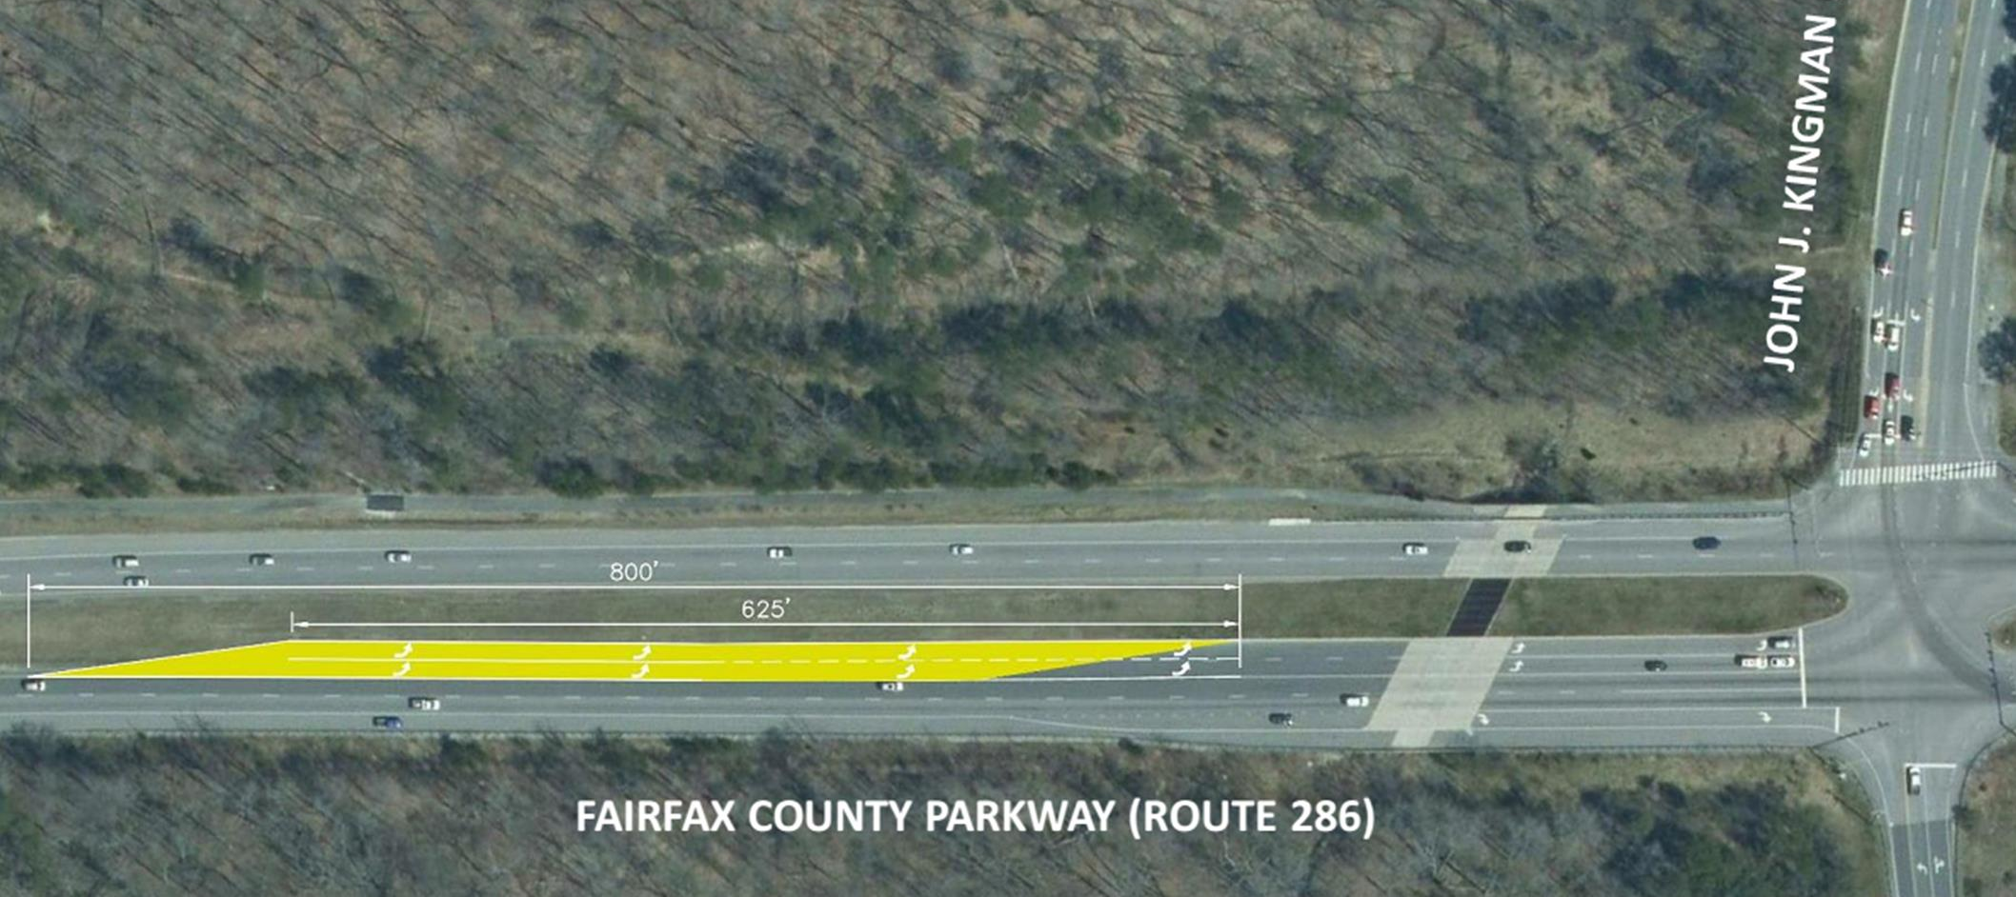
Improvement F1: John J. Kingman Road - Extend Southbound Left-Turn Lane Storage
Improvement Summary:
The project consists of increasing the storage capacity of the SB FCP left-turn lanes at John J. Kingman Road by extending the SB left-turn lanes.
Design Considerations:
John J. Kingman Gate sign in the median will need to be relocated.
Will need to coordinate with the future access to the proposed National Museum of the United States Army
Project Benefits:
Increases SB left storage to 1000’ per lane, to accommodate future AM peak hour queue length.
Minimizes blocking of thru lanes by left-turn queues, and allows left-turning vehicles to access left turn lane when a long thru queue is present
Benefit Cost Ratio N/A
Planning level cost estimate = $460,000
Notes:
[Existing Conditions:] John J. Kingman Road is a four-lane local road with a posted speed limit of 35 mph.
provides access to and from Fort Belvoir northern facilities such as the DLA/DCAA HQ Complex and the North Post Golf Course.
Further access into Fort Belvoir is restricted via the John J. Kingman Gate. There are two left-turn lanes along the southbound Route 286 approach at John J. Kingman Road.
During the AM Peak hour, a long queue was observed along southbound Route 286 at this intersection. The southbound queue was caused by heavy southbound left-turning vehicles and spillover of left-turning vehicles into the thru lanes. During the PM peak hour, the southbound thru queues block access to the turn lanes. Additionally there is a long queue along John J. Kingman Road for exiting vehicles.
The intersection operates at Level of Service D and F in the AM and PM peak hours, respectively

Slide 9
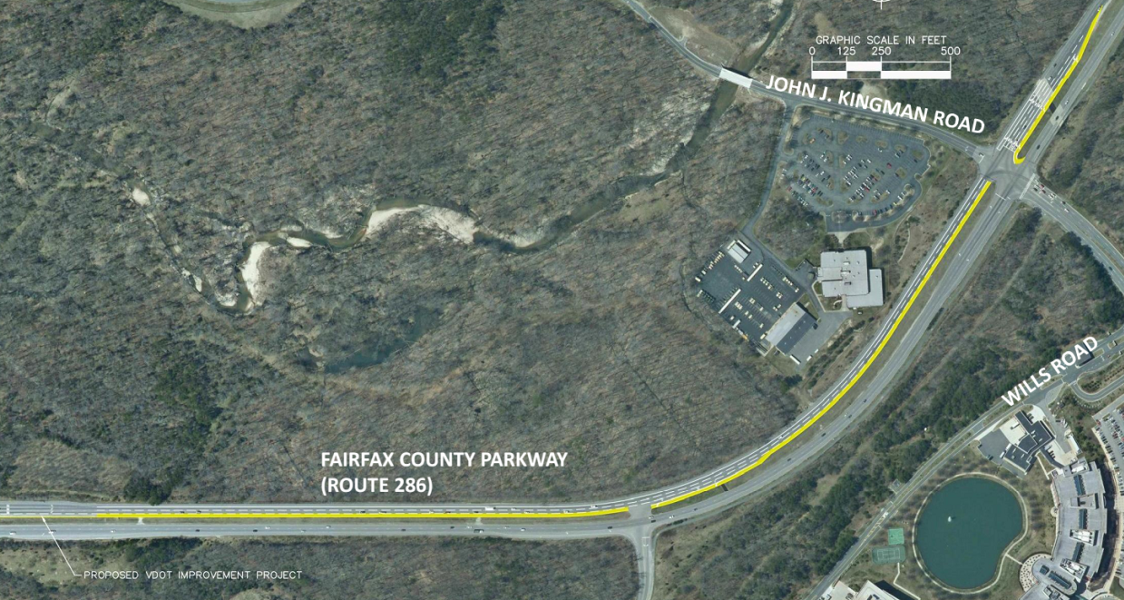
Improvement F4: Southbound Fairfax County Parkway- Add an Auxiliary Lane along Southbound FCP from John J. Kingman Road to US Route 1
Improvement Summary:
Increase the capacity of FCP in the vicinity of John J. Kingman Road by adding a third thru lane in the SB direction to Route 1.
Design Considerations:
Signal modifications will be required to accommodate the auxiliary lane. Design will need to be coordinated with VDOT project at Route 1.
Project Benefits:
Increases capacity of SB FCP.
Reduces potential of through vehicle queuing to block left-turning vehicles at the intersection
Reduces the overall intersection vehicle delay
Benefit Cost Ratio = 5.1
Planning level cost estimate = $3,226,000
Notes:
[Existing Conditions:] John J. Kingman Road is a four-lane local road with a posted speed limit of 35 mph.
The road provides access to and from Fort Belvoir northern facilities such as the DLA/DCAA HQ Complex and the North Post Golf Course. Further
access into Fort Belvoir is restricted via the John J. Kingman Gate.
There are two left-turn lanes along the southbound Route 286 approach at John J. Kingman Road. Route 286 has two thru-lanes in each direction in this area.
During the PM peak hour, the southbound thru queues block access to the left-turn lanes.
The intersection operates at Level of Service D and F in the AM and PM peak hours, respectively.
[Improvement Summary:]
The auxiliary lane is proposed to begin near the location of the existing southbound left turn lane at the intersection of Route 286 and John J. Kingman Road (approximately 500 feet north of the intersection).
A separate VDOT project is under construction to widen Route 1 and improve the Route1/Route 286 intersection. It is envisioned that this auxiliary lane would connect to a turn lane of the VDOT project
[Design Considerations:]
Traffic signal coordination will be required with any timing adjustments
Regulatory signs in the median will need to be relocated.

Slide 10
Other Improvements For Future Consideration
Four improvements are not being considered for funding at this time based on:
Potential right-of-way impacts
Relatively lower regional operational benefits
Notes:
Study Limits: FCP between I-95 and Route 1
Short-term improvements include signal timing updates, lane configuration changes, and other minor infrastructure modifications, not to include more substantial infrastructure improvements such as interchanges or major roadway widening.

Slide 11
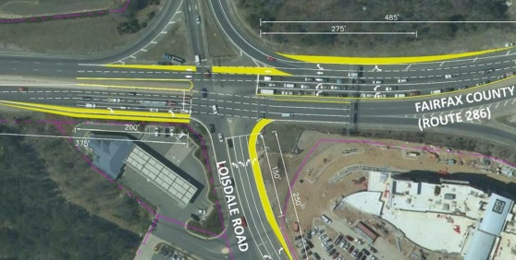
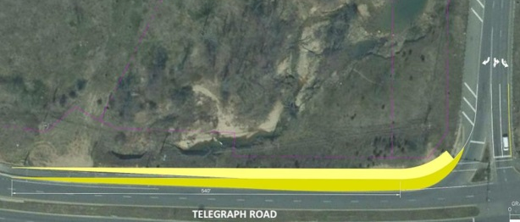
Other Improvements For Future Consideration
Improvement B2: Additional turn lanes at Loisdale Road and FCP
Improvement E1: Change the right-turn lane from southbound FCP to Telegraph Road to provide free-flow operation
Planning level cost estimate = $2,909,000
Planning level cost estimate = $1,231,000
FAIRFAX COUNTY PARKWAY
Notes:
Study Limits: FCP between I-95 and Route 1
Short-term improvements include signal timing updates, lane configuration changes, and other minor infrastructure modifications, not to include more substantial infrastructure improvements such as interchanges or major roadway widening.

Slide 12
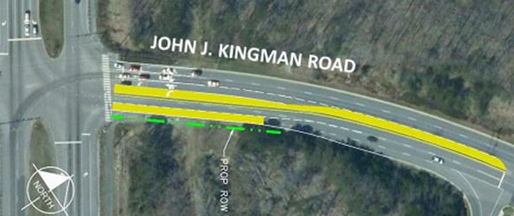
Other Improvements For Future Consideration
Improvement F2: Widen westbound approach of John J. Kingman Road at FCP
Improvement F3: Add Third southbound Left-Turn Lane on FCP at John J. Kingman Road
Planning level cost estimate = $1,408,000
Planning level cost estimate = $2,066,000
Notes:
Study Limits: FCP between I-95 and Route 1
Short-term improvements include signal timing updates, lane configuration changes, and other minor infrastructure modifications, not to include more substantial infrastructure improvements such as interchanges or major roadway widening.

Slide 13
Next Steps
Identify potential funding sources
Establish a timeline for improvement implementation
Begin project scoping
Improvement design
Acquire ROW as necessary
Utility relocation
MOT design
Improvement construction

Slide 14
Summary of Priority Improvements
Improvement C: Terminal Road - Add Left-Turn Lane along Eastbound Approach
Planning level cost estimate = $1,485,000
Improvement D: Backlick Road Connector - Realign Backlick Road Northbound approach
Planning level cost estimate = $96,000
Improvement F1: John J. Kingman Road - Extend Southbound Left-Turn Lane Storage
Planning level cost estimate = $460,000
Improvement F4: Southbound Fairfax County Parkway - Add an Auxiliary Lane along Southbound FCP from John J. Kingman Road to US Route 1
Planning level cost estimate = $3,226,000

Slide 15
Reference Maps – Priority Improvements

Slide 16
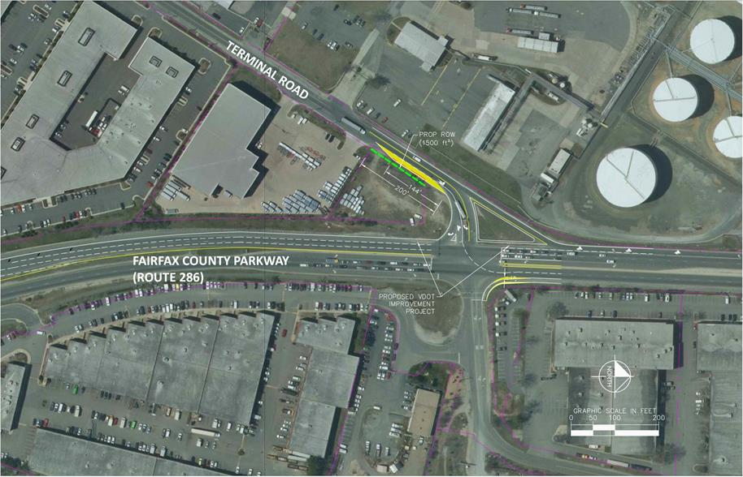
Improvement C: Terminal Road - Add Left-Turn Lane along Eastbound Approach

Slide 17
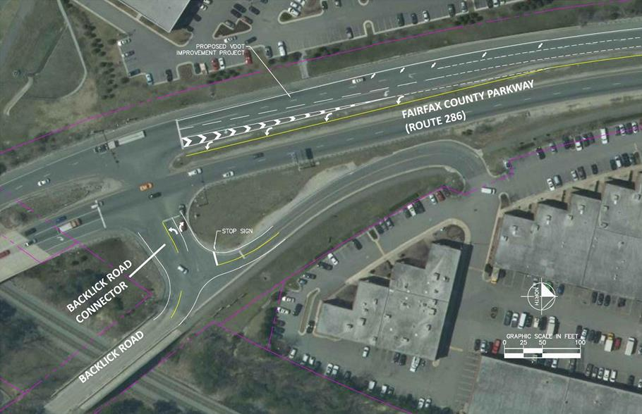
Improvement D: Backlick Road Connector - Realign Backlick Road Northbound approach

Slide 18
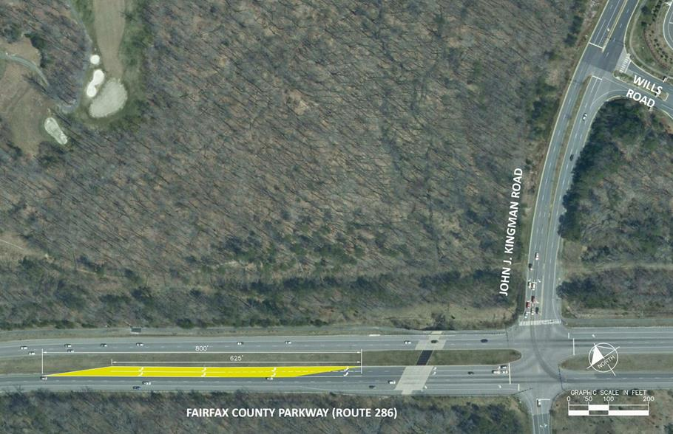
Improvement F1: John J. Kingman Road - Extend Southbound Left-Turn Lane Storage

Slide 19
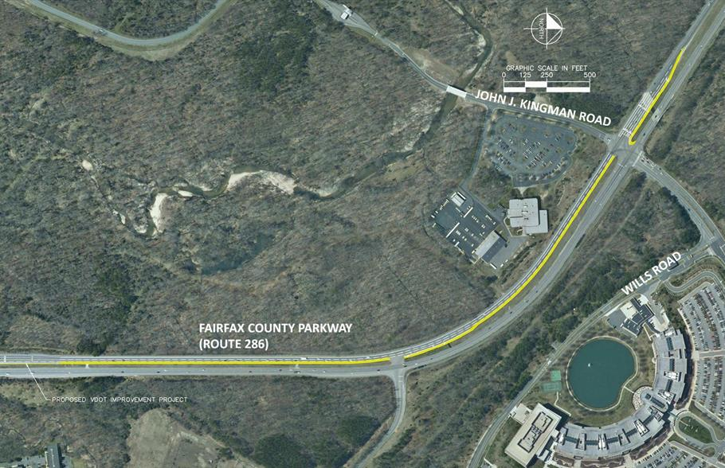
Improvement F4: Southbound Fairfax County Parkway- Add an Auxiliary Lane along Southbound FCP from John J. Kingman Road to US Route 1

Slide 20
Reference Maps – Other Improvements for Future Consideration

Slide 21
Improvement B2: Loisdale Road – Add Southbound Left-, Westbound Left-, and Northbound Right-Turn Lanes
Improvement Summary:
Increase the capacity of the SB, NB, and WB intersection approaches by adding an additional SB left-turn lane, an exclusive NB right-turn lane, and constructing an additional WB left-turn turn lane.
Design Considerations:
WB left- and NB right-turn lanes may require ROW. NB right may require the relocation of the shared-use path. Left-turn lane along Loisdale Road will require a raised median, impacting commercial property access
Project Benefits:
Increases capacities of SB left, WB left, and NB right-turn movements
Minimizes potential for turning vehicles queues to block though lanes
Reduces overall intersection delay in both peak hours and improves PM LOS
Reduces delays for SB left, WB left, and NB thru movements in both peak hours
Reduces queues for WB and SB left-turn movements in both peak hours
Estimated Cost = $2,909,000
Notes:
[Existing Conditions:] Loisdale Road is a two-lane, undivided minor arterial with a posted speed limit of 35 mph.
The southbound approach along Route 286 has two thru lanes and an exclusive left-turn lane at the intersection with Loisdale Road. The northbound approach along Route 286 has two thru lanes and a shared thru and right-turn lane at the intersection with Loisdale Road. The westbound approach has an one exclusive left turn lane and two exclusive right turn lanes at the intersection with Loisdale Road. The existing intersection operates at an overall Level of Service D and C during the AM and PM peak hours.
[Improvement Summary:] There is approximately $338,000 in proffers collected for improvements at this location
[Design Considerations:]
Guardrail and guide sign gantry may need to be replaced to accommodate the new right-turn lane along Southbound Route 286.
Dual left turn lanes lanes may create lane alignment issues through the intersection and will require two 15-foot receiving lanes
Above ground utilities and lighting may need to be replaced or relocated
Traffic signal coordination will be required with any timing adjustments
Lane transitions through an intersection are not desirable by VDOT.
Minor grading/improvements may be required in the existing gore area

Slide 22
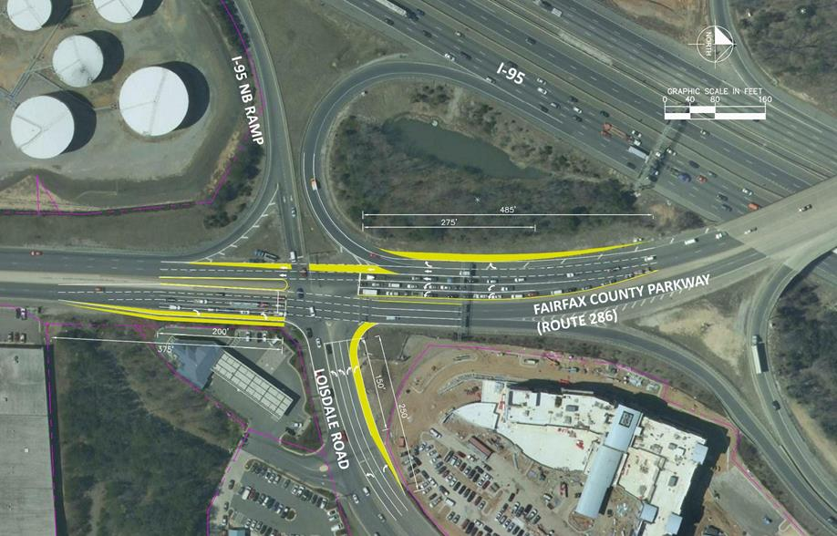
Improvement B2: Loisdale Road – Add Southbound Left-, Westbound Left-, and Northbound Right-Turn Lanes

Slide 23
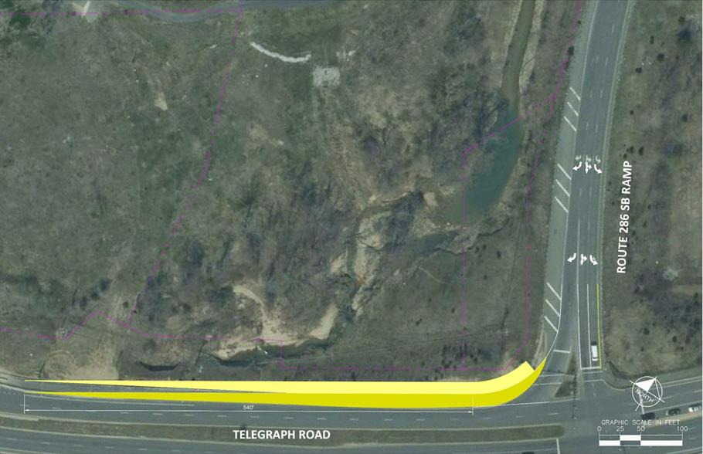
Improvement E1: Southbound Route 286 Ramp to Telegraph Road Intersection - Modify SB Right-Turn Lane to Provide Free-Flow Operation

Slide 24
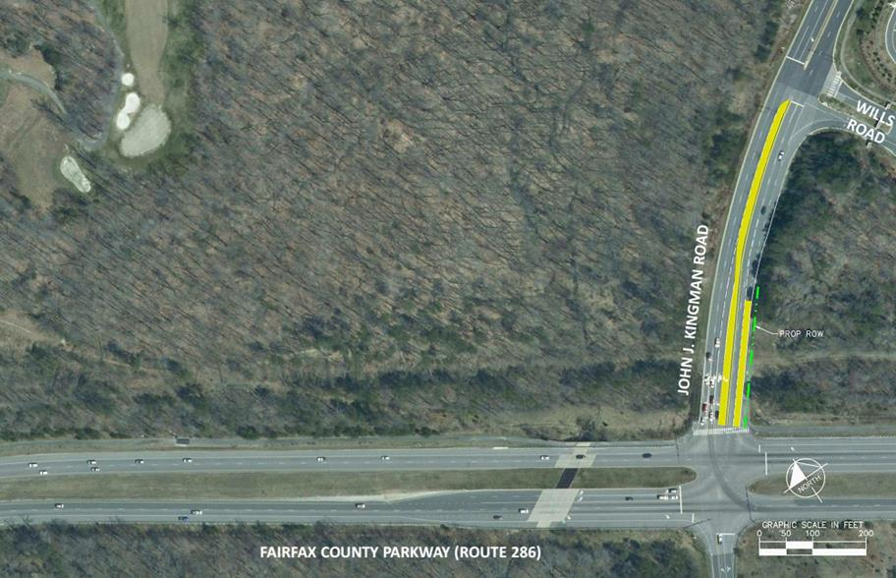
Improvement F2: John J. Kingman Road - Widen Westbound Approach and Modify Lane Configurations

Slide 25
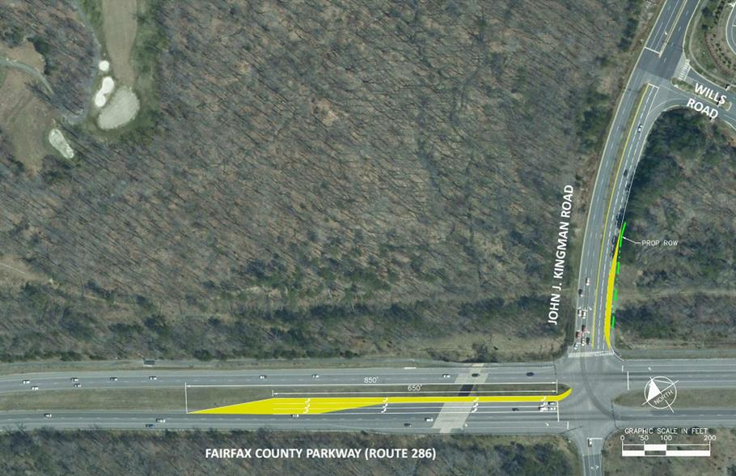
Improvement F3: John J. Kingman Road - Add Third Southbound Left-Turn Lane and Extend Southbound Left-Turn Lane Storage

