Slide 1
Silver Line Update
Board Transportation Committee
December 1, 2015
Mark Canale
Fairfax County Department of Transportation

Slide 2
Status
Phase 1
VDOT, WMATA, Fairfax Punchlist – Ongoing
Fairfax County – 37 open items
VDOT with majority of open punch list items
Dulles Transit Partners Project Closeout anticipated at the end of 2015 (task order contractor work will continue in 2016)
Art in Transit Completion Scheduled – End Feb 2016
Phase 1 close out - $2.982B
Phase 2
Total Project Status (all bid packages)
Overall Project – 26%
Design – 94%
Construction – 10%
Highlights
Tower crane at Innovation Center Station
All Stations in Fairfax County have construction and/or utility work ongoing
Loudoun County Stations in design
Aerial Guideway at Dulles Airport under construction
Rail Yard at Dulles Airport in design
Herndon Monroe – Change in traffic pattern for utility work
Herndon and Dulles Station Tower Crane – December 2015
Earthwork continues for Dulles Rail Yard
Budget - $2.775B
Total Contingency - $551.4M (Remaining $496M)
Contract extension costs under negotiations between MWAA and CRC
Significant County Activities – Past 60 Days
Herndon Monroe (MWAA) utility work beings in kiss and ride area
Coordinated maintenance of traffic with MWAA, CRC, and Fairfax Connector for utility work
Phase 2 Design Reviews
County Coordination
Project Partners (MWAA, VDOT, DRPT, WMATA, Loudoun County, Town of Herndon, Landowners)
Herndon and Innovation Center Stations Garages – Ongoing design work
Innovation North and Reston Town Center North under review by DPZ (SE)
Reston P and Z meeting on Reston Town Center Station – Nov 16, 2015
Innovation South SE Approval (Pavilion)
Planning Commission – Oct 1, 2015
Board of Supervisors – Oct 20, 2015

Slide 3
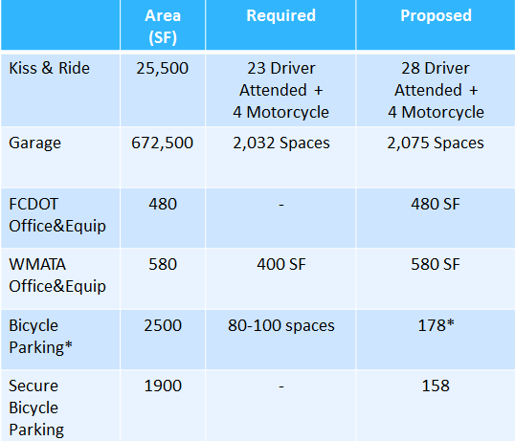
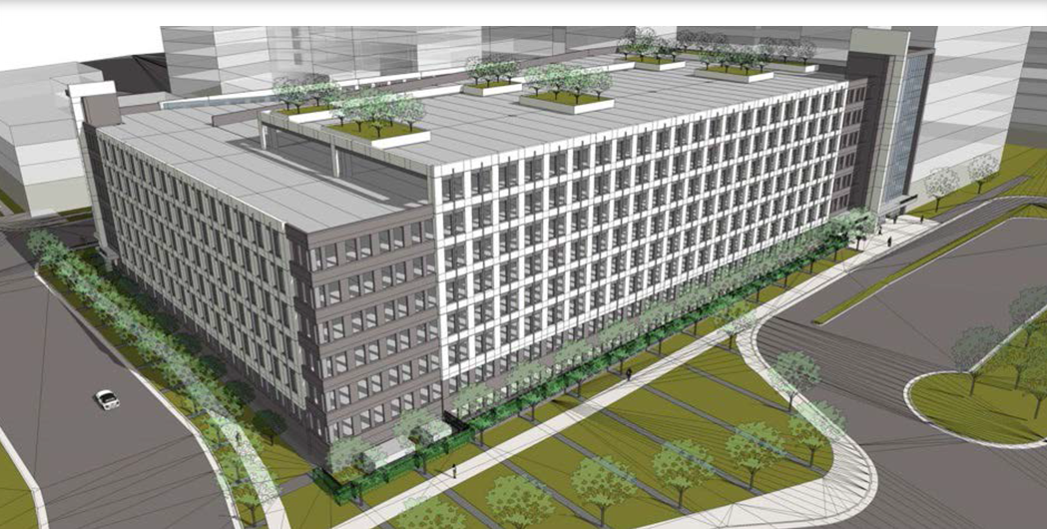
Innovation Center Station Garage

Slide 4
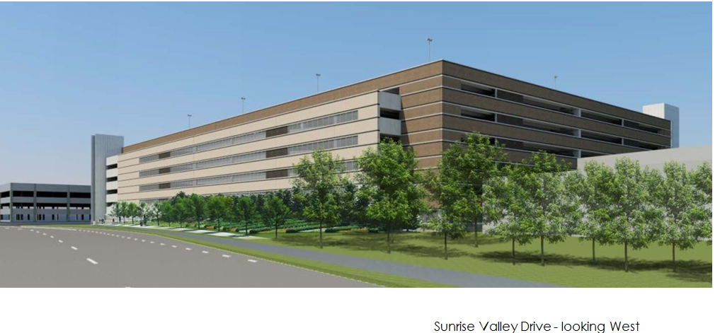
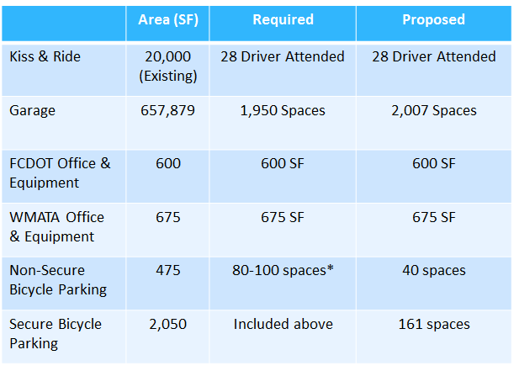
Herndon Station Garage

Slide 5
Questions?

