Slide 1
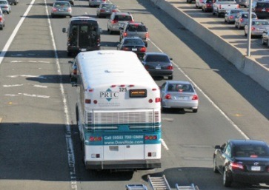
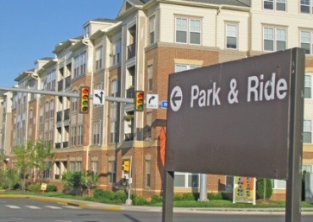
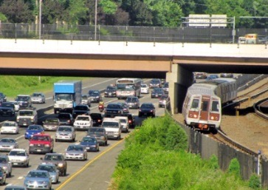
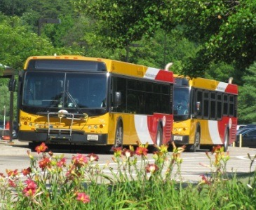
FAIRFAX COUNTY
COUNTYWIDE TRANSIT NETWORK STUDY
Proposed High Quality Transit Network
January 19, 2016
Transportation Advisory
Committee
Arpita Chatterjee
Fairfax County Department of Transportation
Notes:
Thanks to Sharon Bulova for introductory remarks.
Pleased to introduce proposed HQTN concept at tonight’s briefing.
Introductions
Glad to be at the stage of the study with recommendations
Presenting our Proposed HQTN Concept and its measures of effectiveness
Beginning about a month of dialogue
6/18 with interagency technical working group and Transportation Advisory Commission
6/25 briefing materials made available to Board members
7/10 public meeting 6 – 9 PM open house
IdeaScale site

Slide 2
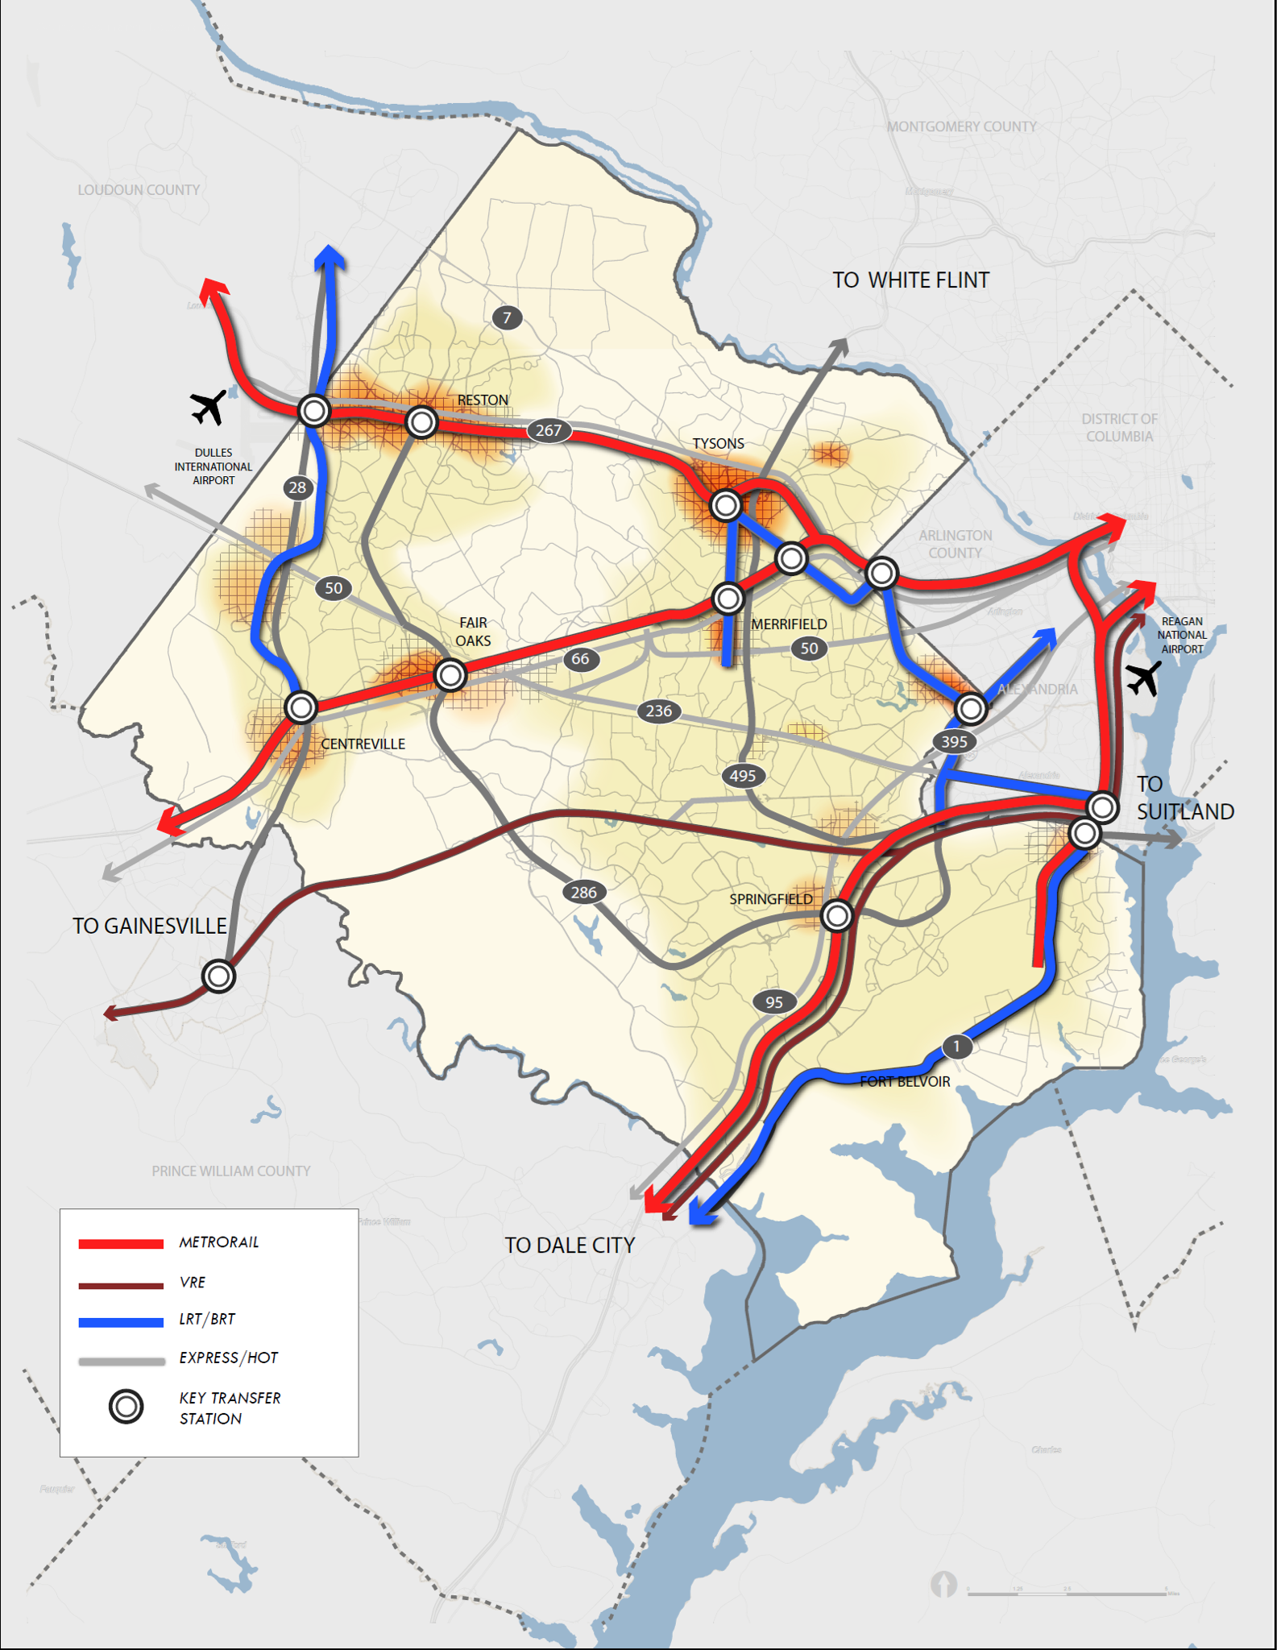
Presentation Context
This presentation summarizes the draft recommendations for Fairfax County’s proposed High Quality Transit Network (HQTN).
The study team is currently conducting analyses to reflect the most recently adopted (October 2015) Constrained Long Range Plan and plans to present the proposed HQTN to the public in early 2016.
Notes:
The current plan has EPTCs:
Silver Line planned as now being constructed
I-66 recommends Metrorail extension to Centreville
US 1 has station locations, but identifies several optional modes
Otherwise, plan is silent on transit function or technology

Slide 3
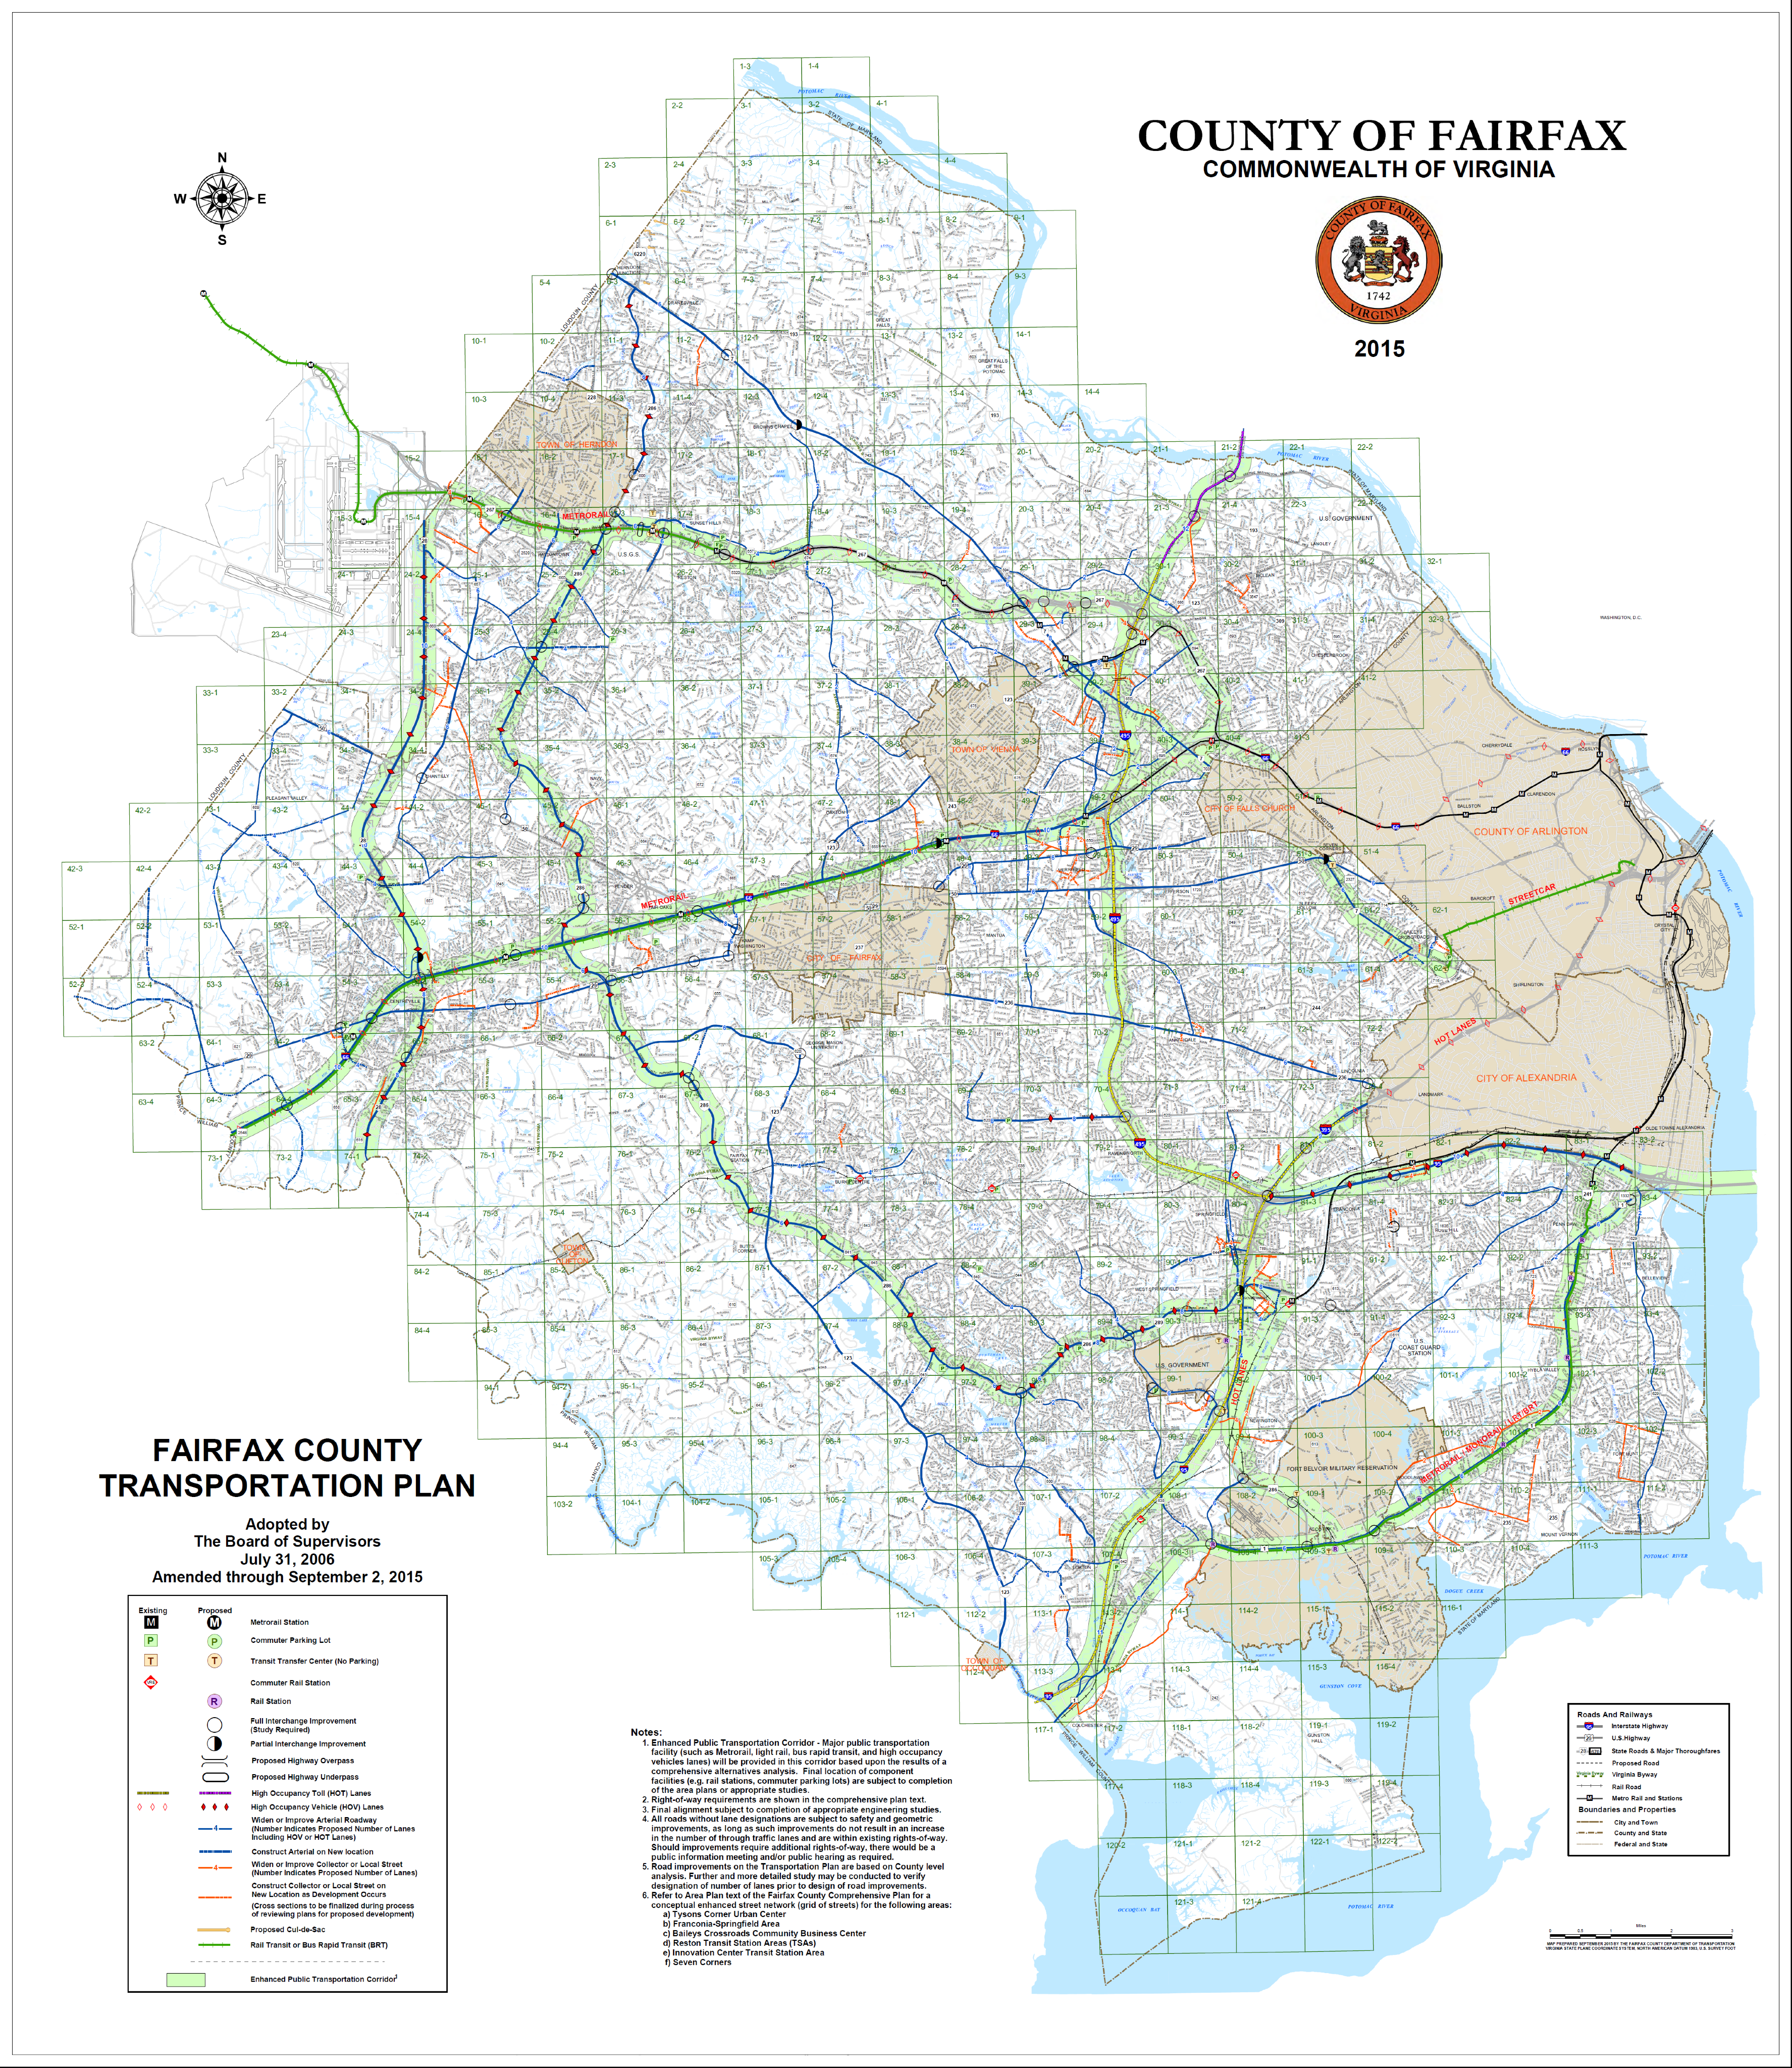
Study Purpose
Establish the most effective way to serve the County’s future growth by improving public transit usage.
Replace the Enhanced Public Transportation Corridors (EPTC) in the Comp Plan with High Quality Transit Network (HQTN) and further define modes, right-of-way needs, and station locations.
Notes:
The current plan has EPTCs:
Silver Line planned as now being constructed
I-66 recommends Metrorail extension to Centreville
US 1 has station locations, but identifies several optional modes
Otherwise, plan is silent on transit function or technology

Slide 4
Study Process
We are at the final stage of public involvement and review:
Goals/objectives (July 2012)
Corridor functions (November 2012)
Proposed High Quality Transit Network Concept (July 2013)
Final concept (early 2016)
Our remaining steps are to:
Reflect current CLRP as baseline
Complete stakeholder engagement
Develop additional details on alignments, stations, and costs
Finalize recommendations
Notes:
We’ve had two public meetings to date:
Setting the stage with goals and objectives (July 2012)
Considering alternative functional transit plans (November 2012)
We are now presenting our proposed concept.
If we find general concurrence with this concept, we will move forward in early fall to develop more specific recommendations on ROW and station location details, and wrap up in November

Slide 5
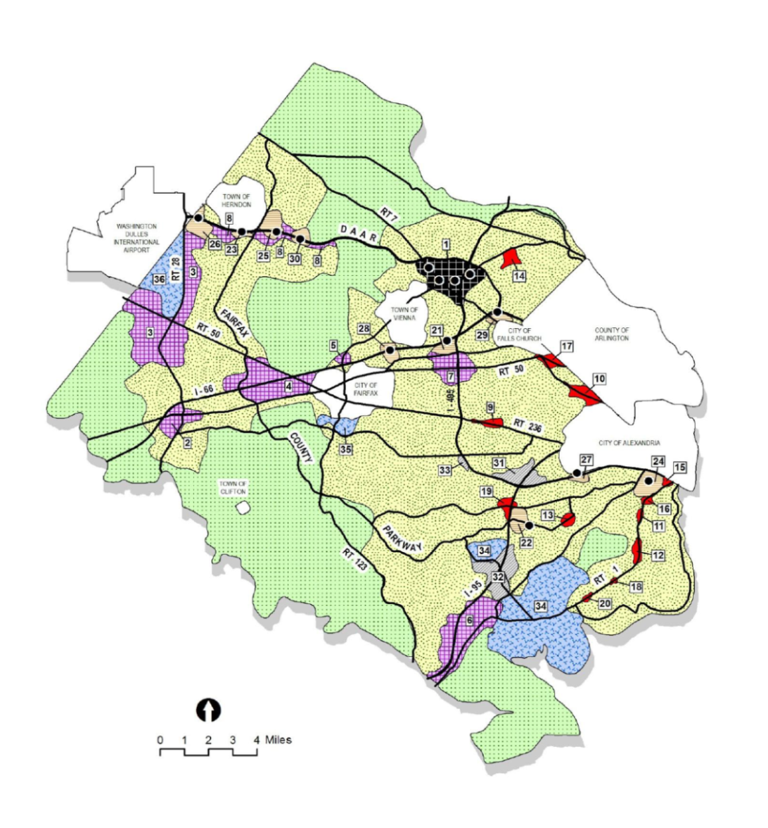
Land Use Concept
The proposed HQTN supports the County’s Concept for Future Development by focusing on service to and from activity centers both within the County and region-wide.
Notes:
Planned growth: The County’s development pattern is largely established; there is little available land for either greenfield development or new roads. New growth is desired and will happen – this forms our study baseline. However, we also have some recommendations for strategic land use changes to enhance TOD opportunities, particularly in the Richmond Highway and Route 28 corridors.
While we do recommend some corridor-specific land use changes, the Proposed HQTN does maintain the overall Future Development Concept.
Review proportions: 37% low density, 48% suburban neighborhoods, 5% institutional, and 10% mixed-use centers
Organization of land use densities lends itself to our TOD destination corridors

Slide 6
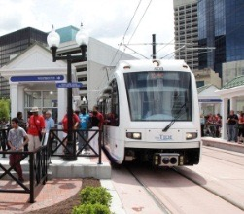
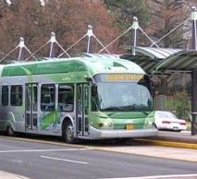
High Quality Transit
Defining elements of the HQTN include providing improved travel speeds and reliable travel times, typically on exclusive right-of-way.
Commuter rail, Metrorail, LRT, and BRT are all examples of High Quality Transit modes.
Notes:
Planned growth: The County’s development pattern is largely established; there is little available land for either greenfield development or new roads. New growth is desired and will happen – this forms our study baseline. However, we also have some recommendations for strategic land use changes to enhance TOD opportunities, particularly in the Richmond Highway and Route 28 corridors.
While we do recommend some corridor-specific land use changes, the Proposed HQTN does maintain the overall Future Development Concept.
Review proportions: 37% low density, 48% suburban neighborhoods, 5% institutional, and 10% mixed-use centers
Organization of land use densities lends itself to our TOD destination corridors

Slide 7
Transit Corridor Function
The type of premium transit service appropriate for each corridor will reflect the traveler needs and land use context in that corridor.
Destination corridors, like the Crystal City Potomac Yards Transitway, connect neighborhoods to multiple activity centers, functioning primarily to provide access.
Commuter corridors, like the Virginia Railway Express, primarily serve one major activity center and tend to focus on journey-to-work trips and function primarily to provide mobility.
Source: Center for Transit Oriented Development
Notes:
The study recommendations focus first on defining appropriate transit corridor function, and then mode

Slide 8
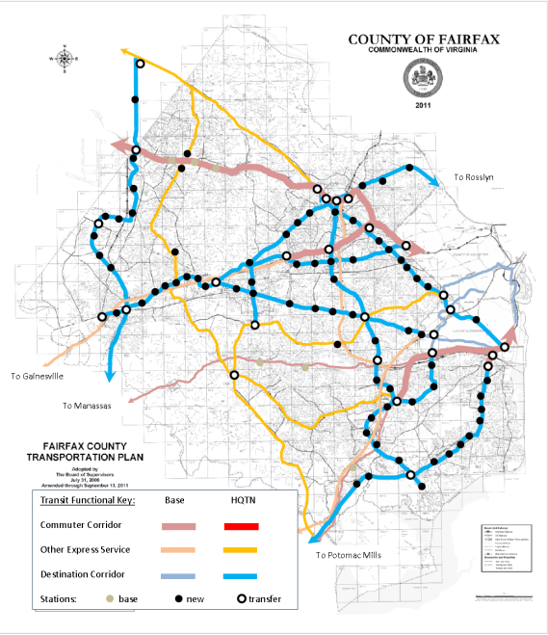
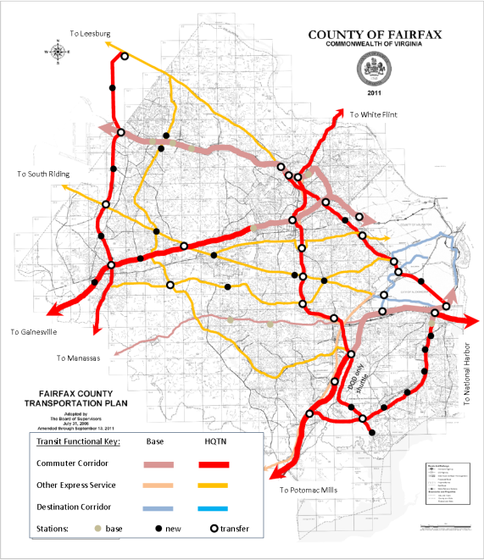
Functional Concepts
Access
Mobility
The November 2012 public meeting presented different functional concepts for a High Quality Transit Network. The access focus attracted more total transit riders, whereas the mobility focus provided better access to regional jobs. Both had a similar benefit in reducing vehicle travel.
Notes:
Notes on slide. Upshot is that access and mobility are both desired attributes, but fixed-guideway transitways don’t serve both objectives equally.

Slide 9
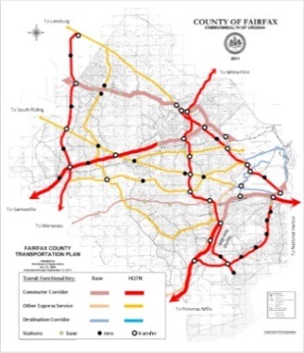
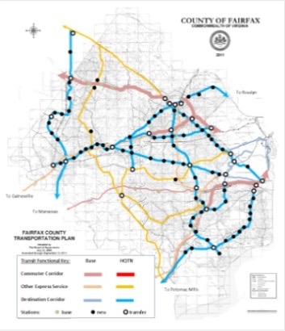
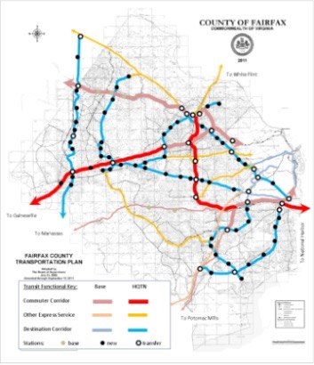
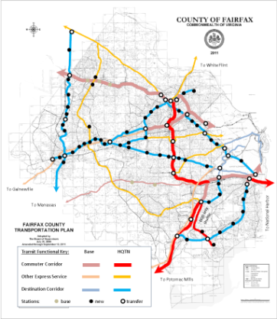
Alternative Concepts
The public values multiple objectives:
Increase access to destinations
Include both high demand commuter and destination corridors
Reduce roadway congestion
Increase transit ridership
Take cars off the road
Encourage TOD
Support Countywide vision for managed growth
Be affordable
Be understandable/usable
Be connected
Four concepts were reviewed with the public in November 2012. The proposed HQTN concept utilizes the best ideas from each for a context-sensitive fit to individual corridor needs.
Notes:
Public recognized the tradeoffs, and recommended considering context-sensitive solutions. In essence, focus on access where land use suggests a linear, densely developed destination corridor. Focus more on mobility in corridors with less compact land use but instead have relatively unobstructed ROW options for longer-distance desire lines.

Slide 10
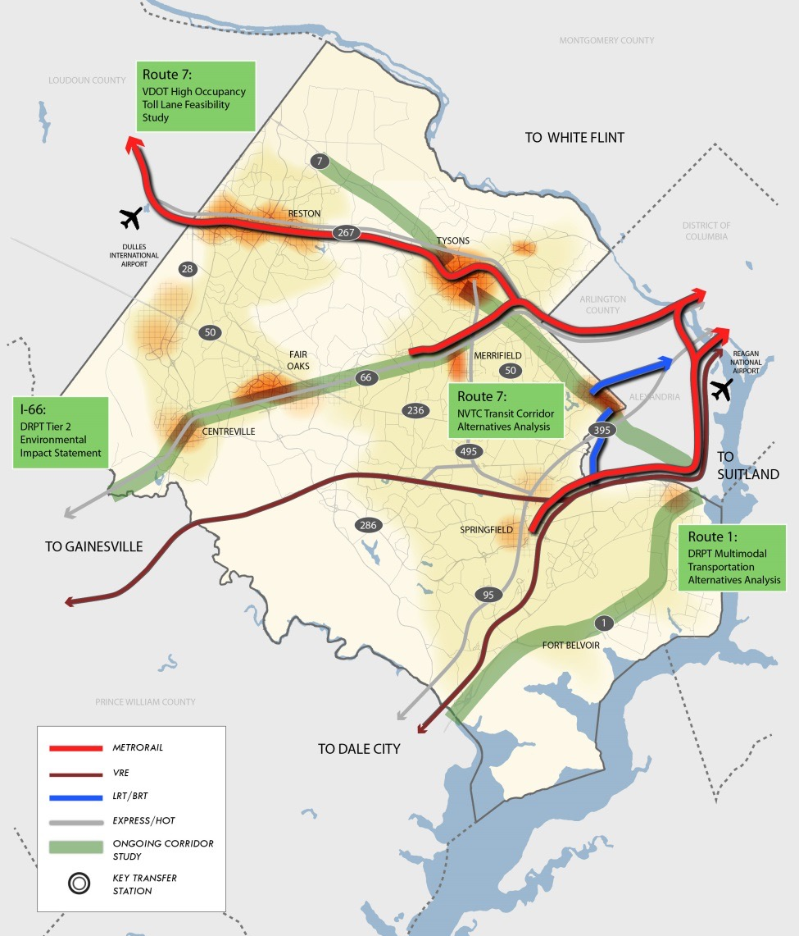
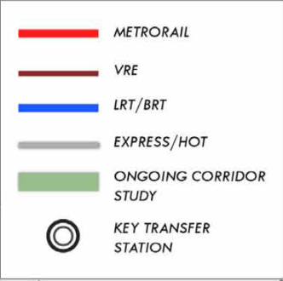
Study Coordination
Extensive coordination with current studies in past two years:
Transform 66
Richmond Highway
Envision Route 7
Alexandria Transitway planning
Route 7 west of Tysons
Coordination at time of 2014 CLRP
Notes:
Building up the story – messages here are essentially the words on the slide.

Slide 11
Proposed HQTN
The proposed HQTN builds upon the existing and CLRP transit investments to create an interconnected network of commuter and destination corridors, supported by connecting express bus routes.
Notes:
The Proposed HQTN concept provides a range of services including those oriented more towards moving long-distance commuters to, from, and through the County (red) and those oriented toward supporting TOD in destination corridors where all-day traffic from one place to another in the corridor is equally important (blue).

Slide 12
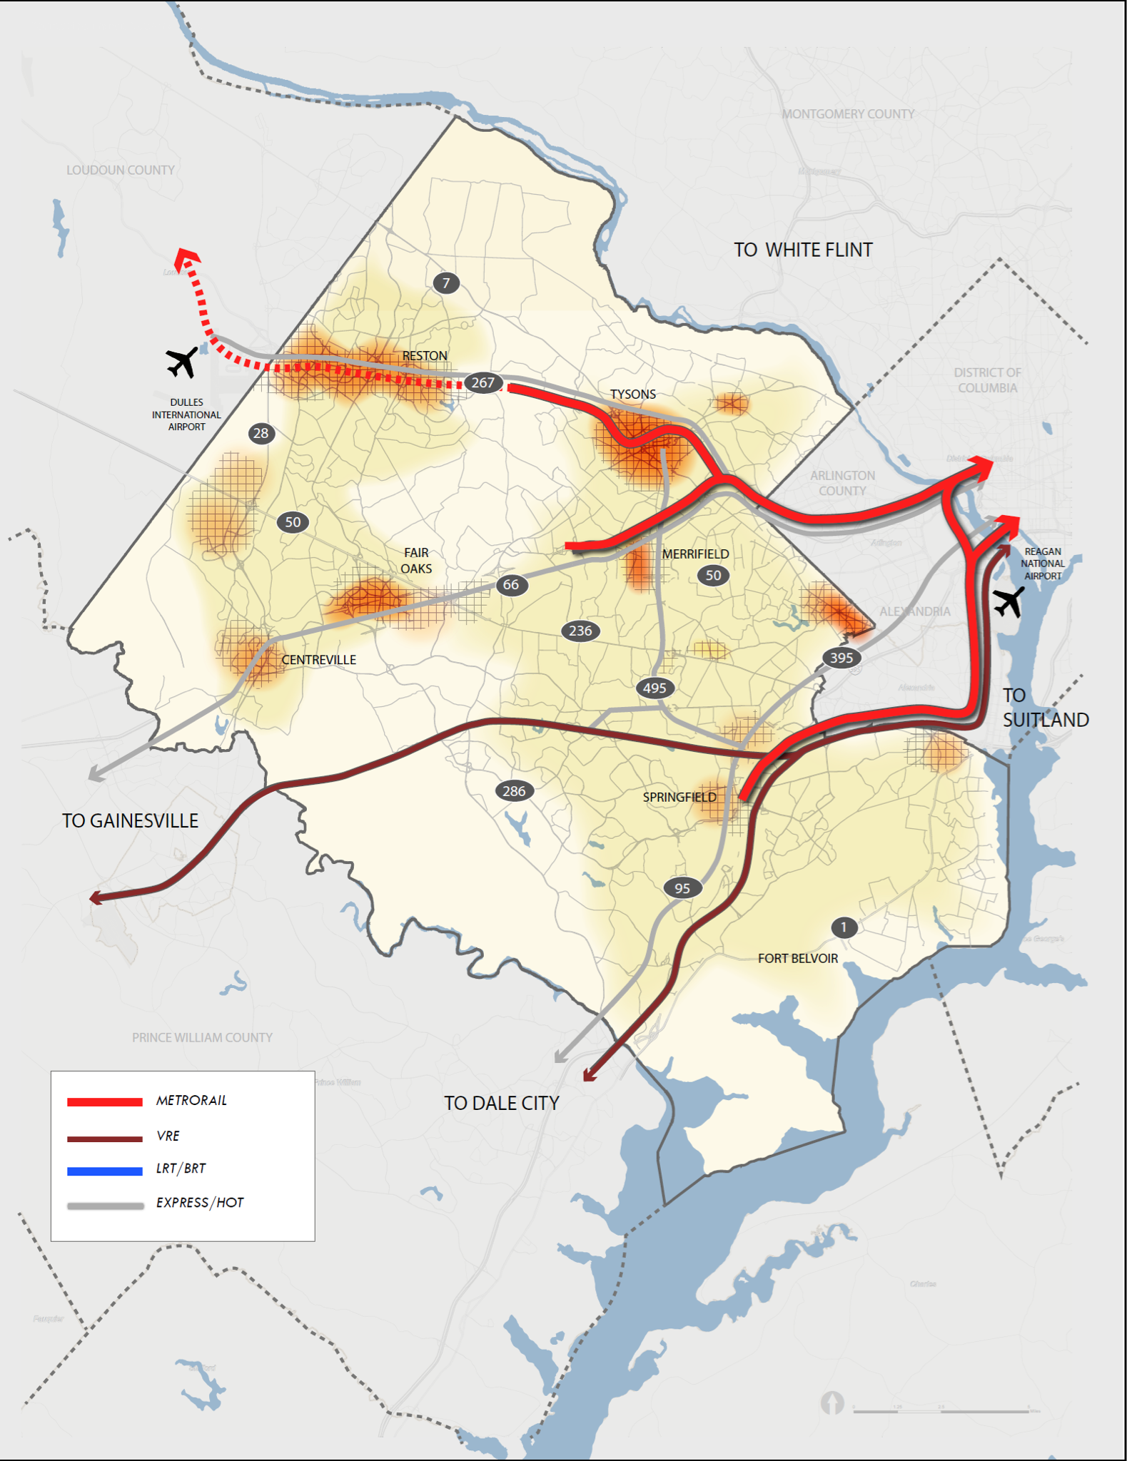
Proposed HQTN Elements
Existing HQTN elements serving Fairfax County include Metrorail and VRE with supportive express bus services on high-occupancy vehicle (HOV) or high-occupancy/toll (HOT) lanes.
Notes:
Building up the story – messages here are essentially the words on the slide.

Slide 13
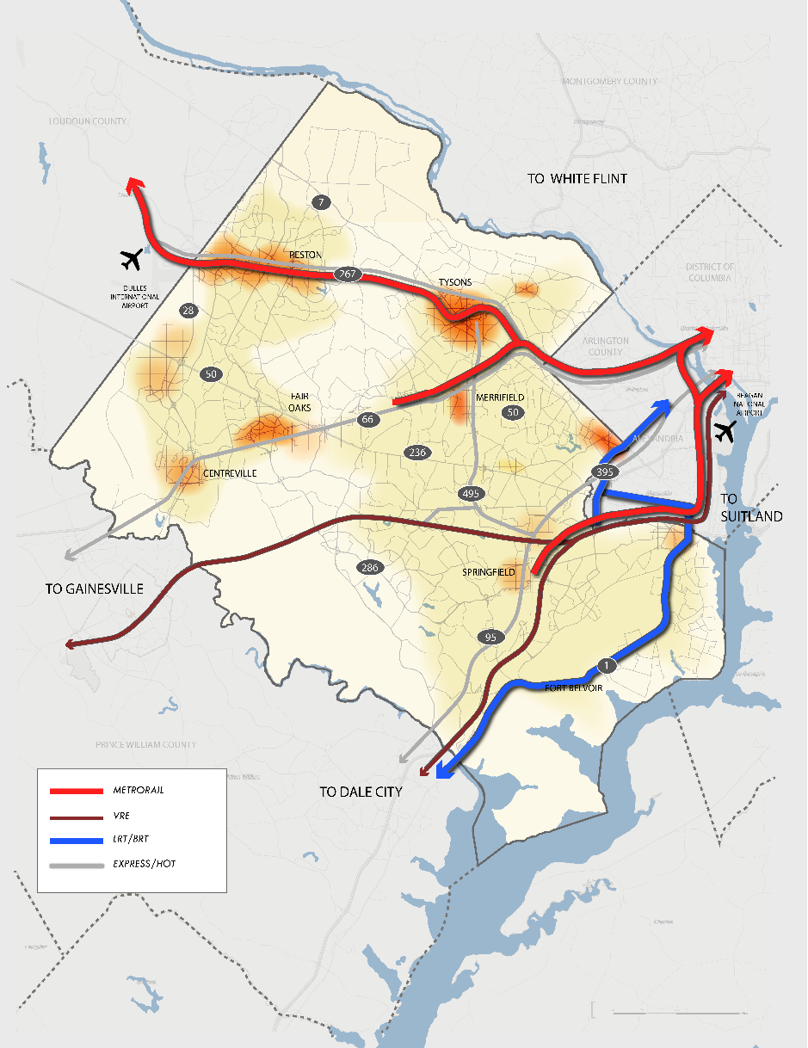
Proposed HQTN Elements (Cont.)
2015 Constrained Long Range Plan transit connections provide the starting point for the proposed HQTN:
Silver Line extension (Metrorail)
Richmond Highway (BRT)
Alexandria’s West End and Duke Street transitways (BRT)
Notes:
Building up the story – messages here are essentially the words on the slide.

Slide 14
Proposed HQTN Elements (Cont.)
Metrorail Extensions provide capacity to both connect Fairfax County with other jurisdictions for longer-distance trips as region expands over time and to serve the County’s activity centers:
Metrorail Orange Line
Metrorail Blue Line
Metrorail Yellow Line
Notes:
Building up the story – messages here are essentially the words on the slide.

Slide 15
Proposed HQTN Elements (Cont.)
Light Rail Transit (LRT) / Bus Rapid Transit (BRT) provide service to support access to and within transit-oriented development along linear corridors:
Route 28 Corridor LRT/BRT
Route 7 LRT/BRT
Gallows Road LRT/BRT
The choice of LRT or BRT will be finalized during alternatives analysis.
Notes:
Building up the story – messages here are essentially the words on the slide.

Slide 16
Proposed HQTN Elements (Cont.)
Express Bus services connect activity centers as well as other transit services, including Transit Centers and Park & Rides, and provide greater routing flexibility:
Radial | Circumferential
Route 50 Route 236 Van Dorn Street | Beltway Express Fairfax County Parkway Route 28
Bus lanes may also include HOV/HOT. Express bus to be > 50% on exclusive right-of-way inclusive of HOV/HOT lanes.
Notes:
Express services connect activity centers. Beltway Express: already have HOT lanes between Springfield and Tysons; additional services using these lanes would connect these growing activity centers, as well as serve longer distance, flexible express bus from Prince William County and the Burke VRE station.
Connections into Maryland via American Legion Bridge and Woodrow Wilson Bridge are somewhat complex: These connections can serve as destination corridors in Maryland (to White Flint and to Suitland, per Montgomery and Prince George’s plans), but are shown as Express Bus here because they really only have a terminal station in Fairfax County
Fairfax County Parkway – focus is on connecting lower density residential areas into the activity centers on the major radial corridors.
Route 28, express service valuable to connect to lower density locations in Prince William County and enable connections either to Silver Line in Herndon, or directly to Dulles Airport.

Slide 17
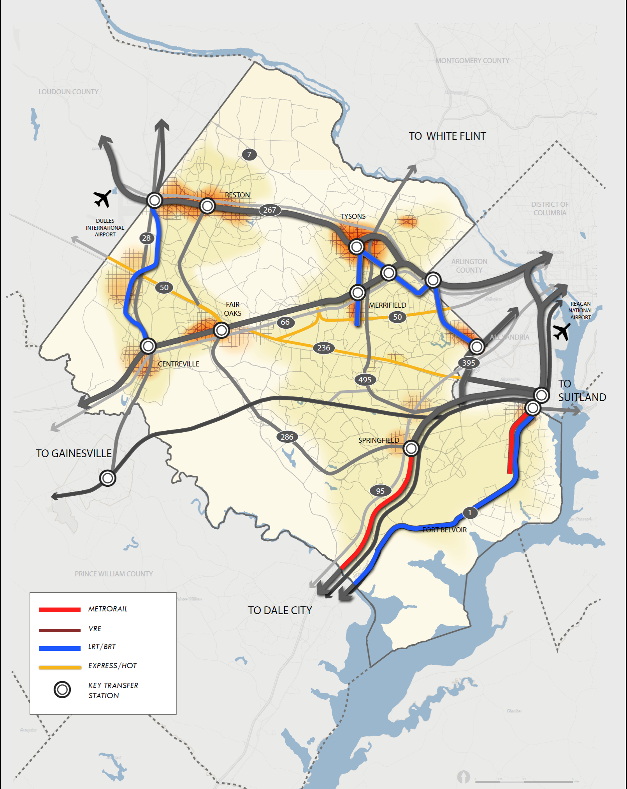
Transportation Plan Changes
The proposed HQTN would result in changes to the Transportation Plan Map, including mode and alignment details in the following corridors:
Blue Line Extension
Yellow Line Extension
Gallows Road: BRT/LRT
Richmond Highway: BRT/Metrorail Extension
Route 7: BRT/LRT
Route Corridor 28: BRT/LRT
Notes:
Express services connect activity centers. Beltway Express: already have HOT lanes between Springfield and Tysons; additional services using these lanes would connect these growing activity centers, as well as serve longer distance, flexible express bus from Prince William County and the Burke VRE station.
Connections into Maryland via American Legion Bridge and Woodrow Wilson Bridge are somewhat complex: These connections can serve as destination corridors in Maryland (to White Flint and to Suitland, per Montgomery and Prince George’s plans), but are shown as Express Bus here because they really only have a terminal station in Fairfax County
Fairfax County Parkway – focus is on connecting lower density residential areas into the activity centers on the major radial corridors.
Route 28, express service valuable to connect to lower density locations in Prince William County and enable connections either to Silver Line in Herndon, or directly to Dulles Airport.

Slide 18
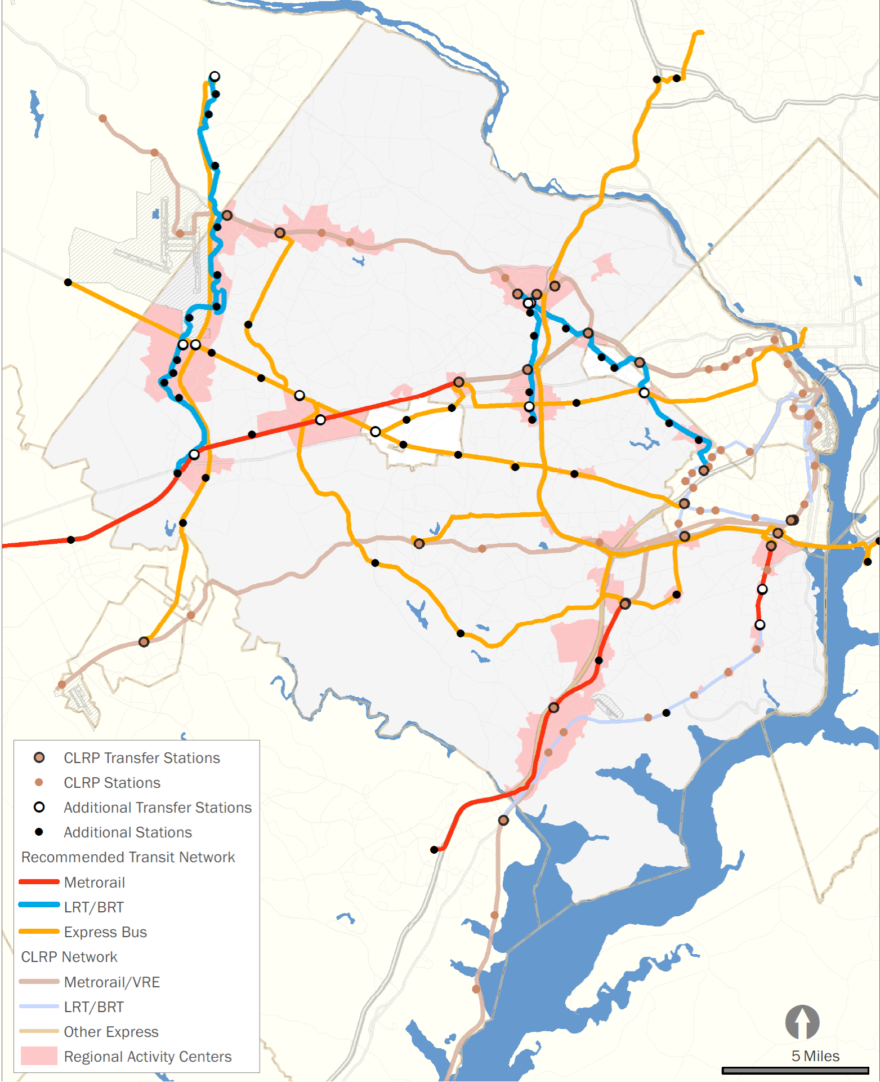
Proposed HQTN
Recommends the following in addition to the current CLRP in Fairfax County:
Metrorail: 34 miles & 10 Stations
LRT/BRT: 33 miles & 27 Stations
Supported by:
Express Bus: 113 miles & 25 stations
Notes:
When we look at the details of the new HQTN routes, we see a total of 214 new transitway and 74 new stations (breakouts on slides)

Slide 19
Measures of Effectiveness
Goal | Achievement (compared to 2050 CLRP conditions)
CONNECT Provide more transportation choices for Fairfax County and regional connectivity | Allows average County resident to reach 190,000 more jobs within a 45 minute transit commute
 | Increases Fairfax County transit trips by 150,000 per day, a 35% increase over base conditions.
 | Introduces rail service to 14 previously unserved activity centers
 | Estimated Cost per passenger consistent with recent New Starts approvals
GROW Support local and regional economic development goals | Serves 27 new station areas within designated activity centers.
 | Brings 120,000 new County households and 263,000 County jobs within ½ mile of high quality transit station
THRIVE Strengthen quality of life by making transit-friendly, sustainable investments | Serves 28 new station areas with higher than average transit dependent populations
 | Reduces weekday peak period Vehicle Hours of Travel by 68,000 and Vehicle Miles of Travel by 147,000
 | Furthers Comprehensive Plan concepts for Enhanced Public Transportation Corridors
Pending refinement with 2015 CLRP base
Notes:
What does this network help us achieve? Won’t take the time to read each of these measures, but the key is looking at our triple-bottom line of economic, environmental, and social benefits. For instance:
Economic benefits:
Line 1: better access to jobs, which leads to:
Line 2: 150,000 new transit trips
Environmental benefits
Second line from bottom – fewer fuel and emissions from reduction of 68,000 VHT
Equity benefits
Line 3: Introducing rail service to 14 previously unserved activity centers
First line in “Thrive”: 28 new station areas where there’s an above average number of transit-dependent residents

Slide 20
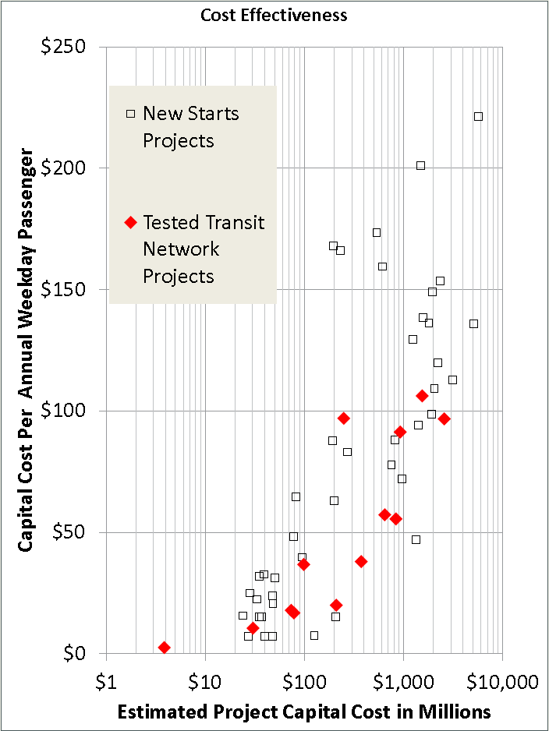
Measures of Effectiveness (Cont.)
Capital cost per annual weekday passenger is a measure of cost effectiveness.
Tested Transit Network projects compare favorably to New Starts approved projects.
Pending refinement with 2015 CLRP base
Notes:
This chart says, “what level of cost effectiveness is currently passing the bar at Federal Transit Administration?”. The horizontal axis shows the current capital cost for projects moving through the New Starts process, and the vertical axis shows how cost effective the project is in terms of capital cost divided by future ridership. In essence, big projects are on the right, and being lower on the chart is better in terms of cost-effectiveness.
The scattergram shows a diagonal relationship – big projects tend to have a lower capital cost effectiveness, for two reasons:
These projects both have lower operating costs per passenger (mostly labor costs; well-utilized trains carry more passengers per operator than do well-utilized buses) and
They are better at promoting desired land use changes.
Our proposed HQTN lines perform cost effectively (being lower on the chart is good) using this same measure. A quick way of summarizing this slide is that our network is competitive based on the decisions that funding jurisdictions are currently making in partnership with Federal Transit Administration.

Slide 21
Supporting Policies
Supporting policies for the CTNS include:
Concentrated growth in Activity Centers
Quality TOD
Feeder Bus Services
Park & Rides
Transit Centers
Circulator Systems
Notes:
The main HQTN services will work best with supporting policies, including those noted here, as well as the land use changes proposed in the Richmond Highway and Route 28 corridors.

Slide 22
Next Steps
Complete documentation (early 2016)
Publish Draft Final Report (early 2016)
Obtain additional public comments (early 2016)
Present Final Report to Board for endorsement (mid-2016)
Initiate process to incorporate study recommendations in Comprehensive Plan (mid-2016)
Notes:
Bullets from slide…

Slide 23
Questions?
FAIRFAX COUNTY
COUNTYWIDE TRANSIT NETWORK STUDY
Arpita Chatterjee
Arpita.Chatterjee@fairfaxcounty.gov
Thomas Burke
Thomas.Burke@fairfaxcounty.gov
http://www.fairfaxcounty.gov/fcdot/2050transitstudy/

