Slide 1
Update of Transportation Priorities Plan
Transportation Advisory Committee
June 20, 2017
Tom Biesiadny/Ray Johnson
Fairfax County Department of Transportation

Slide 2
Background
2012 - Countywide Dialogue on Transportation (CDOT)
Transportation needs, potential revenue sources
2013 – General Assembly approved state and regional transportation funding (HB 2313)
Countywide Dialogue continued; focused on projects and project selection
All available revenues considered for Transportation Priorities Plan (TPP)
January 2014 - TPP approved by the Board
May 2014 – Project timelines completed

Slide 3
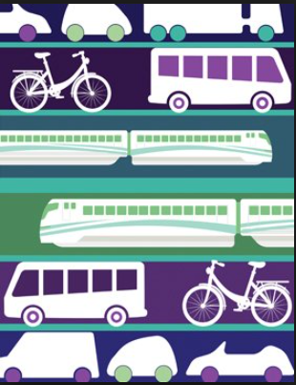
TPP (FY 2015 to FY 2020)
Funding Level: $1.4 B over Six Years
Included approximately 220 projects
Include reserves for several project areas
Fairfax County Parkway
Transit (Including Metro, Richmond Hwy,
Route 7 and others)
Bicycle and Pedestrian
Roadway Spot Improvements
Reminder: Several large projects
were only partial funded in TPP

Slide 4
Progress Since January 2014
Projects
72 projects in queue/32 projects currently in scoping
95 projects in design
13 projects in land acquisition/utility relocation/pre-construction
22 projects completed
10 projects under construction
8 studies completed/18 underway
Cleveland Ramp
Route 7/123 Interchange
Route 123 Superstreets
Does not include projects previously approved as part of the Board’s 1st – 3rd Four Year Plans.

Slide 5
Changes Since January 2014
I-66 Inside and Outside the Beltway
Several projects included in the reserves have been further defined
Transit
Richmond Highway transit solution: Bus Rapid Transit (BRT)
Metro: continuing discussions regionally
Route 7 transit solution: BRT
Fairfax County Parkway (FCP): First Priority: Route 29 to Route 123
Additional study of the entire FCP underway
Many bicycle, pedestrian, and Spot Roadway Improvements

Slide 6
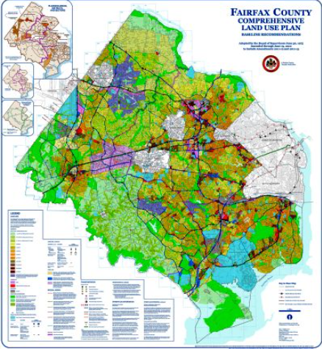
Comp Plan Amendments Since January 2014
Reston (February 2014)
Reston Transportation Funding Plan Adopted – April 2017
Project Prioritization Completed
Seven Corners (July 2015)
Next steps, Project Prioritization
and Funding
Richmond Highway underway

Slide 7
TPP Update (FY 2018 to FY 2023)
Financial Analysis
Incorporating all revenue sources:
State: Smart Scale, Revenue Sharing
Federal: New Starts, Congestion Mitigation Air Quality, Regional Surface Transportation Program, and Transportation Alternatives Grants
Local: C&I, NVTA 30%, General Obligation and Revenue Bonds, Service Districts
Regional: NVTA 70%
Private: Proffers, In-kind contributions
Includes:
Tysons Transportation Funding Plan
Reston Transportation Funding Plan

Slide 8
Process
Started in calendar year 2016
Update cost estimates and timelines for current projects
Unfunded project input received from a variety of sources (citizens, board, schools, etc)
Perform Benefit Cost Analysis (BCA) on new projects
Remove completed and cancelled projects
Over $600M in new revenues (FY 2021 to 2023) needed to ensure:
All projects that were intended to be fully funded between FY 2015 and 2020 are fully funded due to increased costs, scope changes, inflation, unexpected situations, citizen input, etc.
Projects partially funded between FY 2015 & 2020 receive the remainder of funding.
Funding level available for new projects in TPP Update: $170M

Slide 9
Process Continued
Does not include additional funding Fairfax County may receive from the $500M concession payment associated with the I-66 Express Lanes project (Outside the Beltway)
Also does not include investments associated with the Atlantic Gateway project, or projects and services that can be funded with toll and transit funding associated with the I-66 Outside the Beltway, I-66 Inside the Beltway, and I-395 Express Lanes projects.

Slide 10
Recap of Criteria for Project Selection (Not in Priority Order)
Congestion Reduction*
Economically Disadvantaged Populations
Mode Balance
Safety
Travel Time Savings*
Community Input
School and Park Access
Regional Consideration (included in NVTA TransAction 2040)
Countywide Balance
Disabled/Elderly Populations
Economic Development (support for revitalization areas and major Activity Centers)
Healthy Communities Initiative
Air Quality*
*Included in the Cost Benefit Analysis

Slide 11
Reserve Funding (Input Requested)
Funding level available for new projects in TPP Update: $170M.
Recommend using $100M for new projects, and $70M for projects in need of additional funding.
Considerations in allocating new funds:
Future funding plans (Innovation, Seven Corners, Richmond Hwy, etc)
Metro/Transit
Atlantic Gateway
Fairfax County Parkway
Unexpected cost overruns
Small scale projects that may arise between FY 2021 and FY 2023

Slide 12
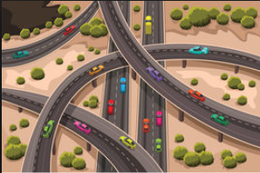
Potential Projects
List of potential projects consolidated from various sources
Cost estimates developed
Benefit Cost Analysis (BCA) being conducted
Bicycle and Pedestrian BCA being prepared with separate methodology
Non-BCA Factors being evaluated
Efforts included outreach to multiple County agencies, the public, and various associations.
Review of project list by district (attachment)

Slide 13
Public Outreach (Input Requested)
Meeting with TAC on June 20 to receive input on outreach efforts
Proposed outreach strategy to include:
Direct-to-community outreach including community meetings (September-October 2017)
Partner agency outreach
Online survey and geo-targeted social
media advertising
Traditional media outreach
and advertising

Slide 14
Schedule (Tentative: Input Requested)
July 18: Board Transportation Committee Meeting
Finalize potential project list and outreach activities
August: Preparation for public outreach; preparation of materials, etc.
September-October: Public Outreach
October-November: Staff review of input and preparation of draft recommendations
Mid-November/Early December: One-on-One meetings with Supervisors
December 12: Board Transportation Committee Meeting
Review of Final Draft Plan Recommendations
January-February 2018: Board Adoption

Slide 15
Questions?

