Slide 1
Local land-use and transportation
Jim Neighbors
jimneighbors@verizon.net

Slide 2
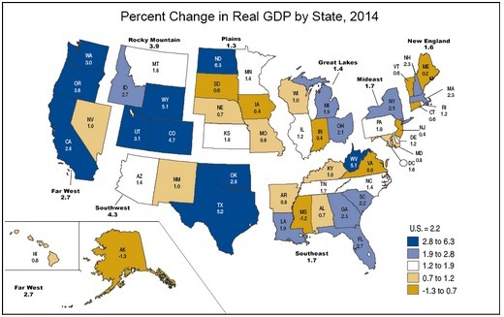
Gross National Product (GDP) by State
Ranked 48th state for real GDP in 2014
Only ahead of AL and MS
Mainly due to federal employment and contracting cuts
Seeking new business opportunities by state leadership

Slide 3
Virginia

Slide 4
Virginia Economic Growth

Slide 5
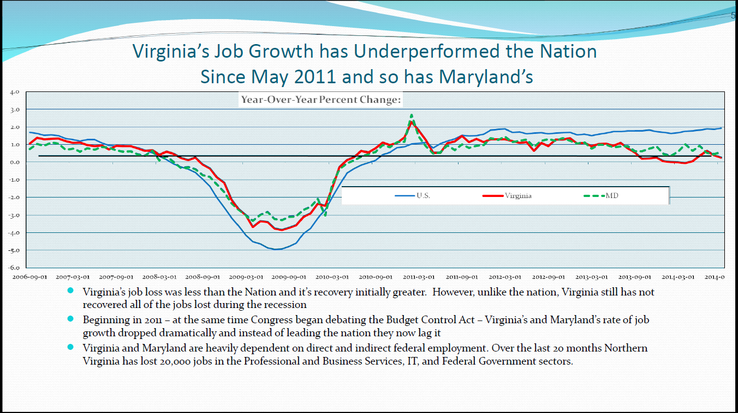
Virginia Economic Growth

Slide 6
Virginia Economic Growth

Slide 7
Northern Virginia Population Growth Changes
Population Numbers in Northern Virginia
Locality | 2010 | 2011 | 2012 | 2013 | 2014 | percent change
Loudoun County, Virginia | 315,505 | 326,900 | 338,165 | 350,959 | 363,050 | 15.07%
Manassas city, Virginia | 38276 | 39,358 | 40,742 | 41,725 | 42,081 | 9.94%
Prince William County, Virginia | 406,370 | 420,004 | 431,226 | 440,166 | 446,094 | 9.78%
Falls Church city, Virginia | 12,446 | 12720 | 13,136 | 13,469 | 13,601 | 9.28%
Arlington County, Virginia | 209,395 | 216,603 | 221,947 | 226,012 | 226,908 | 8.36%
Fairfax city, Virginia | 22,604 | 22,792 | 23,461 | 24,194 | 24,483 | 8.31%
Alexandria city, Virginia | 140,829 | 144,461 | 146,934 | 149,312 | 150,575 | 6.92%
Manassas Park city, Virginia | 14,409 | 14,891 | 15,079 | 15,409 | 15,174 | 5.31%
Winchester city, Virginia | 26,183 | 26,756 | 27,178 | 27,497 | 27,543 | 5.19%
Fairfax County, Virginia | 1,086,723 | 1,105,624 | 1,121,050 | 1,134,423 | 1,137,538 | 4.68%

Slide 8
LOUDOUN COUNTY

Slide 9
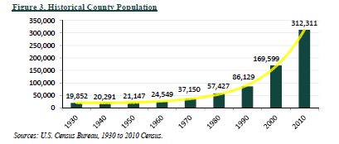
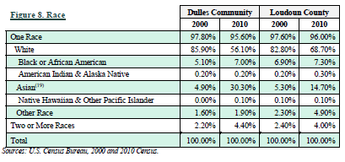
Loudoun County Population Growth
Significant increase of population since 2000
More diverse especially with the Asian population
Planned communities such as Sterling Park and Sugarland Run as well as Dulles International Airport responsible for early population growth

Slide 10
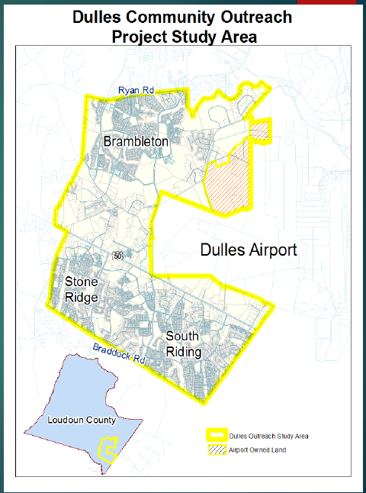
Loudoun County: Dulles Community
500% increase of population since 2002
32.5 years old median age
Health care and aviation cargo jobs growing
Projected 42K jobs in 2040
Over 17K housing units
33K housing units in the “pipeline” in LC
YouTube Video

Slide 11
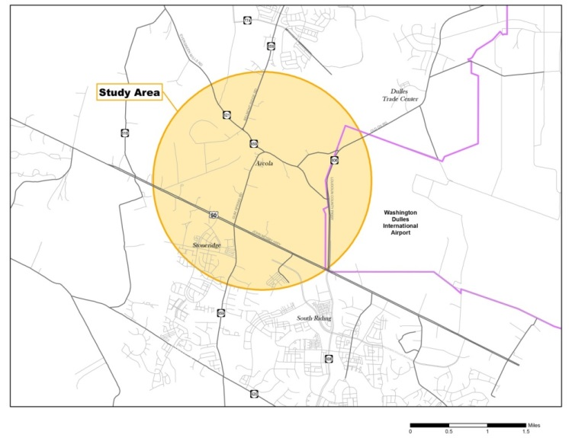
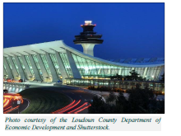
Dulles Airport: Dulles Air Cargo, Passenger, and Metro Access Highway
2014: 21.6 M passengers
2040: 37.8 M passengers
Economic Engine of Northern Virginia if not Virginia
Air Cargo Support for North-South Corridor
5 options include no-build
Costs: $239-936M for each option
Keeps traffic at Level of Service “C” on most roads
Environmental Impact Study (EIS) is TBD

Slide 12
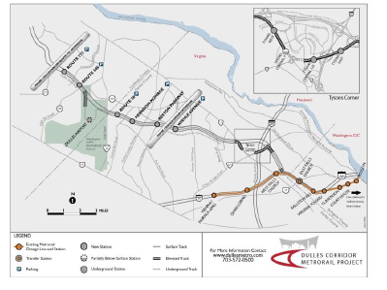
Metro Silver Line Phase II As of January 2015
Aerial guideway under construction
Construction at 1%
Two garages
Innovation Center Station ($57M)
Herndon ($58.7 M)
Construction starts March 2016
Completion from 2018 to 2020

Slide 13
SULLY District fairfax county

Slide 14
Sully District Population Growth
Year | Sully District Population
 | Population | Households | Housing Units
2014 | 129,582 | 42,042 | 42,603
2020 | 130,820 | 42,493 | 43,067
2030 | 140,810 | 46,216 | 46,875
2040 | 150,058 | 49,665 | 50,403
Ages | % in 2013 | % in 2030
Under 5 | 6.7 | 6.0
5-9 | 6.5 | 6.5
10-14 | 6.7 | 7.2
15-20 | 6.4 | 6.1
20-24 | 5.5 | 5.5
25-34 | 14.7 | 13.5
35-44 | 14.0 | 14.6
45-54 | 15.6 | 14.3
55-64- | 12.4 | 11.0
65 and above | 10.7 | 15.2
Race or Ethnicity | % of Sully Population
White alone | 60.7
African American alone | 5.8
American Indian and Alaska Native alone | .4
Pacific Islander or Hawaiian native alone | .1
Asian alone | 23.1
Some other race alone | 6.0
2 or more races | 4
Hispanic or Latino | 15.5

Slide 15
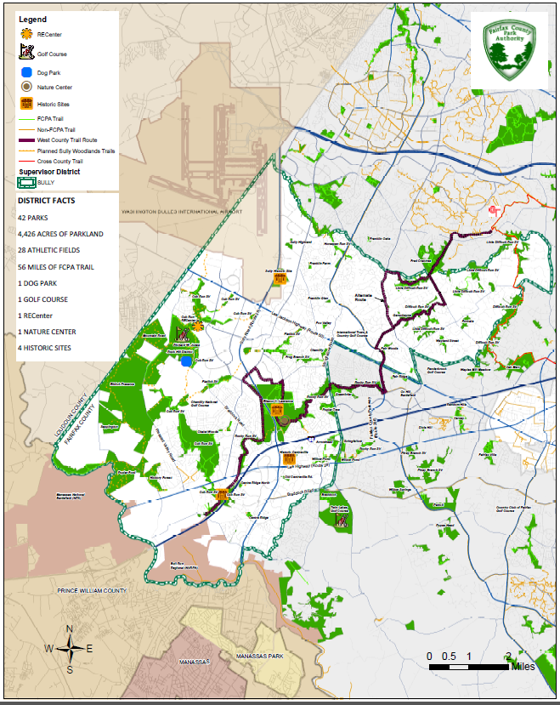
Sully Woodlands
4,400 acres of parkland
43 parks
175 acres of active recreation
Over 20 miles of new trails proposed
78% undisturbed

Slide 16
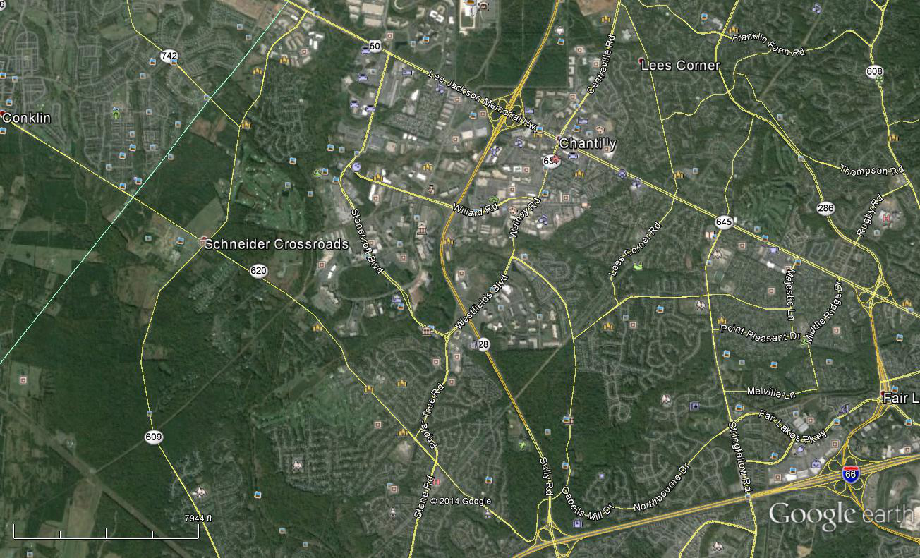
Land-Use
New Office Building Construction
Proposed Wegmans (Unknown Date)
Aerospace Corp Phase I Completion; Phase II TBD
The Proposed Preserve of Westfields

Slide 17
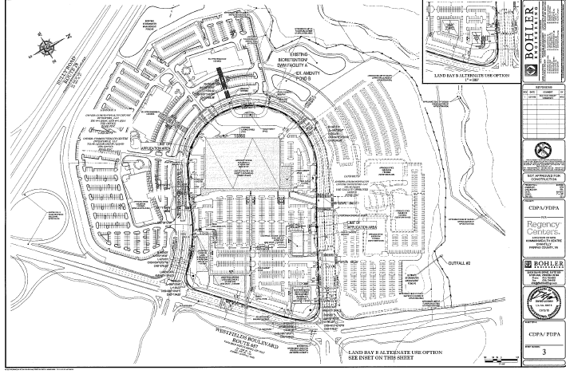
Proposed Chantilly Wegemans

Slide 18
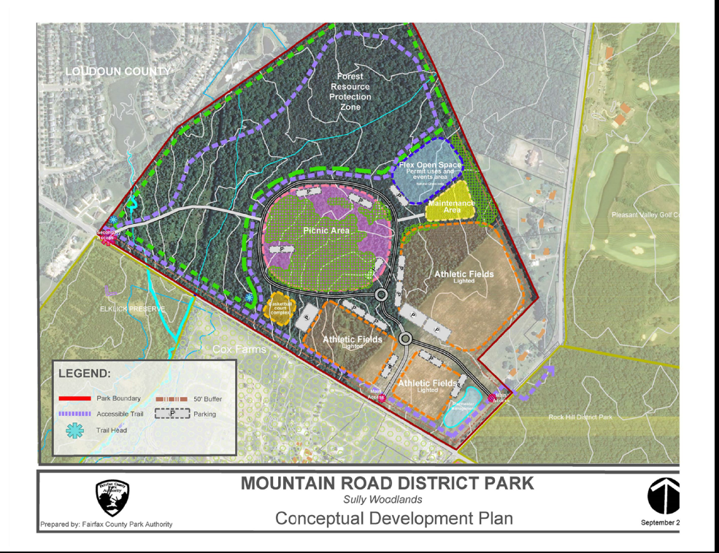
Mountain Road District Park
200 acres
Lighted athletic fields
Parking
Picnic areas
Flex space
Natural resource management
Trails
Probably 2020 or later

Slide 19
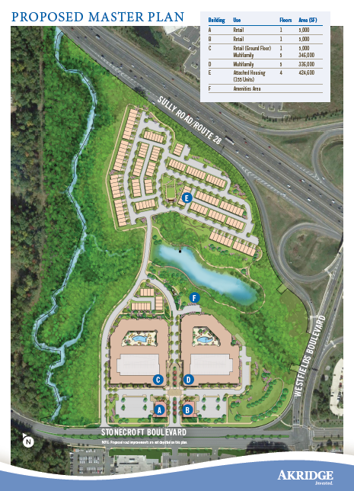
The Preserve at Westfields

Slide 20
RT-50 Widening
6 Lanes/Bike Path:
Dec 2015 Completion
Transportation
Walney Road Bridge
4 Lanes/Bike Path:
Dec 14 – Sept 15
Pleasant Forest Project: Bike Path
July 2016
I-66/Braddock Road/RT-28: Design is underway
PV Road/Braddock Road Roundabout:
June 2015 – Spring 2016
I-66 ATM: Dec 2015

Slide 22
I-66 Corridor Improvement: Alternative 2A

Slide 23
I-66 Corridor Improvement: Alternative 2B

Slide 24
Organizations and Meetings
Western Fairfax County Citizens Association (WFCCA) Land-Use Committee
Third Tuesday of the month
7:00 PM
Sully Government Center
Sully District Council (SDC)
http://www.sullydistrict.org
Fourth Wednesday of the month
7:00 PM
Sully Government Center
VDOT Projects (Northern Virginia)
http://www.virginiadot.org/projects/northern%20virginia/default.asp
Everyone is welcome

Slide 25
Back-Up Slides

