Slide 1
DD South 5 LC RZ/FDP 2017-SU-011
Sully District Council & WFCCA
Land Use and Transportation Committee
November 7, 2017

Slide 2
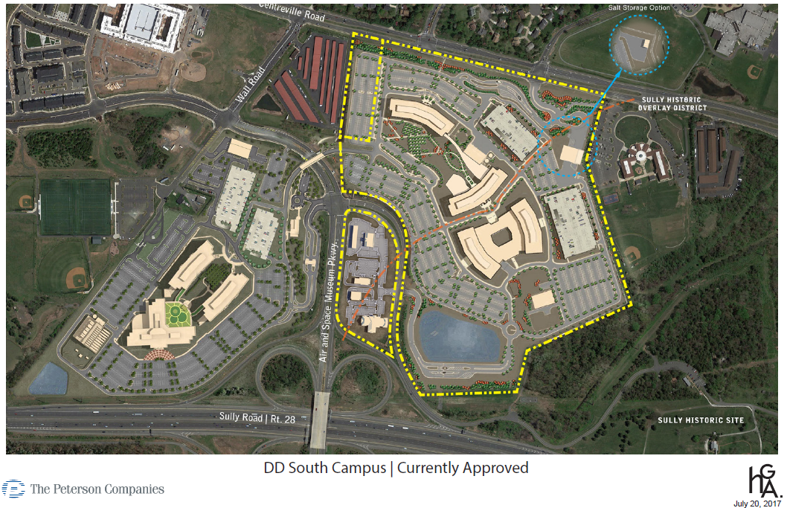
DD South Campus | Currently Approved

Slide 3
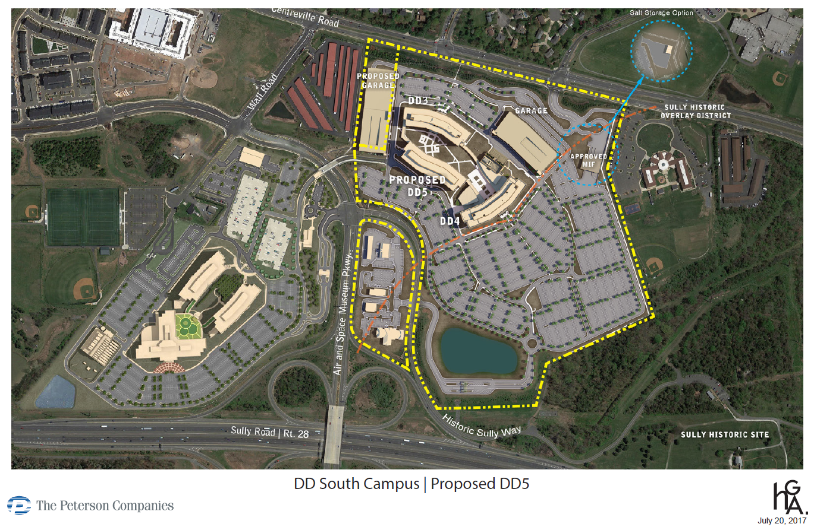
DD South Campus | Proposed DD5

Slide 4
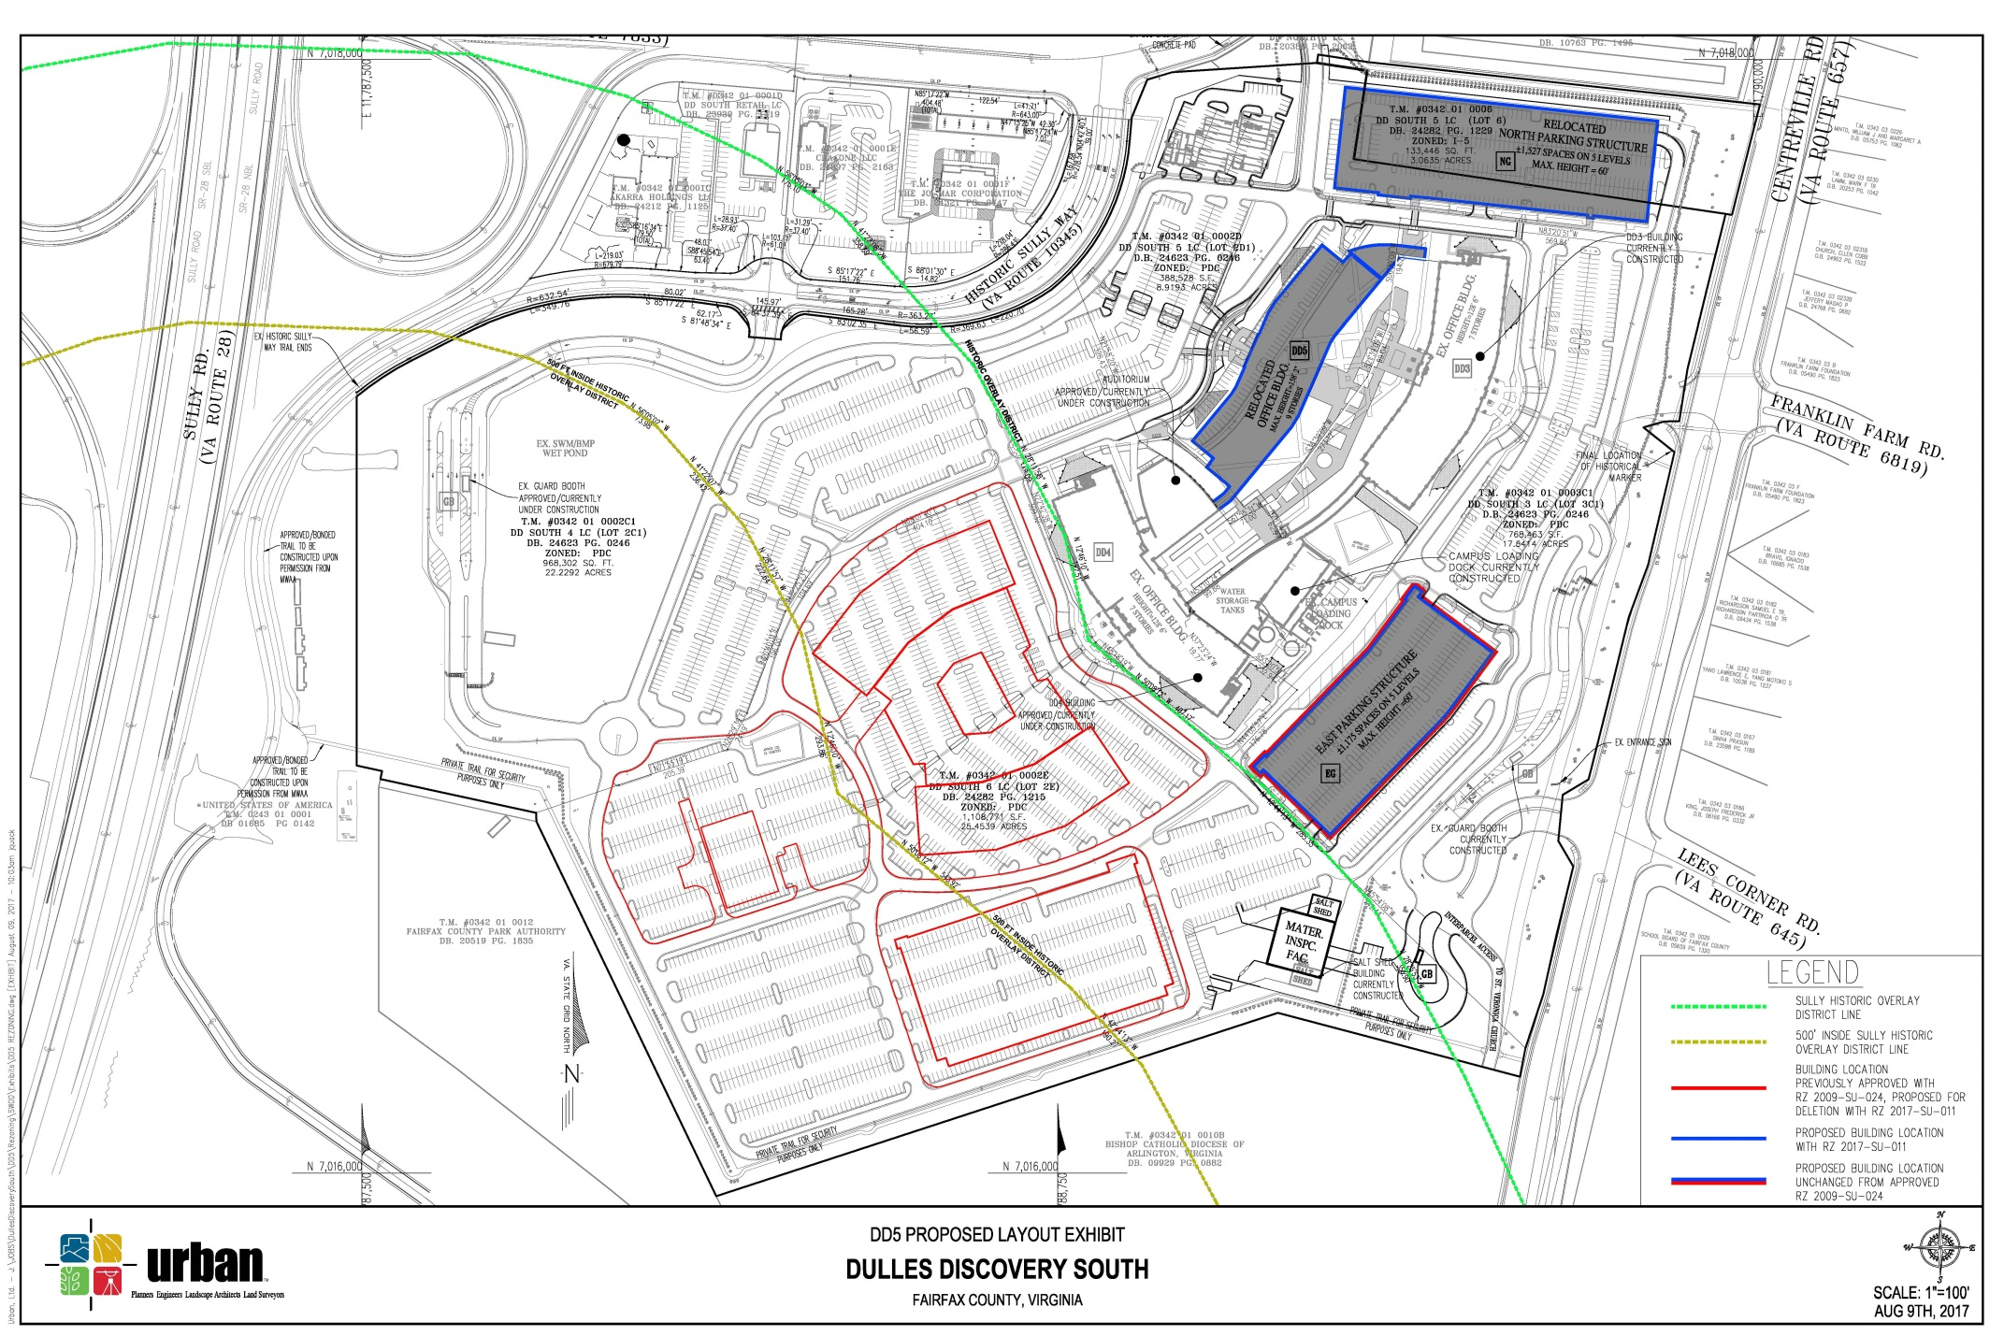
Dulles Discovery South | Proposed Layout Exhibit

Slide 5
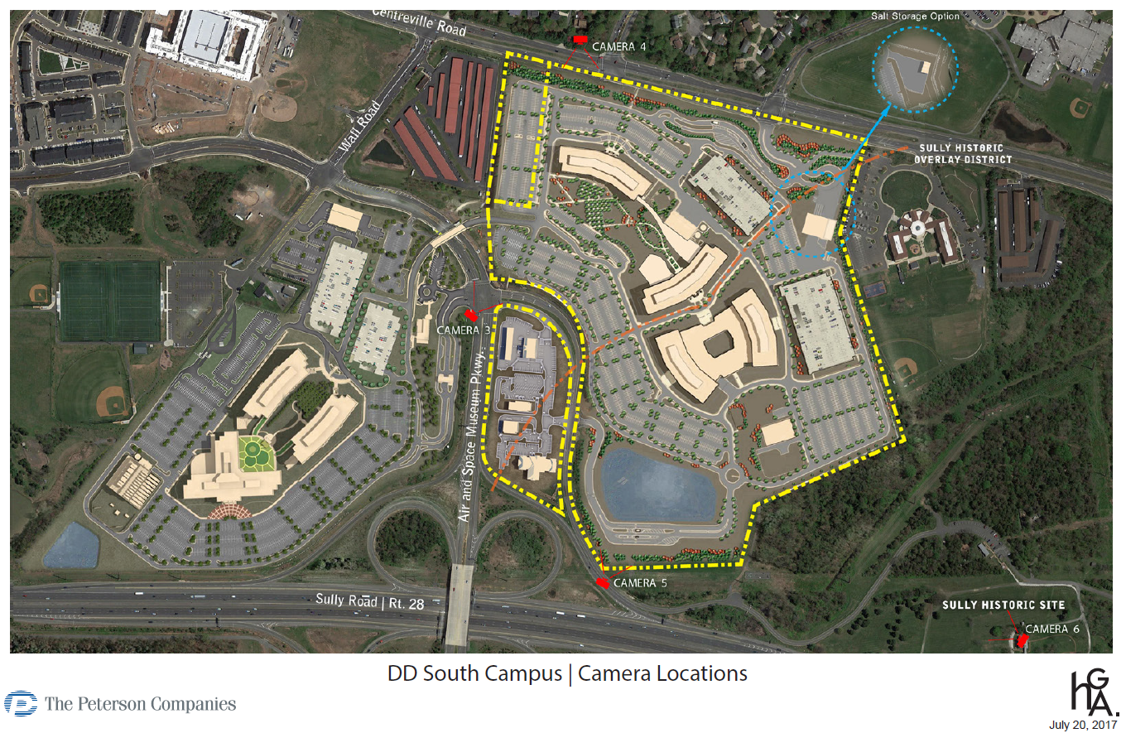
DD South Campus | Camera Locations

Slide 6
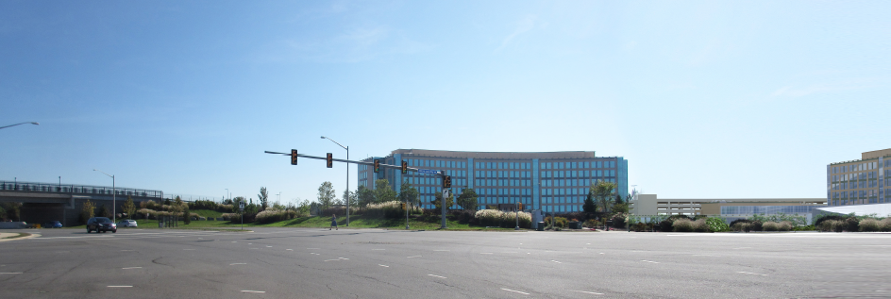
DD South Campus | Camera 3 - Air and Space Parkway Perspective |
Currently Approved

Slide 7
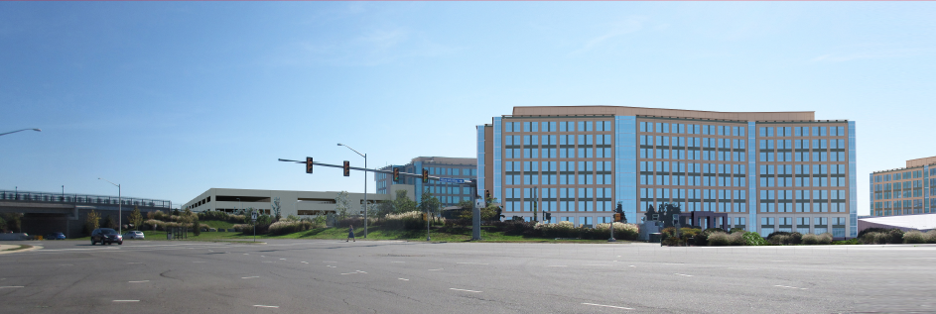
DD South Campus | Camera 3 - Air and Space Parkway Perspective | Proposed

Slide 8
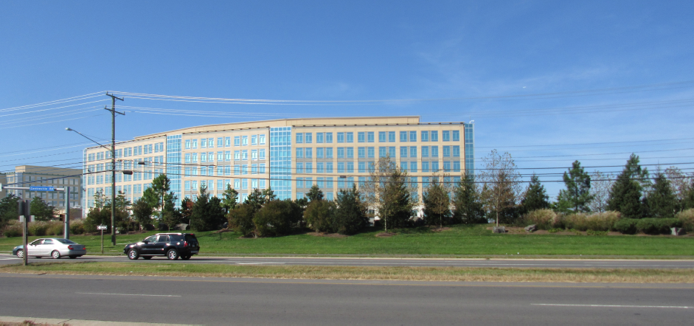
DD South Campus | Camera 4 - Centreville Road Perspective | Currently Approved

Slide 9
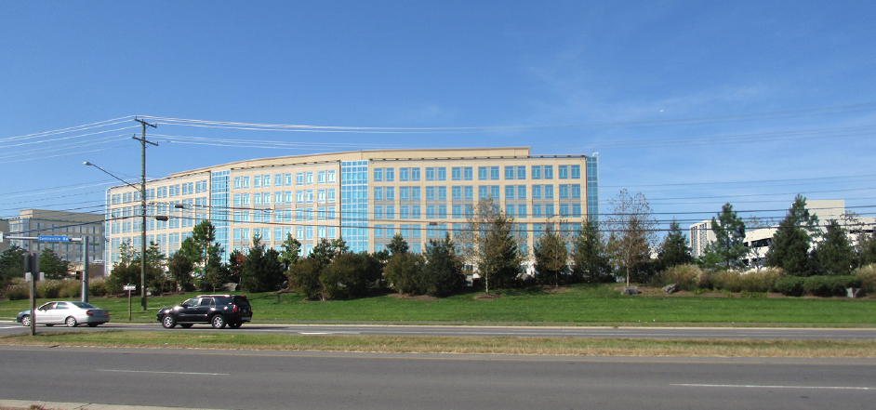
DD South Campus | Camera 4 - Centreville Road Perspective | Proposed

Slide 10
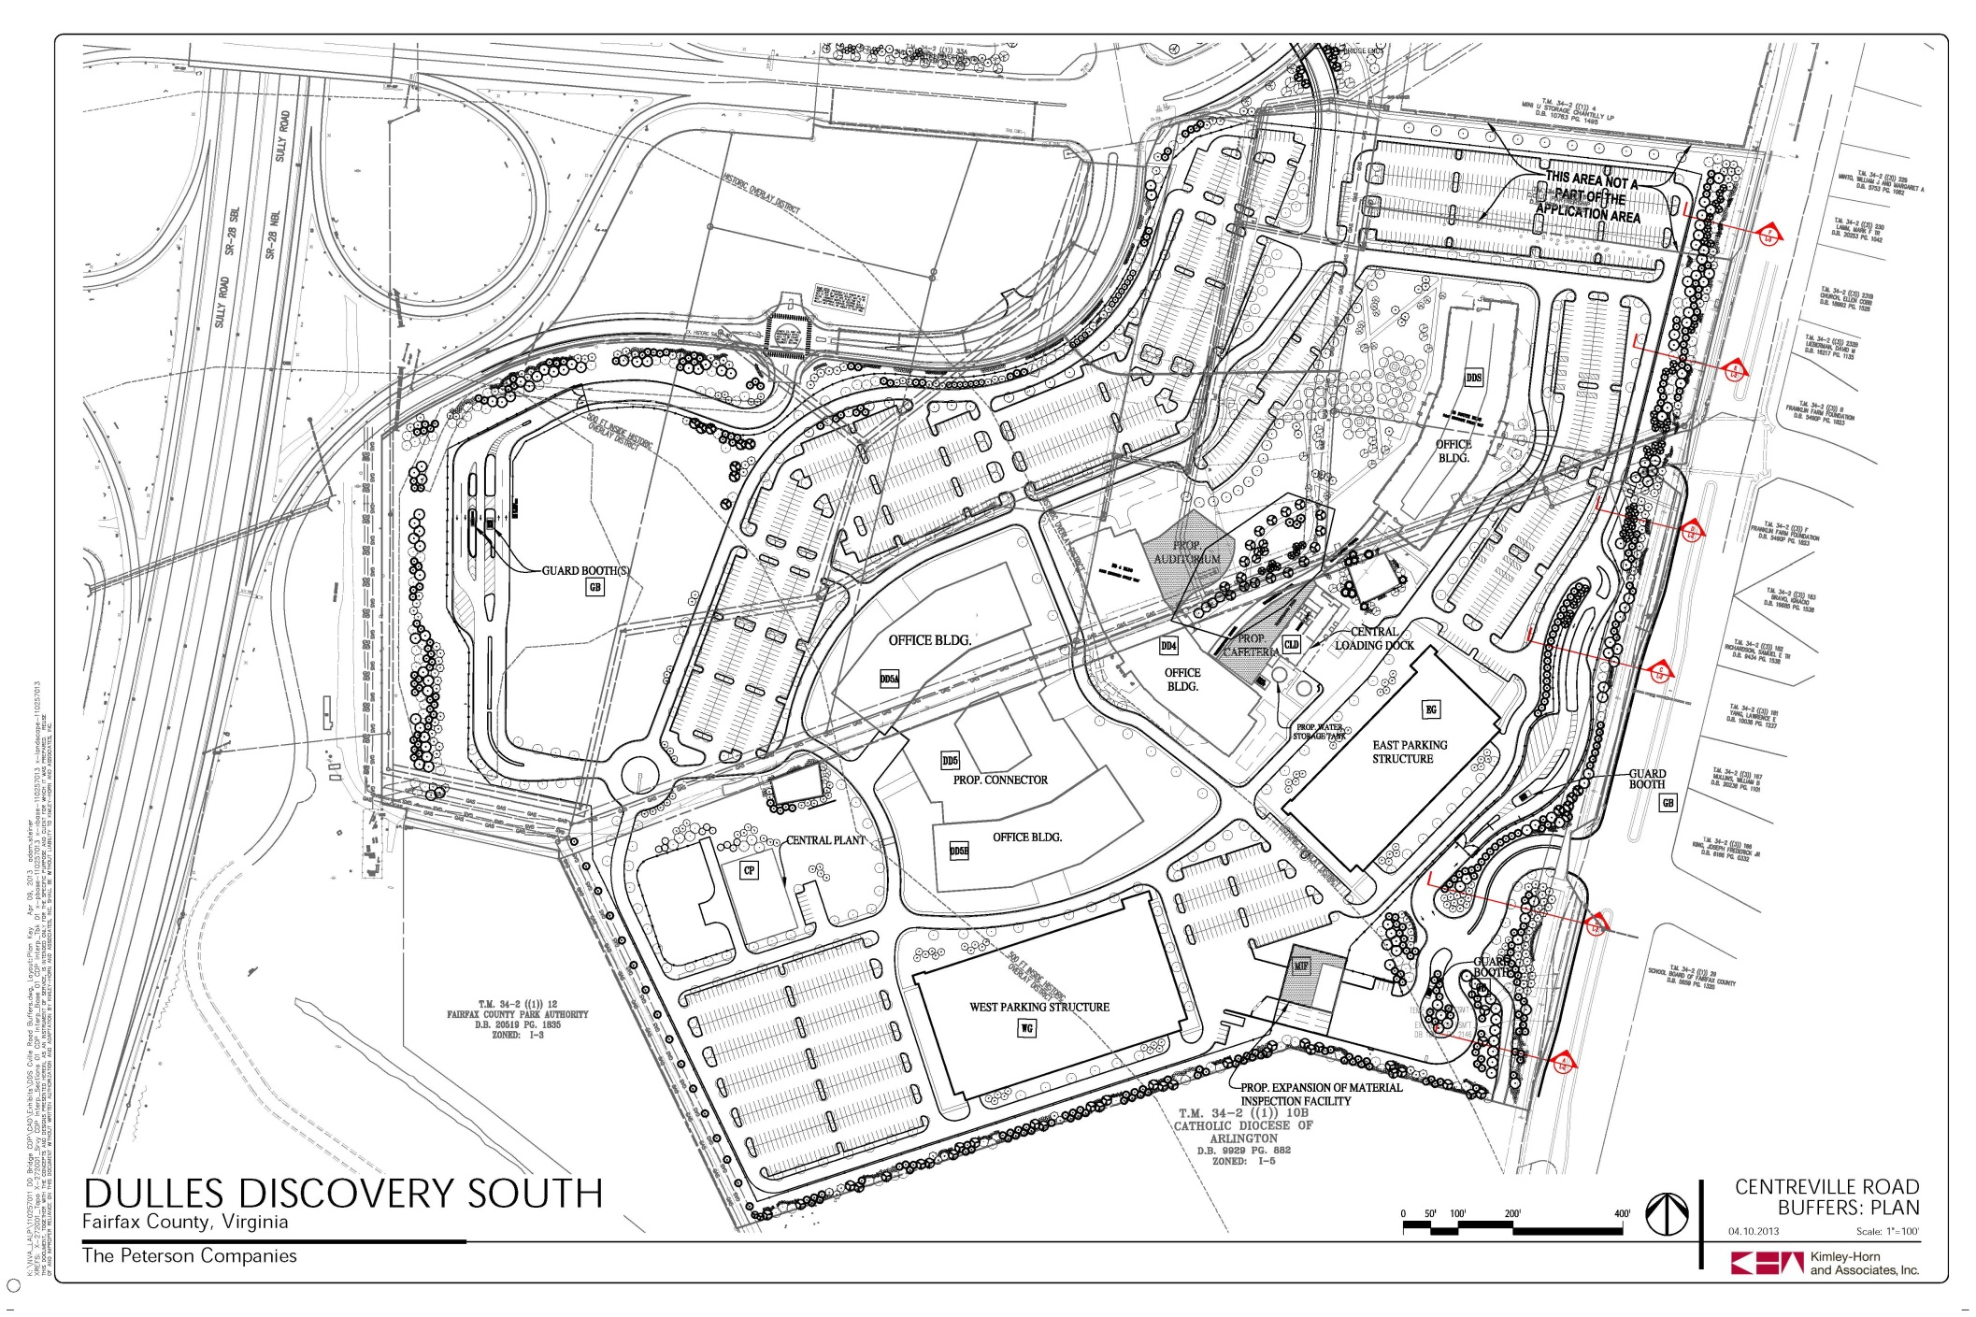
DD South Campus | Centreville Road Buffers: Plan

Slide 11
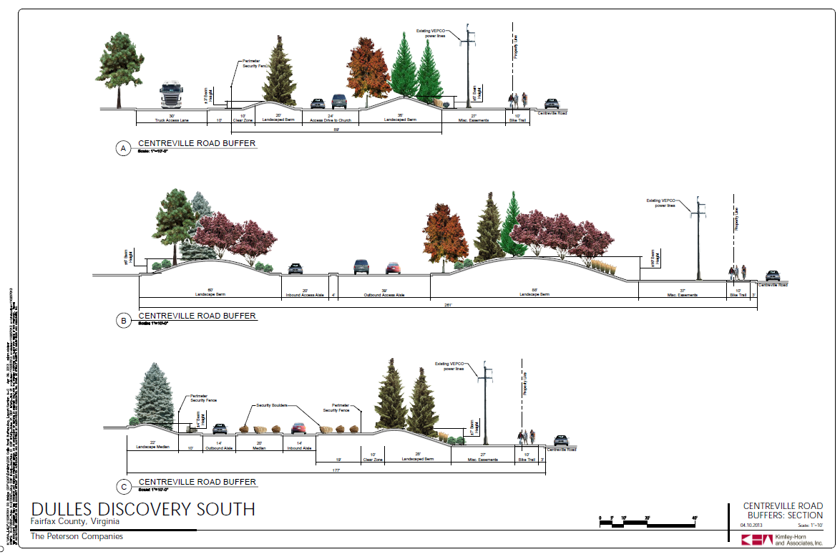
Dulles Discovery South – Centreville Road Buffers

Slide 12
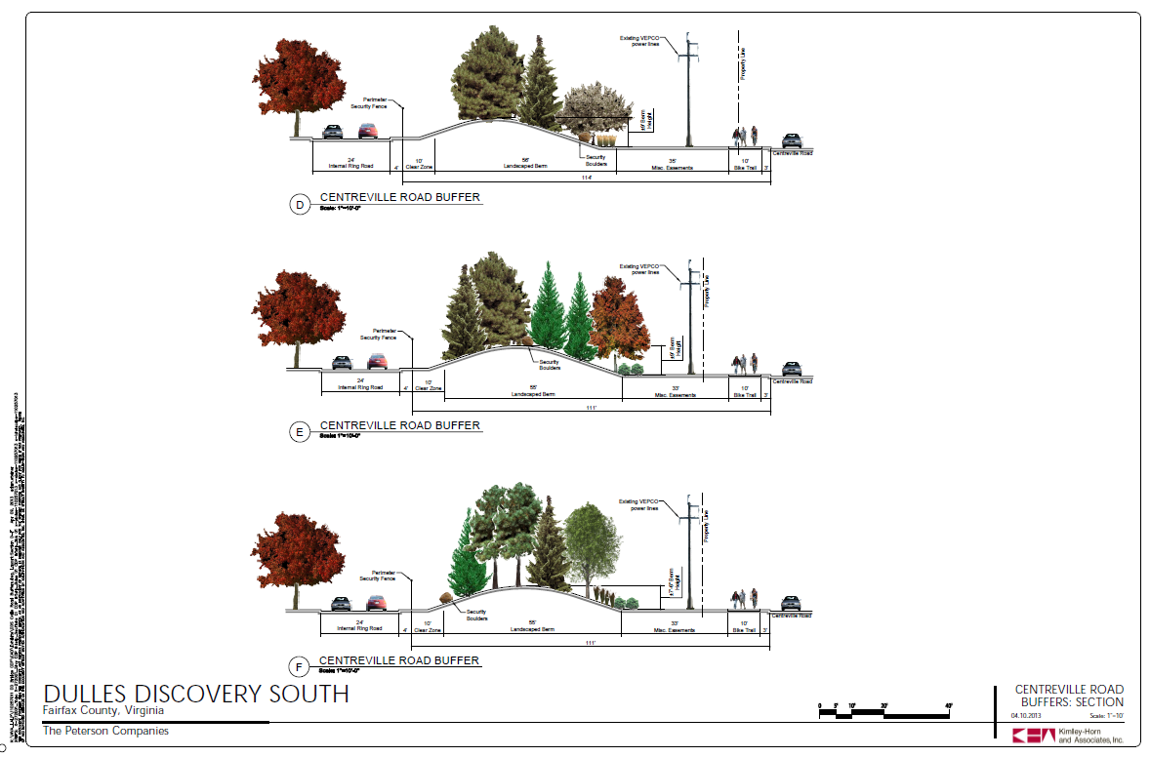
Dulles Discovery South – Centreville Road Buffers

Slide 13
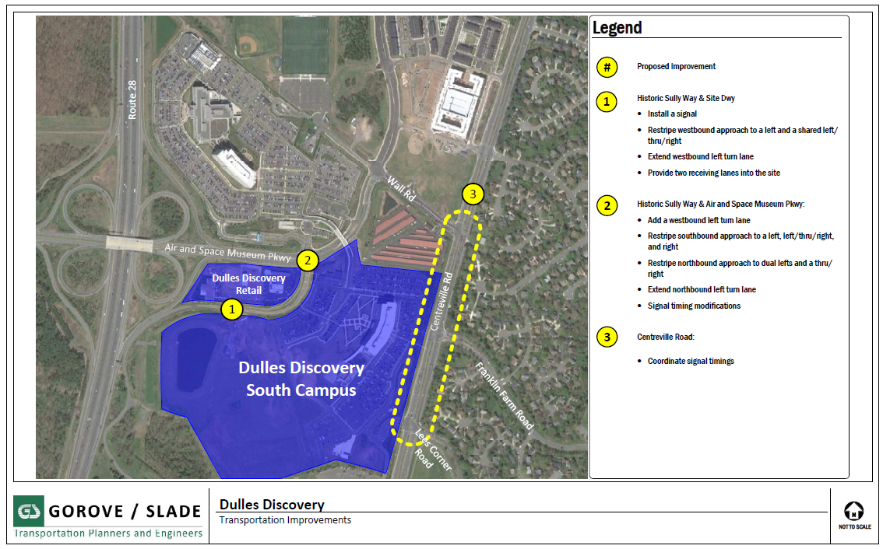
Dulles Discovery South – TransportationProposed Improvements

Slide 14
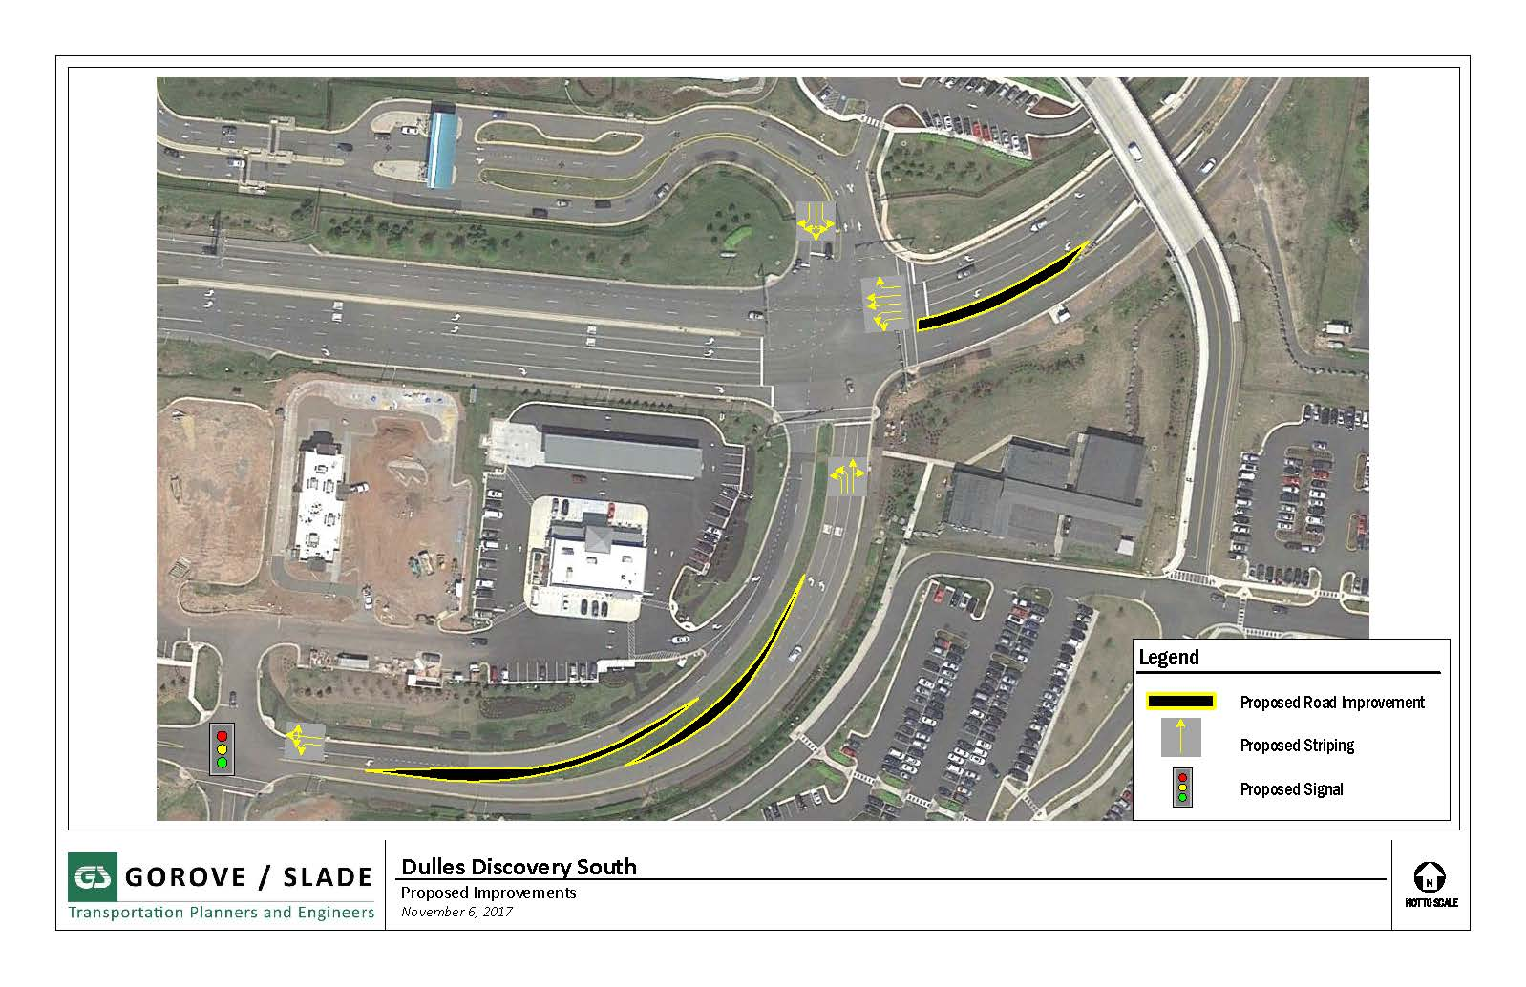
Dulles Discovery South – Proposed Improvements

Slide 15
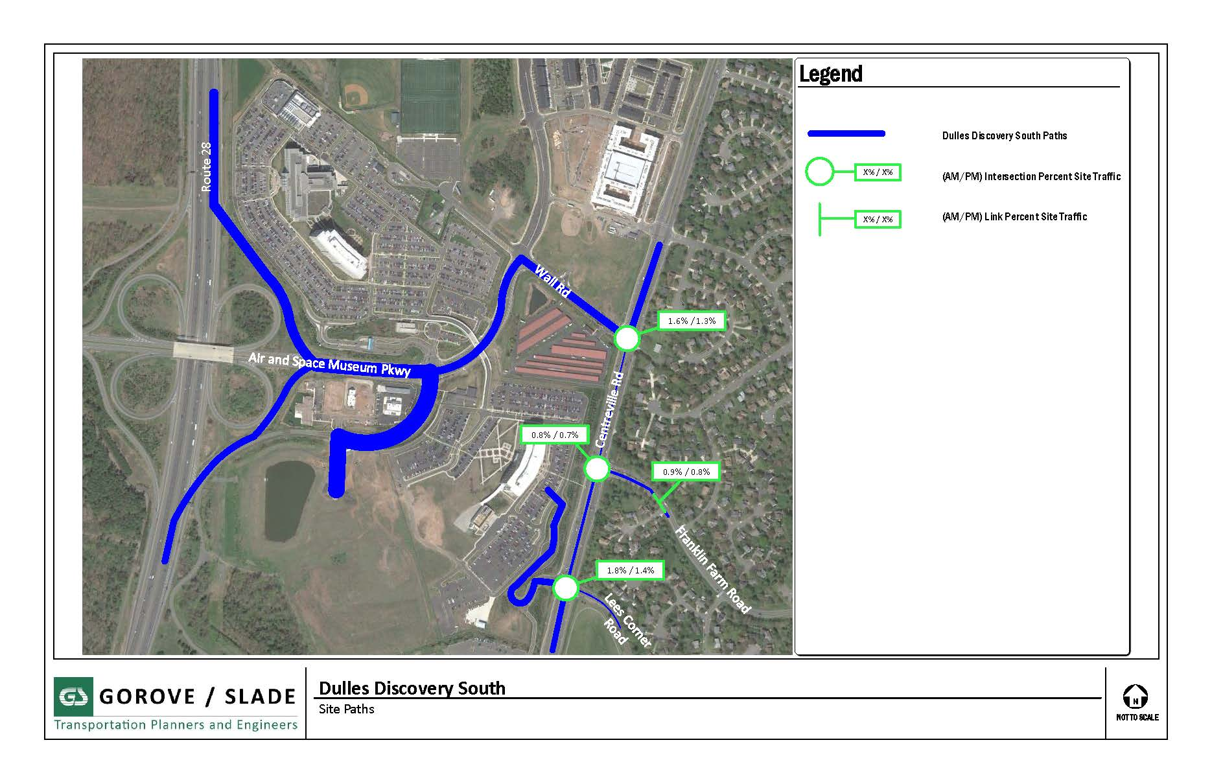
Dulles Discovery South – Site Paths

Slide 16
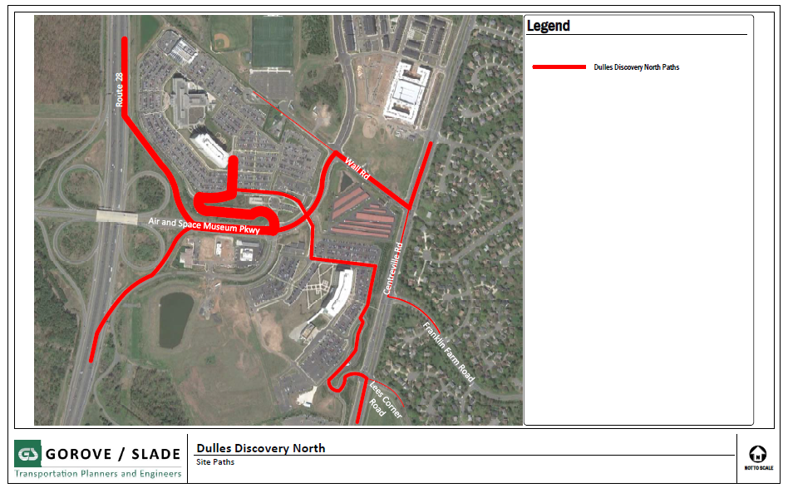
Dulles Discovery South – Site Paths

Slide 17
QUESTIONS

