Slide 1
Local land-use and transportation
Jim Neighbors
jamesneighbors65@gmail.com

Slide 2
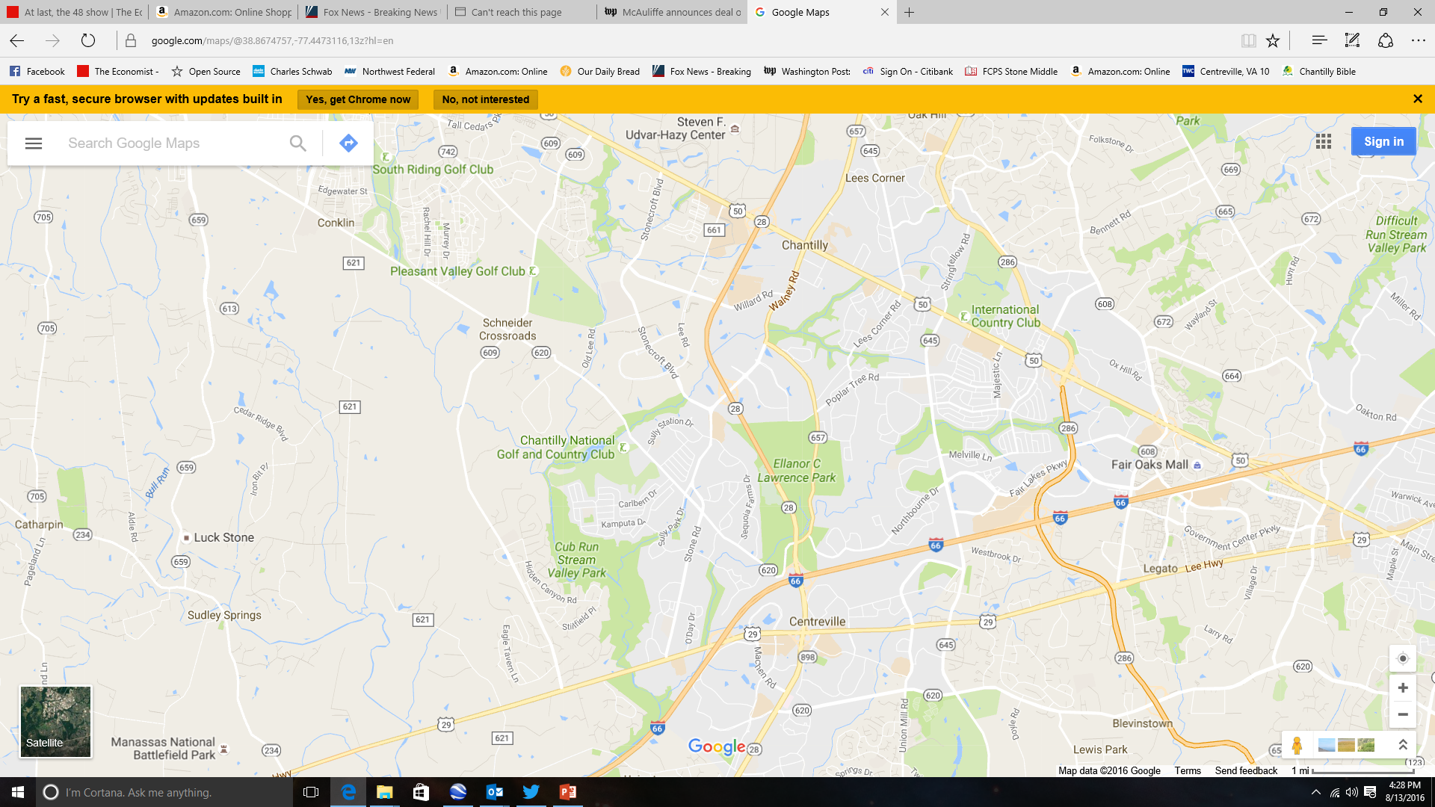
The Preserve at Westfields:
2017-2020
Costco Gas Station Lee Road Light:
2018
New Gas Station:
2017-2018
The Field at Commonwealth:
2017-2020
Park Access Road/Popular Tree Road: 2018-2020
I-66/RT-28/Braddock Road Interchange: 2018-2022
I-66 HOT Lanes:
2018-2022

Slide 3
EC Lawrence Access Road/
Popular Tree Extension

Slide 4
EC Lawrence Access Road

Slide 5
RT-28/I-66 Interchange

Slide 6
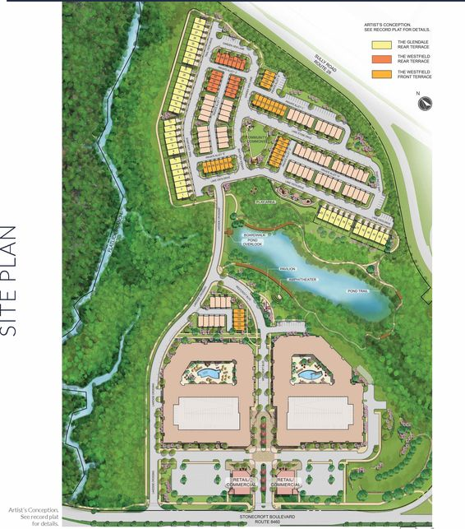
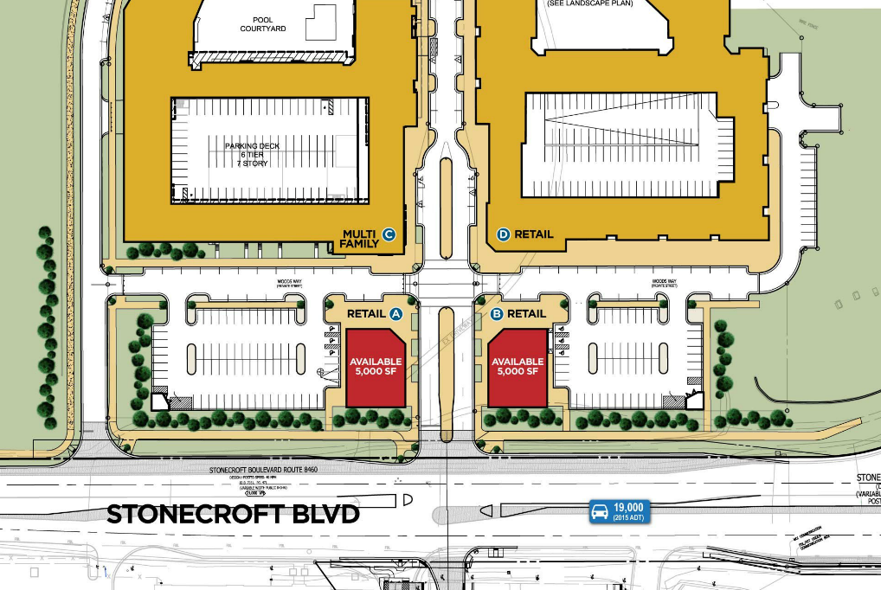
The Preserve at Westfields

Slide 7
The Field at Commonwealth

Slide 8
Points of Contact and Websites
VA 67th District Delegate
  Karen Delaney
  (804) 698-1067
  DelKDelaney@house.virginia.gov
Sully District Supervisor
  Kathy Smith
  703-814-7100
  sully@fairfaxcounty.gov
Fairfax Park Authority Board Sully District
  Marguerite (Maggie) F. Godbold
  703-324-8702
  parkmail@fairfaxcounty.gov

Slide 9
Points of Contact and Websites
VDOT Projects (Northern Virginia)
  http://www.virginiadot.org/projects/northern%20virginia/default.asp
  http://www.transform66.org/splash.html

Slide 10
Organizations and Meetings
Joint Land-Use Committee
  First Tuesday of the month
  7:00 PM
  Sully Government Center
Sully District Council (SDC)
  http://www.sullydistrict.org
  Fourth Wednesday of the month
  7:00 PM
  Sully Government Center
Everyone is welcome!

