Slide 1
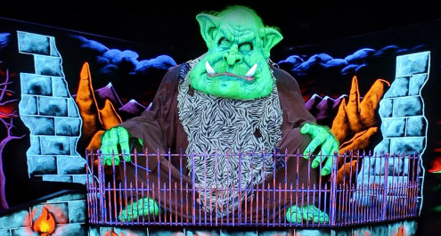
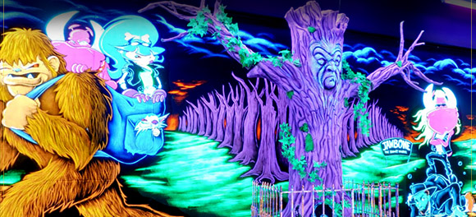
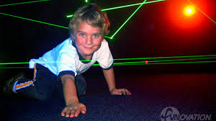
What is Monster Mini Golf?
Indoor, glow-in-the-dark miniature golf
Animated monsters
Monster-themed artwork
Music, DJ station, and lighting
Party rooms hosting birthdays and special events
Arcades with prize redemption
Special attractions including mini bowling alley and laser maze

Slide 2
Who We Are
Tony Claridge and Beth Spratt
Owners of A&E Entertainment, LLC
Opened Monster Mini Golf franchise on February 17, 2017
Parents of four boys combined
Lived and worked in Fairfax County for over 60 combined years
Expansion to Include
Consistent theme throughout
Laser Tag Arena
Café to include
pizza, wraps, salads, desserts
local craft beer and wine

Slide 3
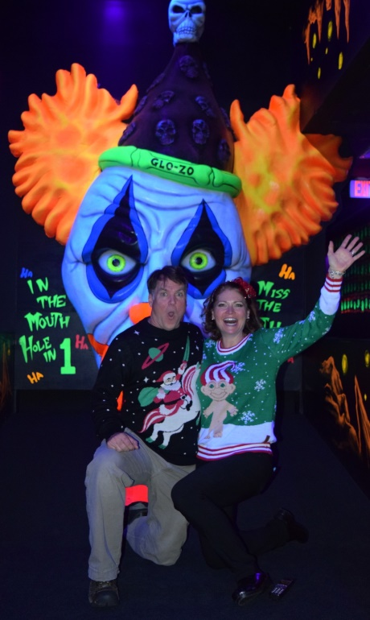
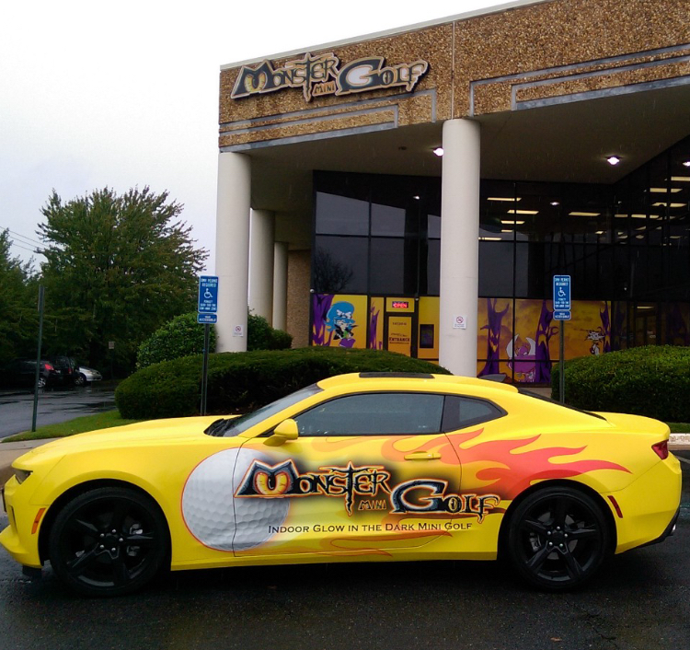
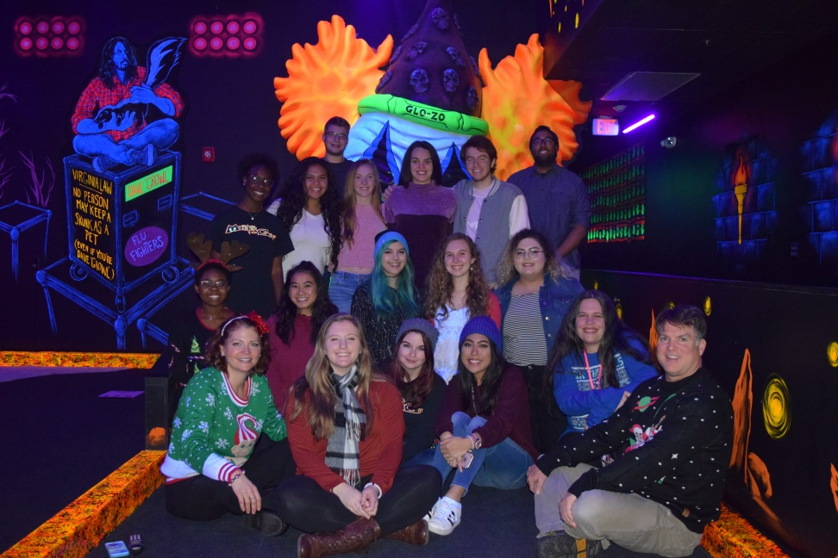
Our Location
We are located in the Sullyfield Circle business area
24 feet high ceilings over golf course
Expanding from 12,200 to 20,000 square feet
The MMG Team

Slide 4
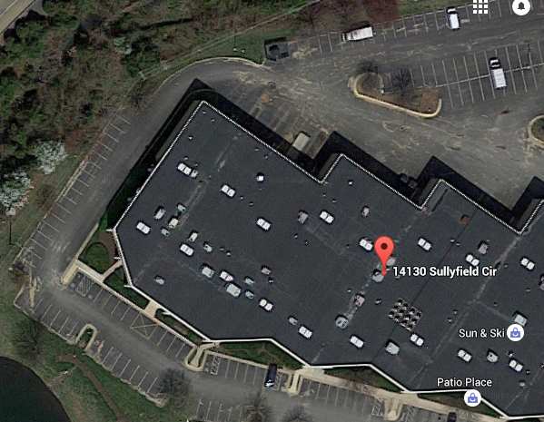
What MMG brings to Fairfax County
MMG is family oriented entertainment
Customer service driven
We are open seven days a week
Employment at about 20 staff
Max 12 – 13 staff on site at any one time
401k established with matching
$1.1M annual revenue in 2018
Ample parking
Most of building is occupied by engineering and insurance firms working weekdays
Our prime business hours are weekends and weekday evenings
Parking fits within previous tenants vacated spaces
Support local schools

Slide 5
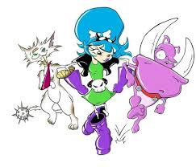
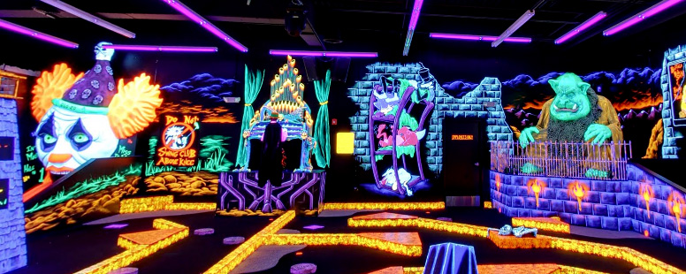
Questions?

