Slide 1
Commonwealth Centre at Westfields Land Bay D Residential CSPA 2006-SU-025-02
Sully District Land Use and Transportation Committee
March 16, 2020

Slide 2
Commonwealth Centre | Site Plan
10/17/19
Rev1. 02/20/20
Commonwealth Centre at Westfield - Land Bay D Residential
Toll VA VII, L.P.
UNDERGROUND
SWM
LAND BAY-C
LAND BAY-A
LAND BAY-D
LAND BAY-B
RETAIL
N
Site Plan | Commonwealth Centre
2

Slide 3
Conceptual Landscape Plan
10/17/19
Rev1. 02/20/20
Commonwealth Centre at Westfield - Land Bay D Residential
Toll VA VII, L.P.
Proposed Stone Walls Entry Feature
Existing Westeld stone wall Entry Feature
Existing Westeld stone walls Entry Feature
N
Conceptual Landscape Plan
3

Slide 4
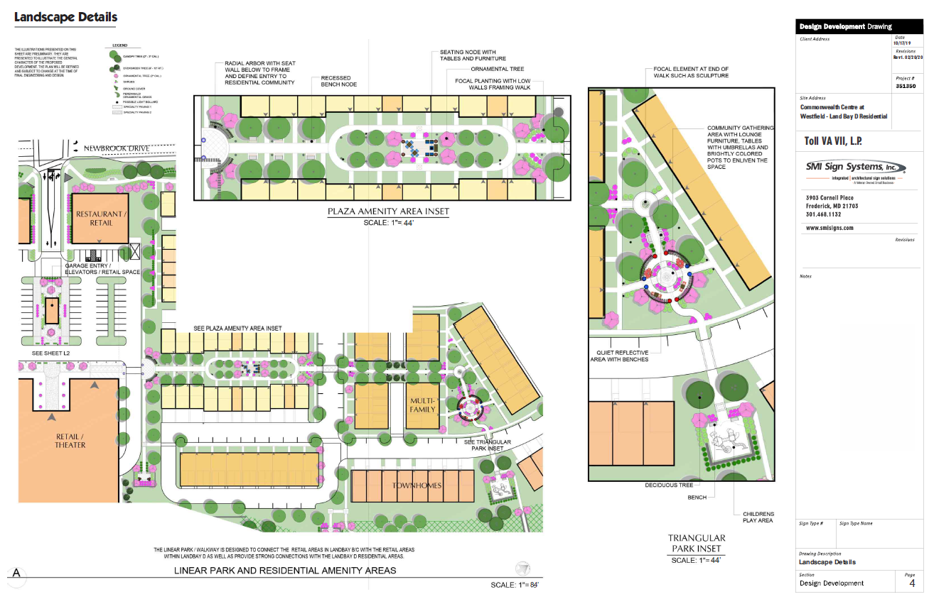

Slide 5
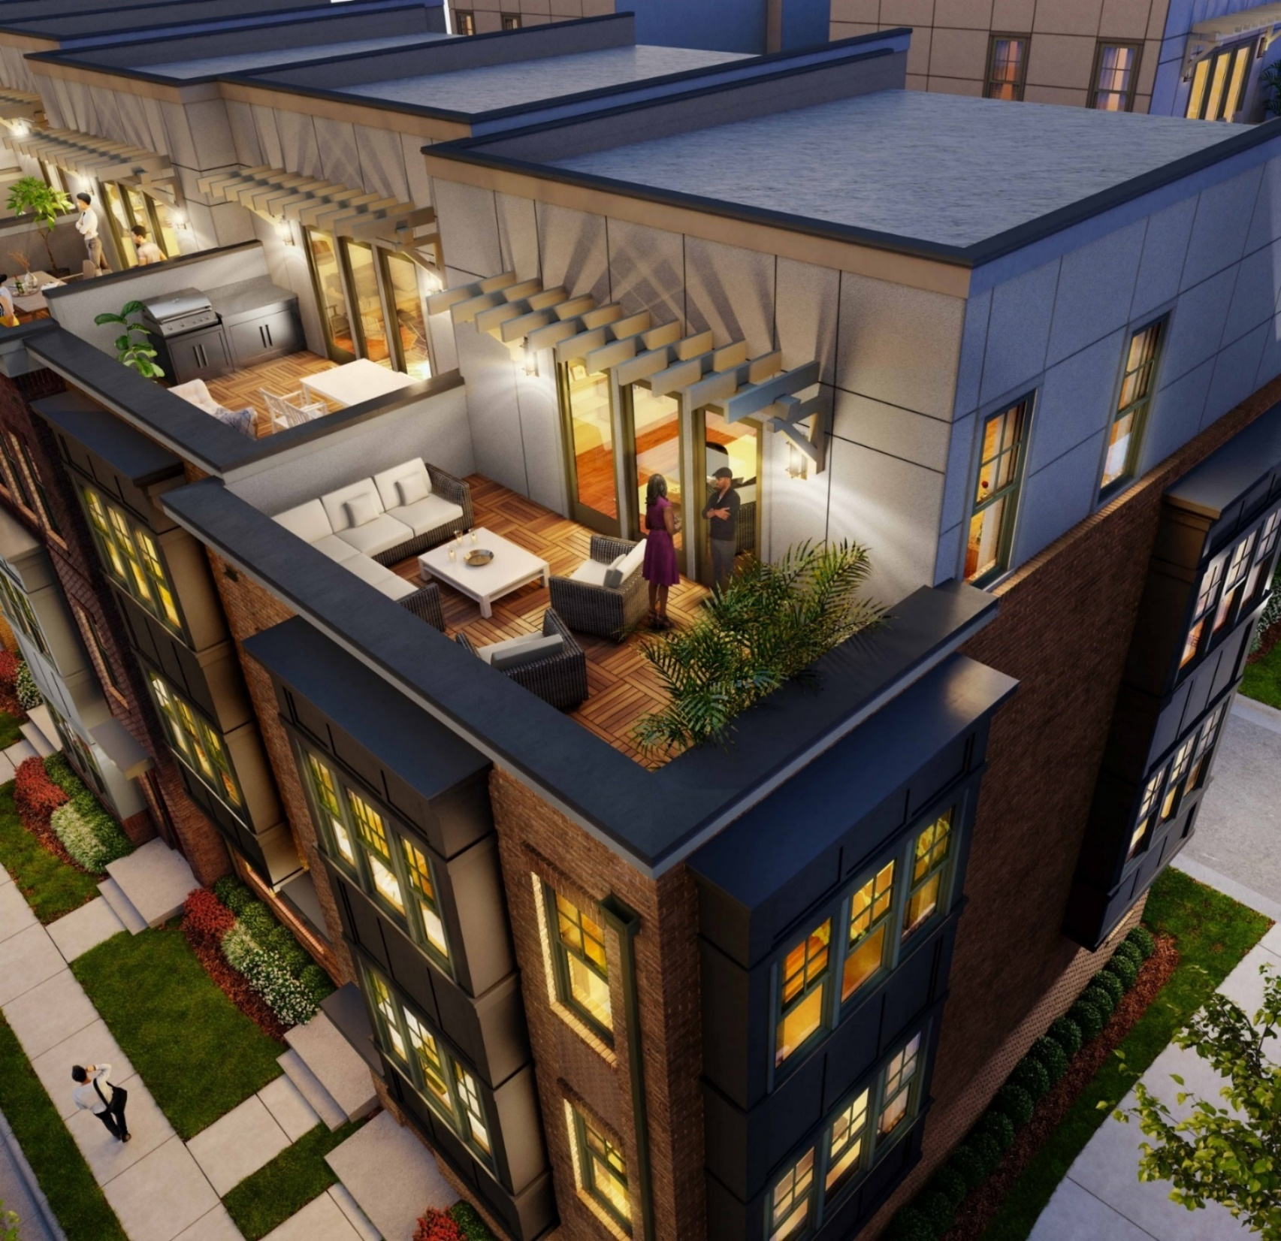
5

Slide 6
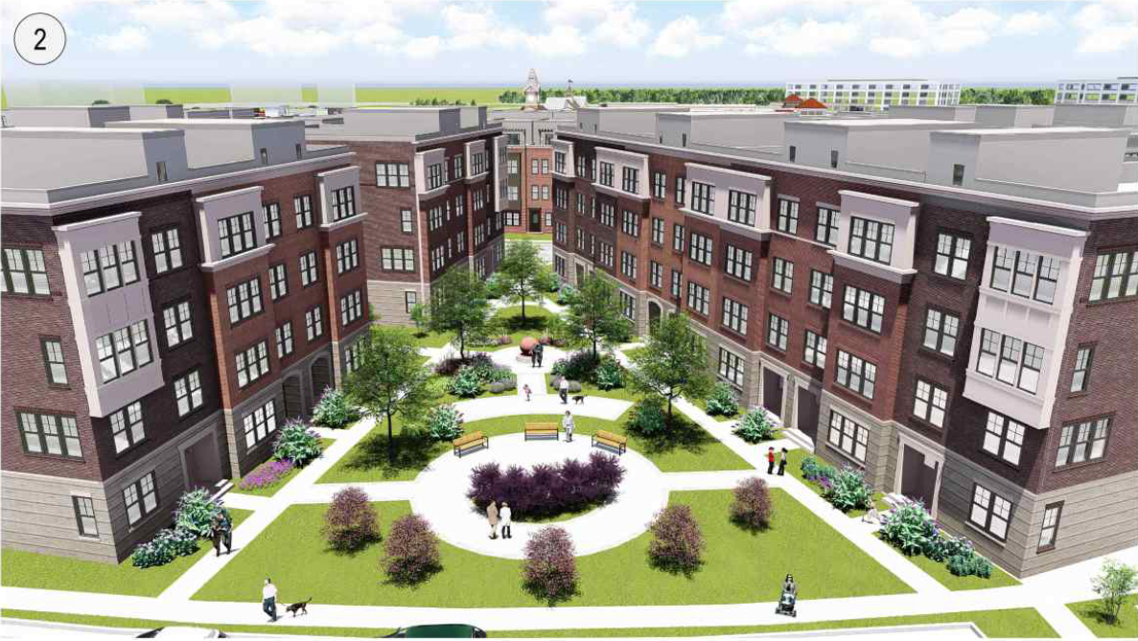

Slide 7
Signage Location Plan | Residential
10/17/19
Rev1. 02/20/20
Commonwealth Centre at Westfield - Land Bay D Residential
Toll VA VII, L.P.
Commonwealth Signage Plan
Temporary Signs
1 | 901.rs | Pole Flags
Permanent Sign
8 | 908b.rs | Monument Sign *
1
8
1
8 1
1
1
1
1
1
Newbrook Drive
Community Entrance Monument Signs
N
Signage Location Plan | Residential
5

Slide 8
Monument Sign | Residential - 908b.rs
Single Sided | Illuminated | Permanent
10/17/19
Rev1. 02/20/20
120”
18”
14”
1”
118”
1”
1” 12” 1”
Commonwealth Centre at Westfield - Land Bay D Residential
Aluminum tube accent painted Silver Metallic
Toll VA VII, L.P.
24”
1/8” Aluminum, over Aluminum angle frame painted Silver Metallic
Letters to be cut out on aluminum face and Backed up with Day/Night Acrylic
Aluminum tube support
Aluminum tube accent painted Silver Metallic
Granite Cap
Stone to match
Commonwealth Centre Sign
Brick Base to match Building
64”
10”
30”
Sign 908b.rs Front Elevation
Scale: 3/4” = 1’
Total: 20 Sq. Ft.
Sign 908b.rs Side Elevation
Scale: 3/4” = 1’
2x (24” x 120”) Single Sided Monument Signs
908b.rs Monument Sign
Residential
Sign 908b.rs Night Elevation
Scale: NTS
6
*Drawings are for Illustrative purposes ONLY & are intended to represent height and square footage only.

Slide 9
Pole Flag | Residential - 901.rs
Double Sided | Non-Illuminated | Temporary
10/17/19
Rev1. 02/20/20
3”
31”
24”
Commonwealth Centre at Westfield - Land Bay D Residential
Toll VA VII, L.P.
72”
156”
156”
7’ MIN
54”
51”
Sign 901.rs Side A Elevation
Scale: 1/2” = 1’
Sign 901.rs Side B Elevation
Scale: 1/2” = 1’
Total: 12 Sq. Ft. (each)
901.rs
Pole Flag Residential
3”
8x (156” x 31”) Double Sided Pole Flag Signs
*Minumum Vertical Clearance to bottom of Flag 7’
Sign 901.rs Footer
Scale: 1/2” = 1’
7
18”
*Drawings are for Illustrative purposes ONLY & are intended to represent height and square footage only.

Slide 10
10/17/19
Rev1. 02/20/20
 |  |  |  |  |  | PROPOSED MAX. SF OF SIGN | TOTAL PROPOSED SIGN AREA
RESIDENTIAL |  |  |  | PERMANENT SIGNAGE
 | 908b.rs | Single Sided Monument | 2 | 10’w x 2’h | Single | 20 sq-ft | 40 sq-ft | “Not to exceed 30 SF, 8’ in height per sign. Total of all signs at a single entrance cannot exceed 30 SF in area (Sect. 12-202).
 |  |  |  | TEMPORARY SIGNAGE
 | 901.rs | Pole Flag | 8 | 2’w x 6’w | Double | 12 sq-ft | 96 sq-ft | Temporary Sign
Commonwealth Centre at Westfield - Land Bay D Residential
Toll VA VII, L.P.
Est. Total: 136 Sq.Ft.
*Regulatory signs mandated by the State or County may be provided without requirement for a sign permit or inclusion in the CSPA.
**No Signs will be located so as to obstruct sight distance or pedestrian walkways.
***Temporary Pole Flags may be posted up to three (3) years.
****Minor signs may be provided pursuant to Article 12 of the Zoning Ordinance
Zoning Size Comparison Chart
8

Slide 11
