Slide 1
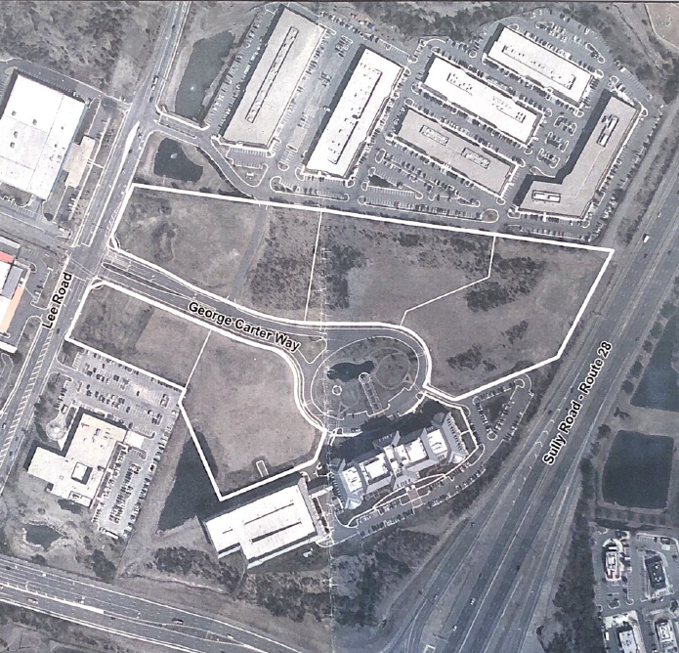
Ellipse at Westfield and Albemarle Point
Sully District
Land Use and Transportation Committee
August 17, 2020

Slide 2
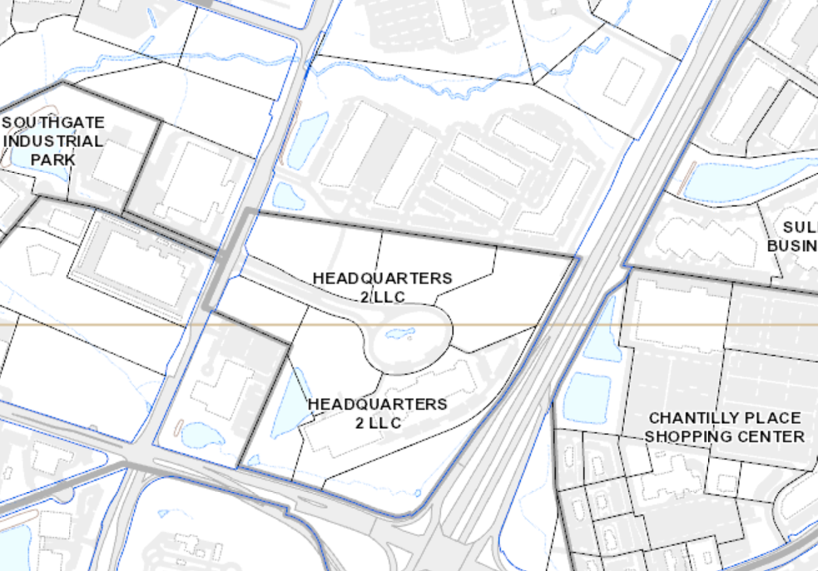
Location and Site Specifics
66 acres combined , Zoned I-5
Developed with L&F headquarters
and 6 flex/office buildings
Five vacant properties on Ellipse
were approved for hotel; no
interest
High quality office/flex uses in
Albemarle
Surrounding area/uses
Rt. 28
Lee Road
Willard Road

Slide 3
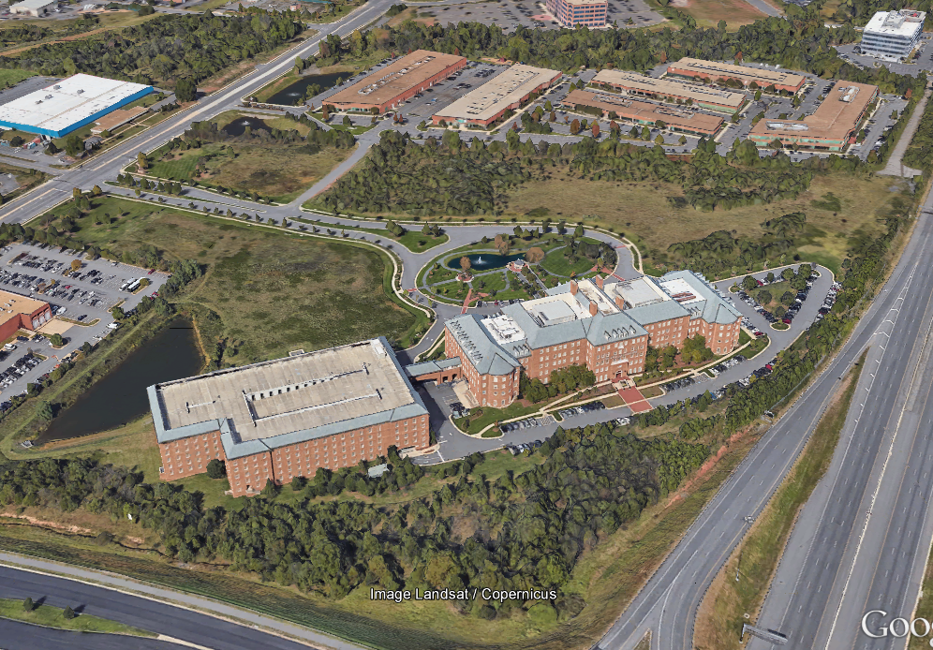
Background
Properties were one of thirteen nominations studied as part of the Dulles Suburban Center Plan Amendment which began in 2016. Approved current Plan language in 2018.
Board recognized the opportunity to:
amenitize the existing L&F building which has consistently experienced high vacancy rates, and
enliven the office/service/flex uses in Albemarle by blending in a residential element.
Filed rezoning to PDC District which better aligns with existing office/flex environment on the properties and allows infusion of residential element

Slide 4
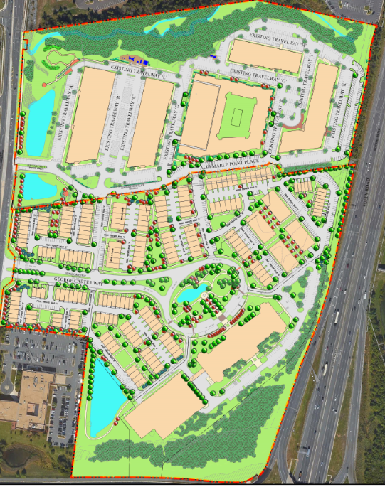
Vision
Project presents an exciting opportunity to create a walkable, 24/7, urban residential community focused on diversity of housing in moderately priced ownership products.
Project follows the well-settled planning and economic development principle that a mix of residential and work-place uses in a concentrated area attracts additional and upgraded retail, services and amenities that benefit both residents and employees of the community.

Slide 5
Highlights of Plan
Total of 683 residential units; diversity of housing types and price points
townhouses of varying sizes
2 over 2 condo units
small 4 story multifamily condo buildings
future 6/7 story multifamily building
Significant commitment to provision of affordable/workforce units
All will be for-sale products
ADUs will be dispersed throughout site in the 2 over 2 units
WDUs will be dispersed and located in the townhouses and
in the 2 over 2 units
All WDUs will be offered at lowest recommended WDU AMI of 80%
Retention of 579,322 sf of existing office and office/industrial flex uses
Introduction of new neighborhood serving retail plus possibility
of a myriad of allowable compatible PDC uses

Slide 6
Highlights of Plan, contd.
Grid of walkable streets, pedestrian connections to and through robust open space amenity areas and to services/retail uses
Property is not in any airport noise contours
Transportation Impact Analysis reviewed and approved by VDOT

Slide 7
Review of Conformance with Comprehensive Plan Language
Provide 400-700 diverse residential units
• A minimum of 12% affordable, distributed throughout development
• Development should be phased
• Provide adequate access and circulation, improve the existing north-south vehicular connection
• Provide pedestrian connections to adjoining trails/walkways and transit stops
• Provide a unified and coordinated development plan; internal and external transitions; logical and balanced orientation of development
• Provide access via George Carter Way and Albemarle Point Place. No additional access on Lee Road and no direct access on Route 28 or Willard Road
• Mitigate any additional transportation impacts to Lee Road and nearby intersections
• Develop an onsite, publicly accessible parks network per the Urban Parks Framework
• Mitigate school impacts

Slide 8
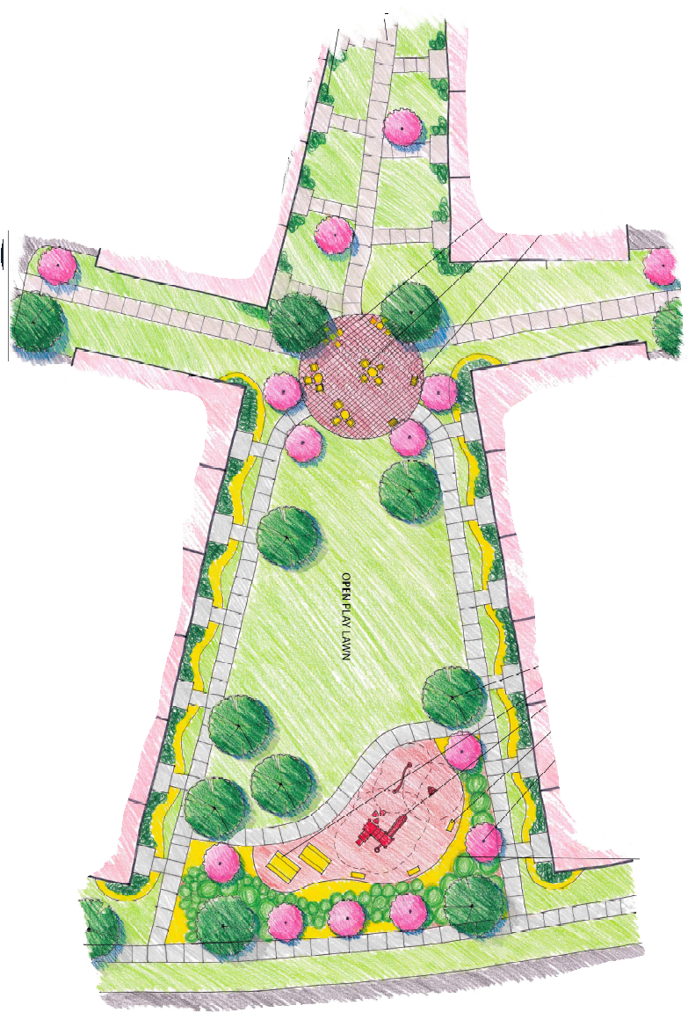
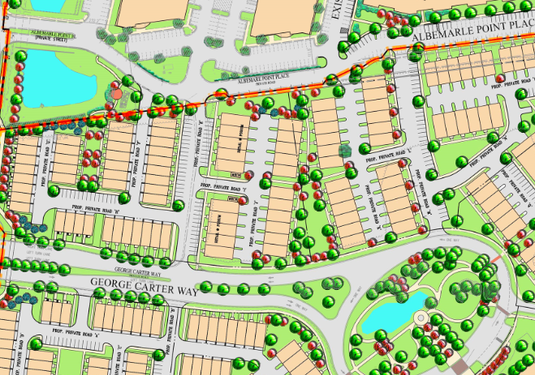
Urban Park Framework
ComPlan Goal – 1.25 acres
Provided – 2.46 acres

Slide 9
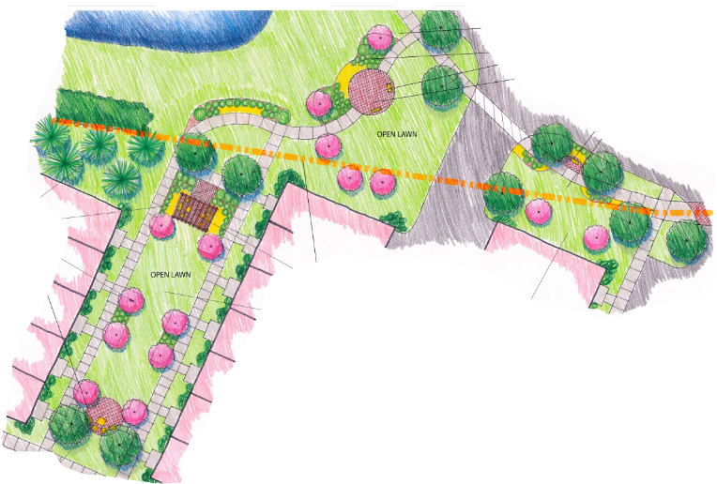
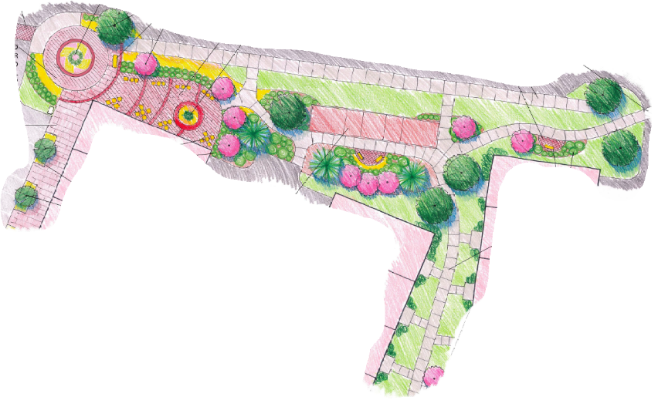
Pocket Park

Slide 10
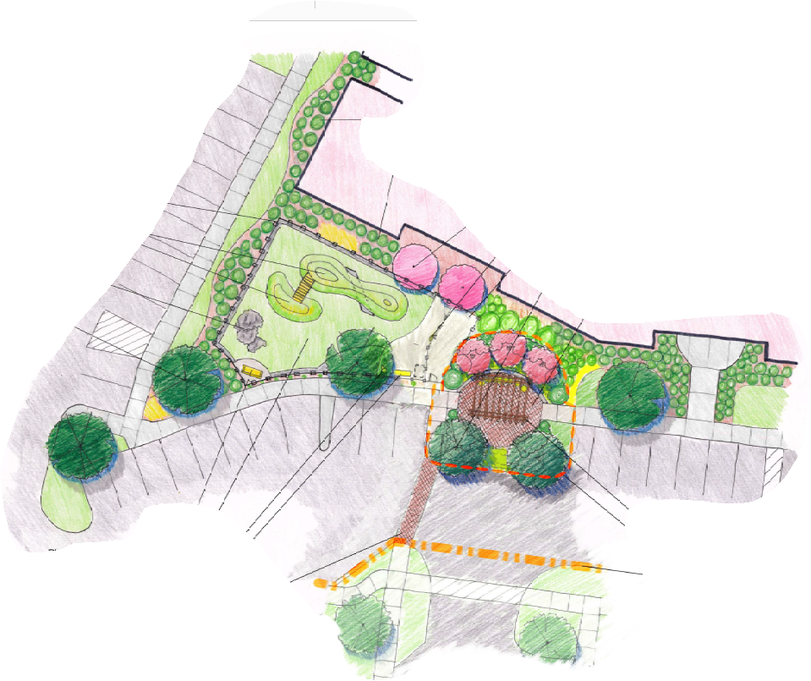
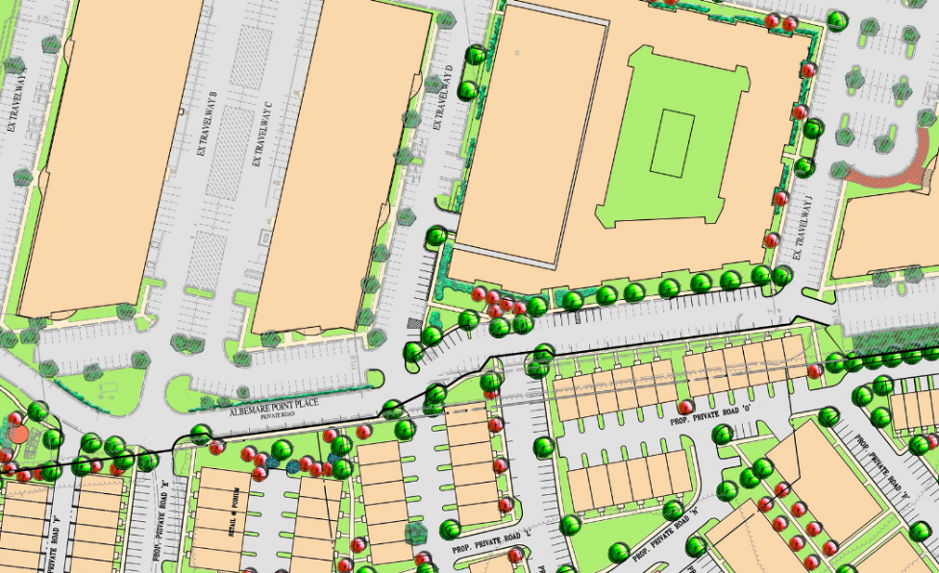
Pocket Park

Slide 11
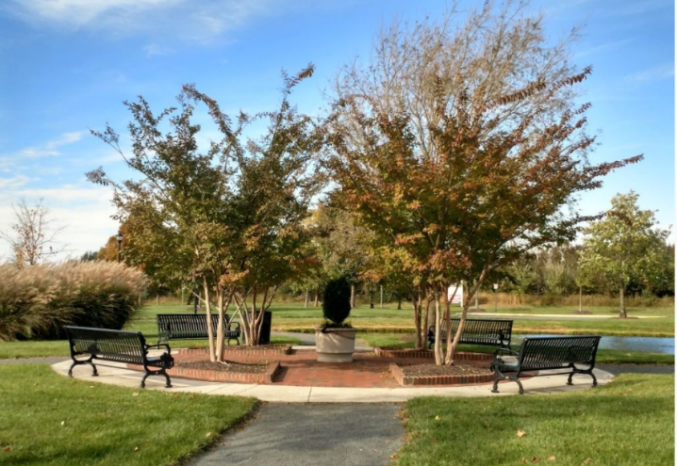
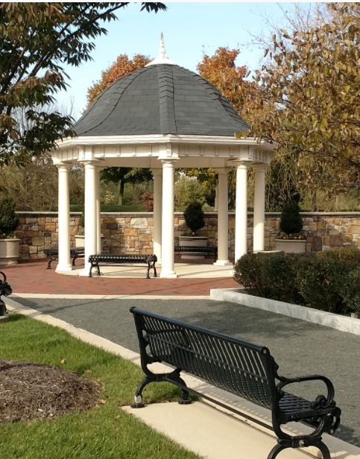
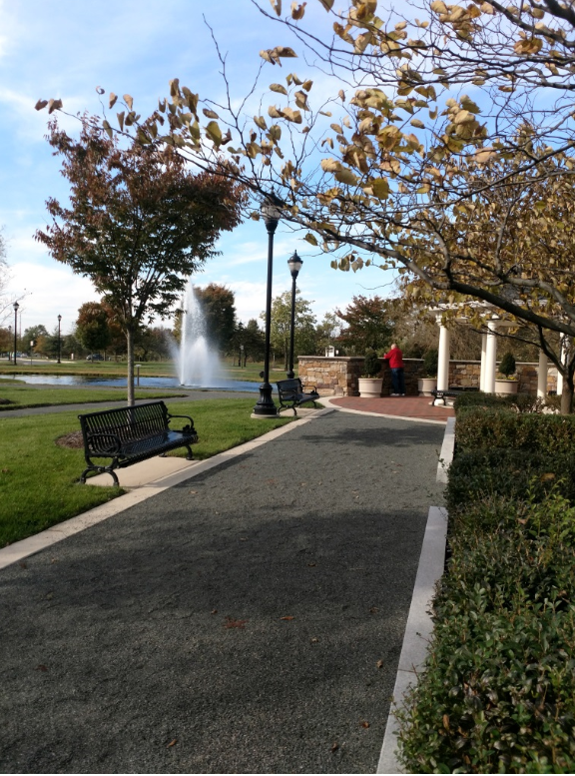
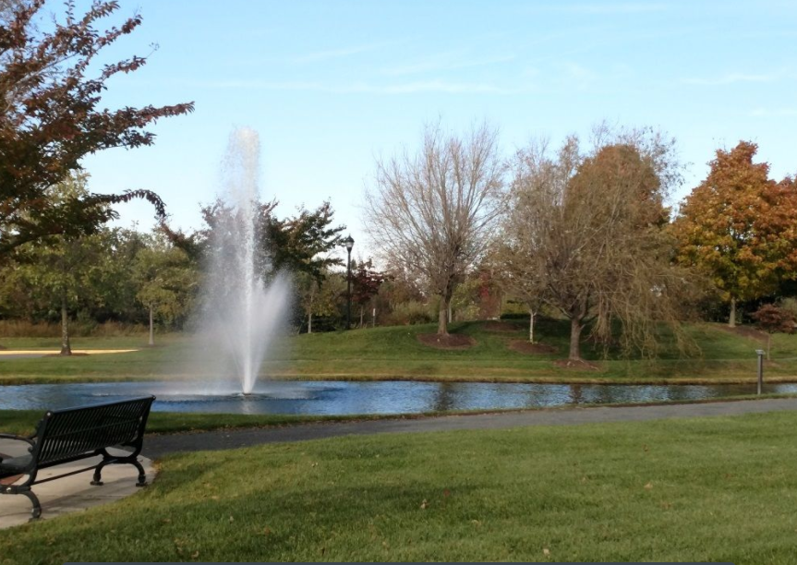
Common Green

Slide 12
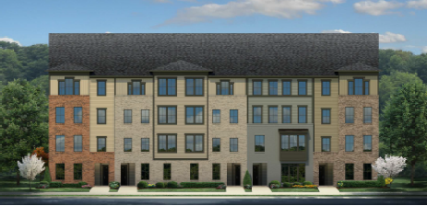
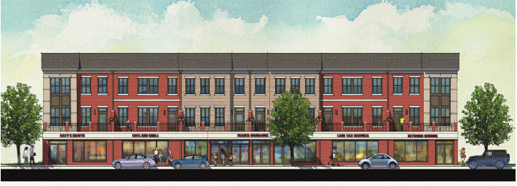
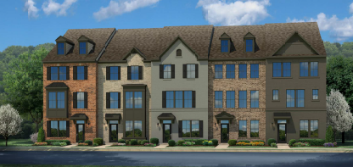
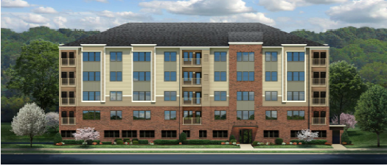
Residential over retail
2 over 2
Townhouses
Condo building

Slide 13
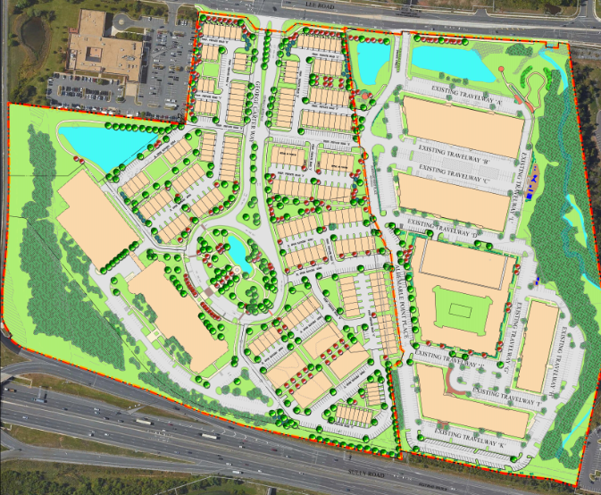
Proffers – extensive commitments
Timeline
Planning Commission 11/4/20
Questions?

