Slide 1
Recovery Innovations, Inc. DBA RI International
Crisis Stabilization Center
14554 Lee Road
Chantilly, Virginia

Slide 2
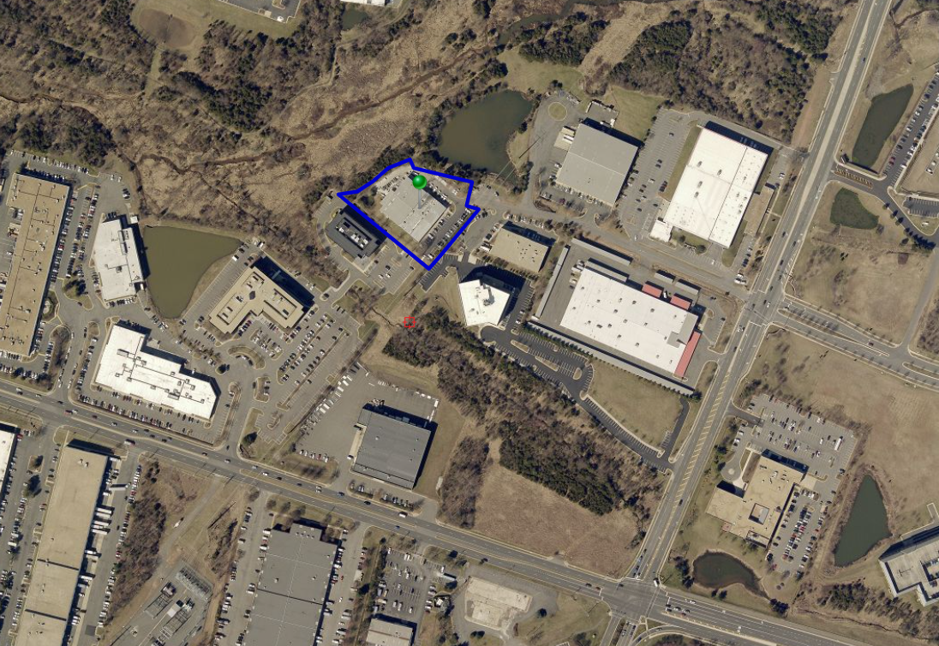
GEORGE CARTER WAY
LEE ROAD
WILLARD ROAD

Slide 4
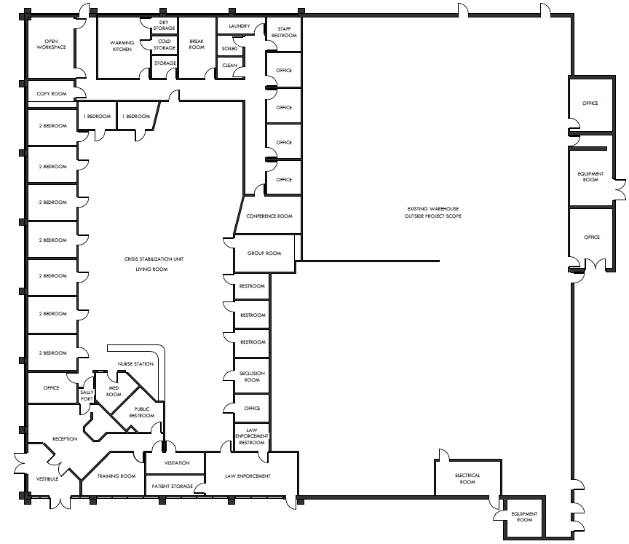

Slide 5
Transportation/Parking
Required Parking: 32 Spaces
Proposed/Existing Parking: 56 Spaces
Trip Generation: Patients, Staff, and Deliveries
+1 trips in AM Peak Hour
+1 trips in PM Peak Hour
By-Right Use (Office): 313 trips per day
Crisis Stabilization Center: 164 trips per day
-145 daily trips

Slide 6
RI International History and Background
RI International is an incorporated, non-profit behavioral health organization that has been providing a variety of crisis services, residential programs and outpatient programs internationally for the past 30 years.
Currently, RI operates programs in Arizona, California, Delaware, North Carolina, Utah, Washington and New Zealand; with new programming starting in Louisiana, New Mexico, Ohio, Virginia and Australia.
Our Core Mission is: Empowering people to recover, succeed in accomplishing their goals, find meaning and purpose in life, and reconnect with themselves and others.
These values of Hope, Wellness, Personal Responsibility, Community Focus and Empowerment are the basis for our work with adults who are experiencing co-occurring substance use and mental wellness challenges.
These core values guide us in our vision of activating the next generation of frame-breaking health care innovation to support people beyond their substance use and behavioral health needs and succeed in the community where they live, work and play.

Slide 7
Chantilly Crisis Stabilization Center 14554 Lee Road
Services and Hours of Operation
24 hours a day / 7 days a week Crisis Stabilization Services to any adults 18 and older experiencing and mental health and/or substance use crisis.
Psychiatric (Psychiatrist and Nurse Practitioners), Nursing (RN’s and LPN’s), and clinical (licensed clinicians) care 24/7 with medication management as needed for individuals.
Peer Support Specialists are embedded in all of our programs as well to provide ongoing engagement, empowerment and connection for individuals.
Therapeutic Programming throughout the day to ensure individuals are working towards and meeting their treatment goals and return to the community.
Discharge planning from the time of admission to work through an individuals needs to stabilize and remain successful in the community.

Slide 8
Community Asset and Resource
RI’s goal is to develop and implement a program that is a long term community asset to help meet the needs of individuals in the community experiencing mental health and substance use challenges.
Our facilities are warm and welcoming environments that offer safety and security as well with a highly qualified team of professionals to provide the highest quality of care.
Our facilities are secure locked facilities and discharge planning is arranged with appropriate parties involved prior to discharge and/or RI assists individuals with transportation to ensure they can safely arrive at their destination.
We intend to locally recruit and employ an estimated 35 employees in a variety of positions, which we hope will add value to the local communities.

Slide 9
Contracts and Funding
Contracts and Funding
Estimated Operating Budget Year 1
RI has currently been contracted with the Region 2 Community Service Boards for start up funding and funding for the uninsured populations to provide this service.
In addition, RI will contract with the variety of Managed Care Organizations (MOC’s) in Virginia.
We currently have contracts with a few of these MCO’s throughout our work in other states and will finalize contracts with the MCO’s that are new to our services in this area.
Expenses
Salaries and Wages | $2,501,723 | Estimated 35 employees
Other Program Expenses | $2,256,790 | Rent and Supplies
Est. Total Program Exp. | $4,758,513
Potential Revenue
Est. Medicaid Revenue | $3,333,166 | MCO Contracts
Uninsured Revenue | $1,900,000 | RFP Contract Award with CSBs
Est. Total Revenue | $4,758,513

Slide 10
Thank you! RI International Amy Pugsley, MA, CHC VP of East Operations amy.pugsley@riinternational.com Thomas Castellanos Chief Financial Officer thomas.castellanos@riinternational.com Kimley-Horn and Associates Ross Stevens ross.stevens@kimley-horn.com Caycee Hart caycee.hart@kimley-horn.com Andy Smith andy.smith@kimley-horn.com Architectural Resource Team Dev Pawar dpawar@art-team.com Bridget Gesser bgesser@art-team.com
Questions?

