Slide 1

Dulles Discovery South
PCA/CDPA/FDPA 2017-SU-011
Sully District Land Use and Transportation Committee Meeting
August 16, 2021

Slide 2
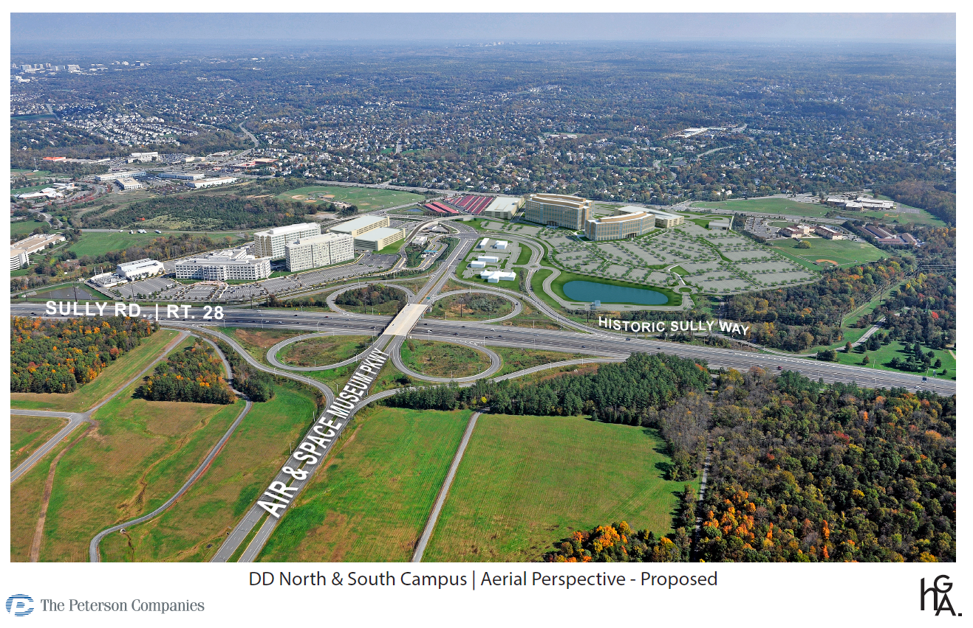
DD North & South Campus | Aerial Perspective

Slide 3
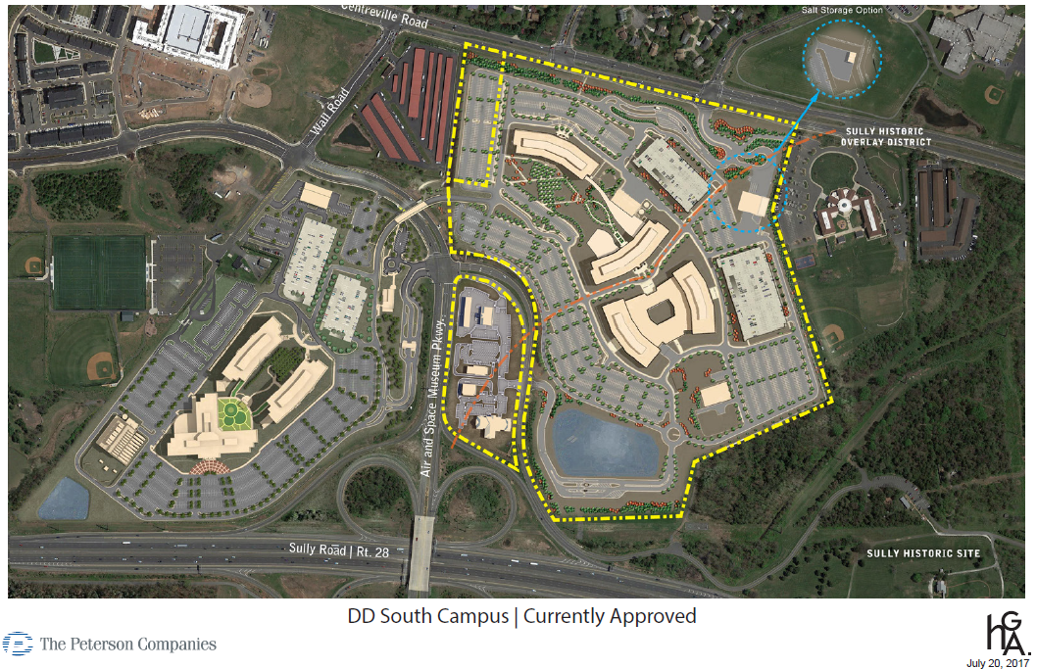
DD South Campus | Prior Approval 2010

Slide 4
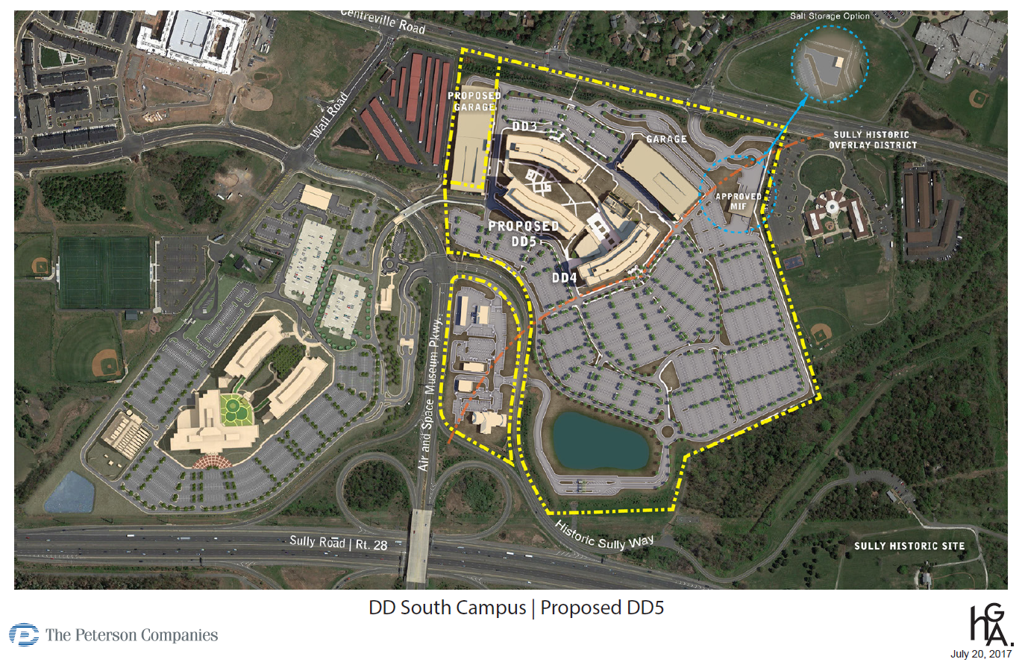
DD South Campus | Approved DD5 Building 2017

Slide 5
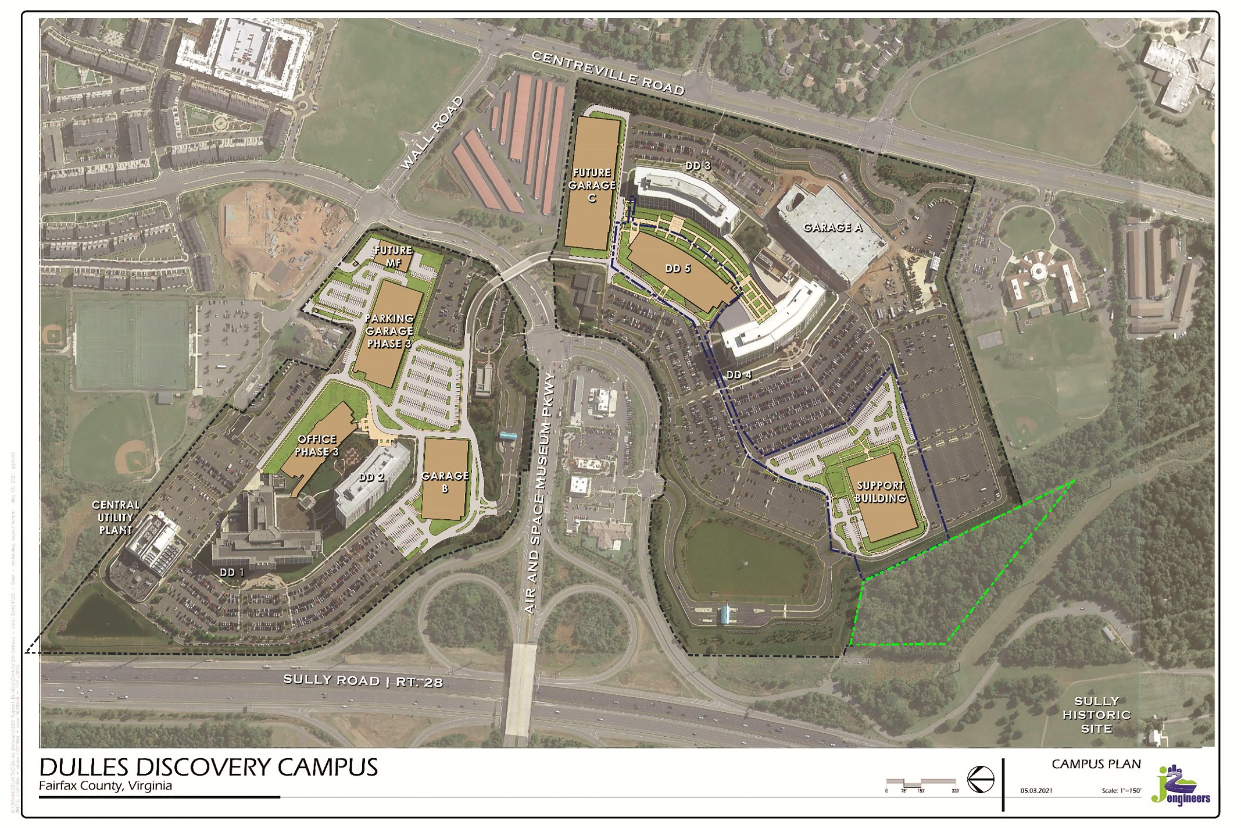
DD South Campus | Proposed Support Building
SULLY HISTORIC DISTRIC BOUNDARY
SULLY HISTORIC DISTRIC BOUNDARY
TREE BUFFER
OWNED BY FAIRFAX CO.
DONATED BY THE PETERSON
COMPANIES
SULLY HISTORIC DISTRIC CORE

Slide 6
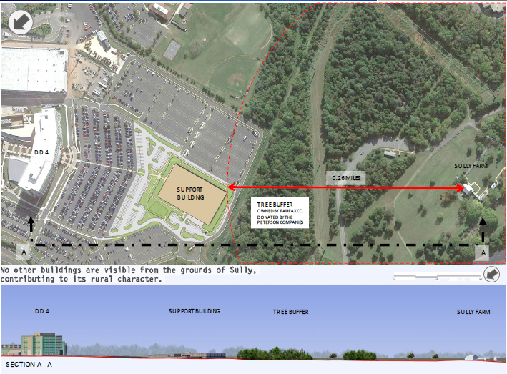
DD North & South Campus | Site Section

Slide 7
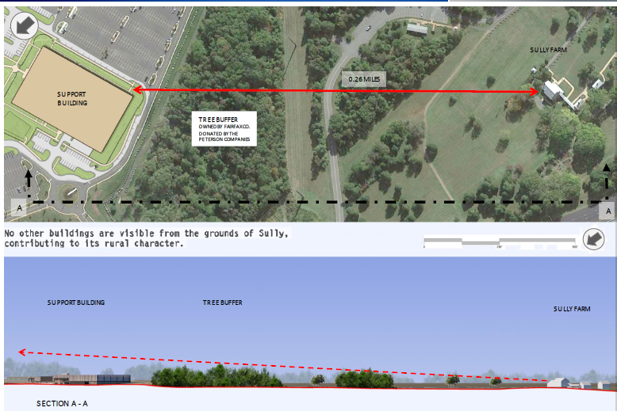
DD North & South Campus | Site Section

Slide 8
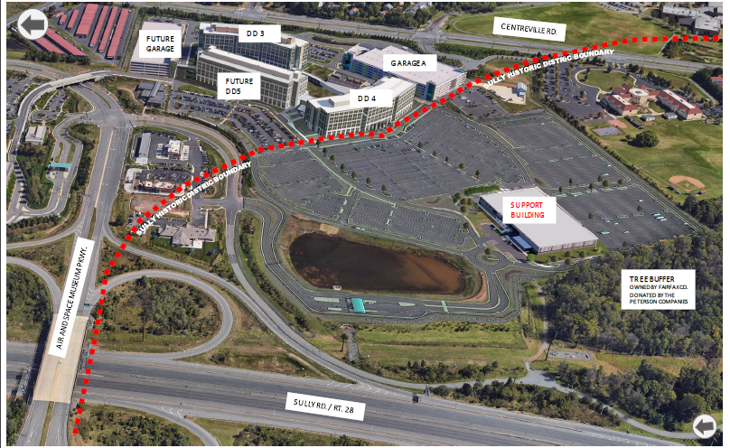
DD North & South Campus | Aerial Perspective

Slide 9
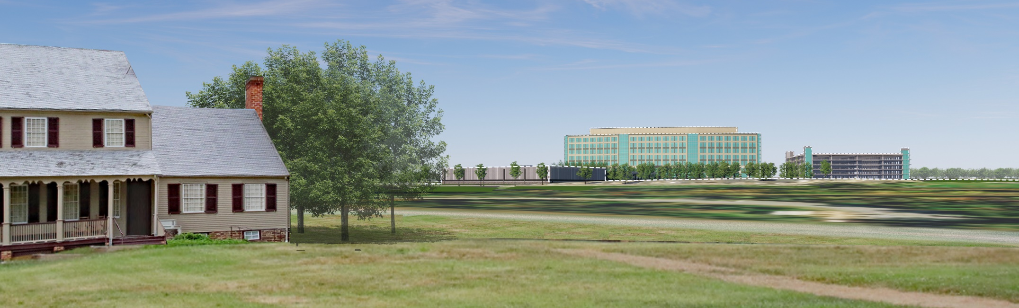
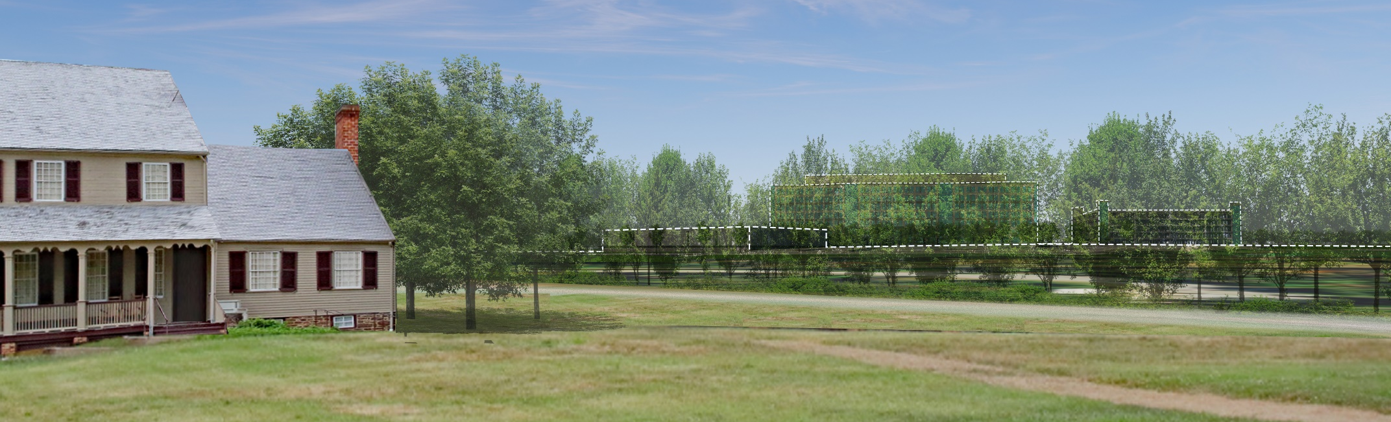

DD North & South Campus | 3D Model View From Sully
SUPPORT BUILDING
DD 4
GARAGE A
Existing Tree Buffer Removed for Clarity of Information
SUPPORT BUILDING
DD 4
GARAGE A
Existing Tree Buffer Screening Views Toward DD

Slide 10
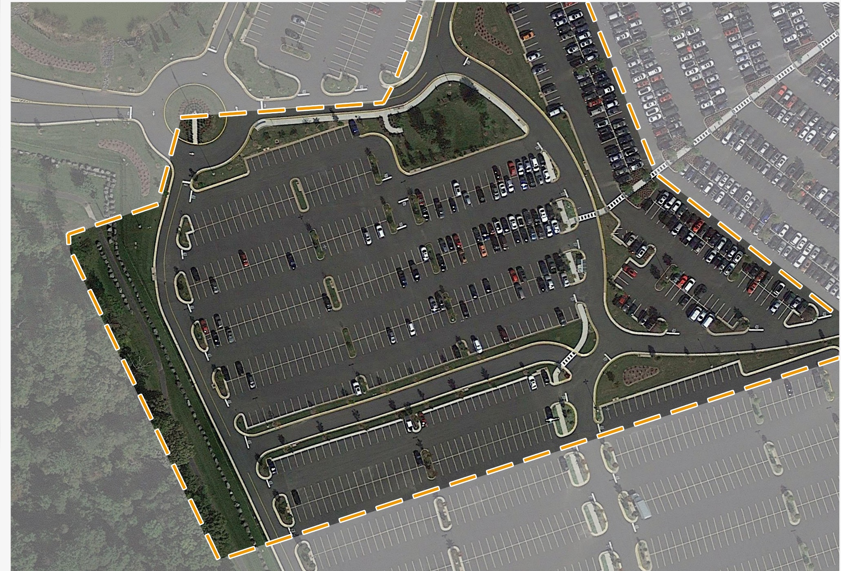
DD South Campus | Support Building Existing Conditions
EXISTING
CEMETERY

Slide 11
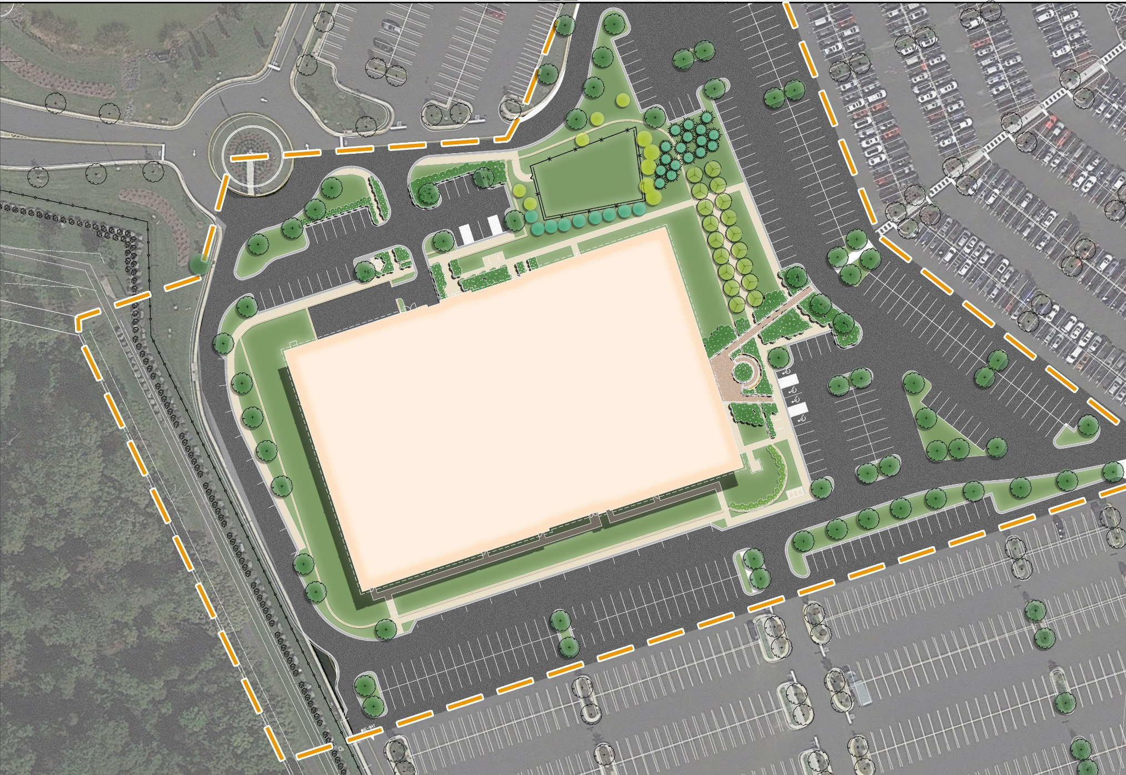
DD South Campus | Support Building Proposed Site Plan
EXISTING
CEMETERY
SUPPORT BUILDING

Slide 12
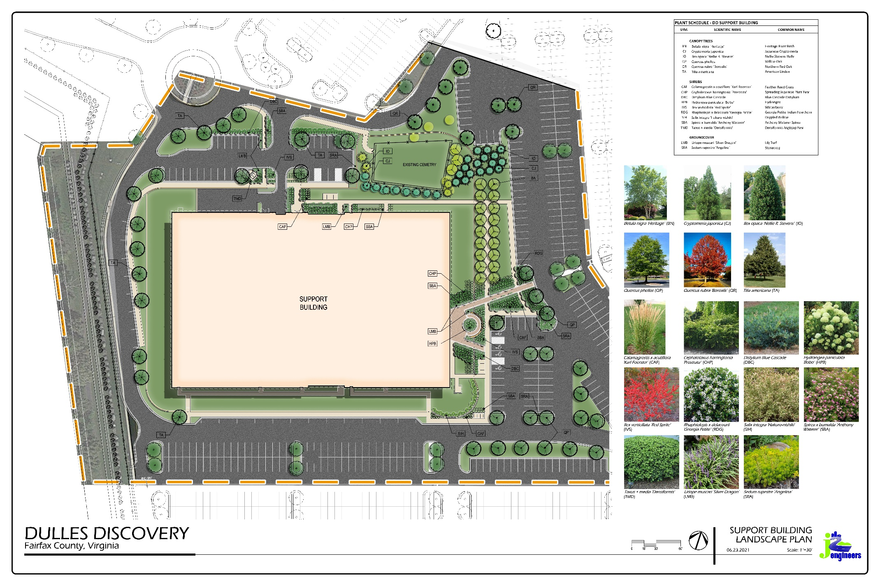
DD South Campus | Support Building Proposed
EXISTING
CEMETERY
SUPPORT BUILDING

Slide 13
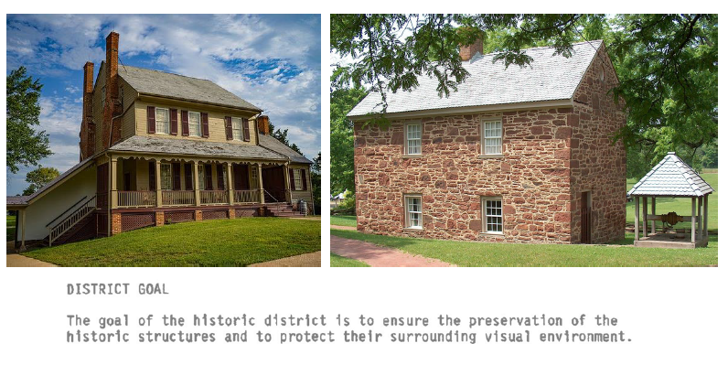
DD South Campus | Context and Inspiration

Slide 14
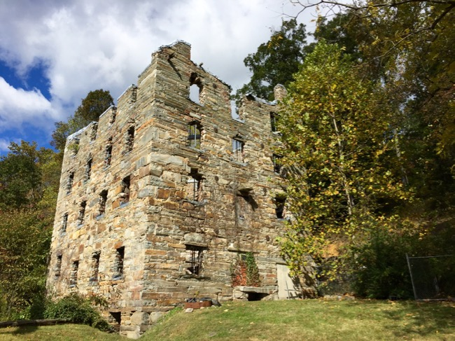
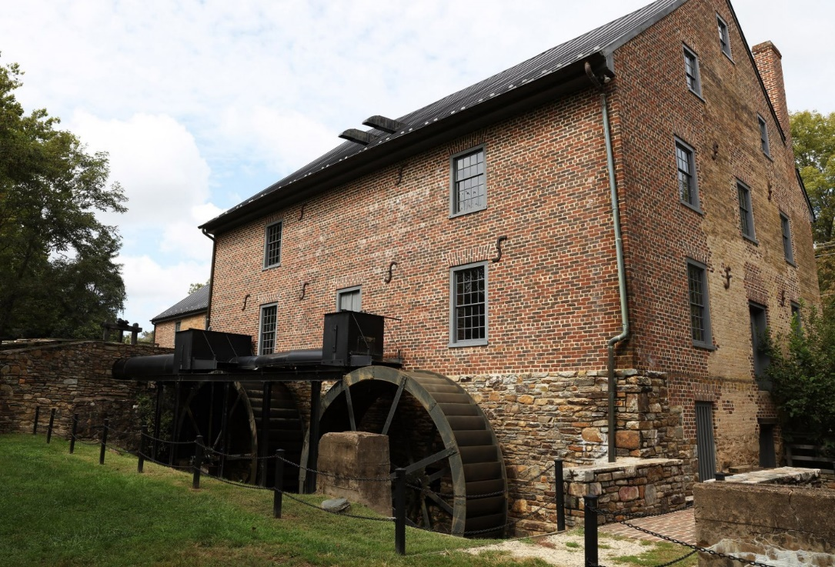
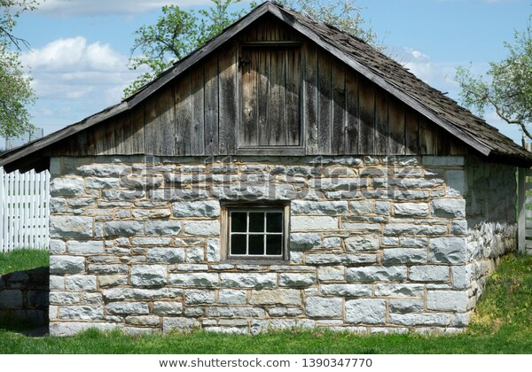
DD South Campus | Context and Inspiration

Slide 15
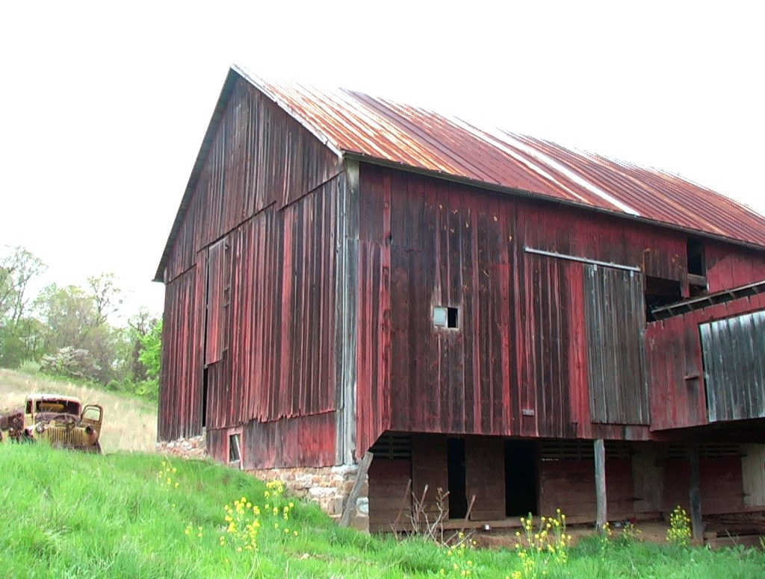
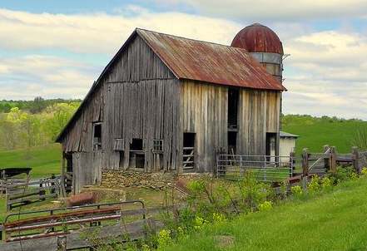
DD South Campus | Context and Inspiration

Slide 16
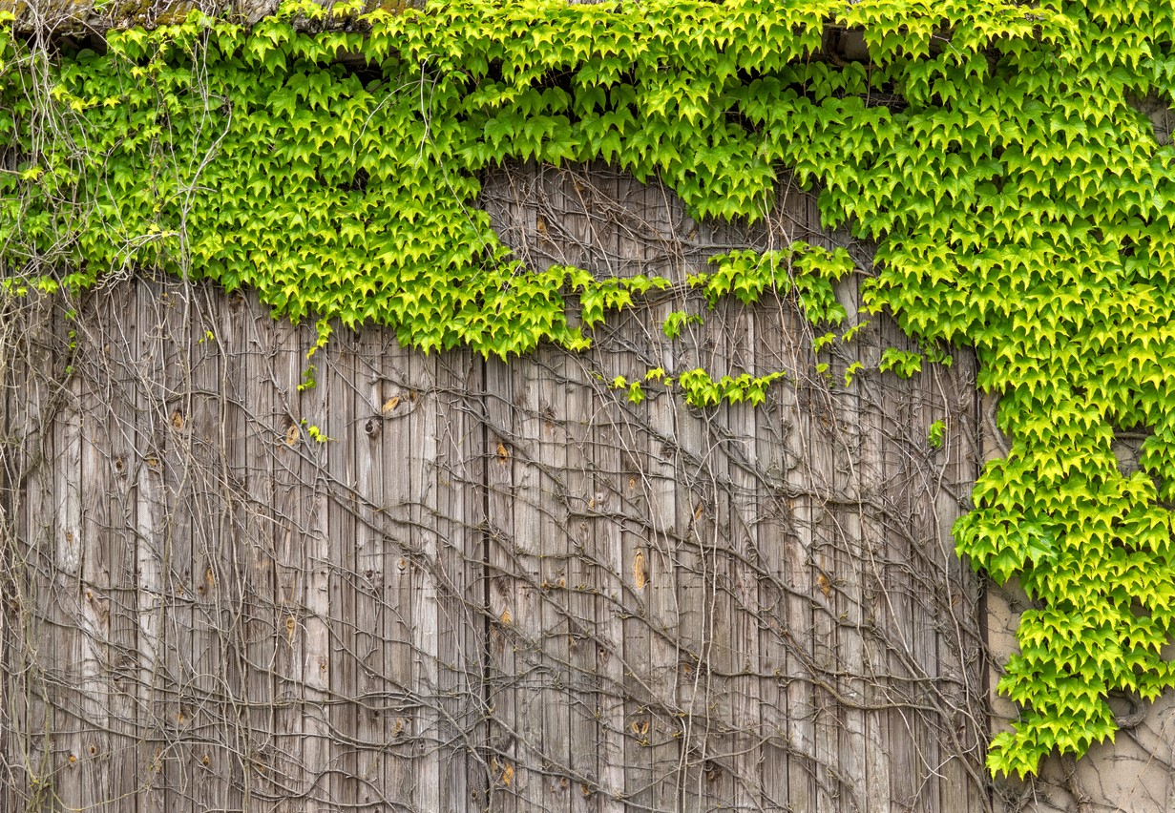
DD South Campus | Context and Inspiration

Slide 17
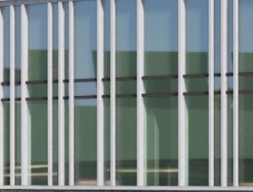
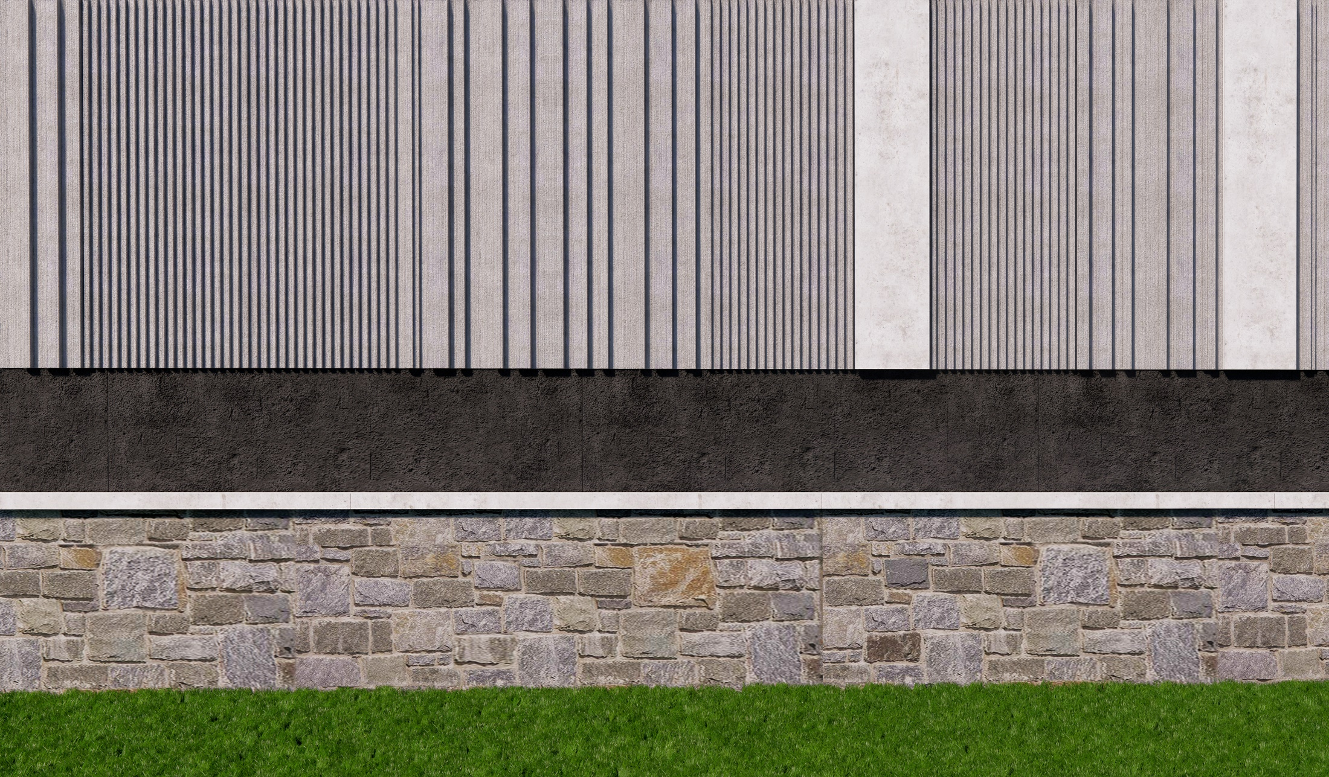

DD South Campus | Material’s Palette
VERTICAL MULLION WITH SNAP-ON COVER EXTENSIONS
CAST-IN PLACE CONCRETE WALL WITH VERTICAL FORM LINER
WOOD TEXTURED METAL PANEL ACCENTS
FIELD APPLIED STONE BASE

Slide 18
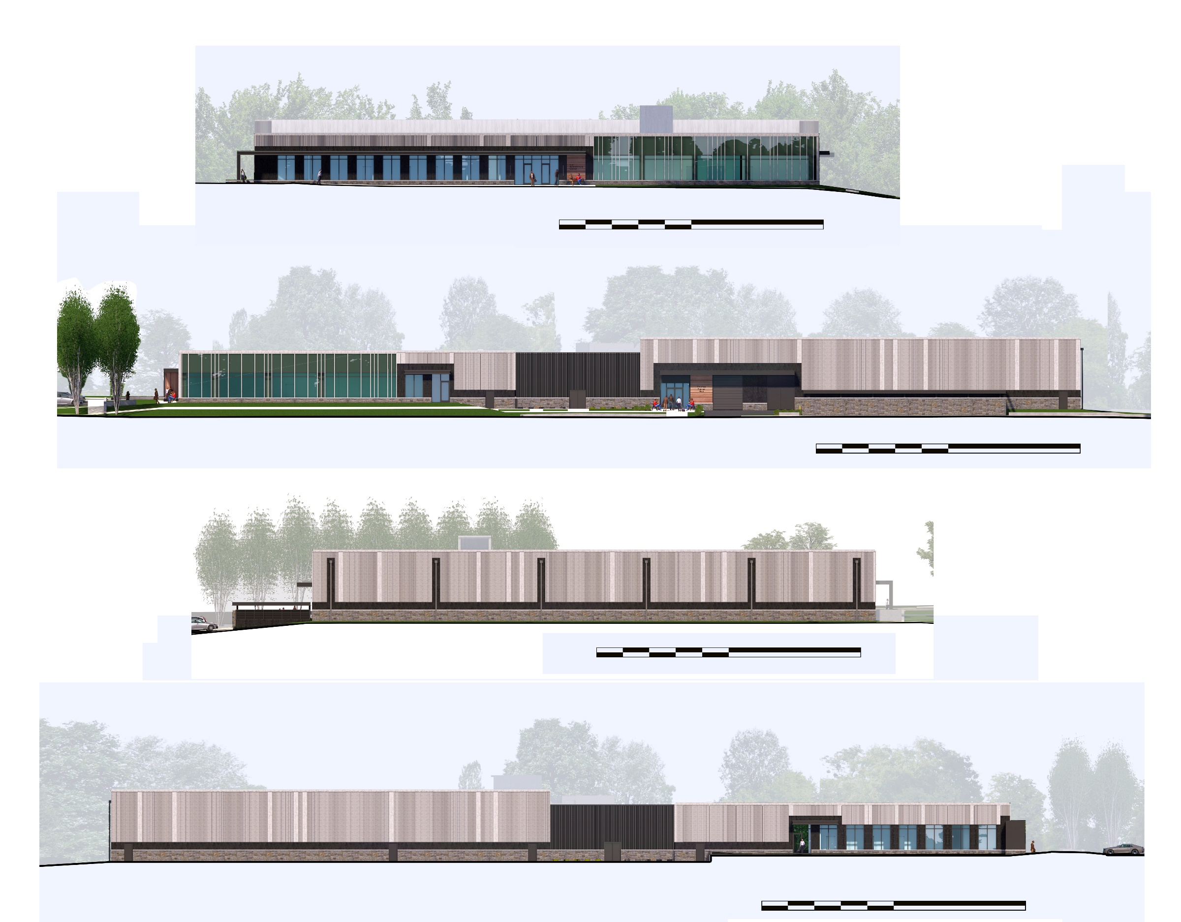
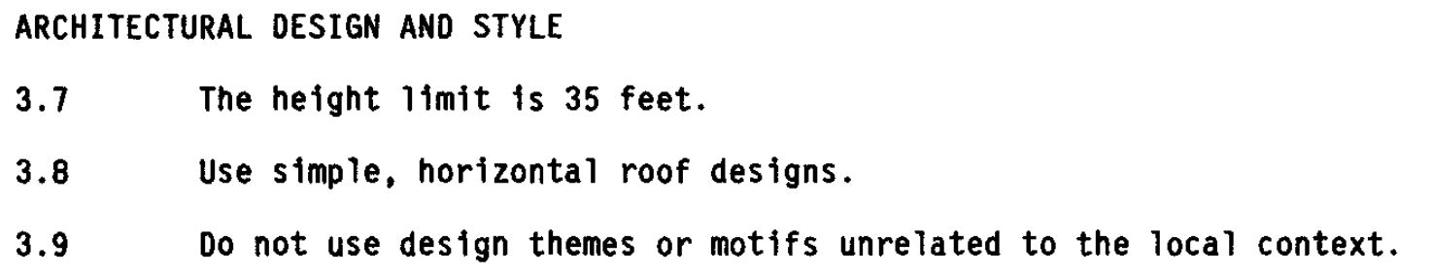
DD South Campus | Facades
27’-3”
West Facade
0’
100’
27’-3”
19’-9”
South Facade
0’
100’

Slide 19
DD South Campus | Facades
19’-9”
East Facade
0’
100’
27’-3”
North Facade
0’
100’

Slide 20
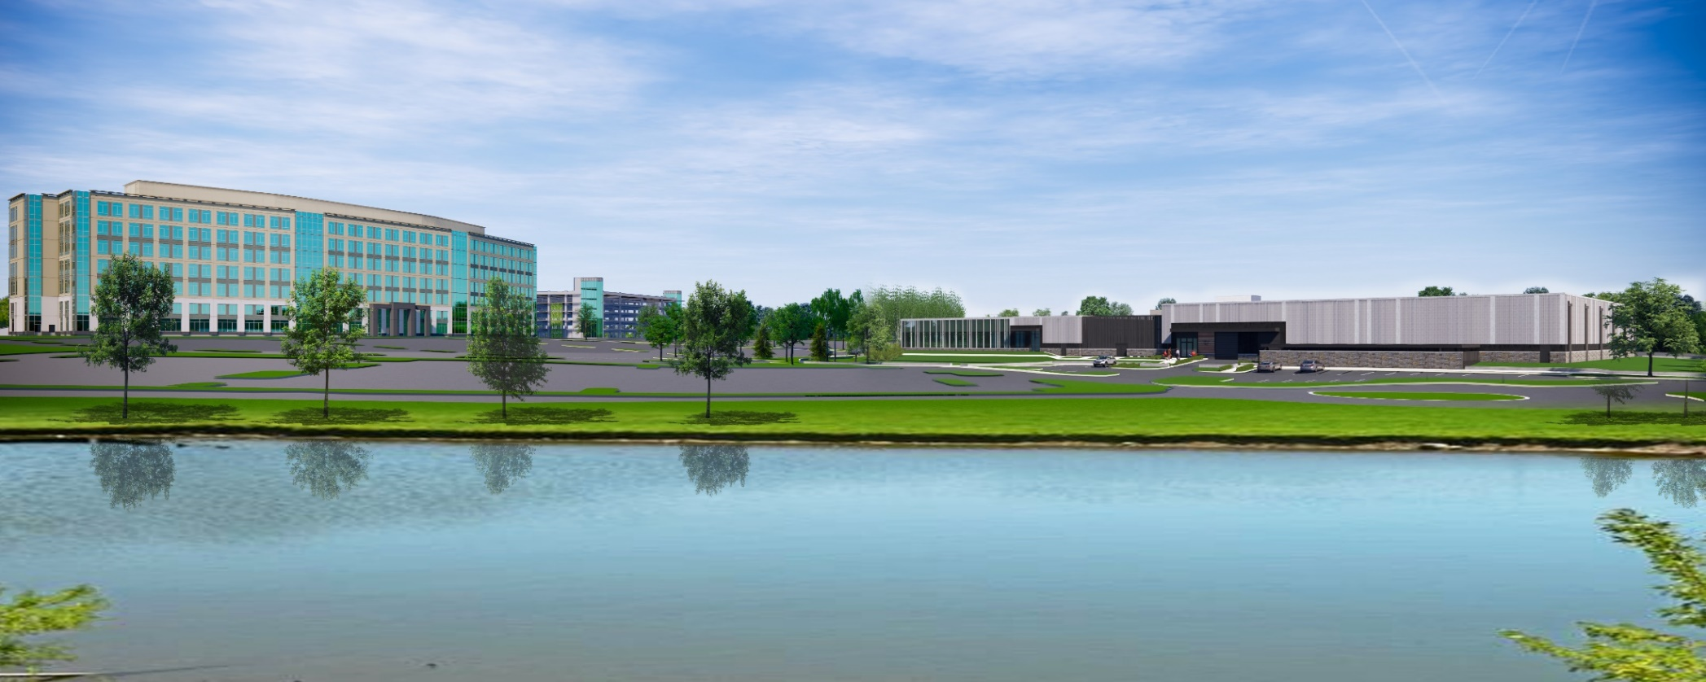
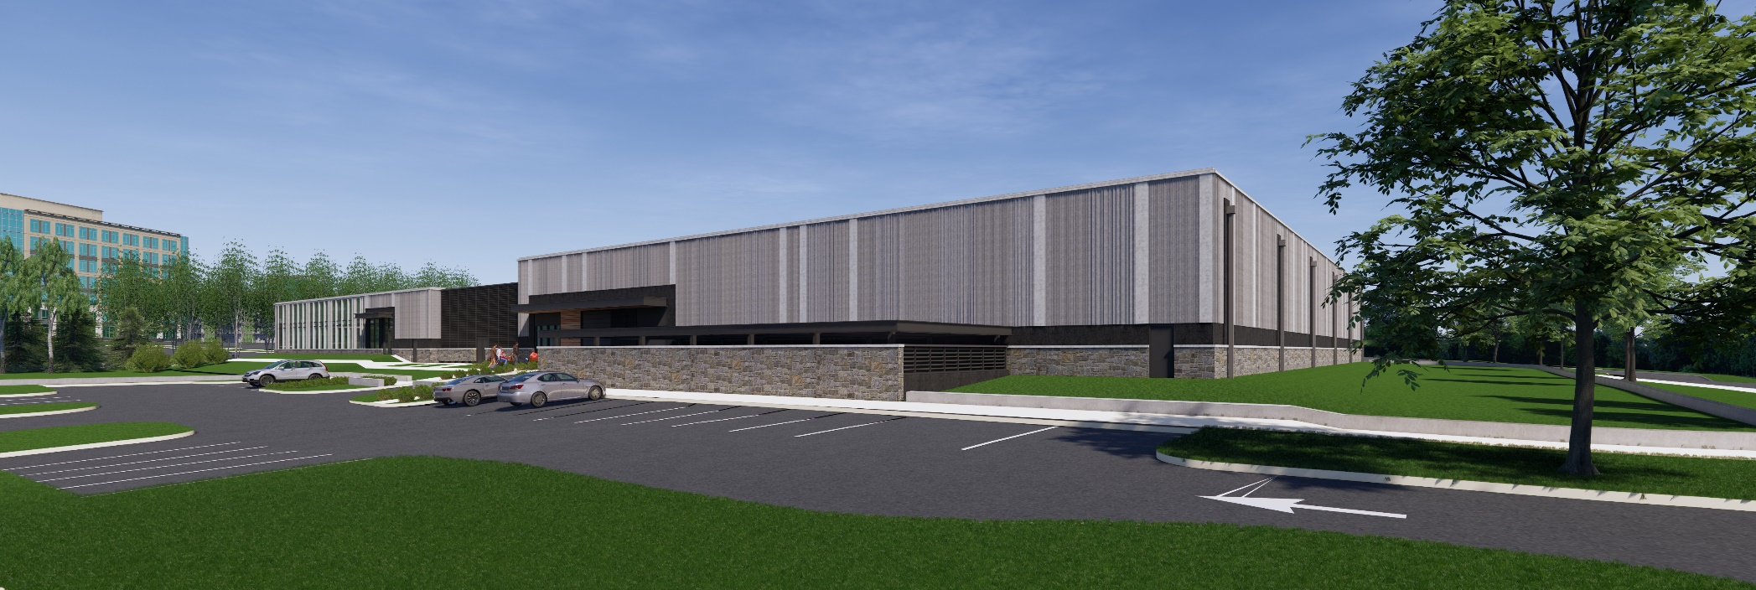
North Facade
North West Corner

Slide 21
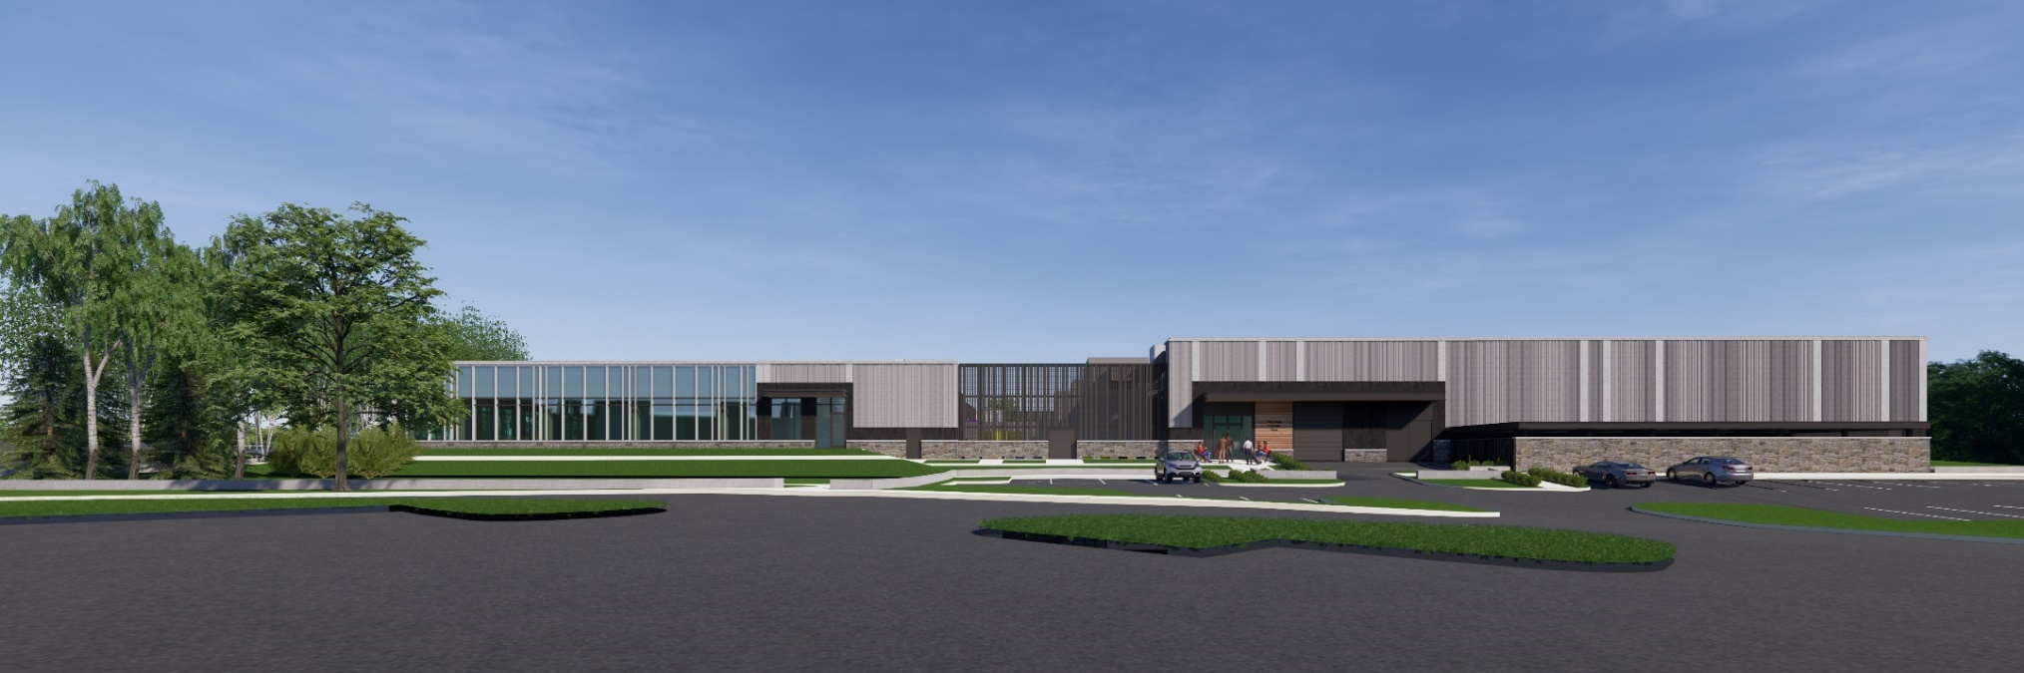
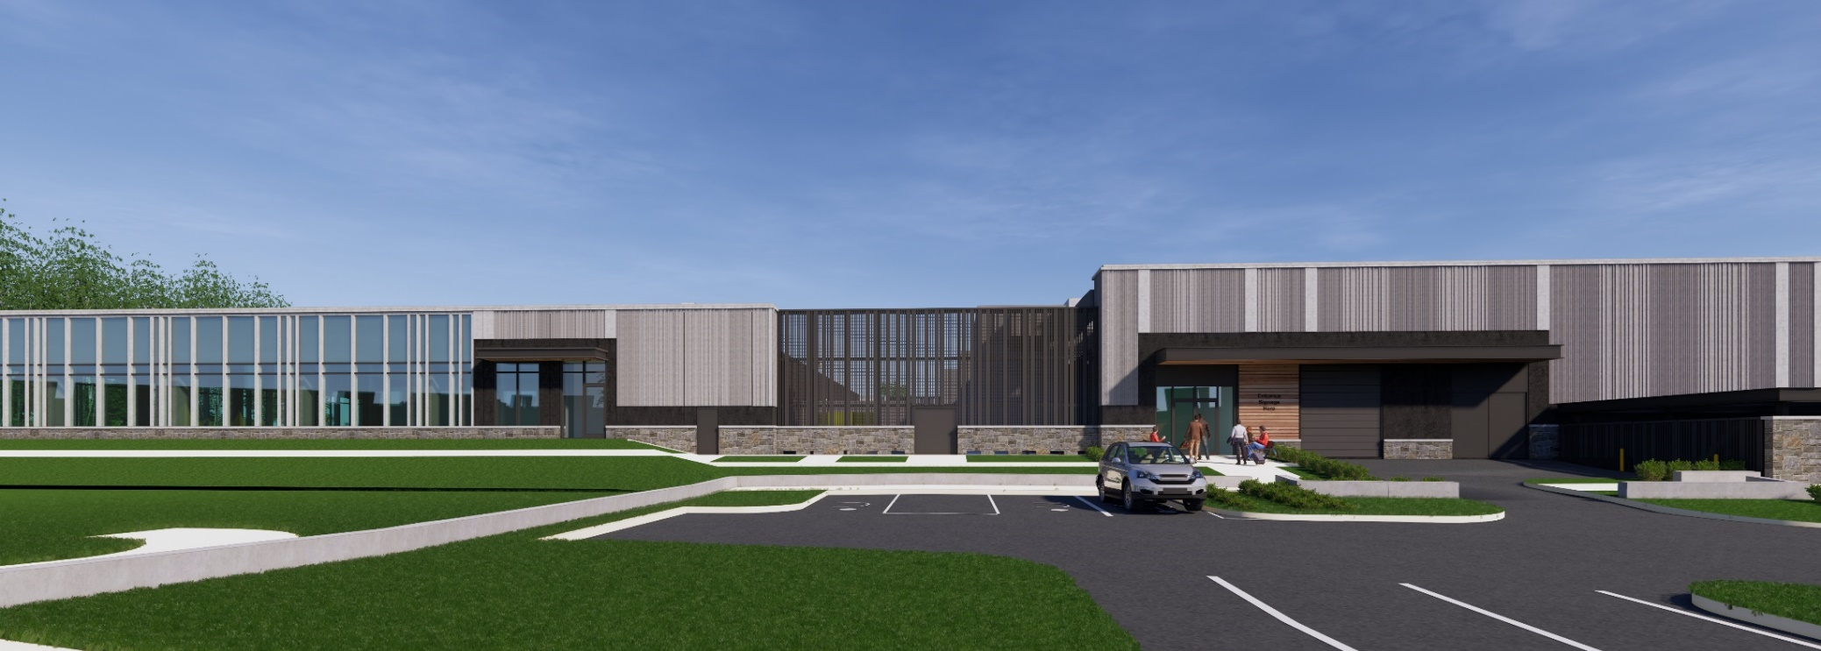
North Facade
North Facade (Mech. Yard)

Slide 22
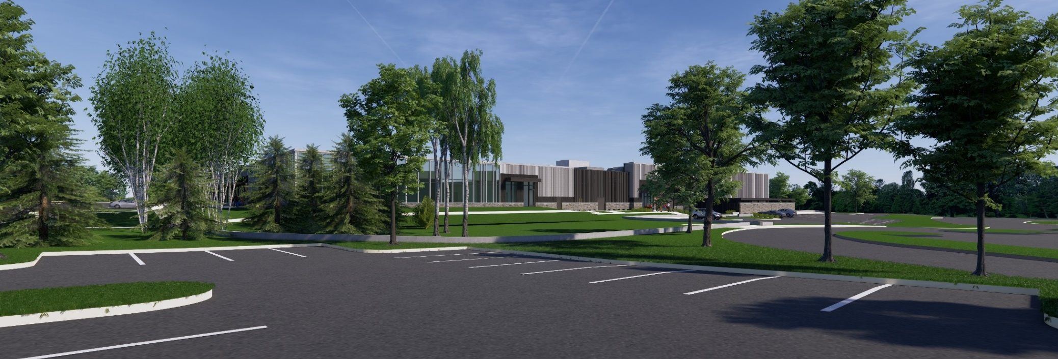
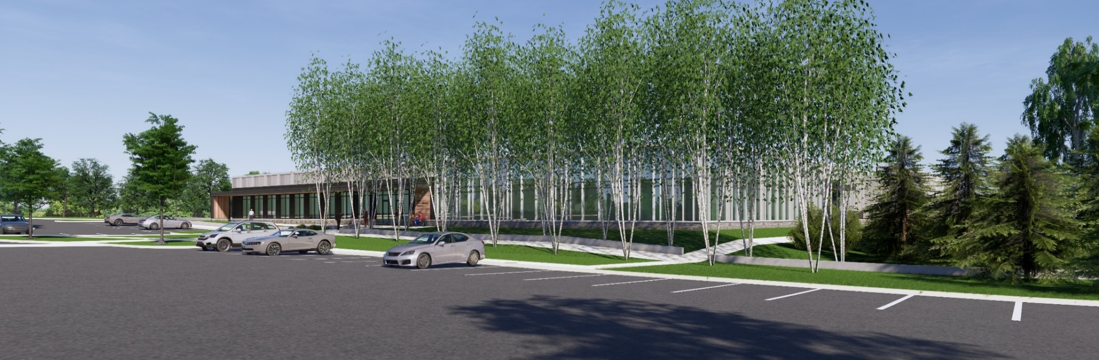
North West Corner (Distant View)
North West Corner (With Trees)

Slide 23
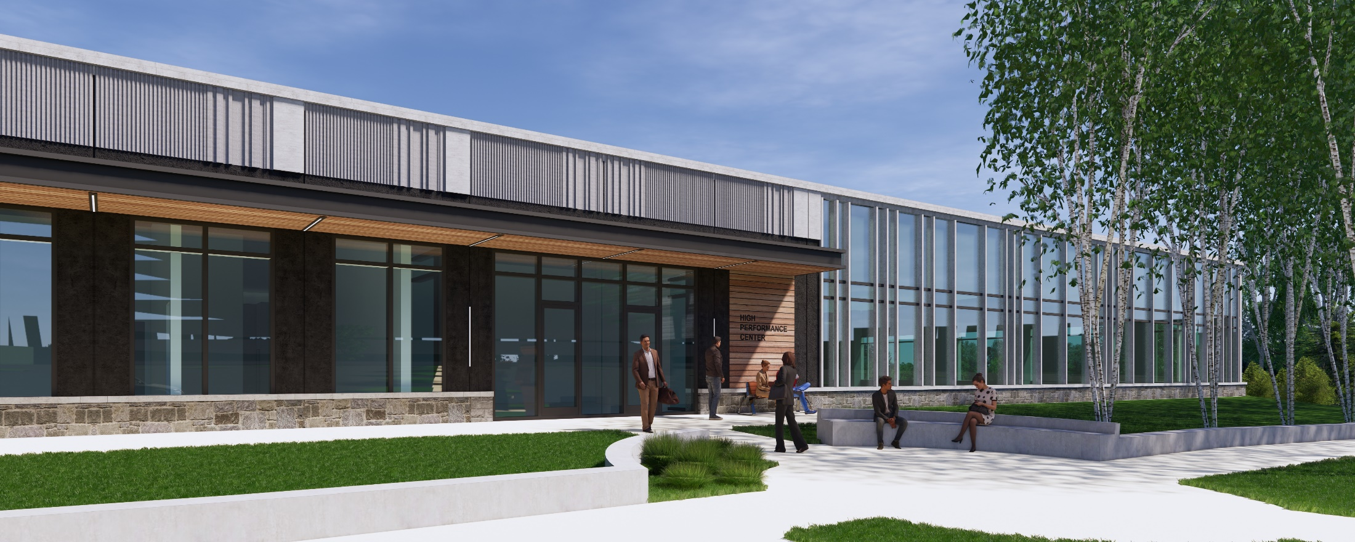
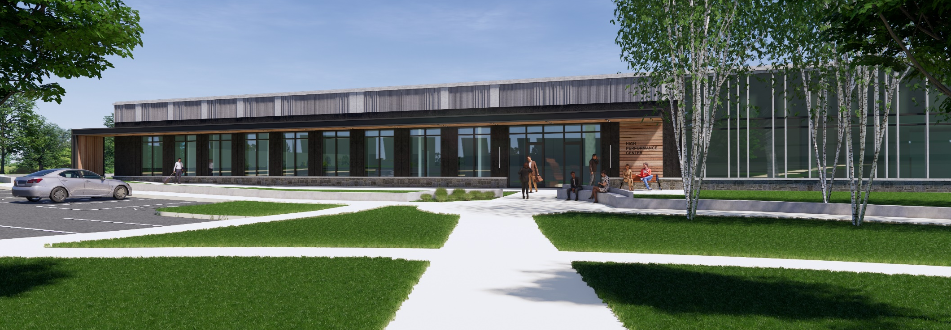
Support Building Entrance

Slide 24
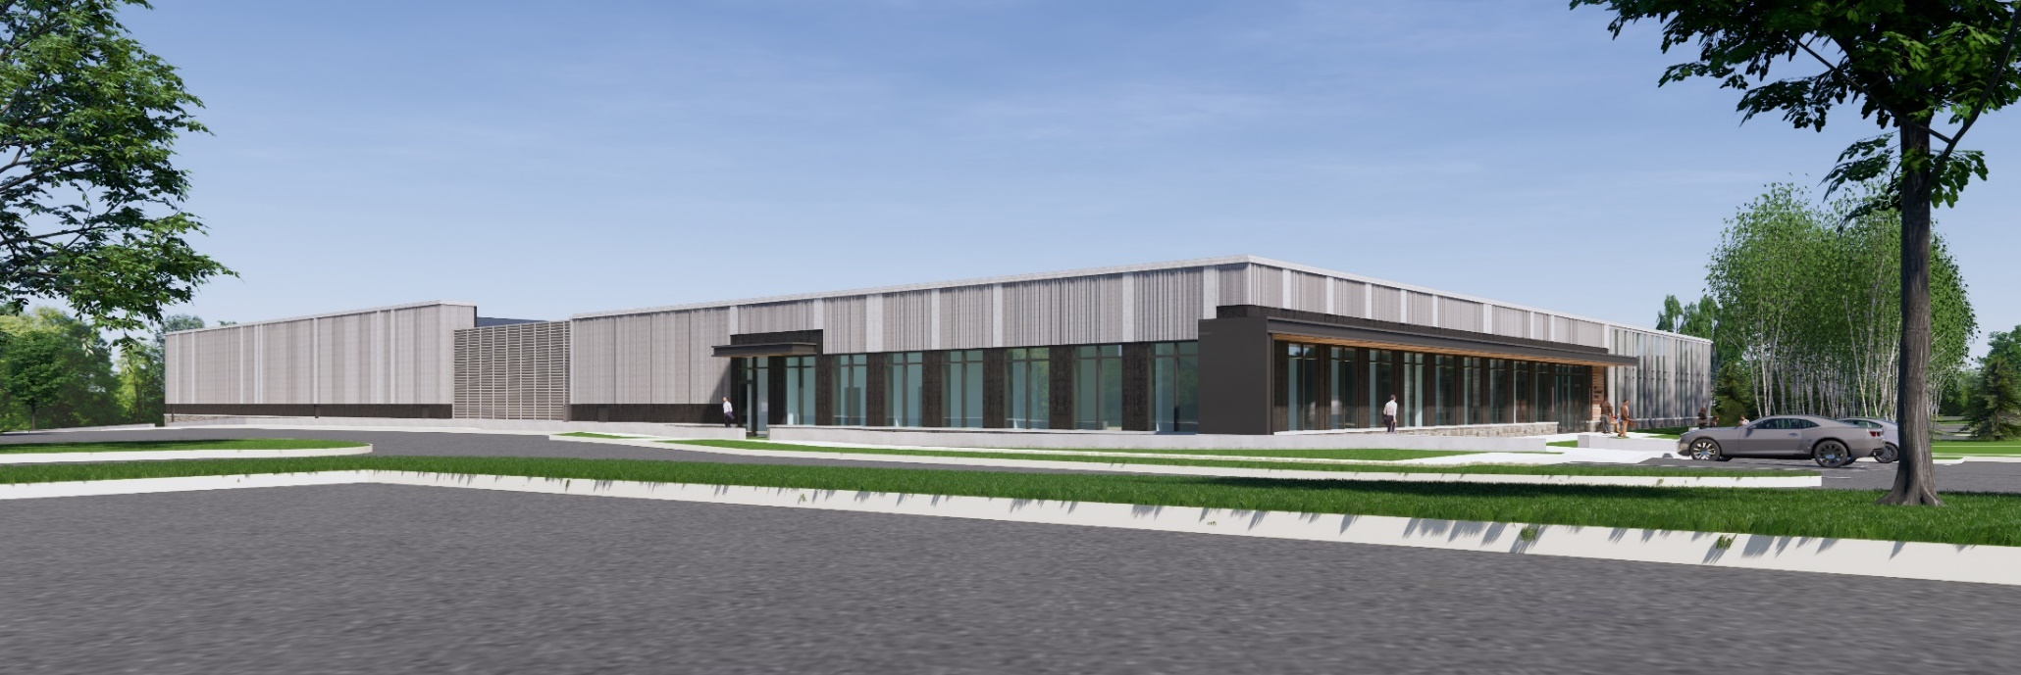
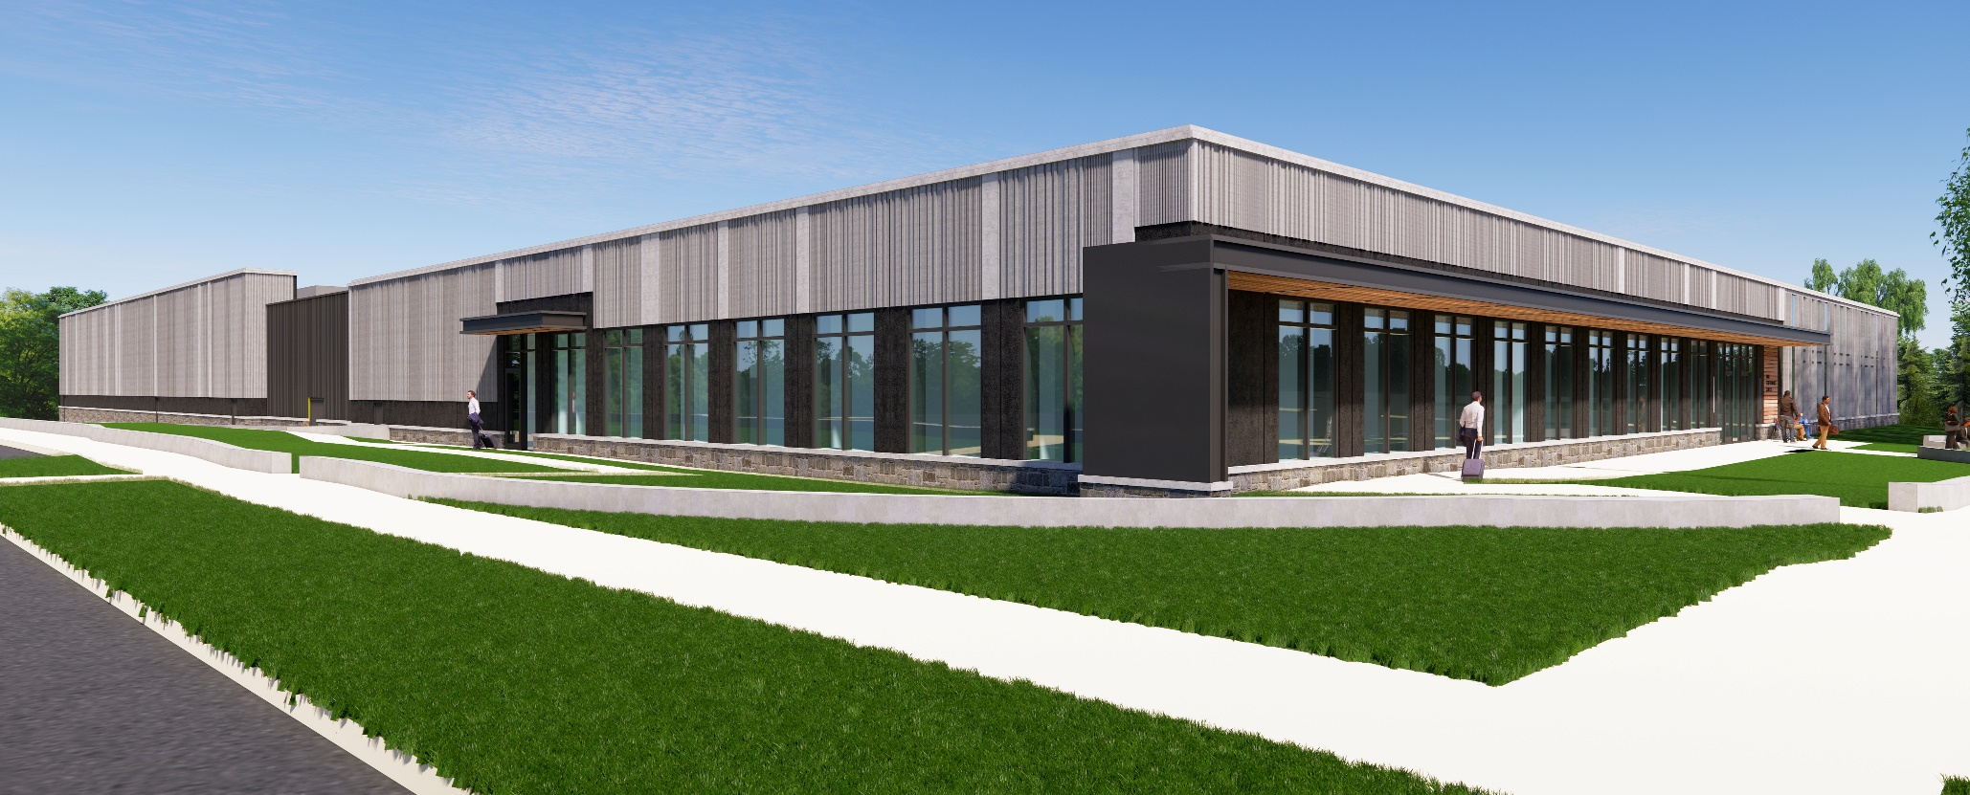
South East Corner

Slide 25
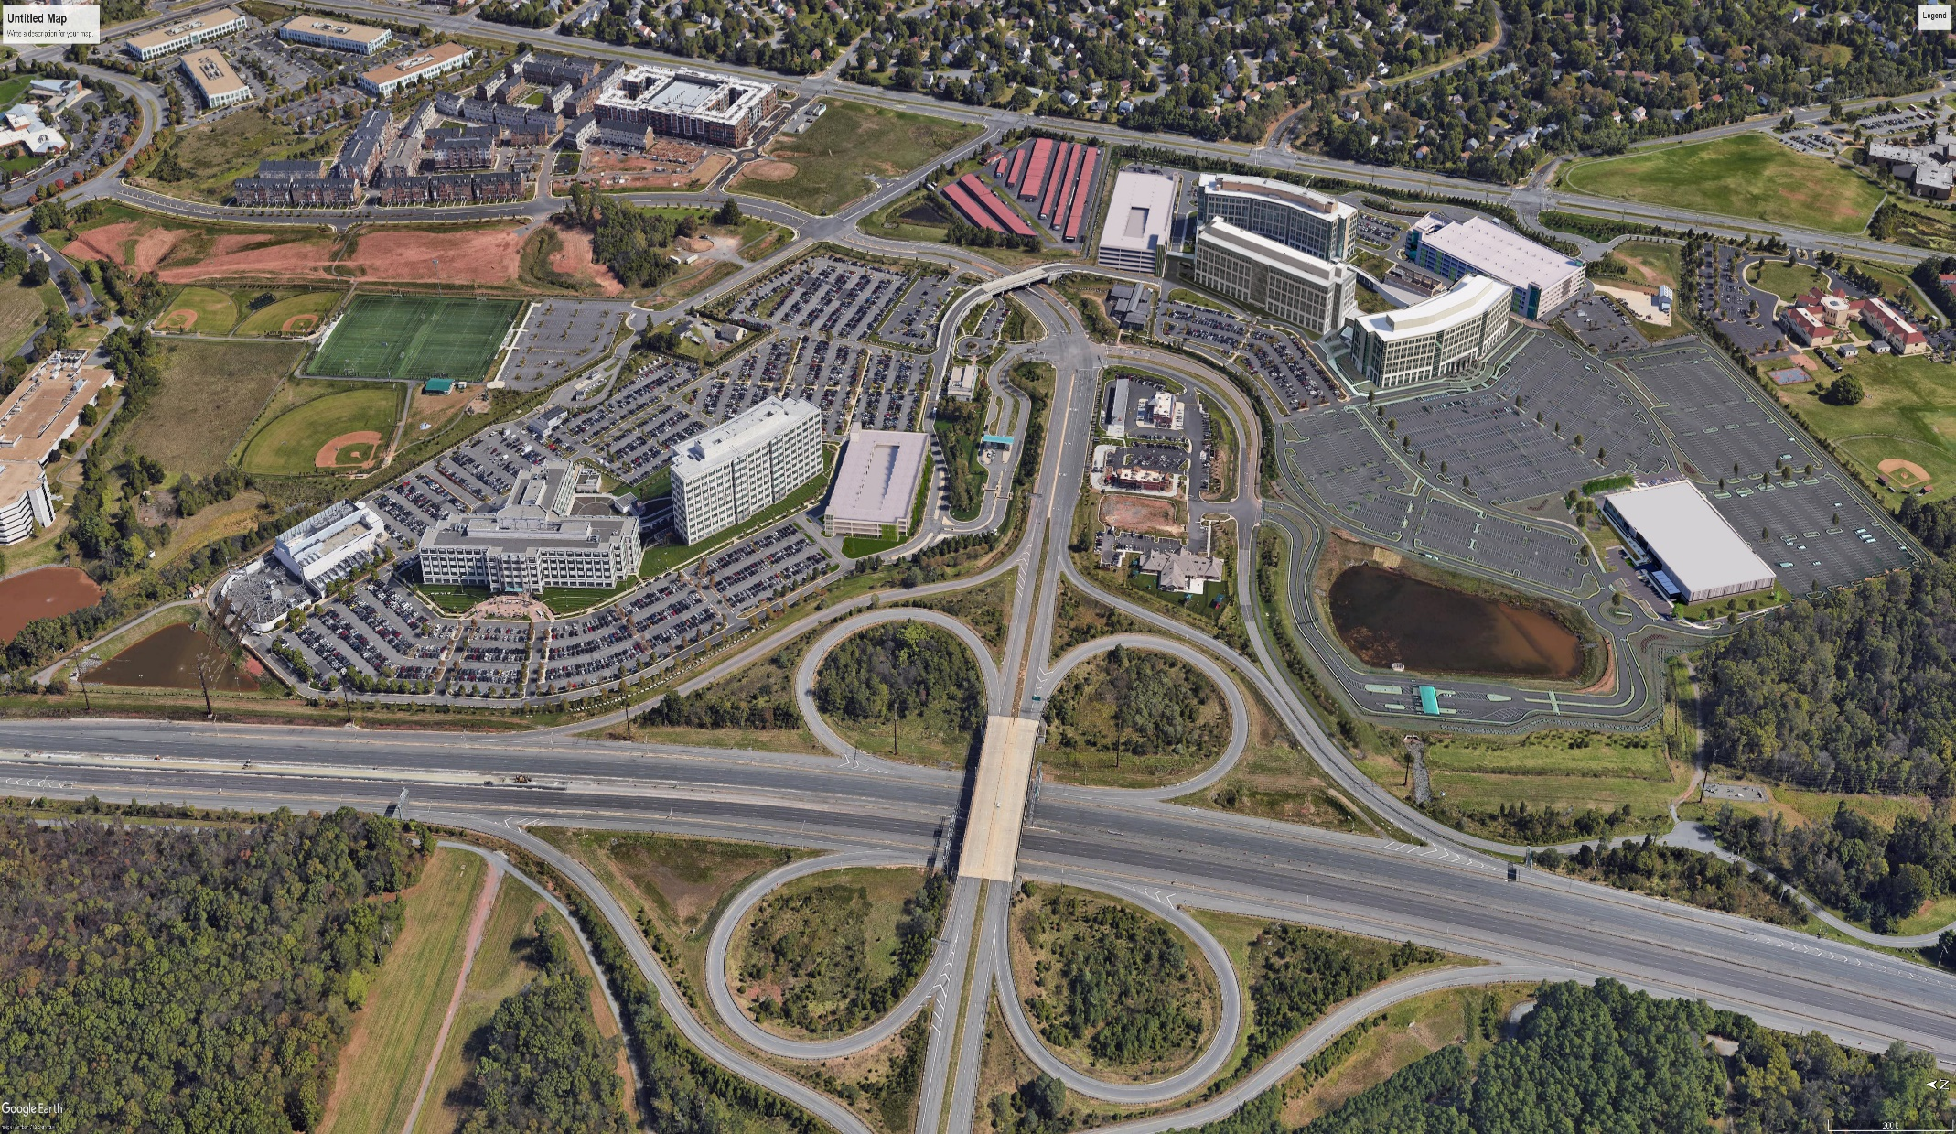
DD South Campus | Proposed Support Building
FUTURE GARAGE
DD 3
CENTREVILLE RD.
FUTURE DD 5
GARAGE A
DD 4
SUPPORT BUILDING
TREE BUFFER
OWNED BY FAIRFAX CO.
DONATED BY THE PETERSON COMPANIES
AIR AND SPACE MUSEUM PKWY.
SULLY RD. / RT. 28

Slide 26
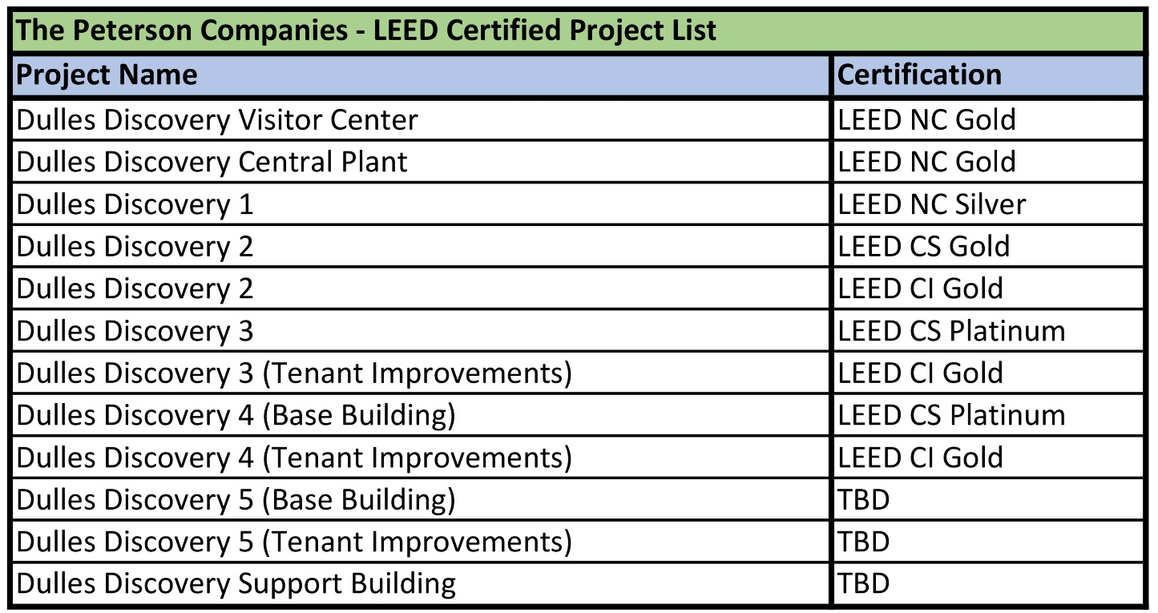
DD South Campus | Proposed Support Building

Slide 27
THANK YOU

