Slide 1
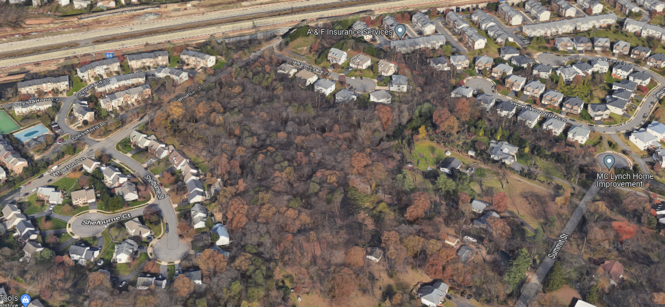
SITE-SPECIFIC PLAN AMENDMENT CPN22-SU-006
WHARTON LANE

Slide 2
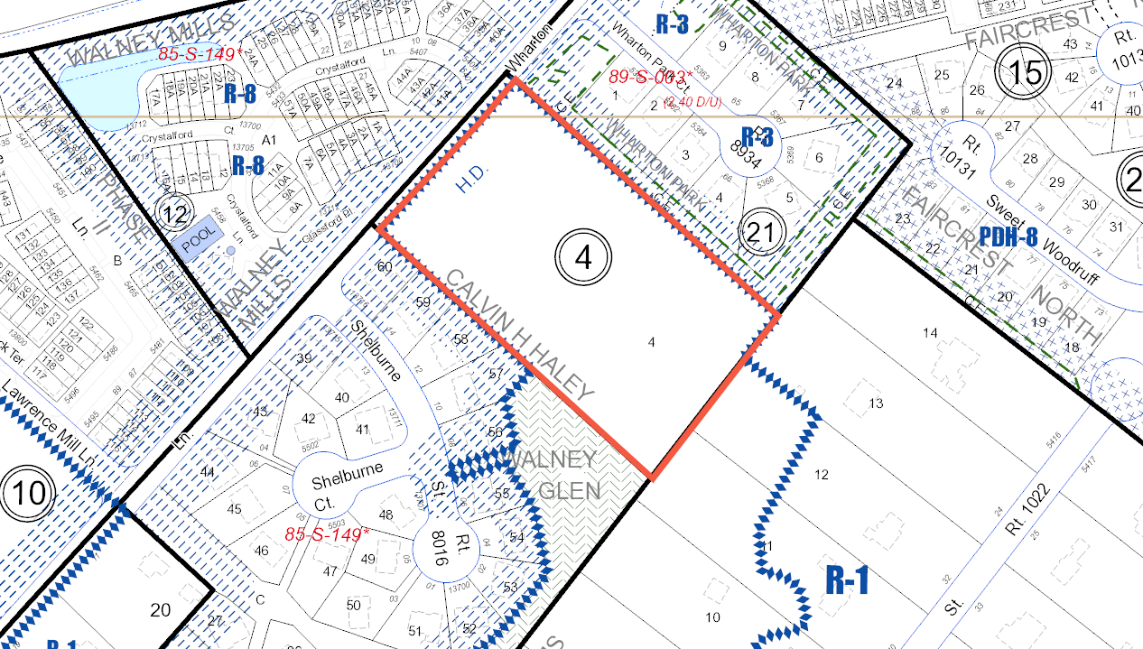
ZONING MAP
Subject Property
R-3

Slide 3
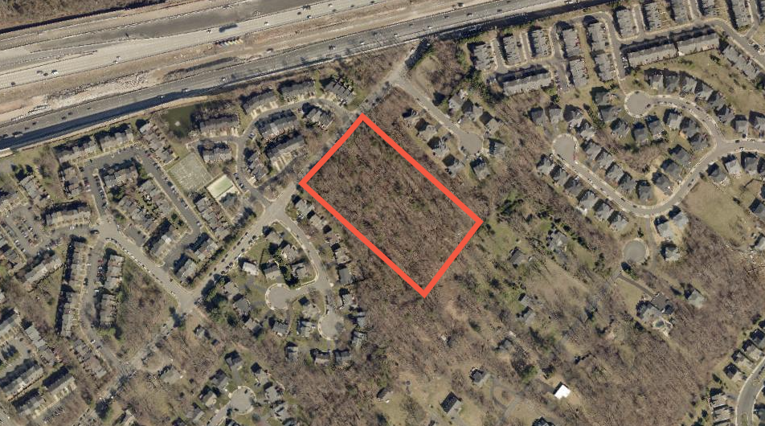
EXISTING CONDITIONS
Interstate 66
Wharton Park Court
Wharton Lane
Subject Property
Shelburne Street

Slide 4
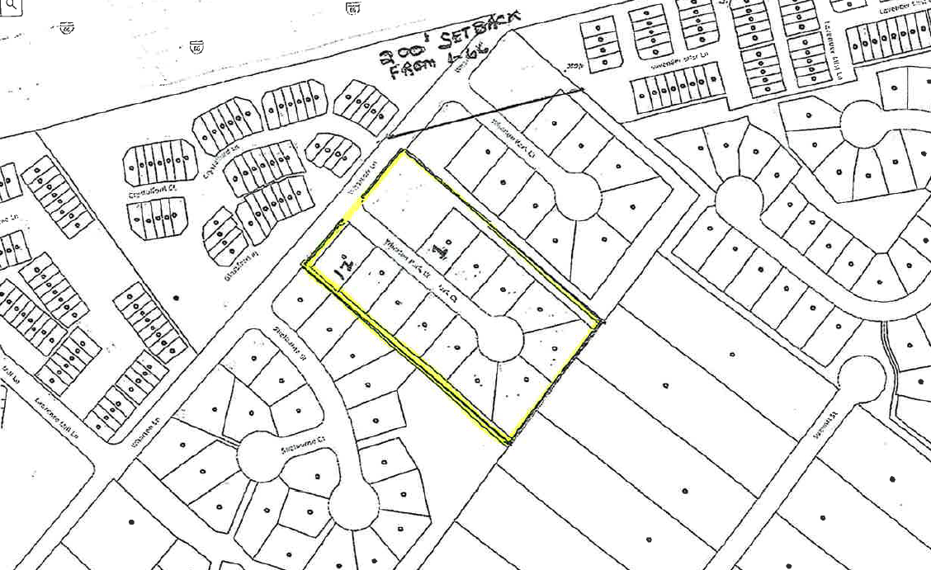
CONCEPT PLAN
Interstate 66
Wharton Park Court
Subject Property
Wharton Lane
Shelburne Street
Summit Street

Slide 5
OUR REQUEST
Authorize a Plan Amendment to amend the following Plan Text
Fairfax County Comprehensive Plan, 2017 Edition, Area III, Bull Run Planning District, as amended through 02/23/2021, Centreville Area and Suburban Center, Page 26:
“B-4 (45 acres)
“… This land unit is planned for single-family detached residential use at 2-3 dwelling units per acre, except for parcel 54-4 ((4)) 4.”
“Parcel 54-4 ((4)) 4 is planned for residential use at 1-3 du/ac 2-3 dwelling units per acre. Density above 1 du/ac dwelling units per acre is contingent upon consolidation with properties conditions described under the redevelopment option for Centreville Farms Land Unit F.” [Example Edit]

