Slide 1
3155 W Ox LLC CPN22-SU-008
Sully District Land Use and Transportation Committee
February 20, 2023

Slide 2
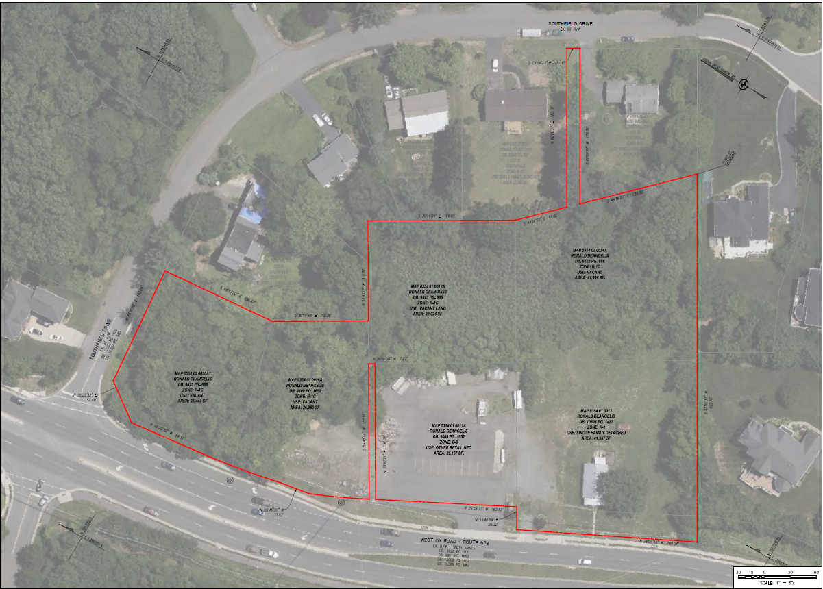
Subject Property

Slide 3
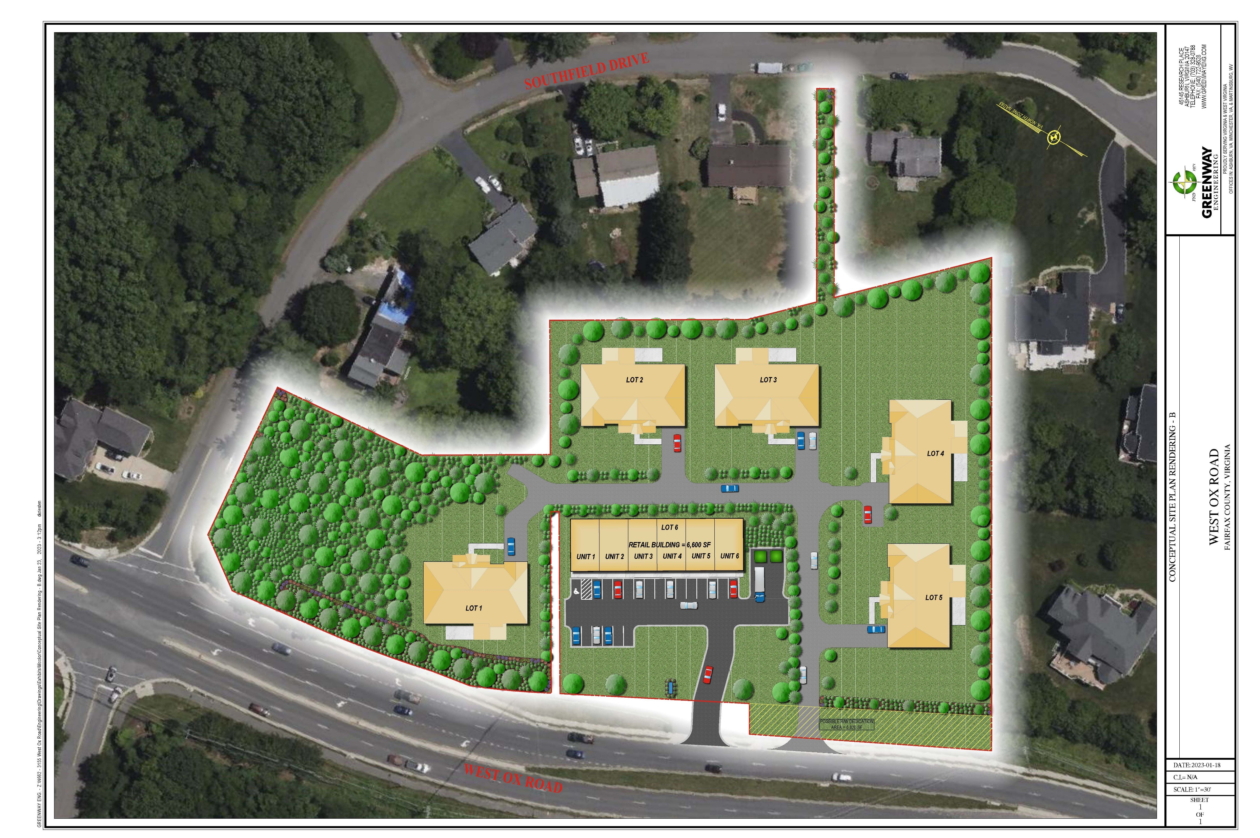
Permitted By-Right
5 residential lots and one commercial lot.
Approximately 5,550 sf dwellings.
Up to 13,068 square feet of commercial use possible.

Slide 4
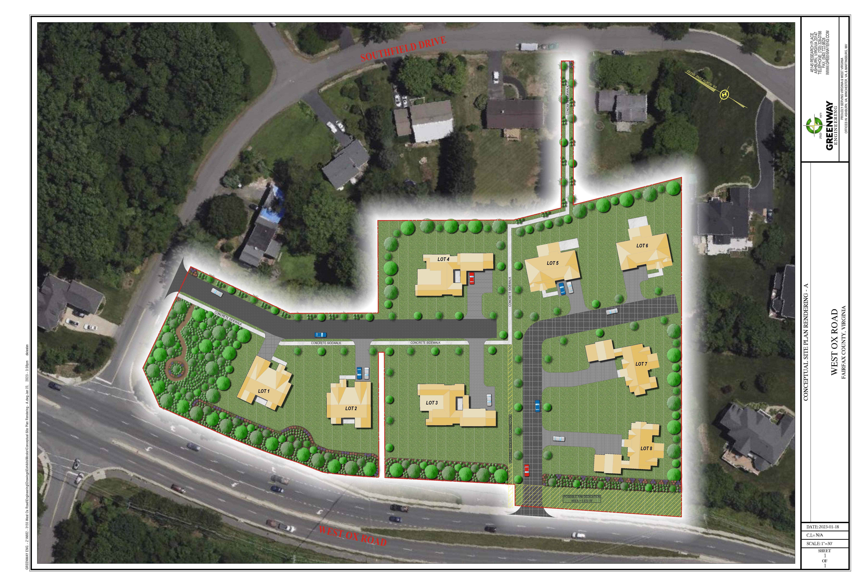
Proposed Plan
Remove the commercial Plan designation.
The lot size and house size are more consistent with the community.

Slide 5
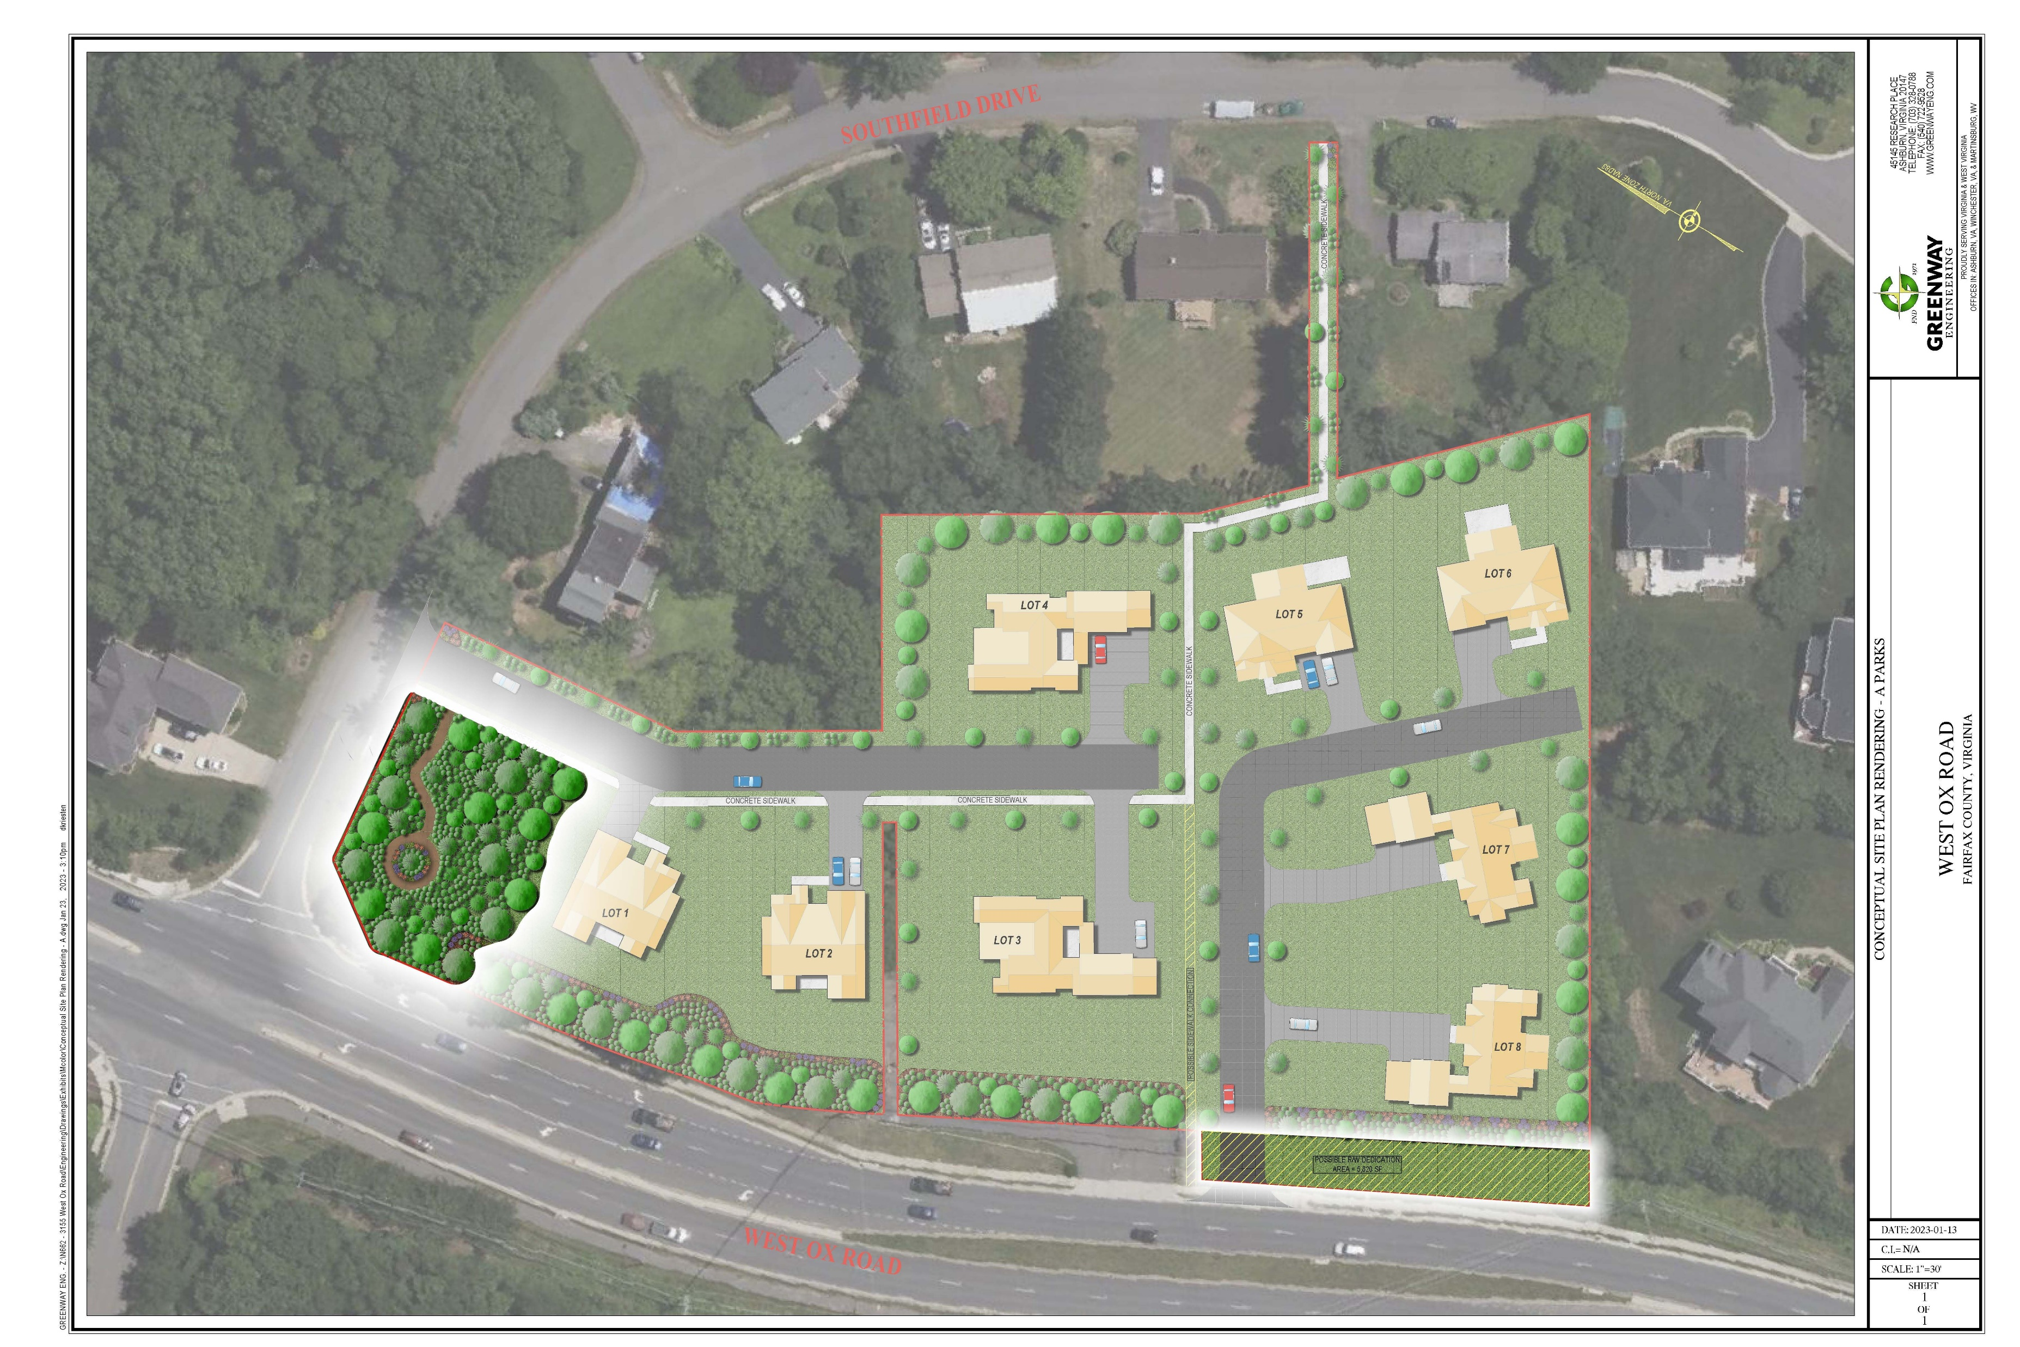
Community Benefits
Enhance pedestrian connectivity
Create and preserve usable open space
Provide frontage improvements
Remove incompatible land use designation

