Slide 1
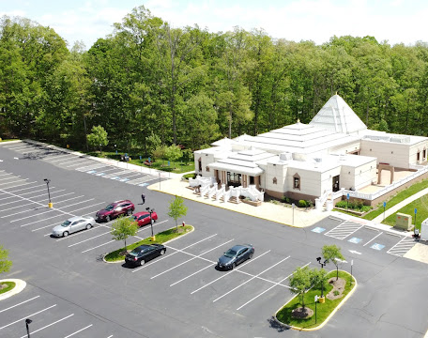
Proposed Expansion of Rajdhani Temple
Community Briefing
February 2023

Slide 2
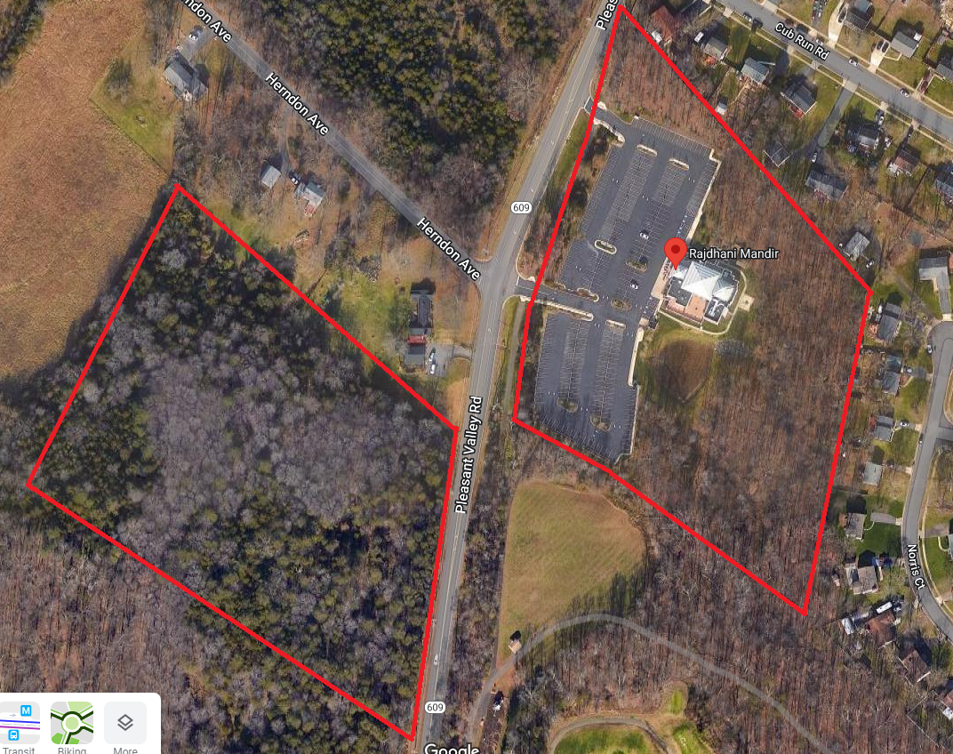
Site Location

Slide 3
Existing Temple Expansion Profile
Total acreage of the existing site – 7.87 acres/ 342,882 sq ft
Total undisturbed open space provided – 107,905 sq ft
Total area of the existing temple – 8,000 sq ft
Total building area of existing and proposed – 32,885 sq ft
Total number of parking spaces – 297 spaces; code requires 175 spaces with the expansion (2.35 pat/spa)
Current Maximum occupancy – 250
Proposed Maximum 700 occupancy

Slide 4
Proposed Expansion of Existing Building

Slide 5
Existing Conditions

Slide 6
Proposed Expansion

Slide 7
Parcel 13 (Cross the Street) Profile
Total acreage of the existing site – 9.696 acres/ 442,376 sq ft
Total undisturbed open space provided – 271,814 sq ft
Total area of the proposed community center – 13,600 sq ft
Total number of parking spaces – 132 spaces; code requires 54 spaces with the expansion (2.27 pat/spa)
Proposed Maximum 300 occupancy

Slide 9
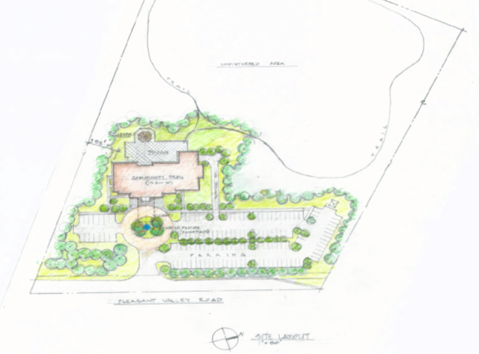

Slide 10
Proposed Plan

Slide 11
What has been done to date
Application filed and accepted by the County
Briefing to Sully District Council in March
Public hearings in May

Slide 12
Next Steps
Staffing and Review of the proposal by the staff:
Community informative meetings:
Addressing staff comments and resolving issues:
Notices:
Public hearing by BZA

Slide 21
  QUESTIONS

