Slide 1
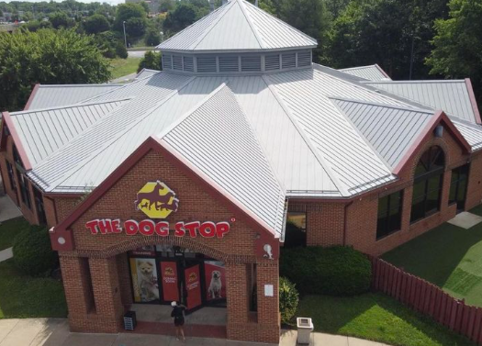
The dog stop
December 18, 2023

Slide 2
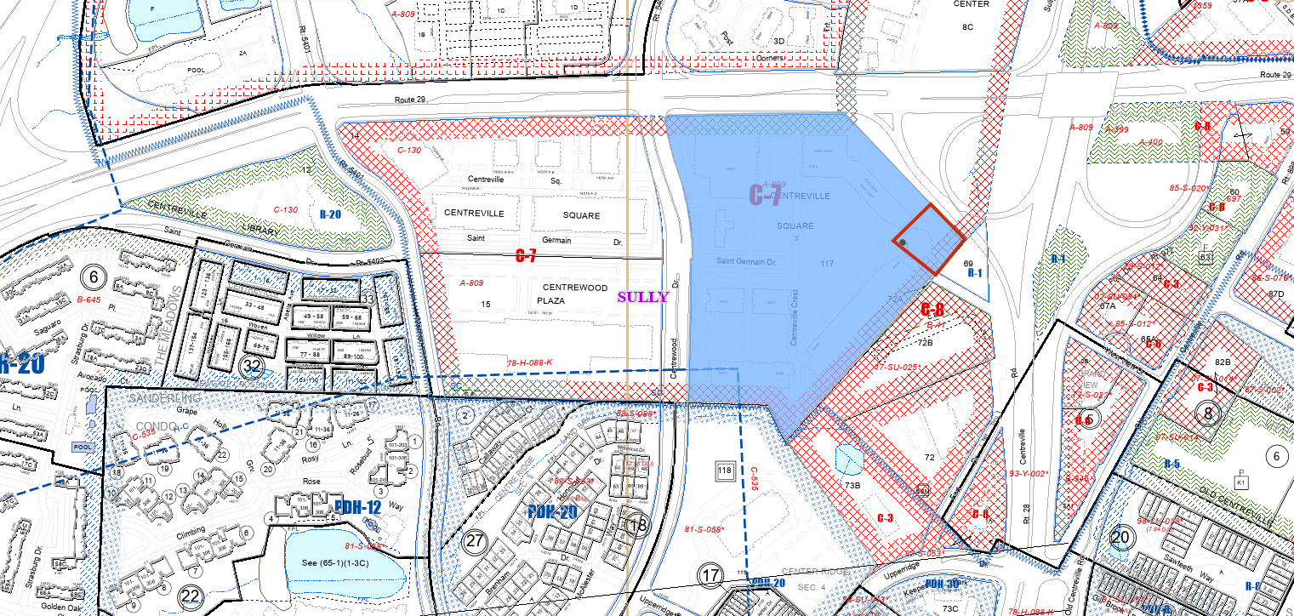
Location

Slide 3
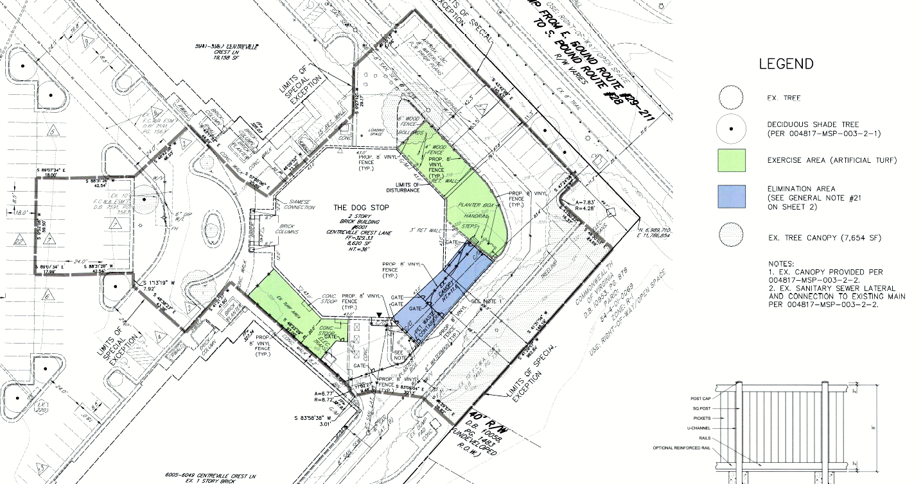
proposal

Slide 4
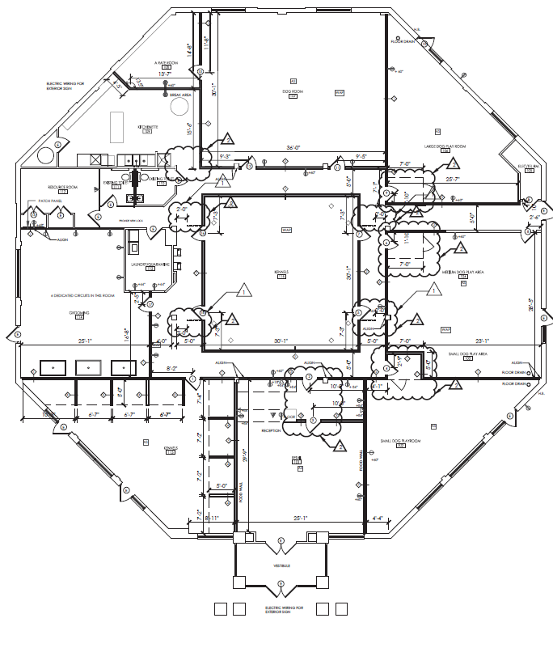
Interior layout

Slide 5
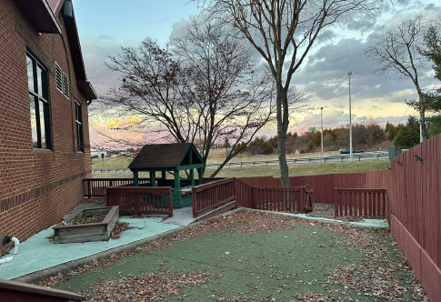
Elimination Area – existing condition

Slide 6
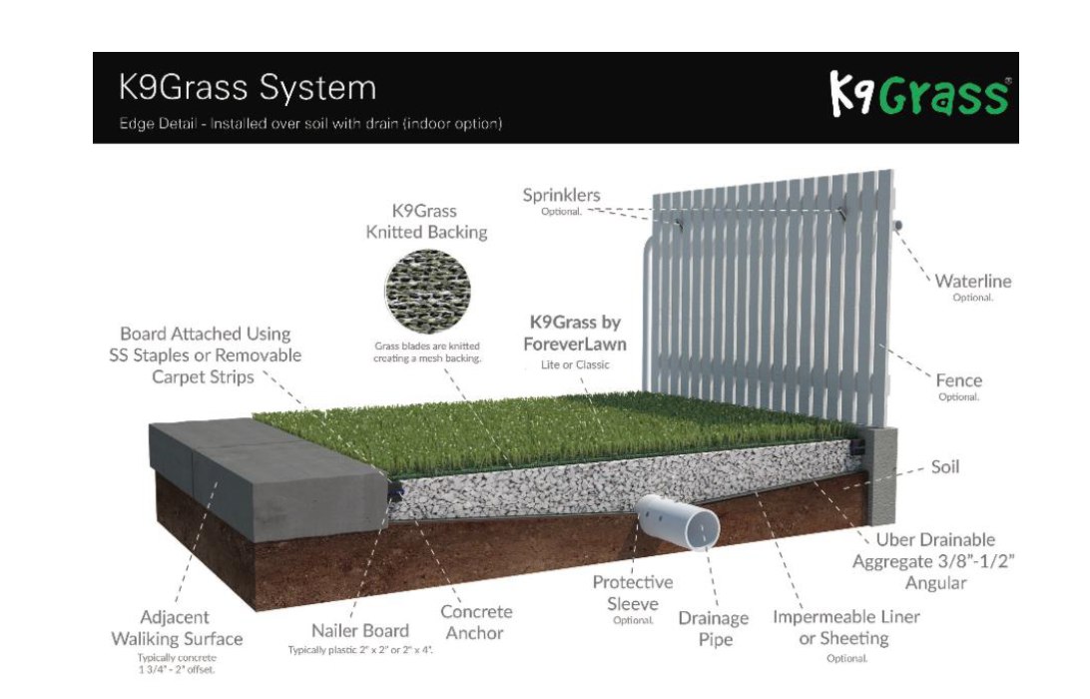
Elimination Area – Proposed condition

Slide 7
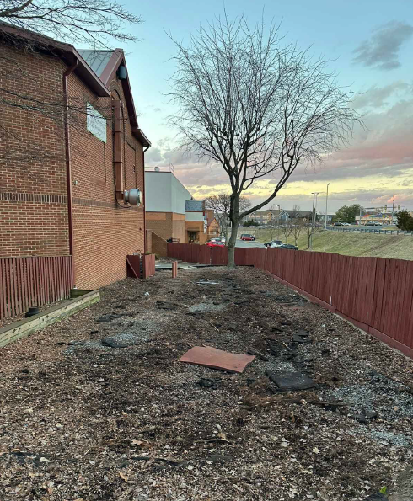
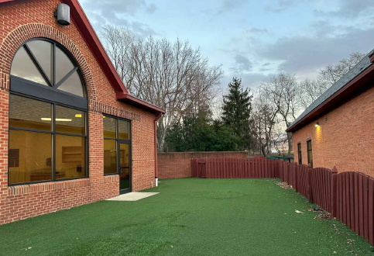
Exercise and Agility Areas
South Yard
North East Yard

Slide 8
PROCESSING SCHEDULE
Resubmission – February 1, 2024
Staffing – February 29, 2024
Sully District land use & transportation – march 2024
Planning Commission Hearing – April 24, 2024
Board of Supervisors Hearing – tbd
Staff Coordinator – Andrew stone

Slide 9
Thank You

