Slide 1
Park East at Westfields RZ/FDP 2023-SU-00017 PCA 78-S-063-14
Sully district LAND USE AND TRANSPORTATION COMMITTEE MEETING
May 20, 2024

Slide 2
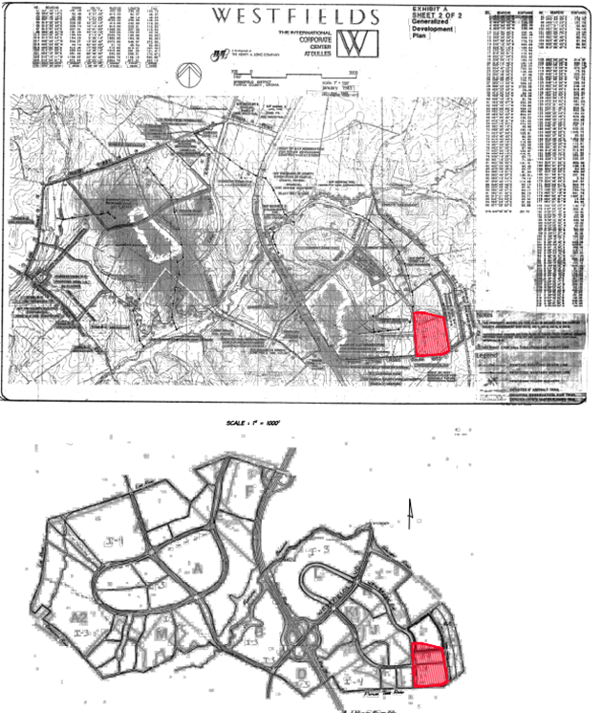
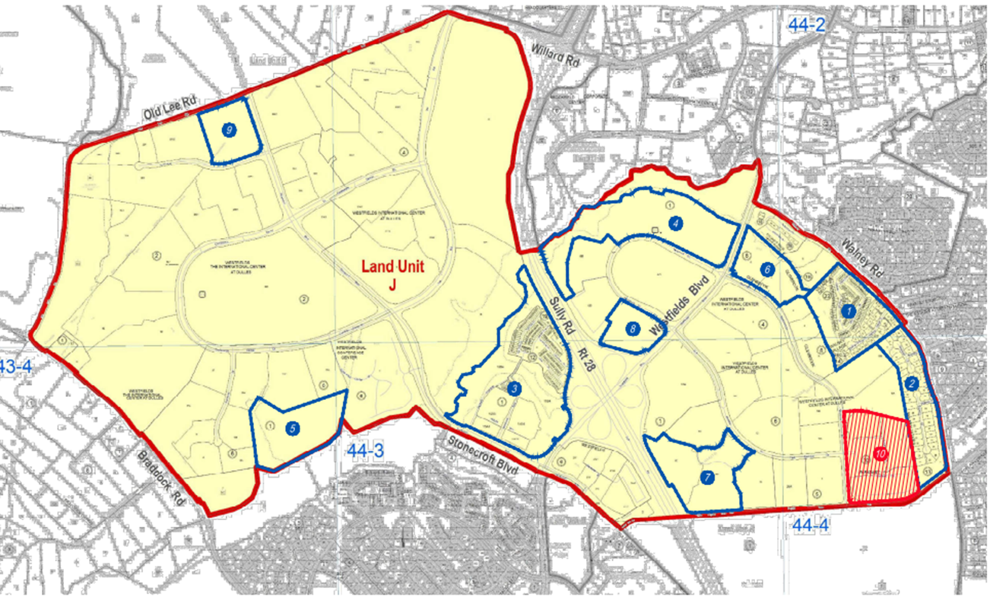
WESTFIELDS REZONING

Slide 3
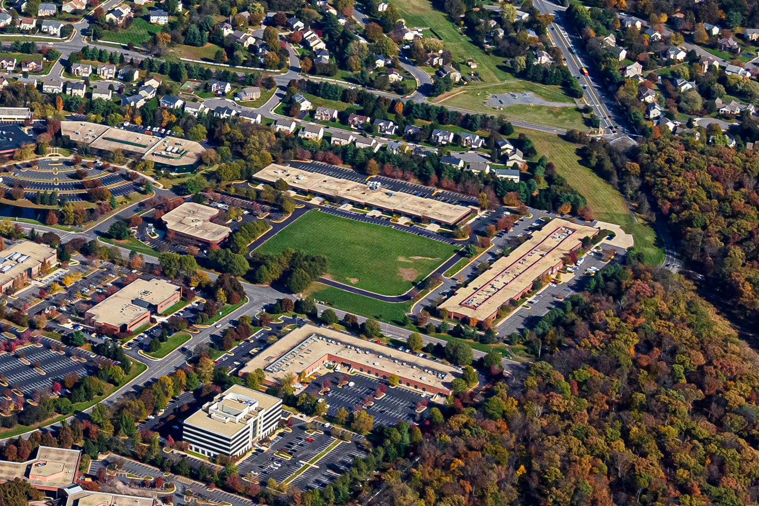
AERIAL VIEW

Slide 4
Approximately 23.43 acres – Northwest quadrant of Poplar Tree Road and Newbrook Drive
A rezoning from the I-4 District to the PDH-16 District
Change in use from commercial to residential
Phased development with a mix of residential uses to provide a transition from low intensity office to single-family detached.
PROPOSED DEVELOPMENT

Slide 5
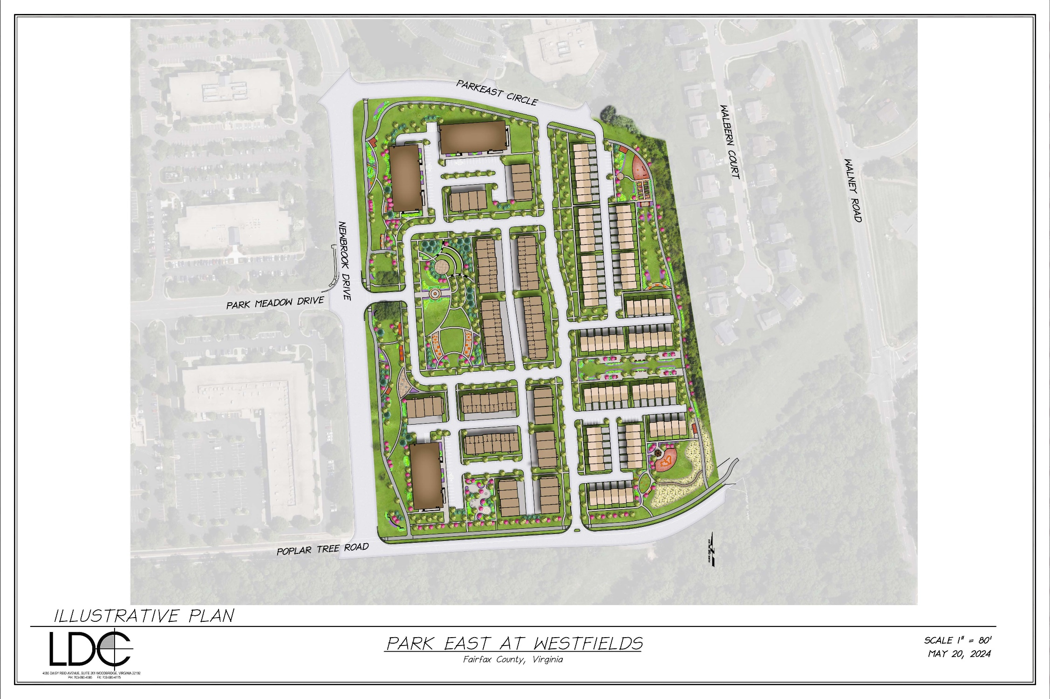
PROPOSED ULTIMATE DEVELOPMENT PLAN

Slide 6
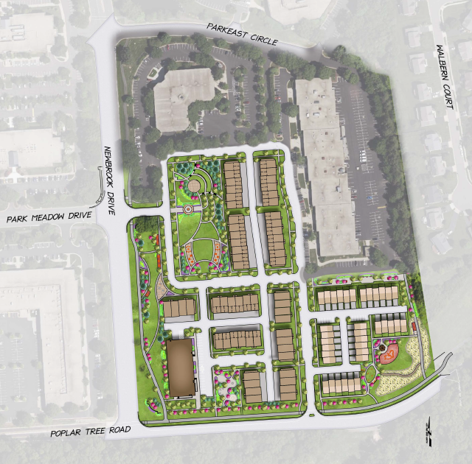
35 Townhouses
116 Stacked Townhouses
1 Multifamily Building with 32 Units
PROPOSED DEVELOPMENT PLAN – PHASE ONE

Slide 7
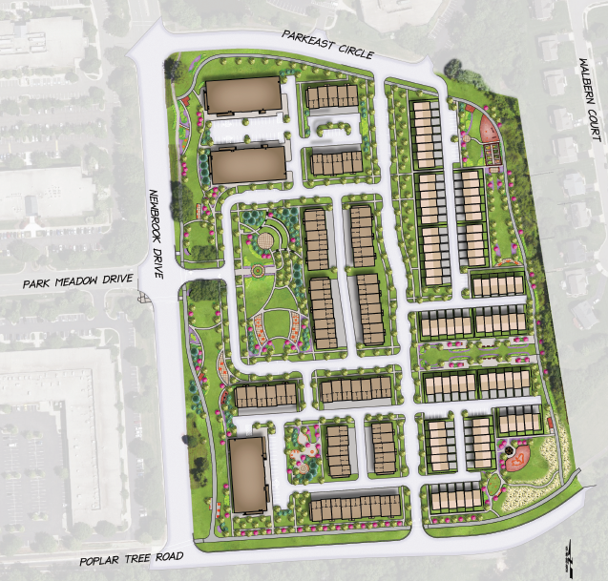
85 Townhouses
132 Stacked Townhouses
3 Multifamily Buildings each with 32 Units (96 multifamily units)
PROPOSED DEVELOPMENT PLAN – PHASE TWO

Slide 8
Phased Replacement of Aging Commercial Buildings
Better Transition of Density Between Office and Surrounding Residential Development
Community Benefits
Connectivity - vehicular and pedestrian
Creation of live-work opportunities
Open Space
Linear park along frontage
Common Green
Multiple Pocket Parks
Landscaping
Opportunity for Placemaking
Amenities
Entry sign/landscaping
Proximity of Park
Reduction in Traffic
CONSIDERATIONS FOR A CHANGE IN USE

Slide 9
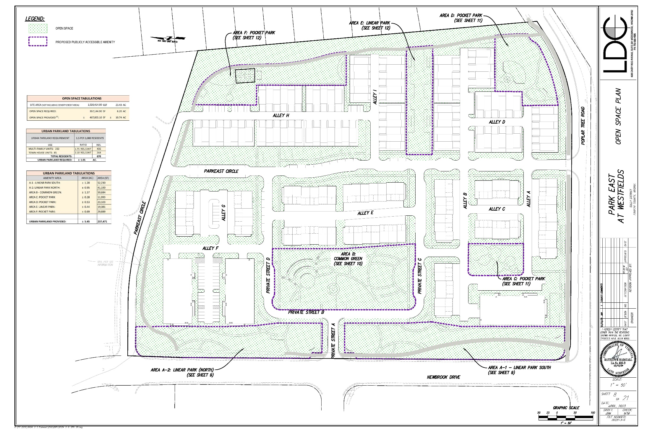
CONSIDERATIONS
OPEN SPACE

Slide 10
LINEAR PARK

Slide 11
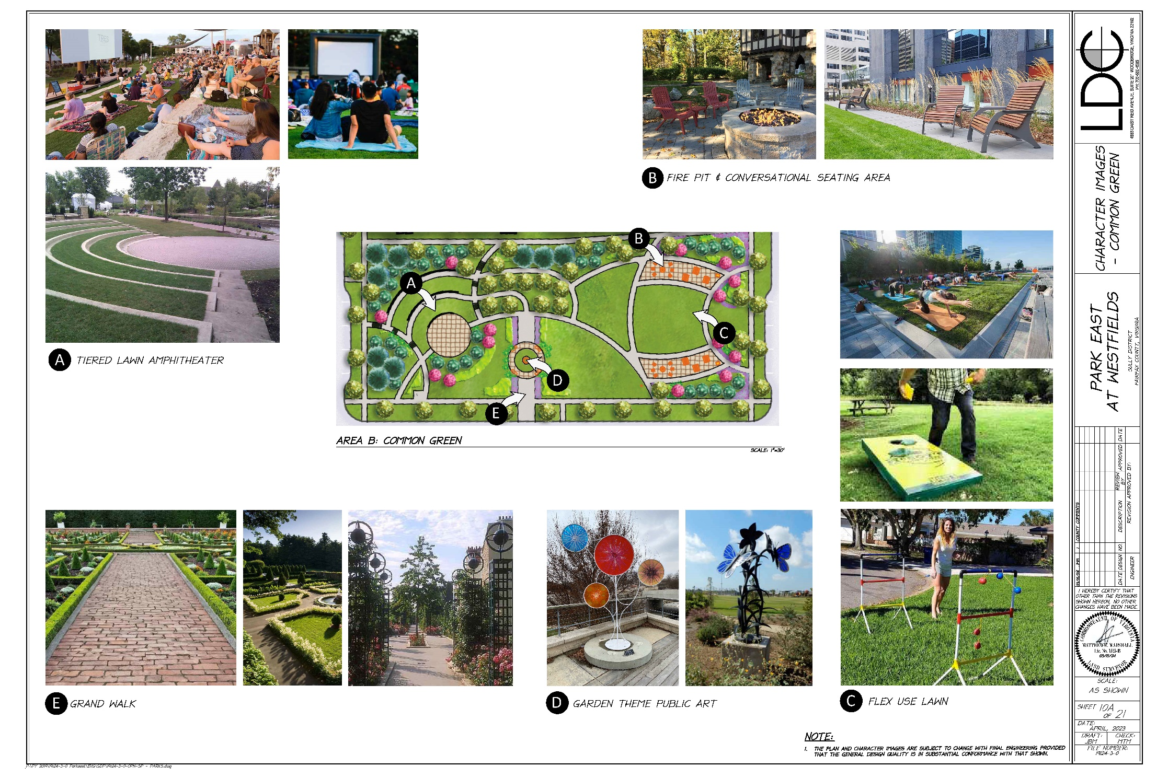
CONSIDERATIONS
COMMON GREEN

Slide 12
POCKET PARKS

Slide 13
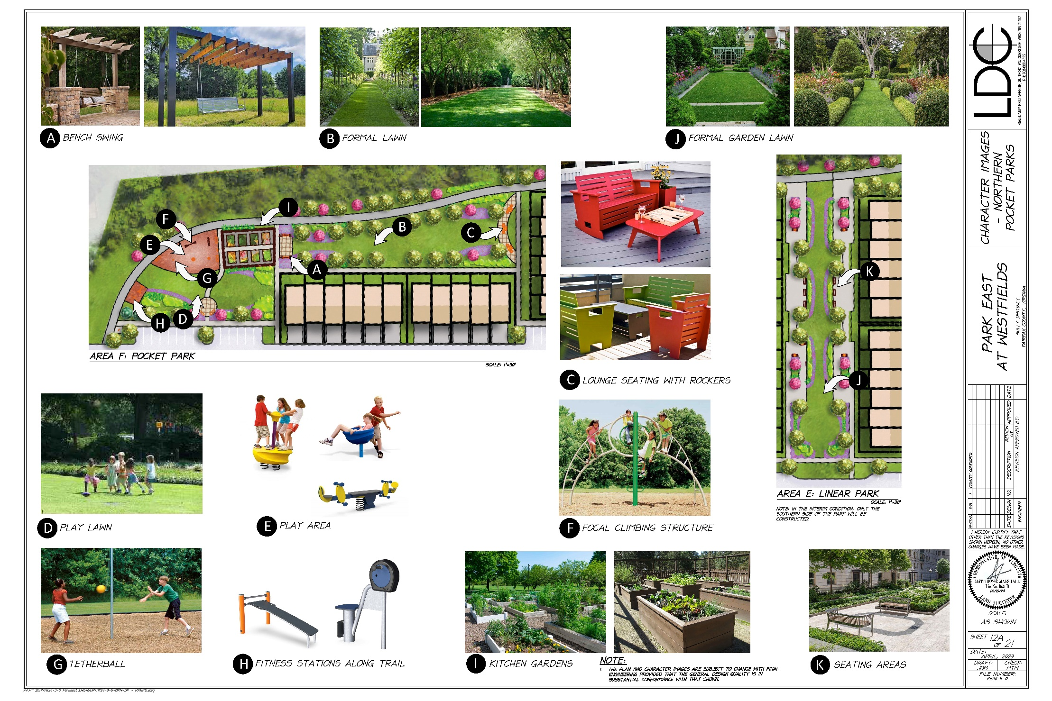
POCKET PARKS

Slide 14
PERIMETER TRAIL SYSTEM

Slide 15
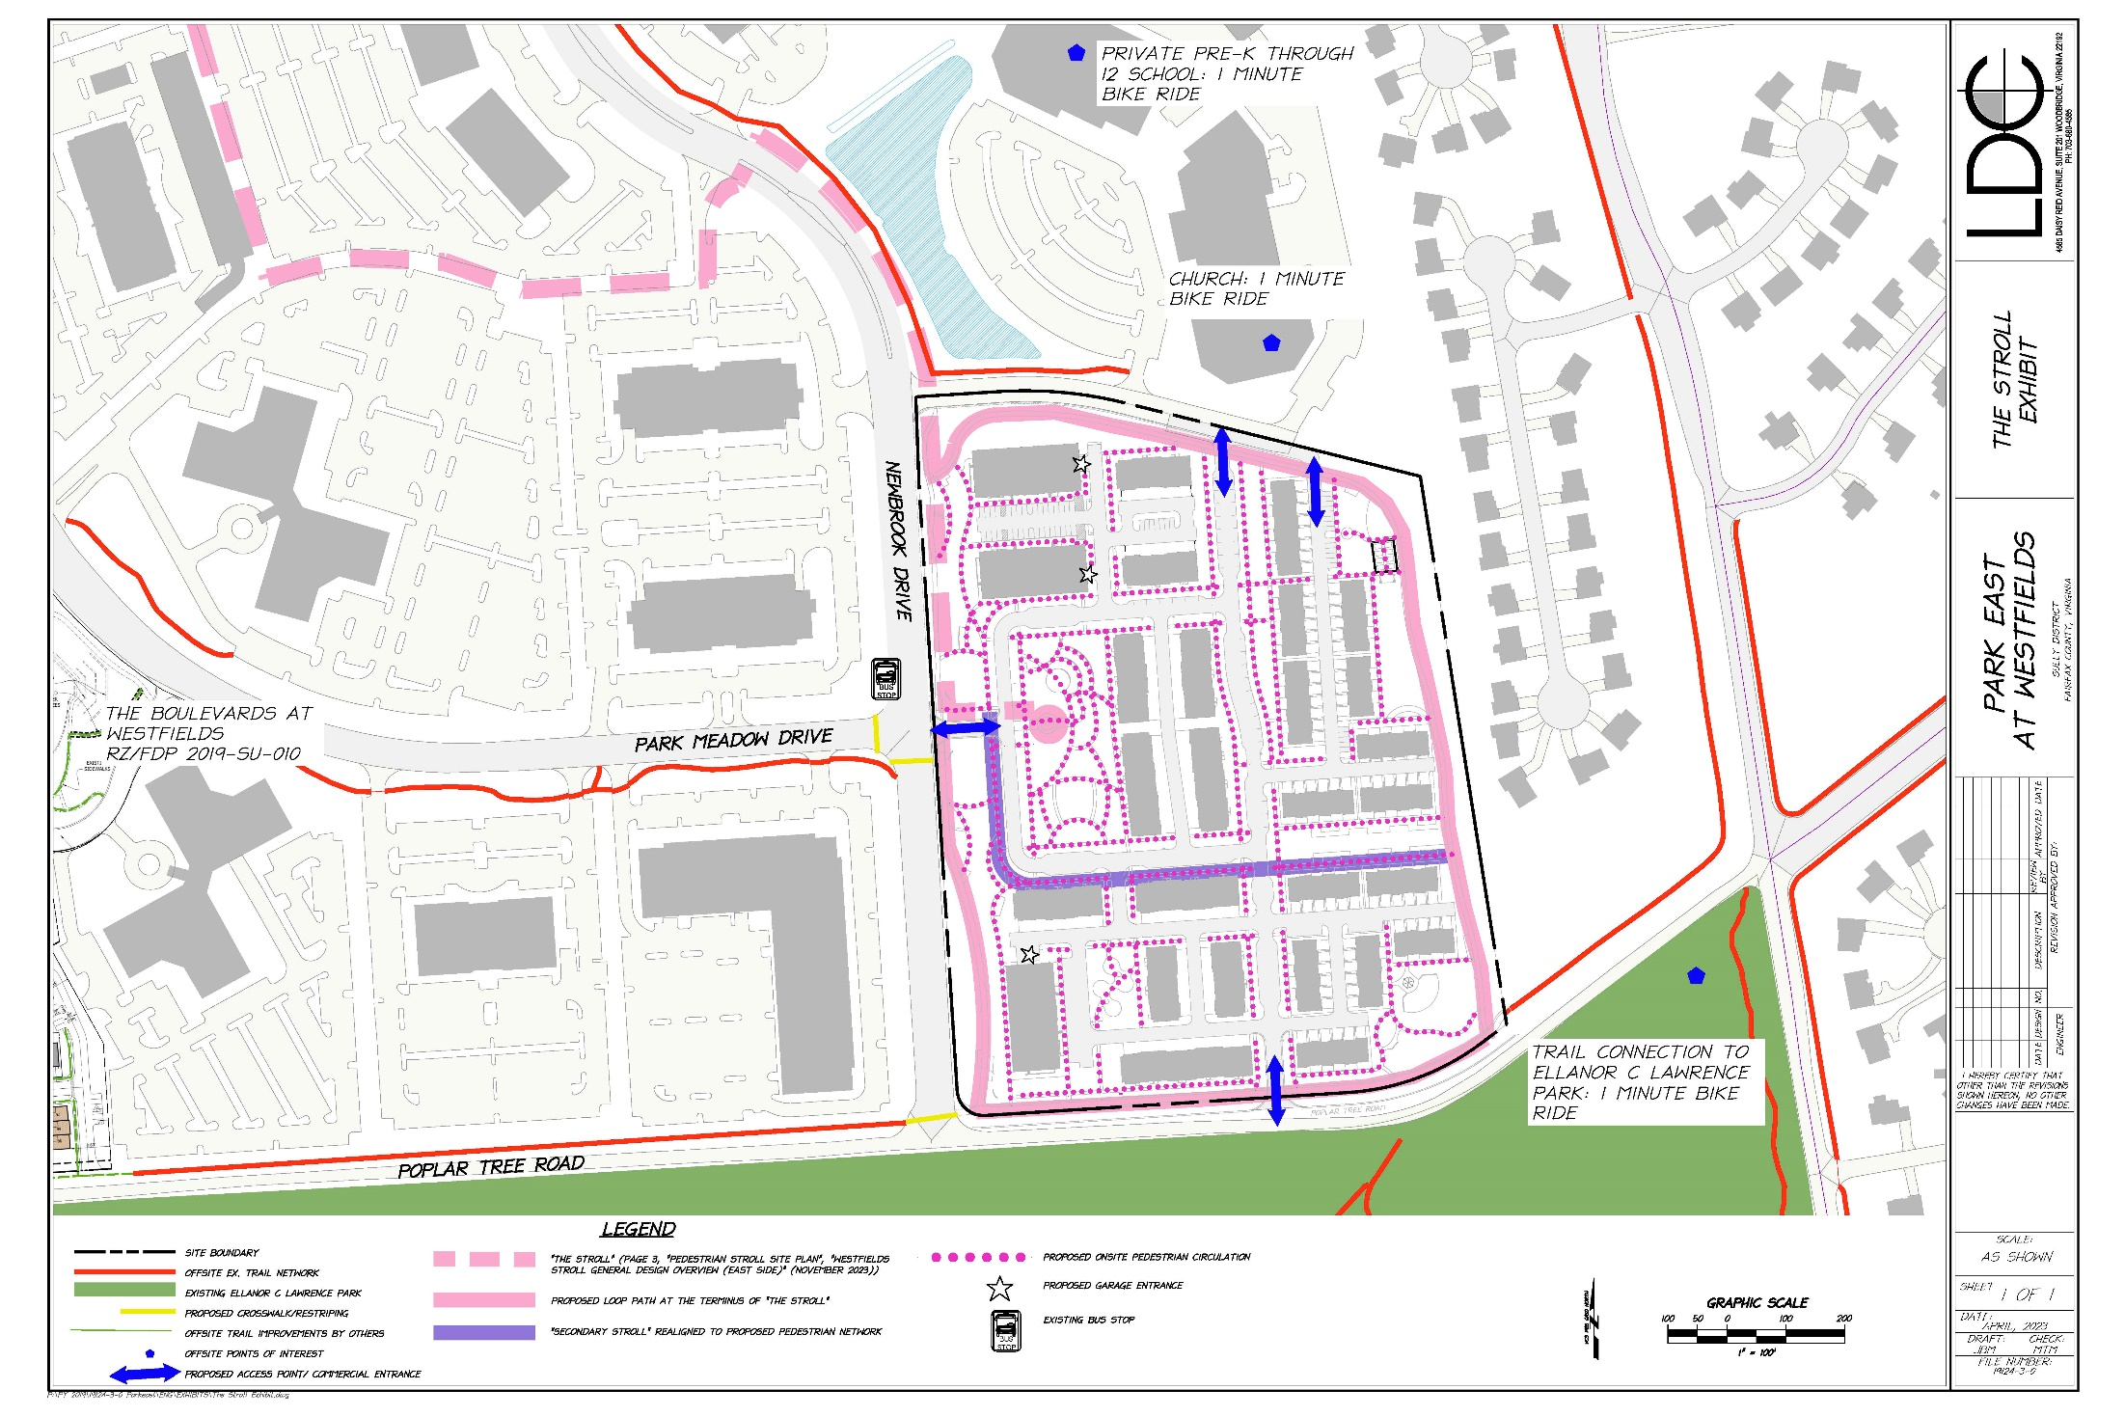
CONNECTIVITY – THE STROLL

Slide 16
ELEVATION

Slide 17
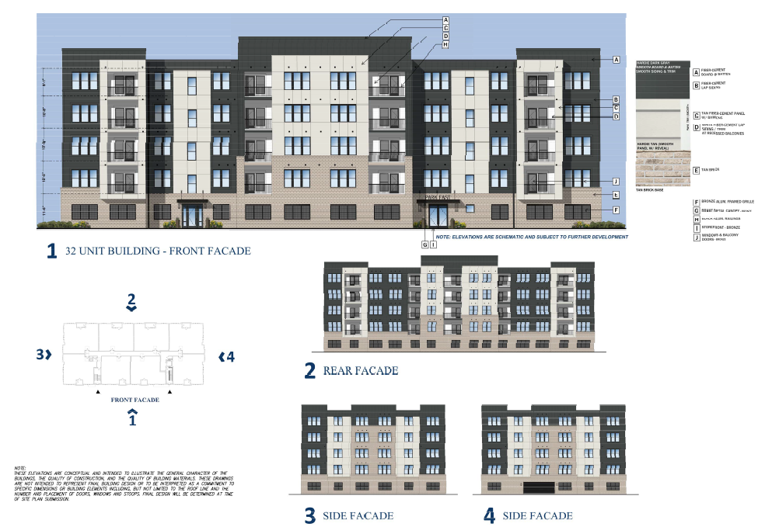
MULTIFAMILY UNITS

Slide 18
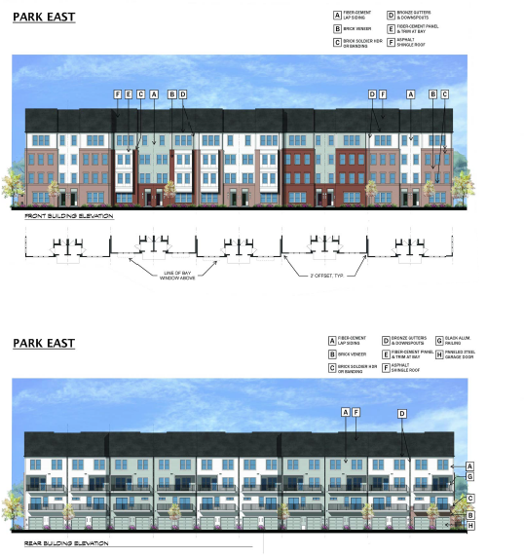
STACKED TOWNHOUSES

Slide 19
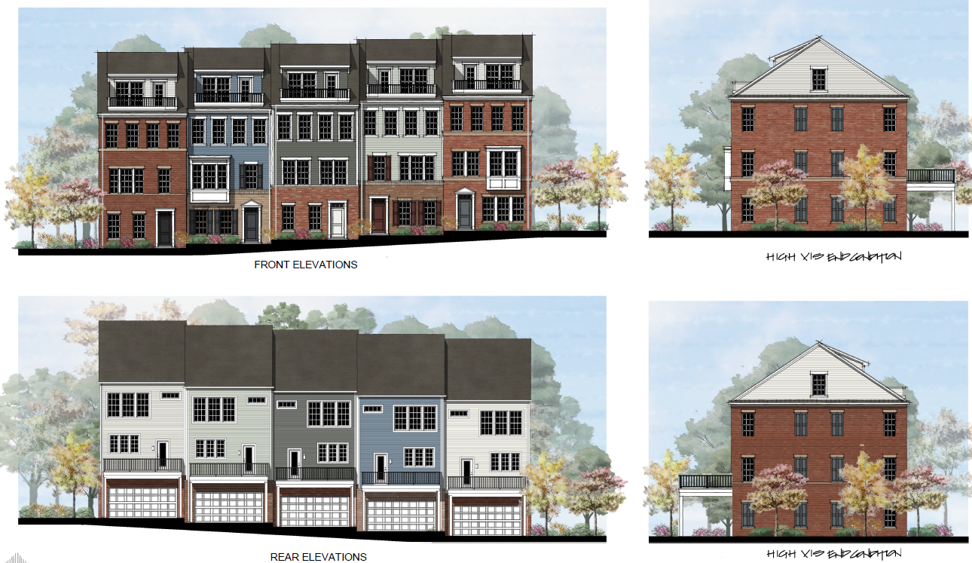
TOWNHOUSES

Slide 20
Staff Coordinator: Tabatha Cole
Planning Commission: July 10, 2024
Board of Supervisors: TBD

