Slide 1
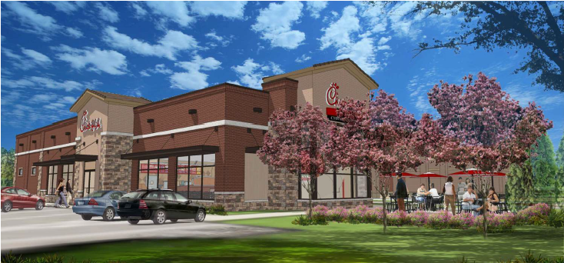
Chick-fil-A – Historic Sully Way 3454 Historic Sully Way June 17, 2024 – Sully District Land Use & Transportation Committee Meeting FDPA-2003-SU-035-04
Esencia Architecture, LLC

Slide 2
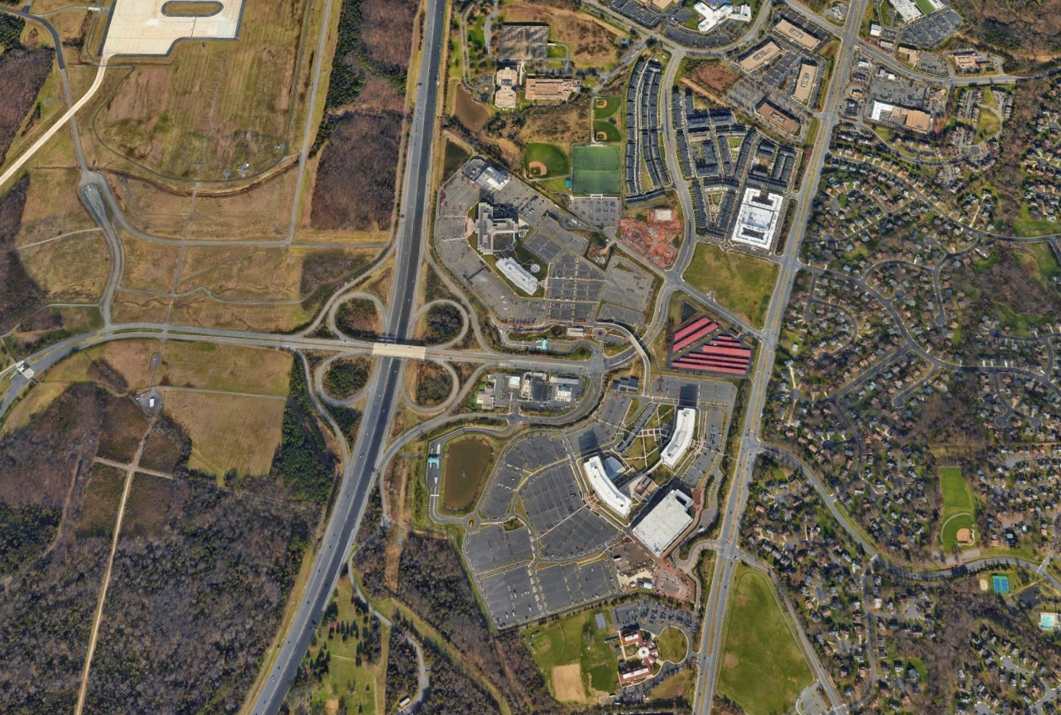
Location
Dulles Airport
Route 28
Air & Space Museum Pkwy
Franklin
Farms
Way
Sully
Historic
Centreville Rd
Route 28

Slide 3
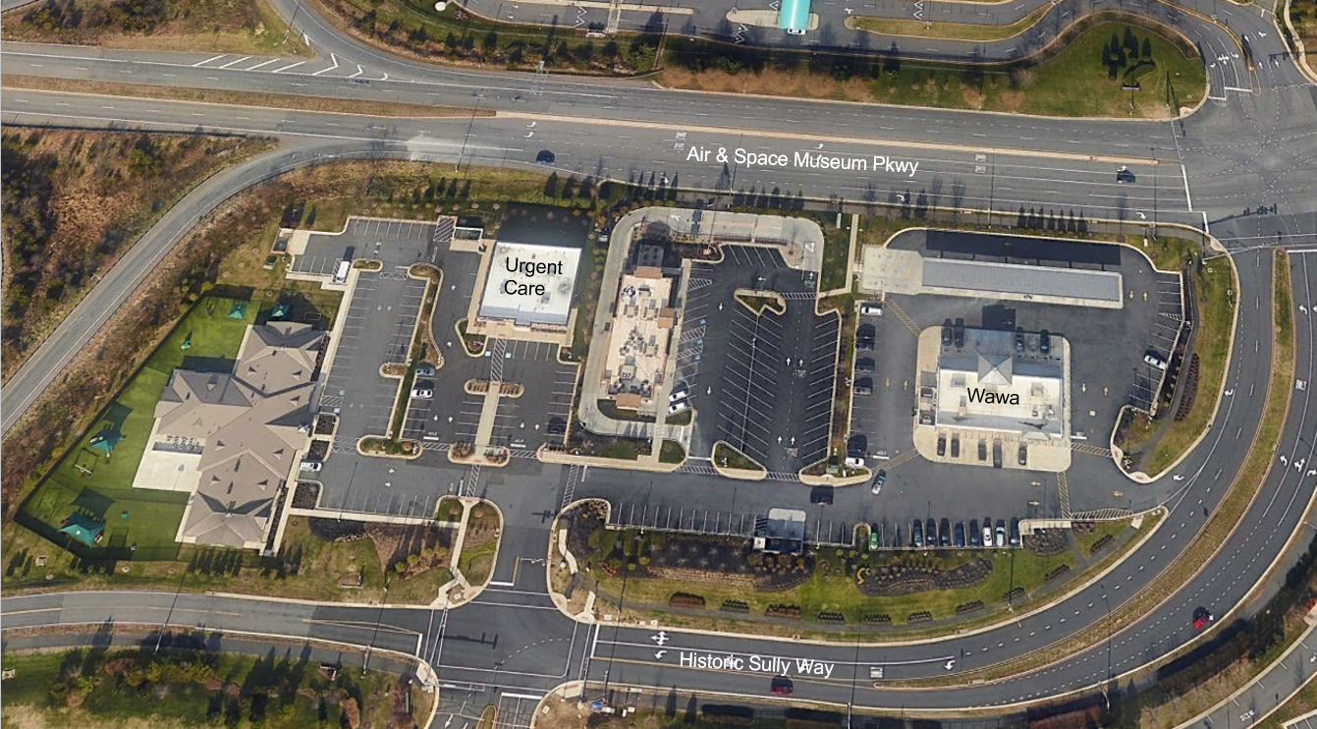
Existing Site
Air & Space Museum Pkwy
Urgent
Care
Wawa
Historic Sully Way

Slide 4
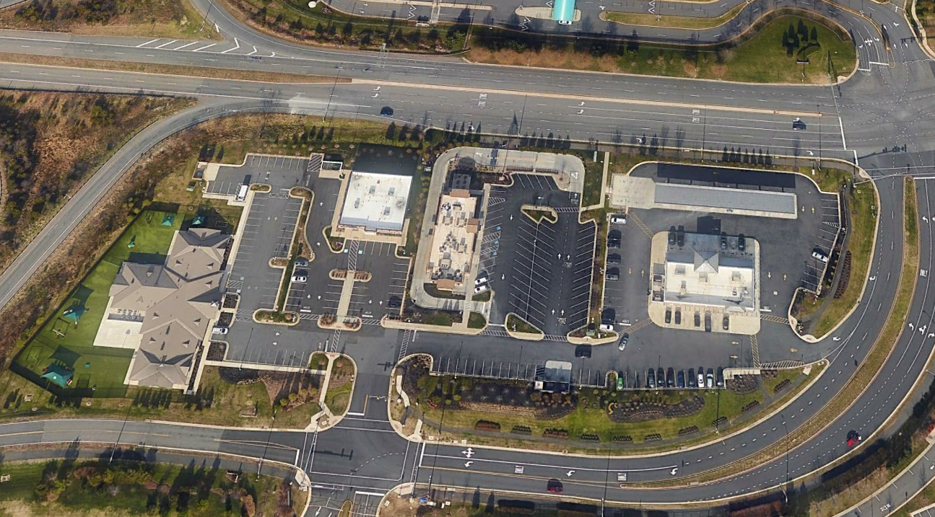
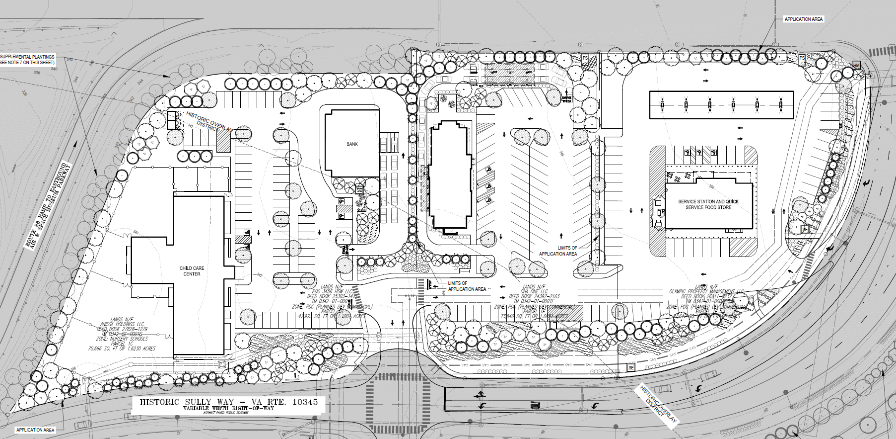
Canopy Locations
Air & Space Museum Pkwy
Urgent
Care
Wawa
Historic Sully Way

Slide 5
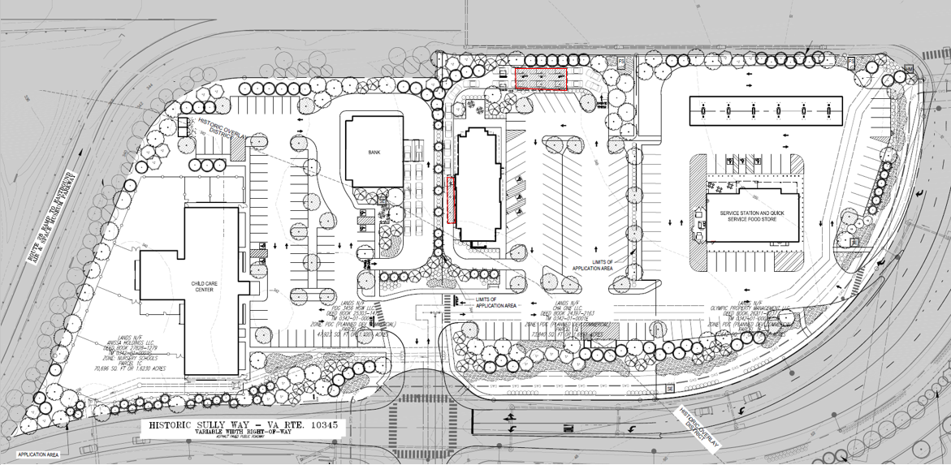
Site Modifications
Canopies
Ordering Area – 23’6” x 54’ (1,280 sf)
Pick-Up Area – 8’9” x 50’ (437 sf)
Heights – 10.33 feet max
Recessed Lighting
Climate Controlled
Drive-Thru
No Changes
Landscaping/Open Space
No Changes

Slide 6
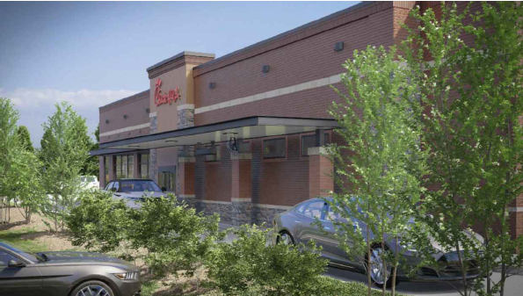
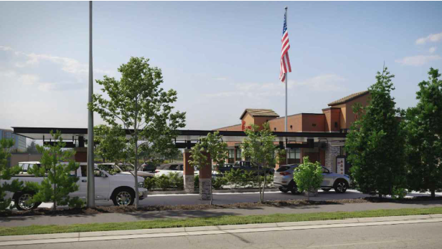
Renderings

Slide 7
Questions or Comments?
www.mcguirewoods.com
Esencia Architecture, LLC

