Slide 2
The Problem
Comstock Companies and Clemente Development Company are seeking to build a casino in Fairfax County that is unwelcome and unwanted
In January, Sen. Dave Marsden (Burke) introduced state legislation to build a casino in Fairfax County
In February, VA Senate Finance & Appropriations Committee voted to continue the legislation to 2025 and recommended a study regarding impacts
Marsden has vowed to reintroduce legislation in January 2025
Comstock has made financial contributions to several political campaigns at the state and county levels

Slide 3
Why Does It Matter?
A casino will not grow our economy. It will harm local businesses, increase gridlock and public safety problems, lower property values, and encourage risky behaviors while forever changing the character of our community
Casinos:
Cannibalize local businesses, resulting in job loss at other entertainment, food, and retail venues
Lead to increased crime: human trafficking, armed assault, burglary and more
Decrease home property values
Encourage gambling addiction, bankruptcy, drinking and driving
Increase traffic congestion and adversely impact neighborhood streets due to cut-through traffic
Deter large corporations from locating nearby as they don’t want a presence near a casino – image, safety, surveillance, temptations

Slide 4
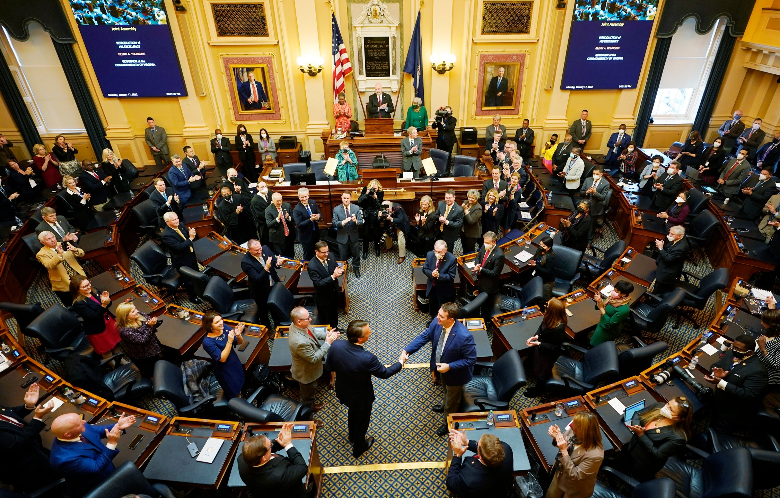
What Needs to Happen?
The Fairfax County Board of Supervisors and Virginia State legislature should publicly oppose casino development given the overwhelming opposition.

Slide 5
How Sully District Residents Can Help
Sign the No Casino Petition!
Go to https://nocasinocoalition.org/petition to call on Supervisors to publicly oppose a Fairfax casino and State casino legislation.
Invite your friends and neighbors to do likewise.
Get the word out in Sully District
Help at our booth at Centreville Day on Saturday, October 19.
Put up a yard sign.
Talk to your friends, neighbors, and local businesses.
Attend and speak at Board of Supervisors’ Public Hearings
Sign up to speak during Public Comment time on September 24, October 22, November 19, or December 3.
Show up to support speakers and be seen.
Thank Supervisor Smith and; ask how you can help stop a casino in Fairfax.
Donate at https://nocasinocoalition.org/donate.

Slide 6
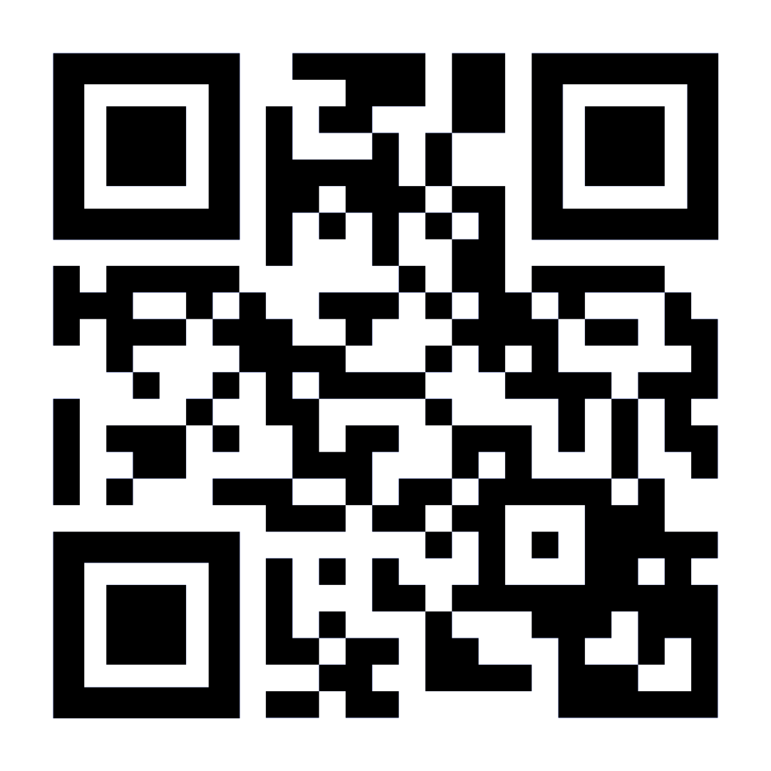
Where to Find Us
NoFairfaxCasino
www.NoFairfaxCasino.org
NoFairfaxCasinoCoalition@gmail.com

