Slide 1
Commonwealth Place at Westfields
Special Exception for Sign Modifications
SE 2023-SU-00043
October 21, 2024
Joint Sully District Council Land Use and Transportation Committee Meeting

Slide 2
Site Specifics
4.65 acres
South of Newbrook Drive, north of Sully Road (Route 28), and west of Westfields Boulevard (Route 662)
Commonwealth Centre
Planned Development Commercial (“PDC”) District
81 multi-family triplex units

Slide 3
Previous Approvals
CDPA-2006-SU-025-03/PCA-2016-SU-025-05/FDPA-2006-SU-025-05 was approved by the Board of Supervisors on October 19, 2021, to replace the unbuilt portions of non-residential development in Land Bay A with residential uses.
CSP-2006-SU-025 was approved by the Planning Commission on February 18, 2009. This CSP provided guidance for the location, size, and material of various hotel, retail, office, direction, and regulatory signs for the 97.60-acre development.
CSPA-2006-SU-025 was approved by the Planning Commission on November 16, 2017. This still governs the non-residential signage within Commonwealth Centre (including the Property although it is no longer approved for non-residential uses).

Slide 4
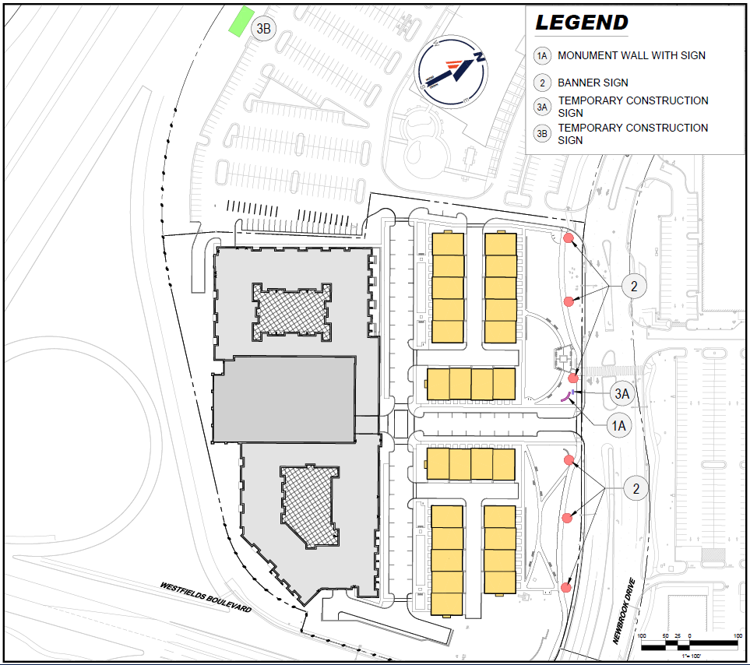
Proposed Signage - One Permanent - Three Temporary

Slide 5
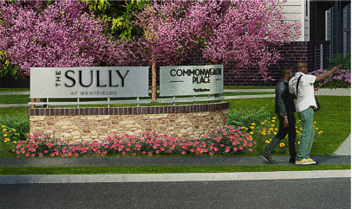
Monument Signage

Slide 6
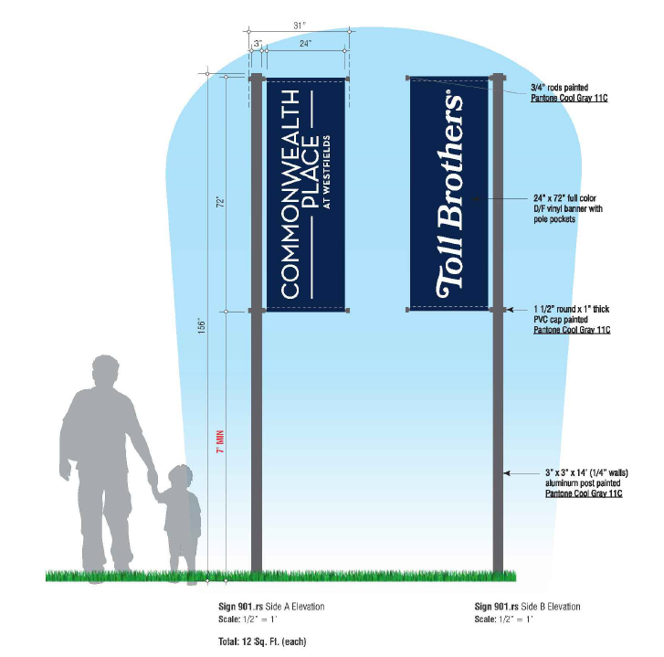
Temporary Signage

Slide 7
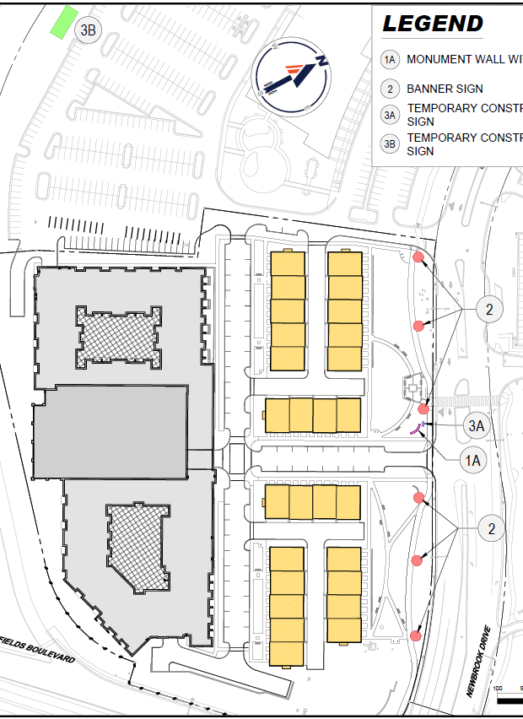
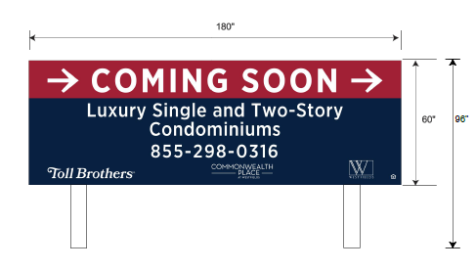
On-site Temporary Sign

Slide 8
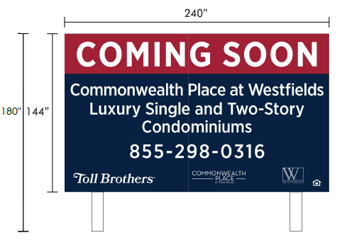
Off-site Temporary Sign

