Slide 1
Centreville Mews RZ/FDP 2022-SU-00005
Joint Sully District Land Use And Transportation Committee
November 18, 2024

Slide 2
Existing Conditions
The Property is 6724 Centreville Road, Centreville, Virginia.
Zoned R-1 (Residential District, One Dwelling Unit/Acre).
The Property is approximately 4.55 acres and is improved with a single family home and two accessory dwellings.
Surrounded by residential communities to the west, substation to the north, Centreville Road to the east, and a newly constructed stormwater pond to the south
Comprehensive Plan recommends 2 – 3 dwelling units per acre

Slide 3
Zoning Map

Slide 4
Aerial Context

Slide 5
Proposed Development
The initial submission proposes to rezone the Property from R-1 to the PDH-3 district and construct 13 single family dwellings.
Access provided via a new private street off Old Centreville Road – aligned with Tracy Schar Drive
Initial submission provided 1.4 acres of open space (31% of site) and 11,257 sf of tree preservation – Applicant is working to improve and increase based upon staff’s comments
Private community open space area on south side of site

Slide 6
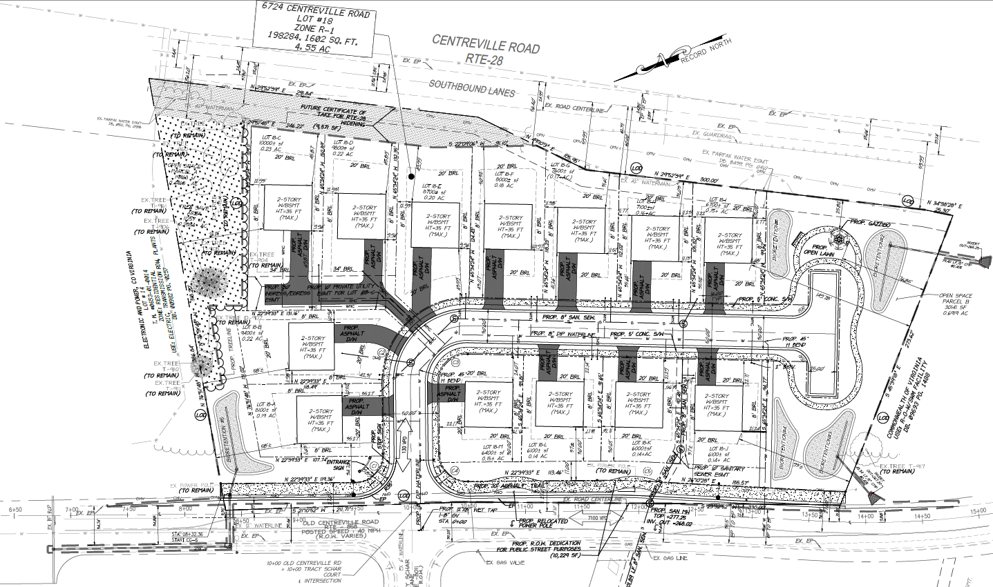
Initial Submission
Concept is not final and is subject to change

Slide 7
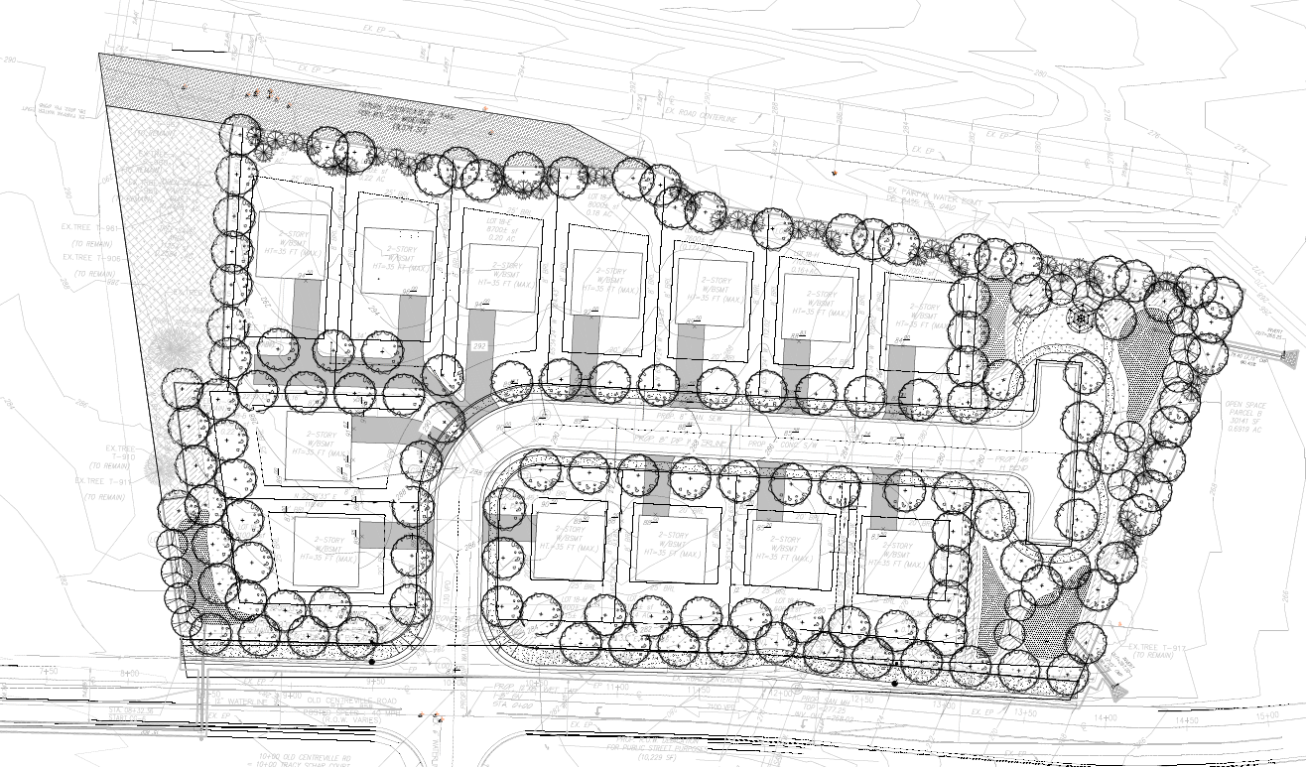
Landscape Plan
Landscape Plan is not final and is subject to change

Slide 8
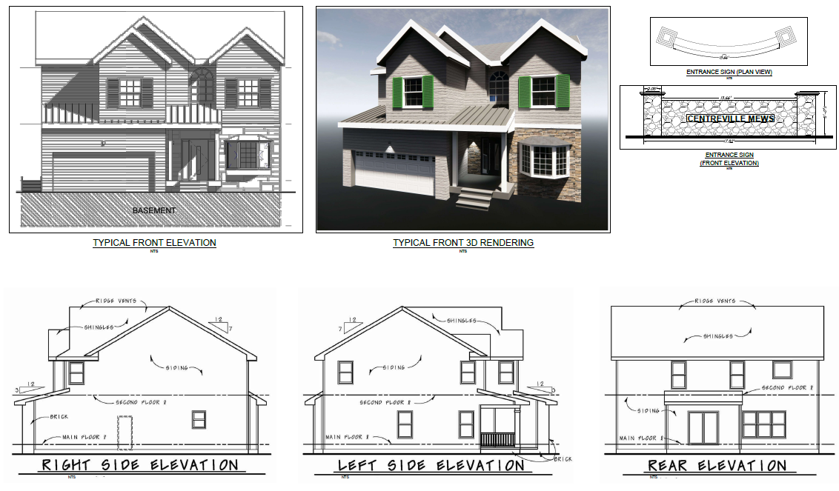
Conceptual Architecture
Architecture is not final and is subject to change

Slide 9
Revisions in Progress
The Applicant received comments from staff in April 2024, and met with staff and Supervisor Smith to discuss
Based on staff’s comments, Applicant will be eliminating at least one lot to increase tree preservation and improve site layout
Applicant will provide a 10’ trail along Old Centreville Road as recommended by the Comp Plan
Crosswalk to be provided across Old Centreville Road in coordination with VDOT and FCDOT
Exploring refinements to lot layouts and driveway configurations, additional enhancements to open space

Slide 10
Next Steps
Community Outreach
Meet with Sully District Council Land Use & Transportation Committee
Outreach to surrounding neighborhoods

