Slide 1
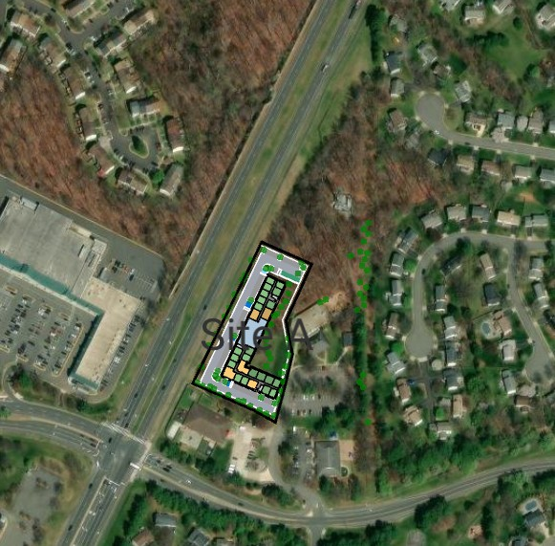
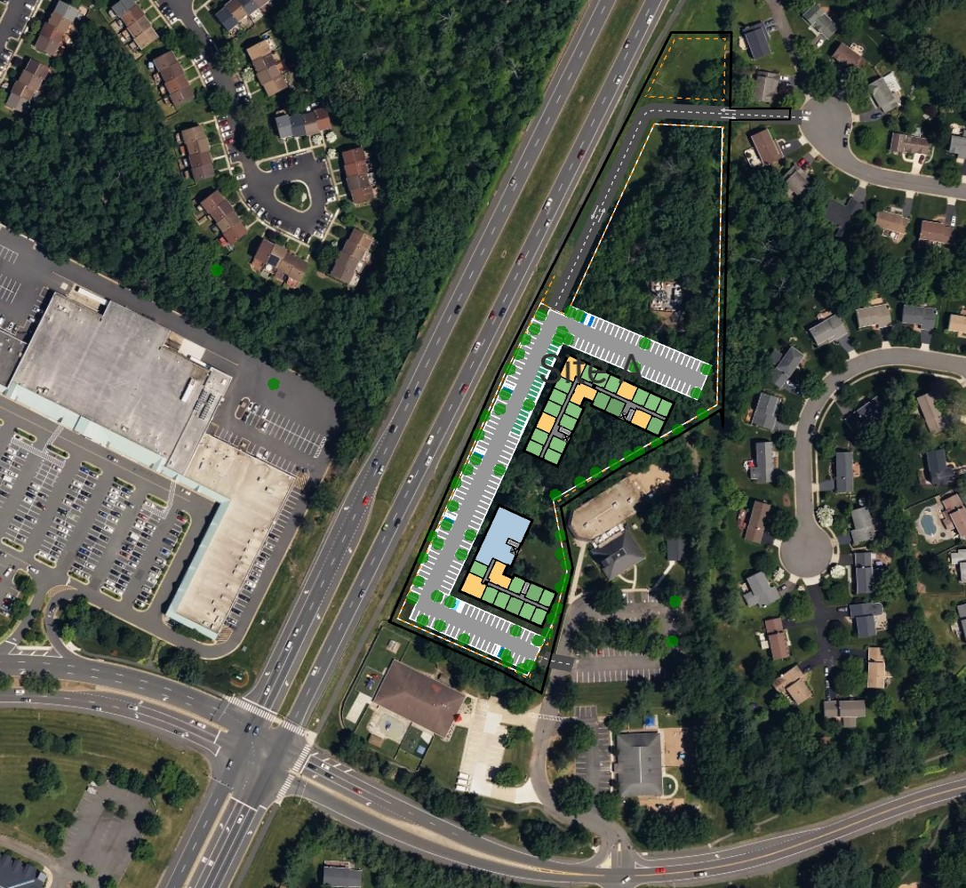
REVISED
CONCEPT
REVISED OPTION SITE A
93 Units
3 Floors (30 – 36 Feet High)
72 Parking Spaces
PREVIOUS CONCEPT

Slide 2
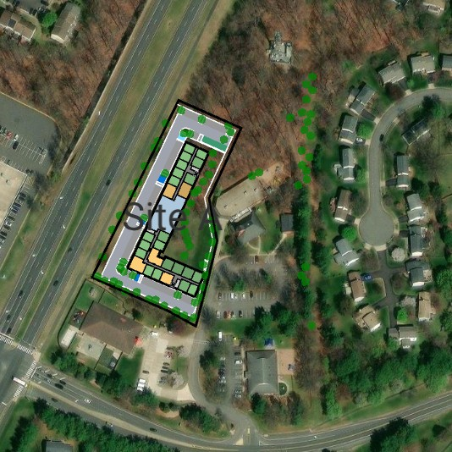
REVISED
CONCEPT
REVISED OPTION SITE A
93 Units
3 Floors (30 – 36 Feet High)
72 Parking Spaces
PREVIOUS CONCEPT

