Slide 1
Raising Cane’s
Fairfax County Tax Map Parcel 34-4 ((12)) 2
14050 Thunderbolt Place, Chantilly
Sully District
Site-Specific Plan Amendment Nomination
CPN-2025-III-SU-037
April 21, 2025

Slide 2
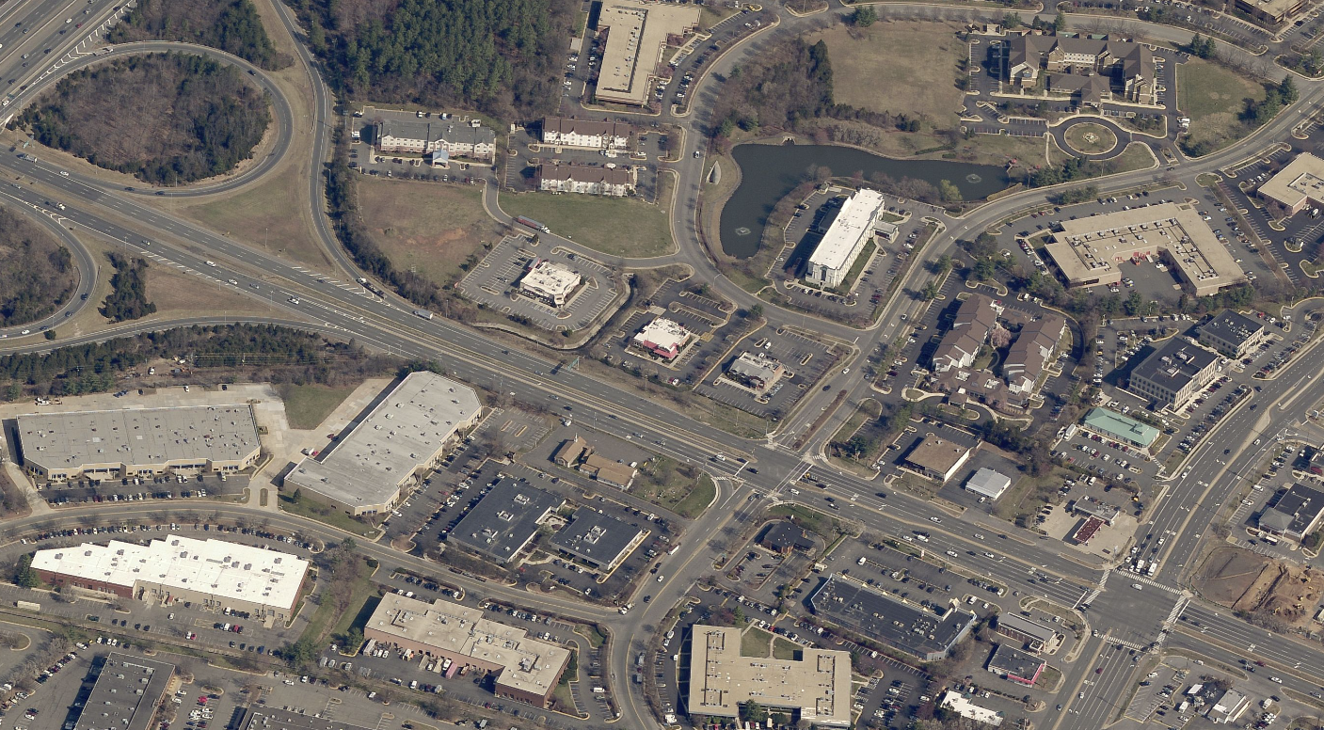
Site Location and Context
North
Hotel
Hotels
Hotel
Retail
Thunderbolt Place
Subject
Property
Hotel
US Route 50
Retail
Retail
Centreville Road
Centerview Drive
Office / Industrial Flex Uses

Slide 3
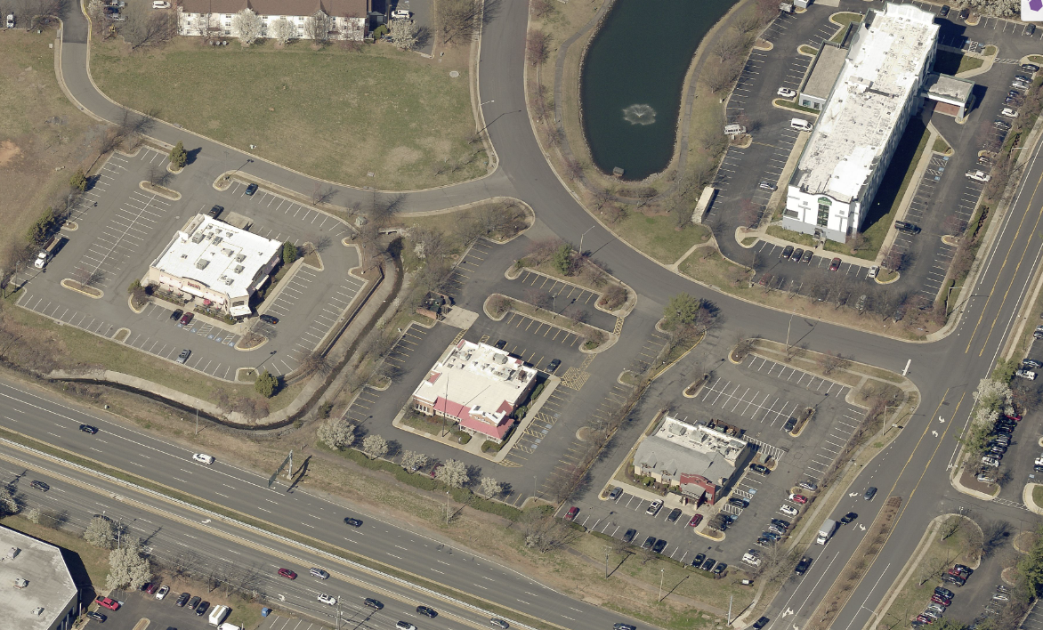
Hotel
Site Location and Context
North
Land Area: 71,356 Square feet
1.64 Acres
Hotel
Retail
Subject
Property
Thunderbolt Place
Centerview Drive
Retail
Retail
US Route 50
Hotel
Retail
Office Uses

Slide 4
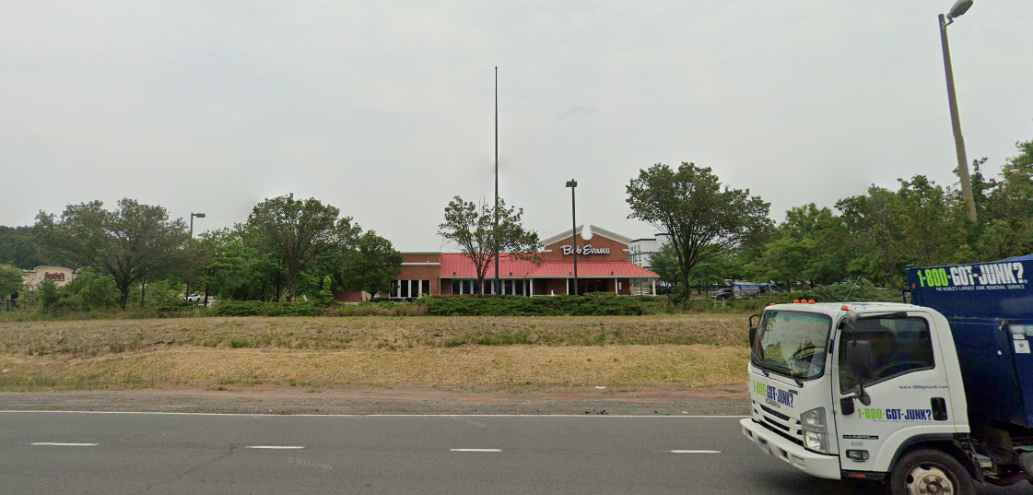
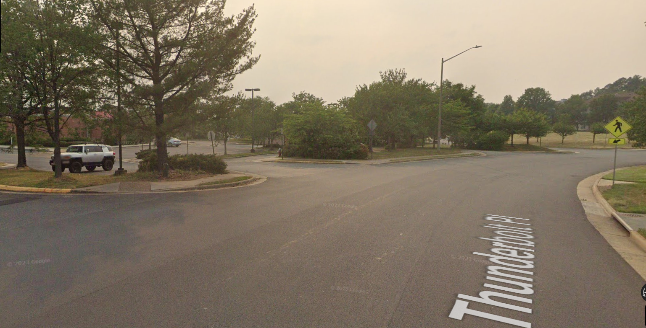
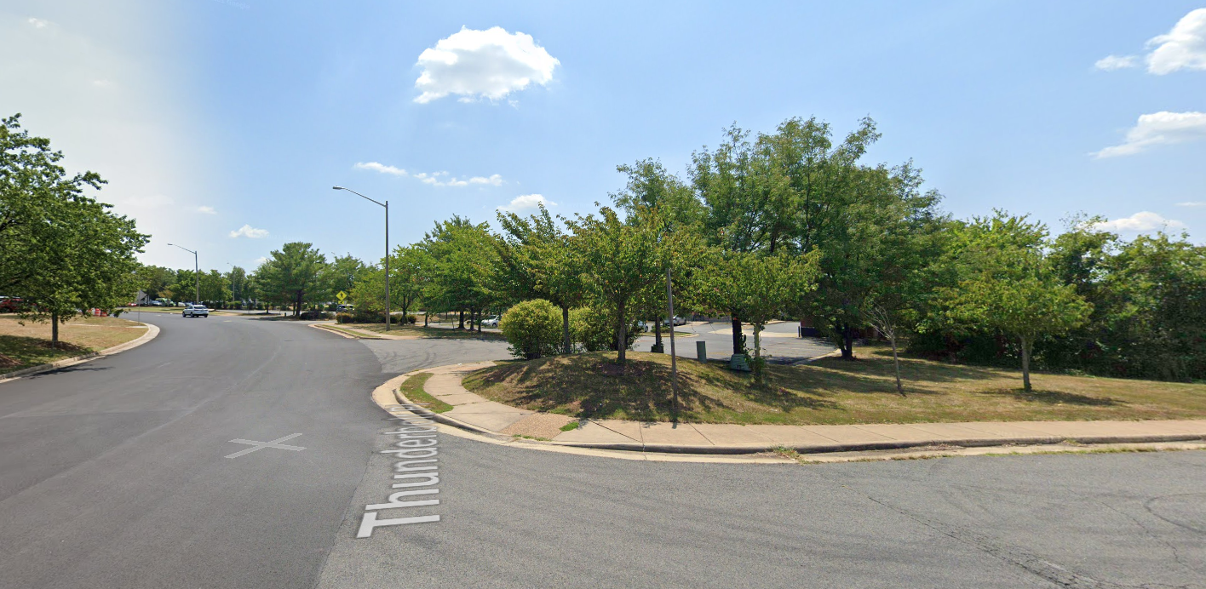
Existing Conditions
View looking North from US Route 50
View looking West from Thunderbolt Place
View looking Southeast from Thunderbolt Place

Slide 5
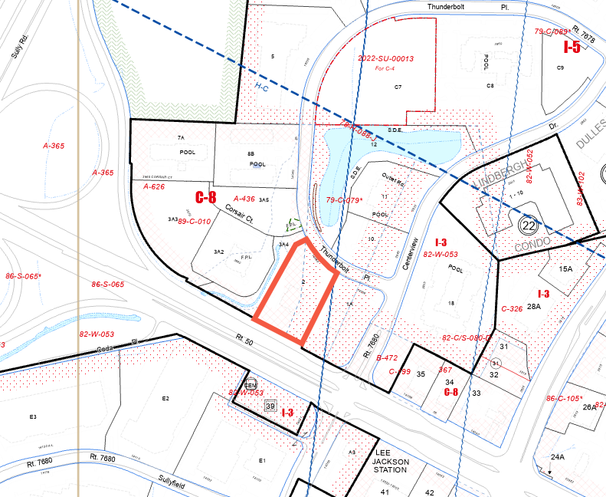
Tax Map Parcel
34-4 ((12)) 2
1.64 acres
Free-standing restaurant
Surface parking lot
Current Zoning
C-8 Highway Commercial
I-5 General Industrial
Highway Corridor Overlay
Water Supply Protection Overlay
Airport Noise Impact Overlay
Prior Approvals
RZ 1979-C-079 (I-5 District)
RZ 1989-C-010 (C-8 District)
North
Subject Property

Slide 6
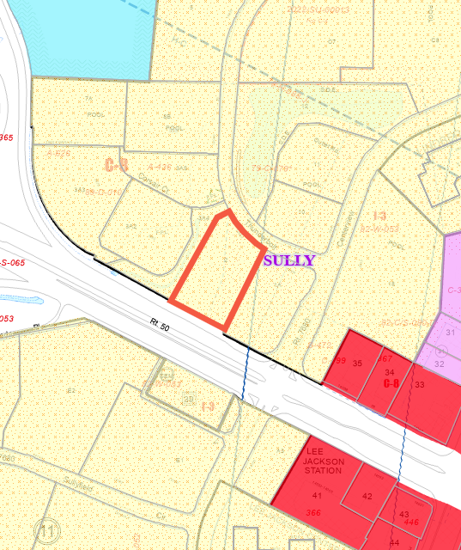
Dulles Suburban Center
Land Unit E-1
Planned for campus-style office, and industrial/flex use up to a maximum FAR of 0.35 to be compatible with existing development. Ancillary retail use up to 20 percent of the total development may be appropriate within office or industrial/flex buildings. In no event, however, should retail uses be developed as free-standing uses or as a shopping center.
Comprehensive Plan Land Use Map
Mixed Use

Slide 7
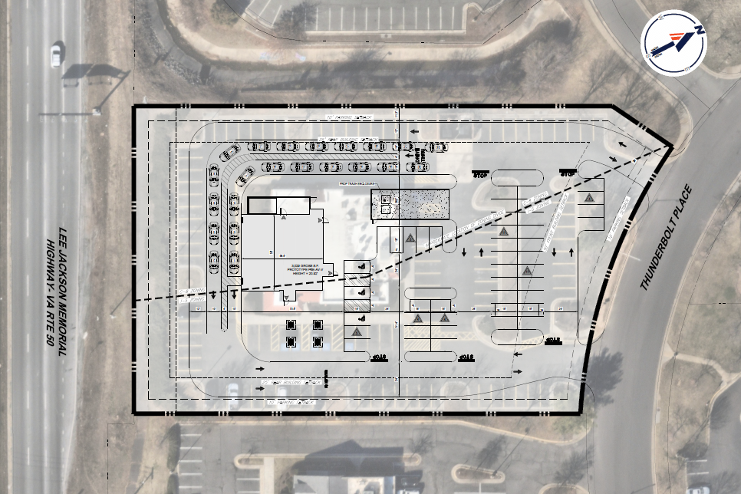
Concept Plan

Slide 8
Proposed SSPA and Required Land Use Applications
SSPA to allow freestanding retail/restaurant uses on the Property
Current Plan text is incongruous with existing and surrounding uses
Current Plan recommendation for campus-style office or industrial/flex is applicable to uses to the north and east, but not viable for this site
Anticipated Next Steps:
PCAs to remove land area from RZ 1979-C-07 (I-5 for general industrial and offices) and RZ 1989-C-010 (C-8 for hotel and commercial uses)
Rezone Subject Property to C-8, HC, WS, and AN
Special Exception for a restaurant use with drive-through

