Slide 1
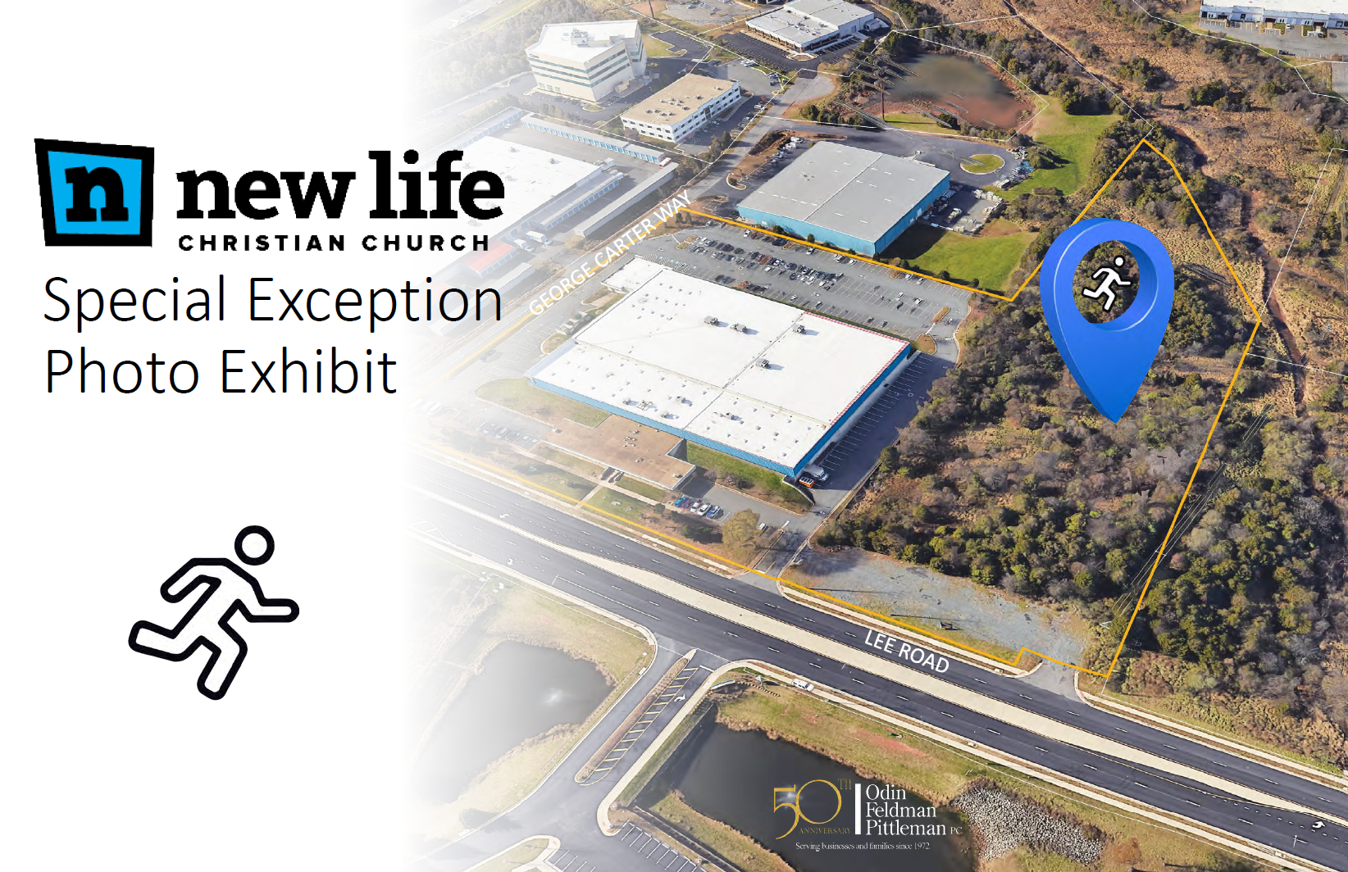
SE-2023-SU-00009

Slide 2
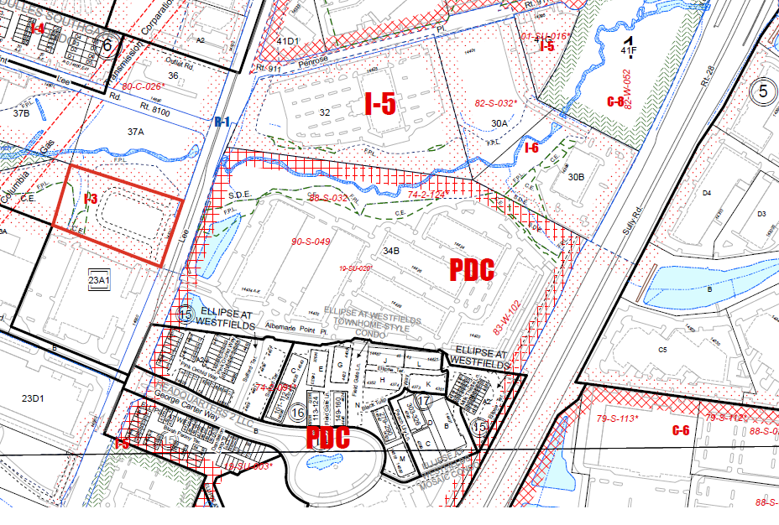

Slide 3
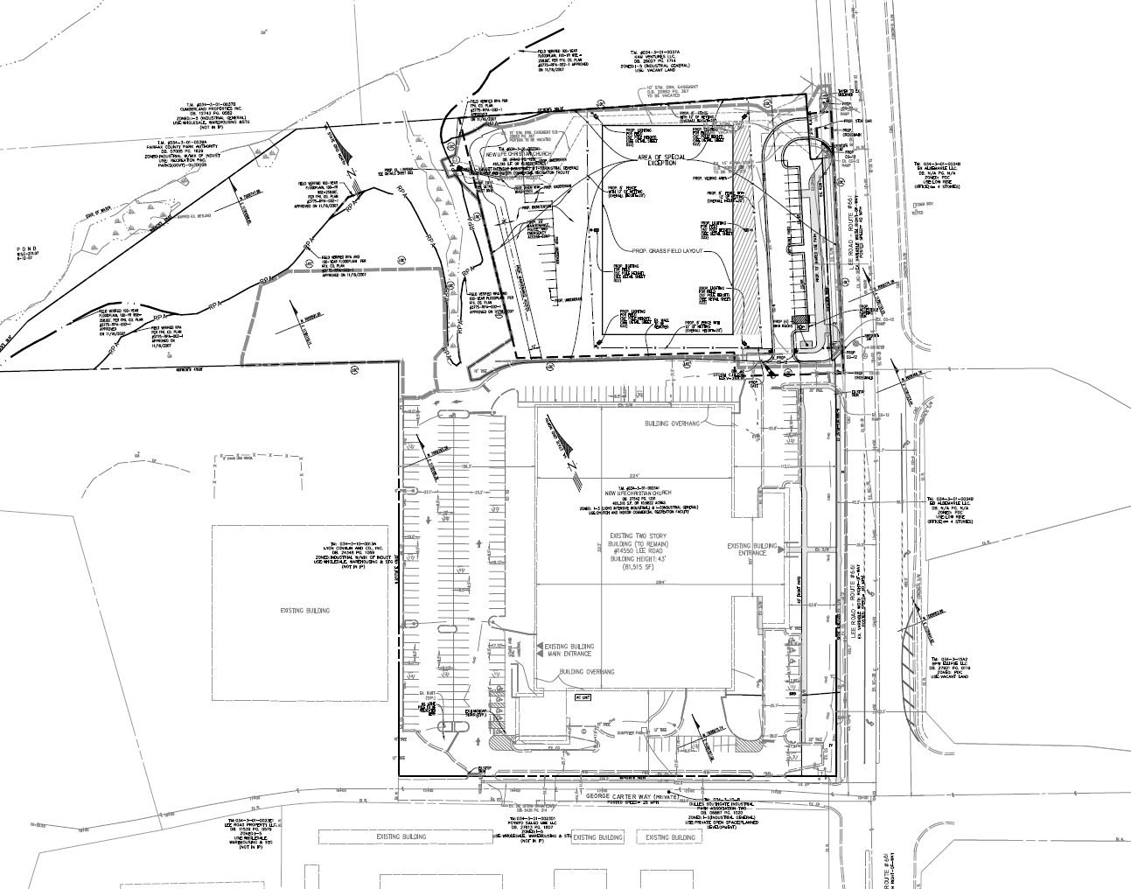

Slide 4
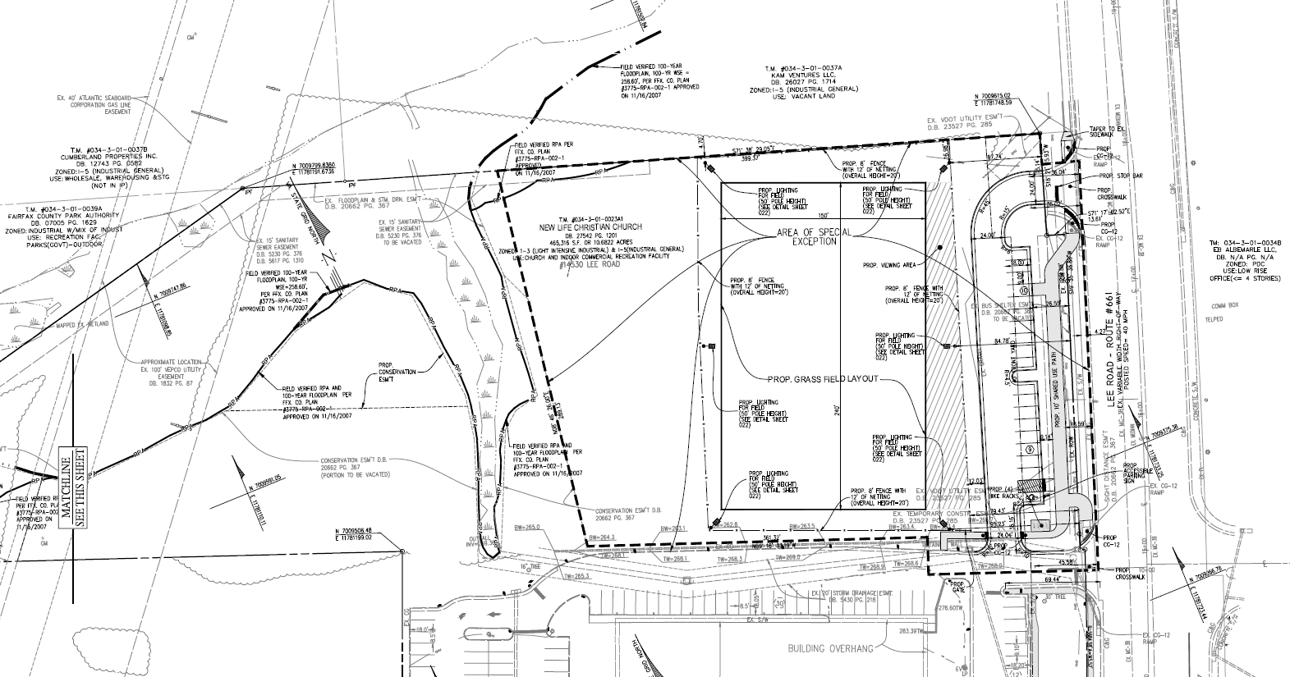

Slide 5
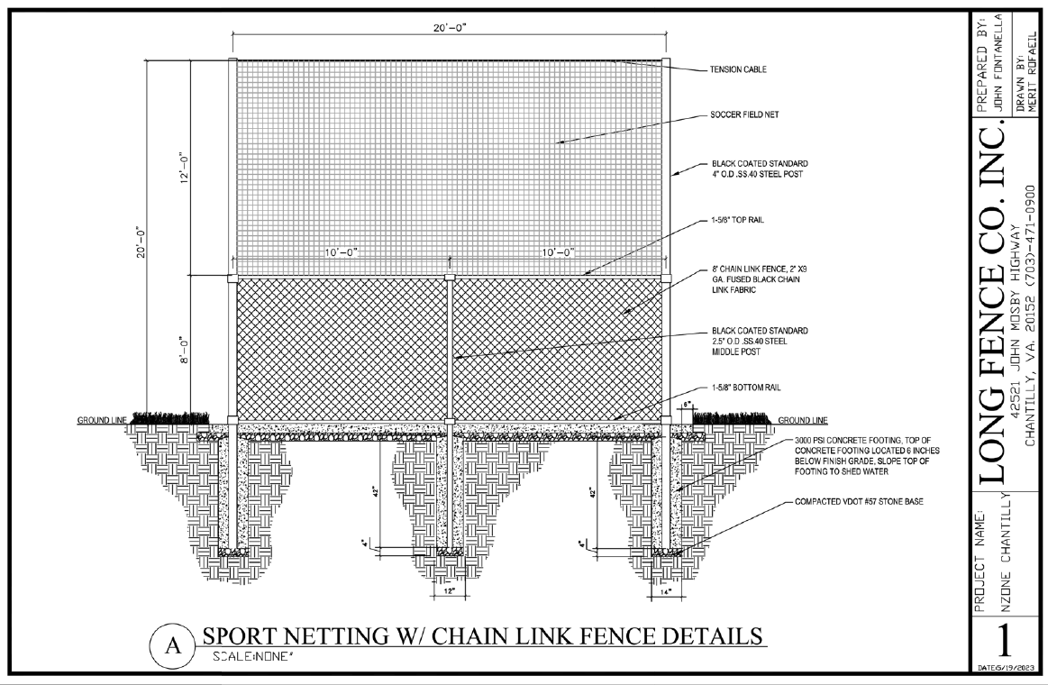

Slide 6


Slide 7
Application Details
Staff Coordinator - Ciarra Downing
Planning Commission Public Hearing – September 17, 2025

Slide 8
SE-2023-SU-00009

