Slide 1
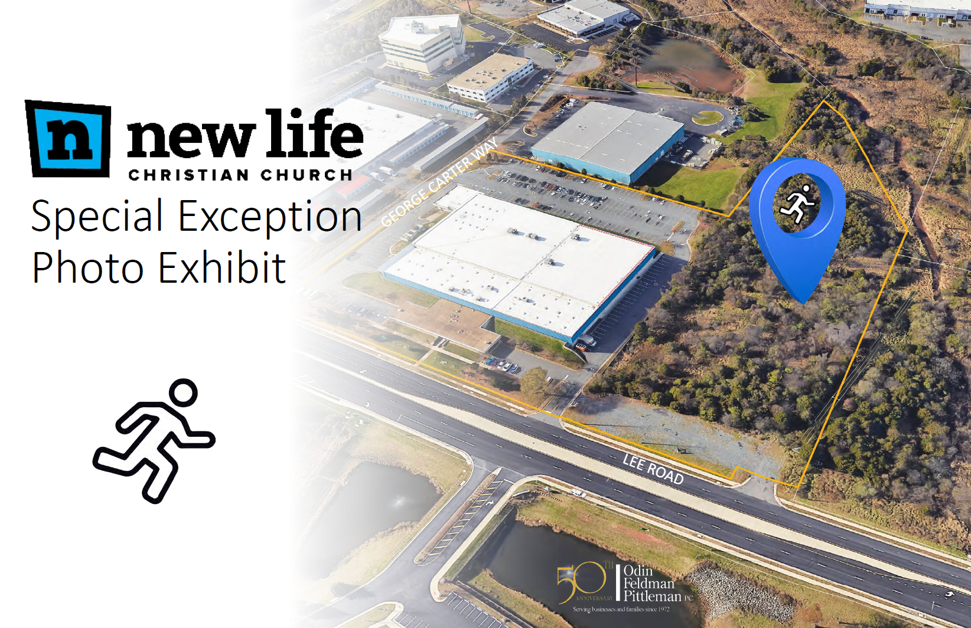
SE-2023-SU-00009

Slide 2
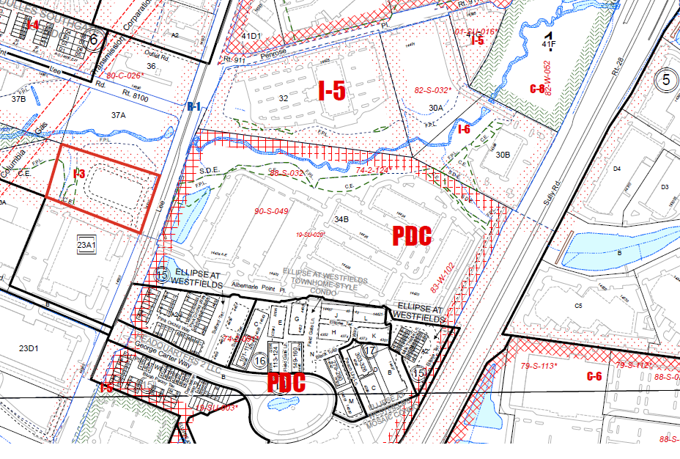

Slide 3
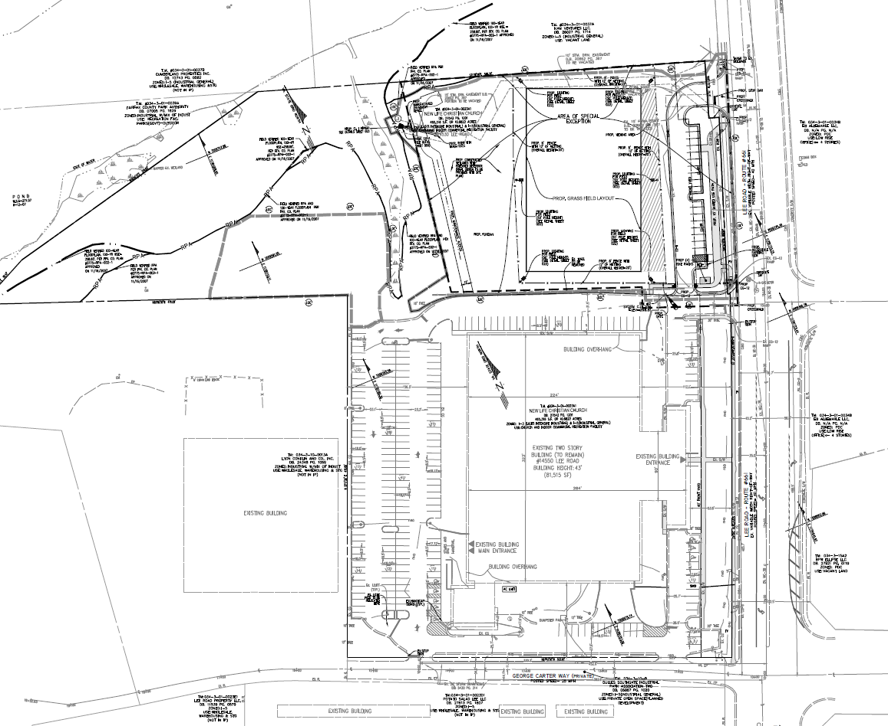
Existing Church

Slide 4
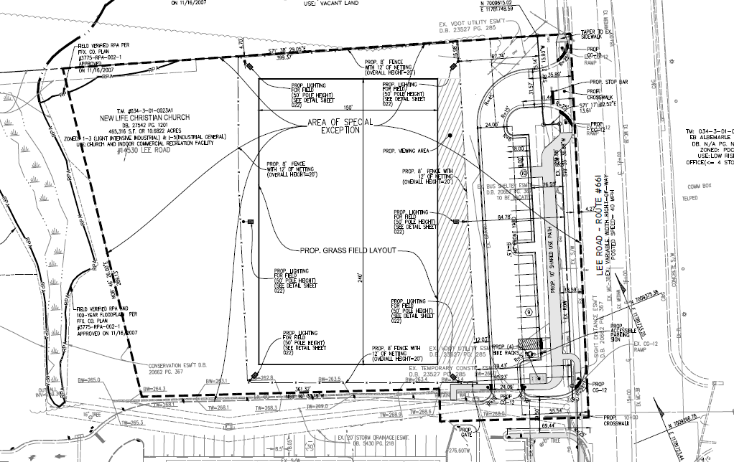

Slide 5
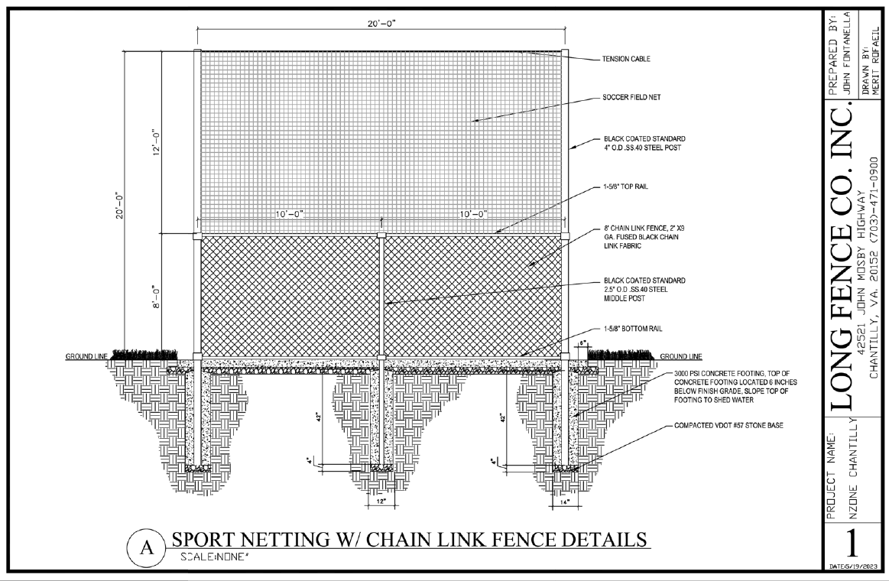

Slide 6
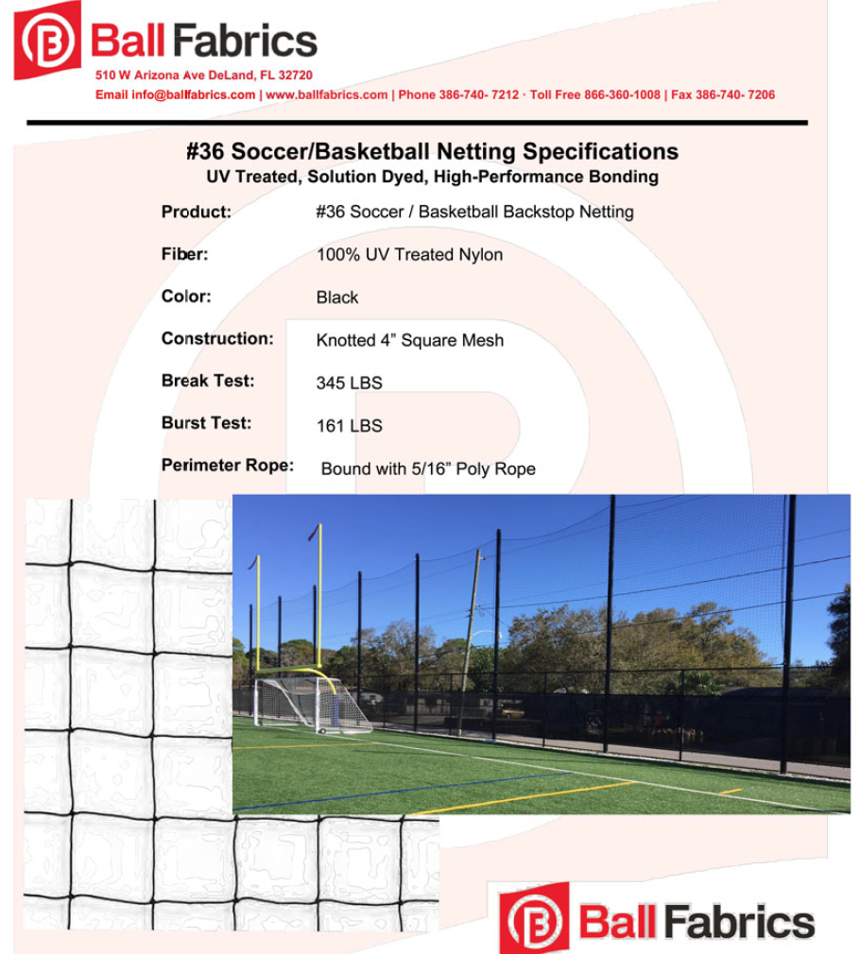

Slide 7
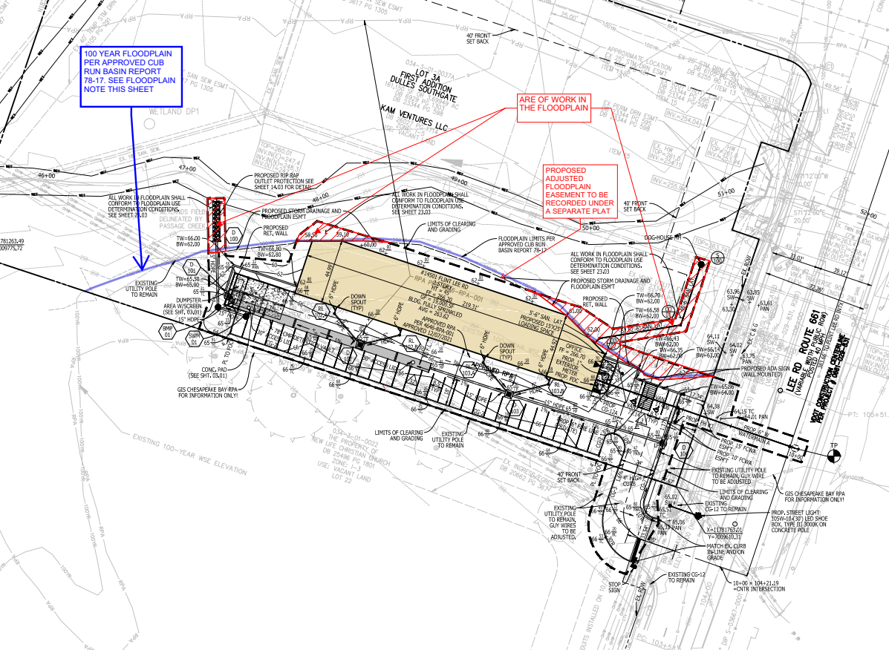
Proposed Field

Slide 8
Application Details
Staff Coordinator - Ciarra Downing
Staff recommending approval of the application.
Planning Commission Public Hearing – September 17, 2025

Slide 9
SE-2023-SU-00009

