Slide 1
COPT DEFENSE PROPERTIES
Joint Sully District Land Use & Transportation Committee Presentation
November 17, 2025

Slide 2
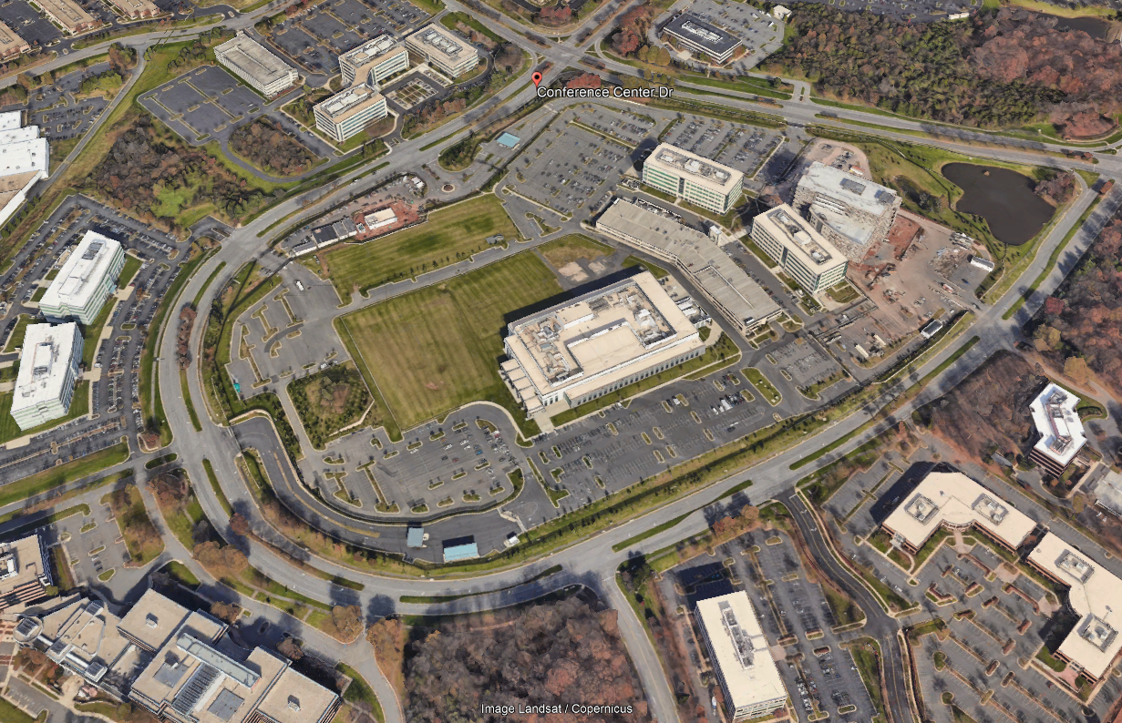
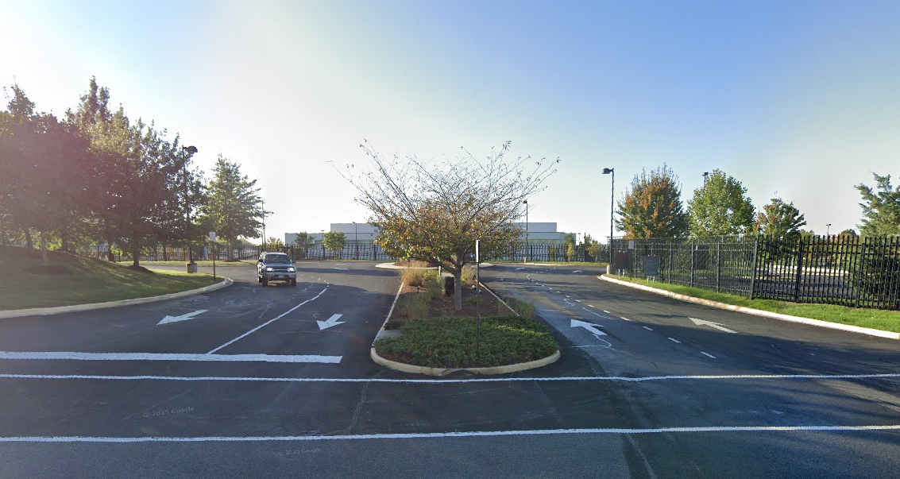
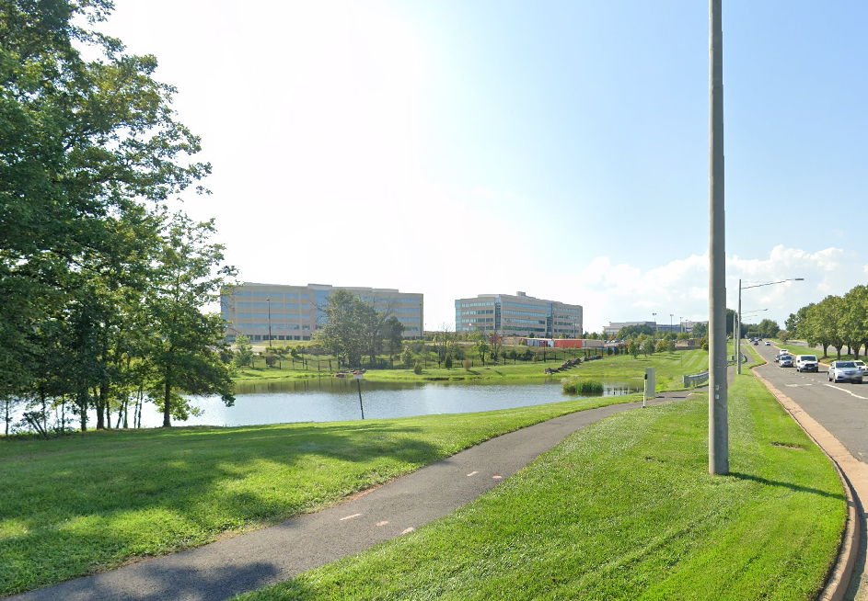
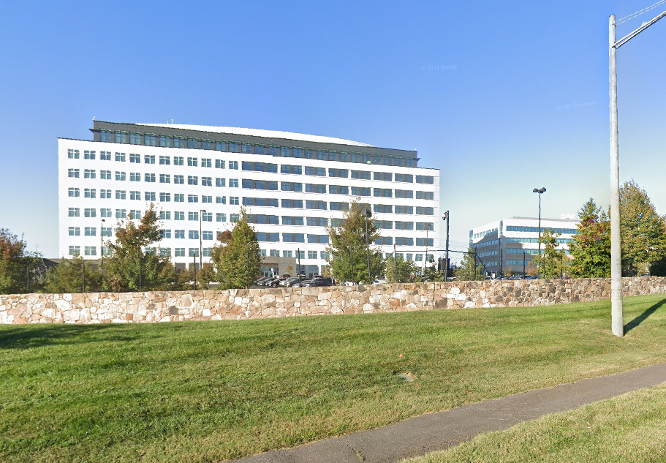
Existing Conditions
Owner: COPT Defense Properties
Current Zoning: I-3
Size: 64.28 acres
Use: Developed with secure Federal Government facility

Slide 3
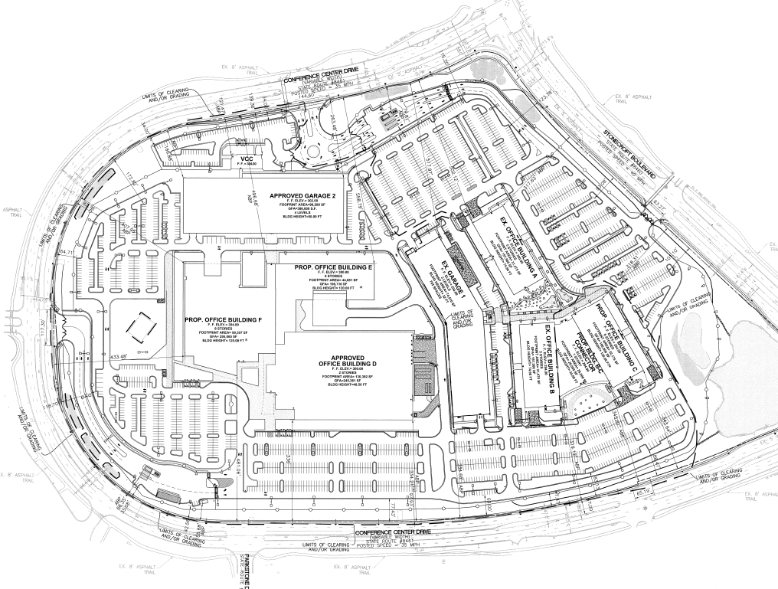
Existing Approvals
Existing buildings
Site plan approved but not built
Special exception approved but not built
Total approved GFA: 1,417,091 sf
Total approved FAR: 0.5
Total proposed GFA: 1,926,610 sf
Total proposed FAR: 0.69

Slide 4
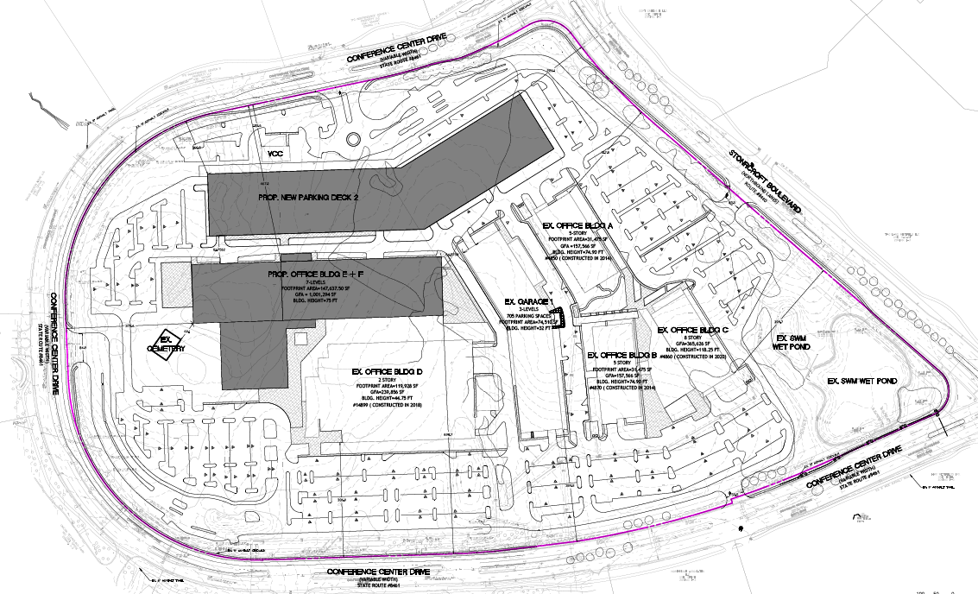
REZONING/SPECIAL EXCEPTION PROPOSAL
Existing Approval

Slide 5
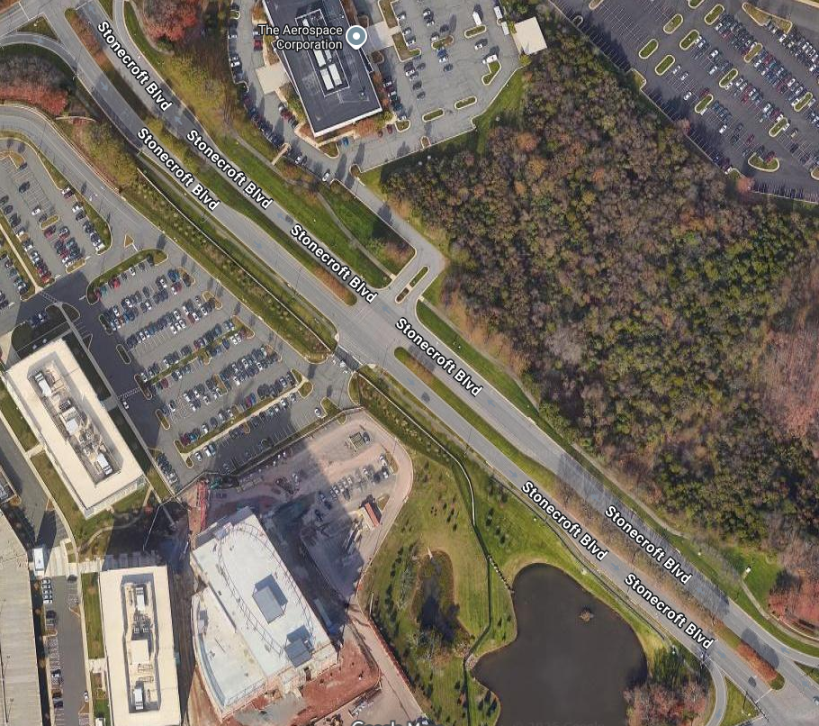
Proposed Pedestrian Improvements
New Crosswalks at Lee Road and Stonecroft Blvd.
New Crosswalks at Conference Center Dr. and Stonecroft Blvd.
New pedestrian signals at both intersections
Widen existing Stonecroft Blvd. Trail

Slide 6
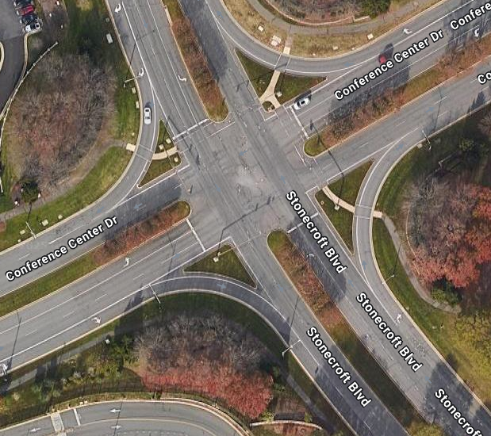
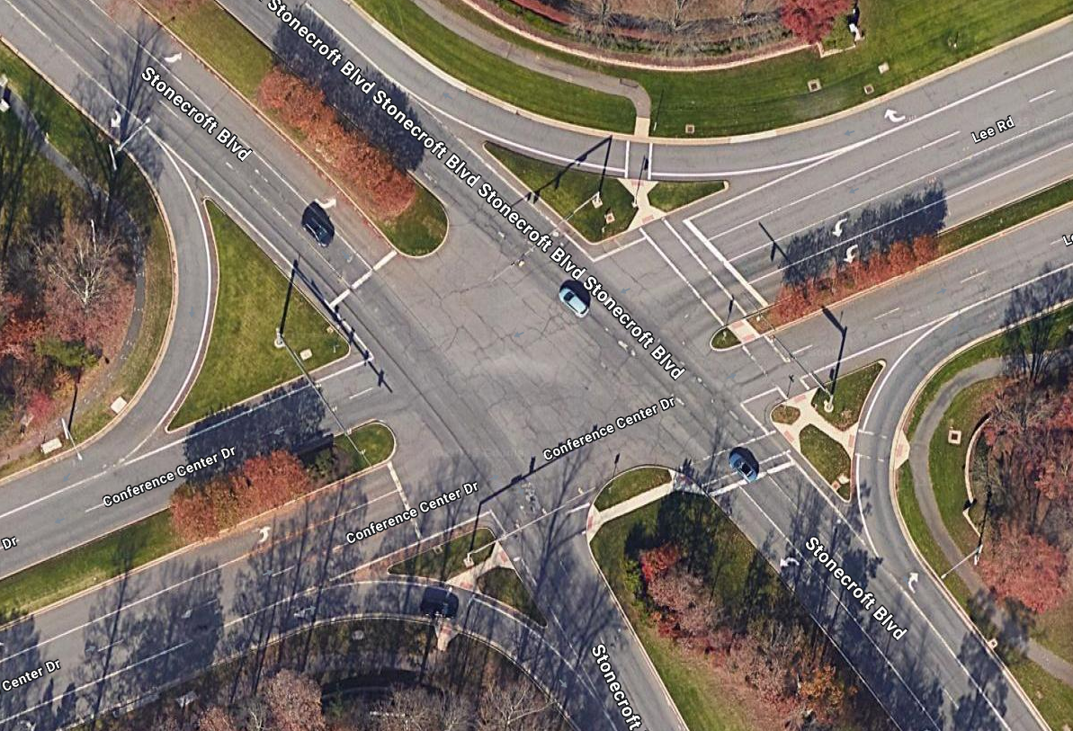
Proposed Pedestrian Improvements
Conference Center Dr. and Stonecroft Blvd.
Lee Rd. and Stonecroft Blvd.

Slide 7
Other Project Benefits
Transportation Commitments
Environmental Commitments
Public Art
FCPA Contribution

Slide 8
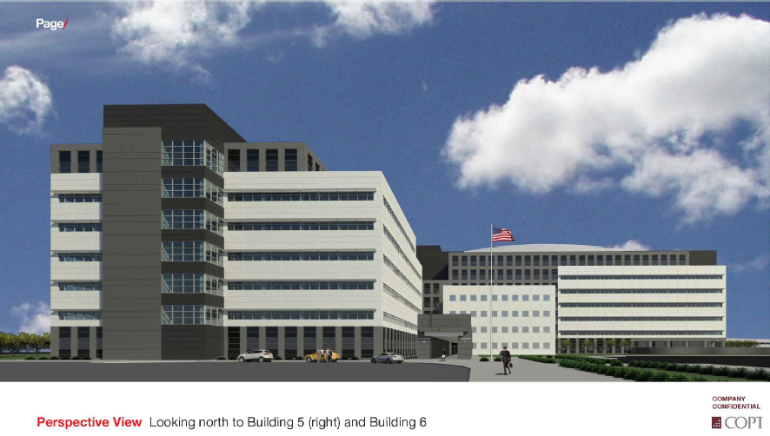
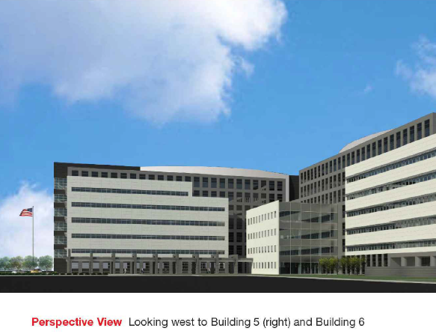
Conceptual Project Architecture

Slide 9
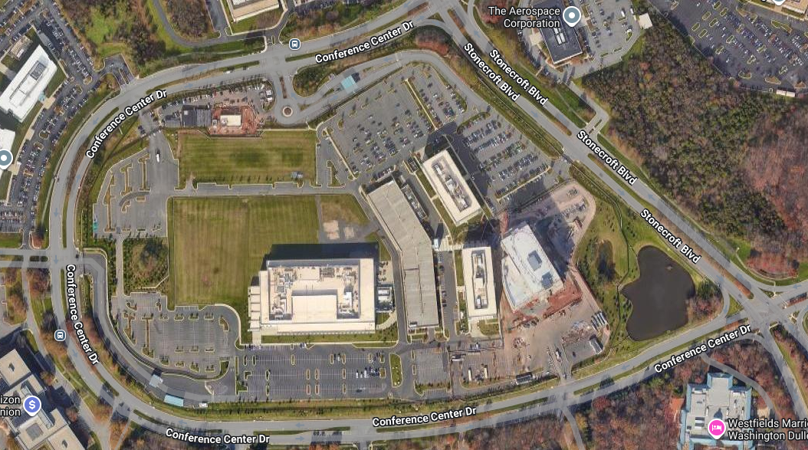
Questions?

