Slide 1
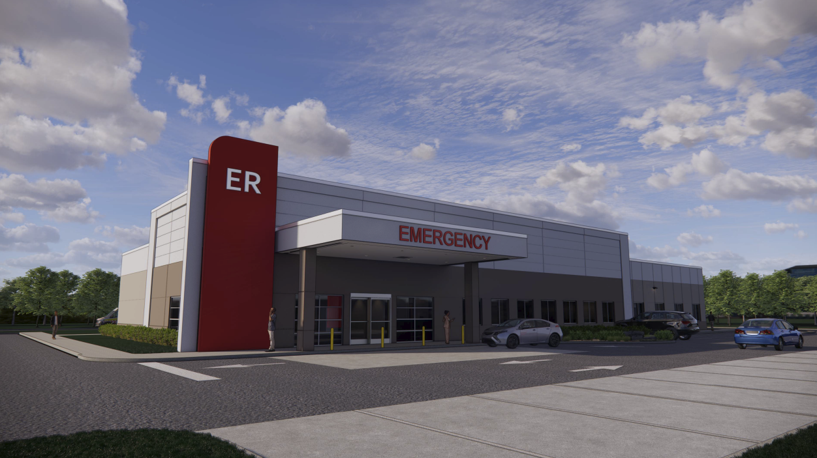
Chantilly Freestanding Emergency Department
SE-2025-SU-00014

Slide 2
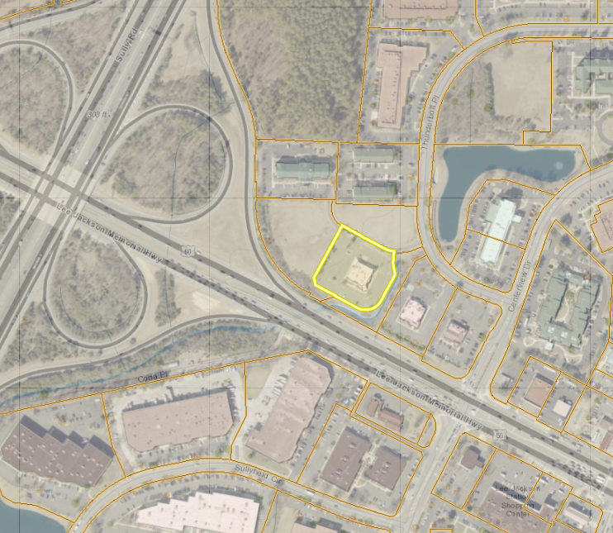
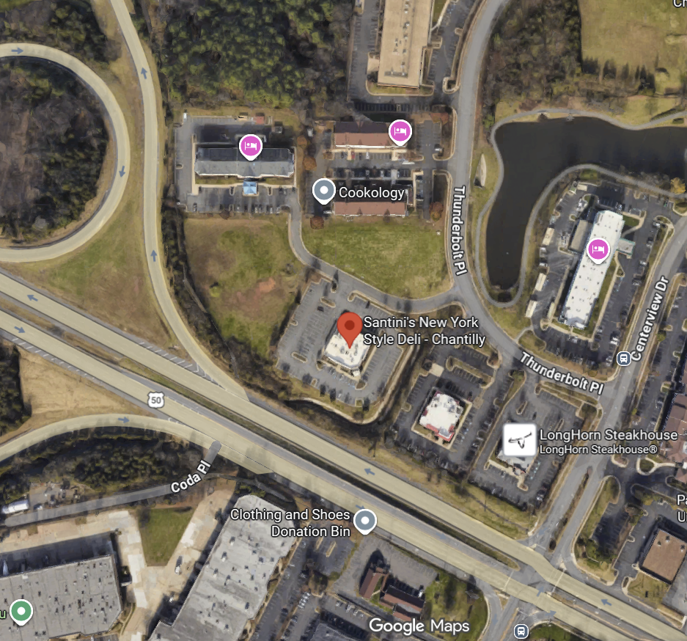
Location & Surrounding Area

Slide 3
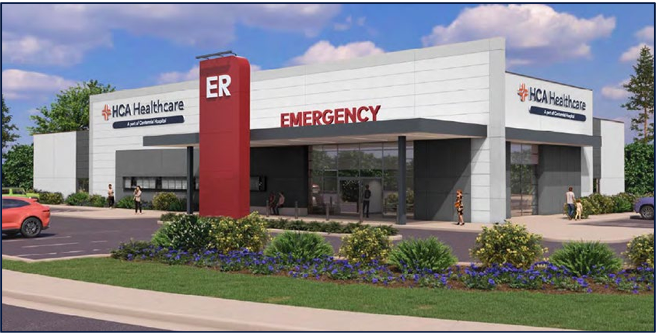
HCA Chantilly FSER
The FSER will have 10,860 sqft, 11 exam rooms, one triage room, one trauma room.
Operating 24 hours per day, providing hospital level emergency care in a convenient and accessible location.
A satellite location of StoneSprings Hospital Center, located 6.5 miles away from the Hospital.
FSER will be operated by between 15 and 22 members of staff during a 24-hour period.
Staffed with Medical Doctors board certified in Emergency Medicine, and Nurse Practitioners.
Staffed with Registered nurses, Patient Care Techs, Laboratory personnel, and Radiology Personnel.
RNs are required to maintain BLS, ACLS, PALS & active Nursing License.

Slide 4
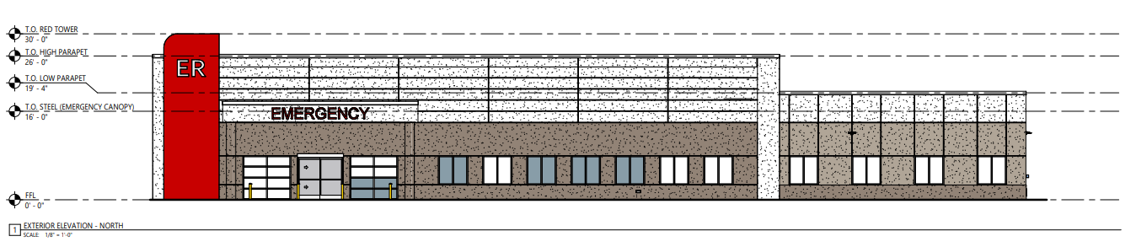
Need for Emergency Department
State Health Commissioner issued a Certificate of Public Need (COPN) in September 2024.
Fairfax County Fire and Rescue EMS support this project providing closer access to emergency care.
Fairfax County Healthcare Advisory Board reviewed the application and recommend approval

Slide 5
Planning & Zoning Framework
Property is zoned C-8
A freestanding emergency department is considered a ‘medical care facility’ in the zoning ordinance
  A medical care facility requires a special exception in every zoning district.
Property is located within the Dulles Suburban Center
  Baseline recommendation for campus-style office, and industrial/flex uses up to a maximum FAR of .35 to be compatible with existing development.
  The Project is being reviewed in accordance with the optional use criteria of the Dulles Suburban Center,
    Other uses may be appropriate under certain conditions
      Generate fewer peak-hour trips
Loudoun County Pkwy
Dulles West Boulevard

Slide 6
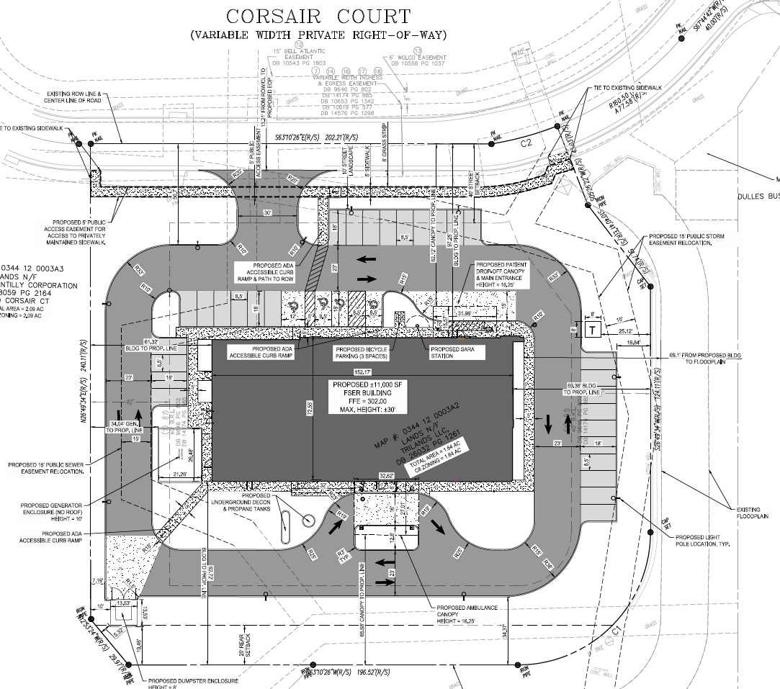
Site Plan Overview
Compared to Existing Use
Reduced vehicular trips
Reducing parking
Reducing impervious surface
Improved stormwater management

Slide 7
Process and Questions
Healthcare Advisory Board Recommended Approval in December
Sully District Council
Staff Recommendation (Forthcoming)
Planning Commission Hearing (March 25th)
Board of Supervisors (TBD)

Slide 8
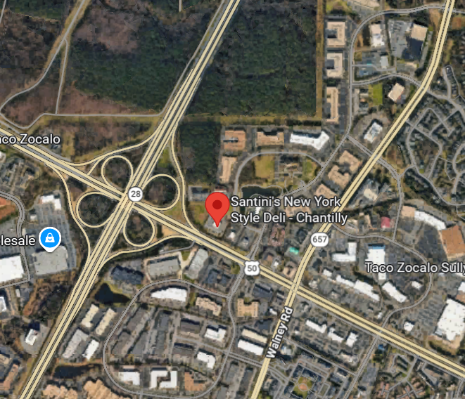
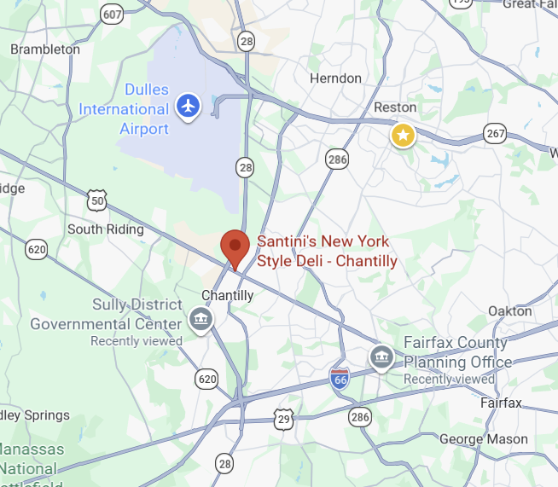
Location

Slide 9
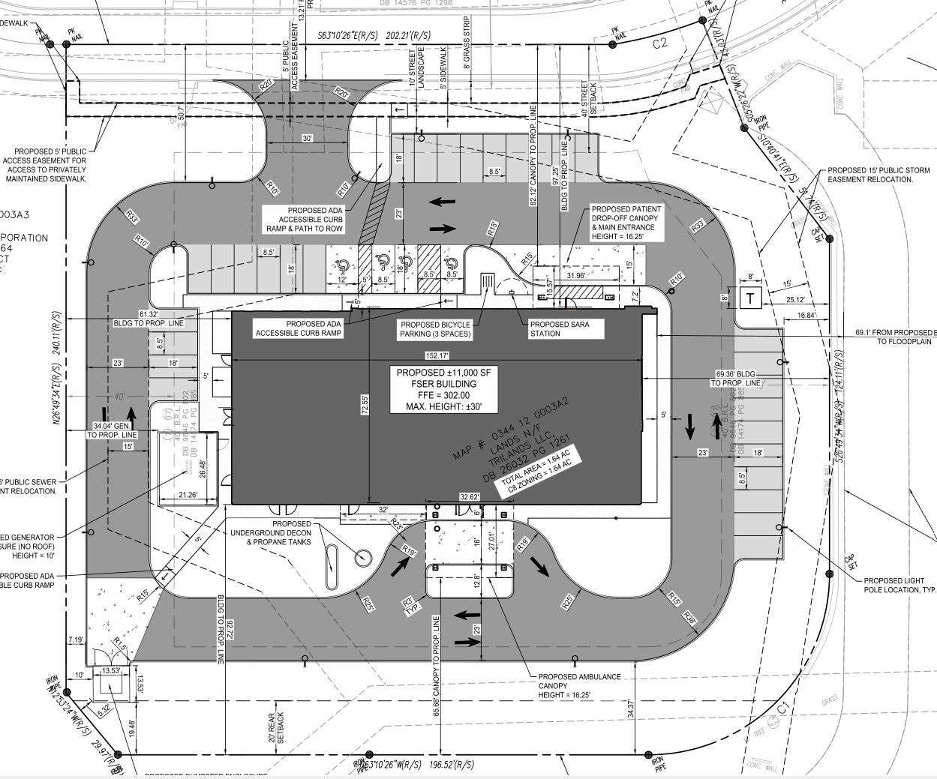
Site Plan

Slide 10
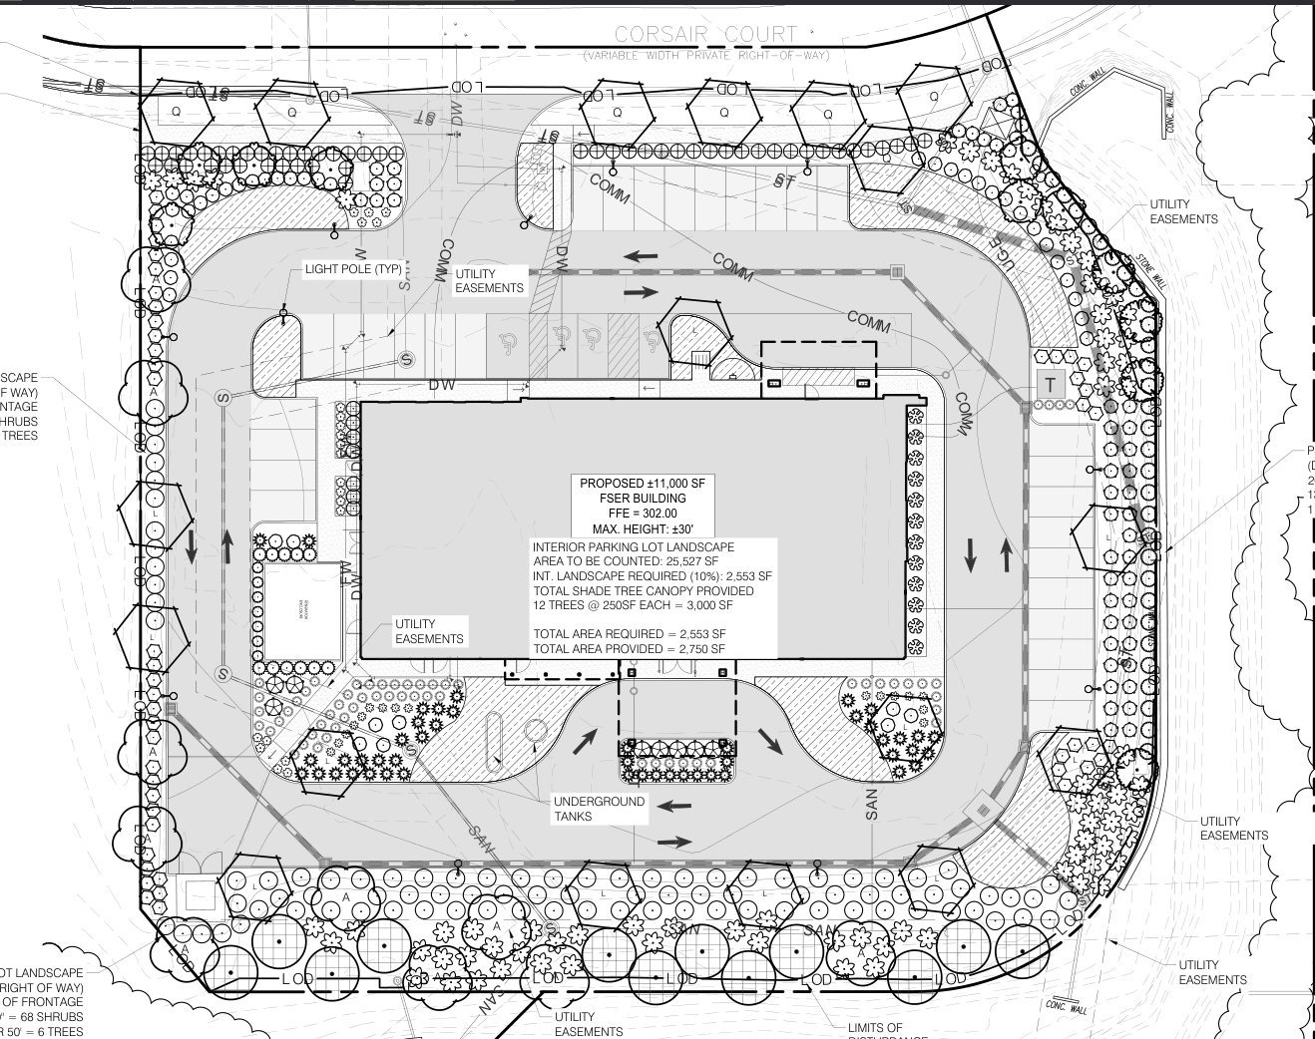
Landscaping

Slide 11
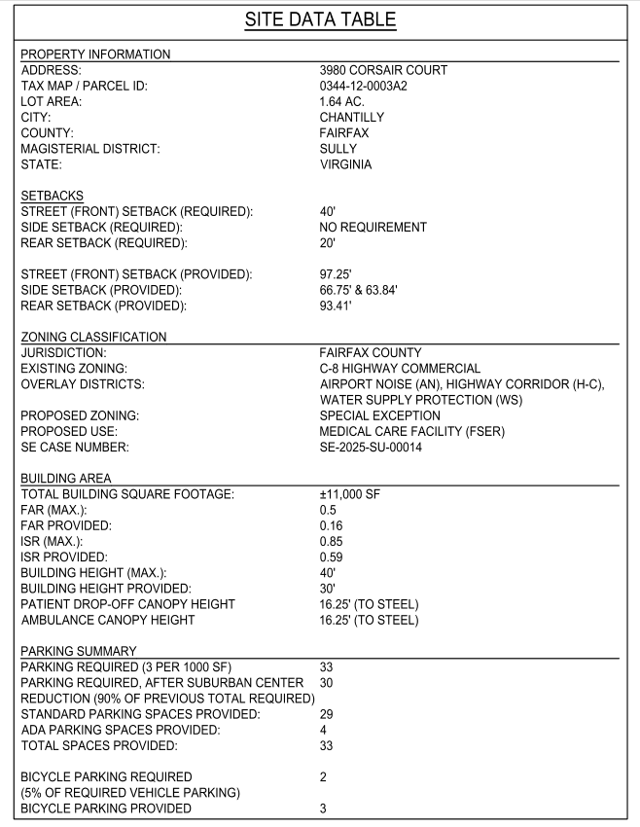
Details

Slide 12
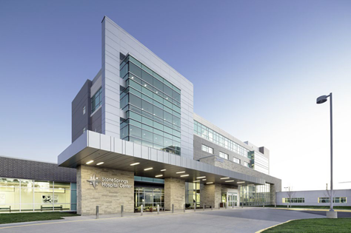
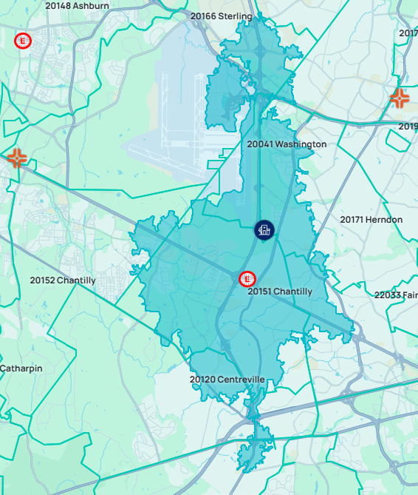
StoneSprings Hospital Center
Opened 2015 – First New Hospital in Loudoun in 100 Years
124 Licensed Beds
400+ Employees
3,200 Admissions; 20,000+ Outpatient visits
Emergency Department – 20,000+ Visits
Behavioral Health – 17-Bed Inpatient Unit
Women’s and Children’s Services – 1,300+ Deliveries
Surgical Services – 3,700+ Surgeries
Stone Springs Hospital
Reston
Hospital

