Slide 1

Skyview High School 2232-2025-SU-00010
Sully District Land Use and Transportation Committee
March 16, 2026

Slide 2
Overview
Convert existing 355,000 square foot private school located at 2950 Education Drive (32.7 acres) to a public use
Open the public high school (main building only) for the 2026-2027 school year for 9th and 10th graders (with 9th – 12th graders expected by 2028/2029 school year)
Expected to offer a full spectrum of academics, electives, athletics, and activities
Possible special programming pathways, such as aerospace, robotics and engineering, and artificial intelligence
Anticipates a maximum enrollment of approximately 2,000 students (9th – 12th grade)
Needed to alleviate capacity concerns primarily for the Centreville, Chantilly, and Westfield High School pyramids
Exact boundaries will be determined prior to 2026-2027 school year

Slide 3
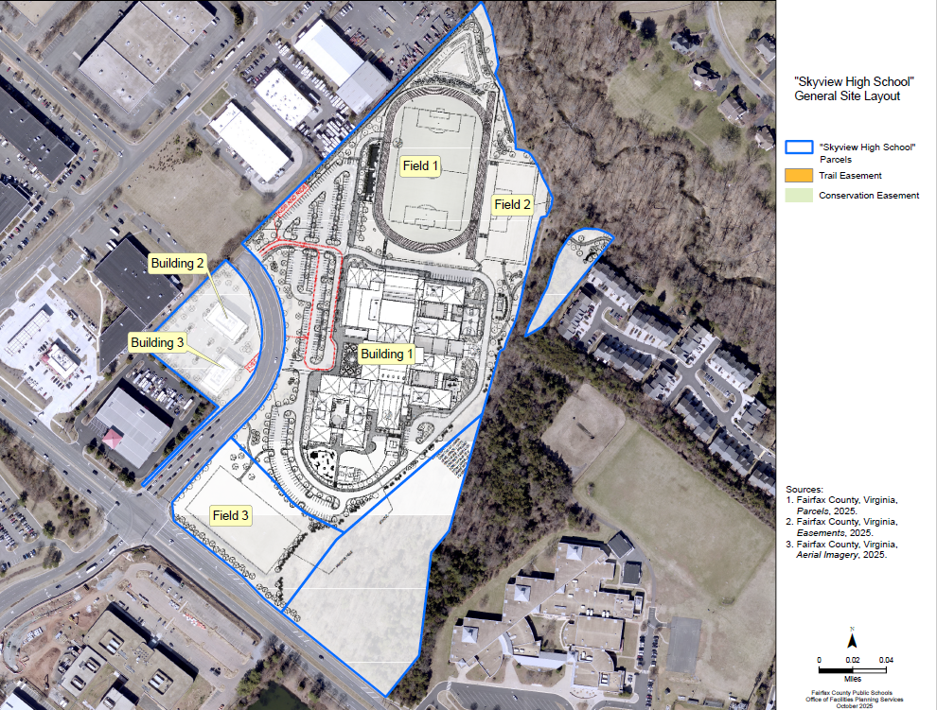
General Site Layout

Slide 4
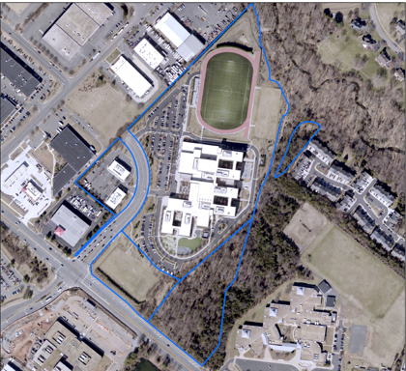
Aerial View

Slide 5
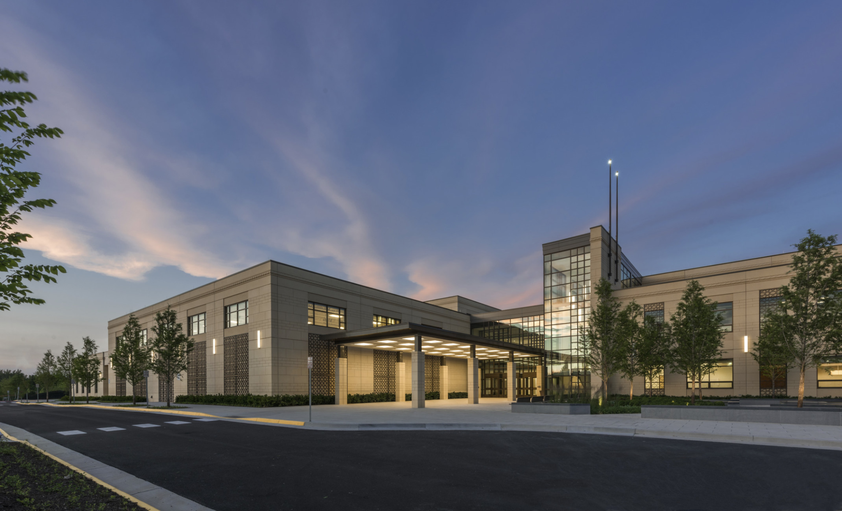
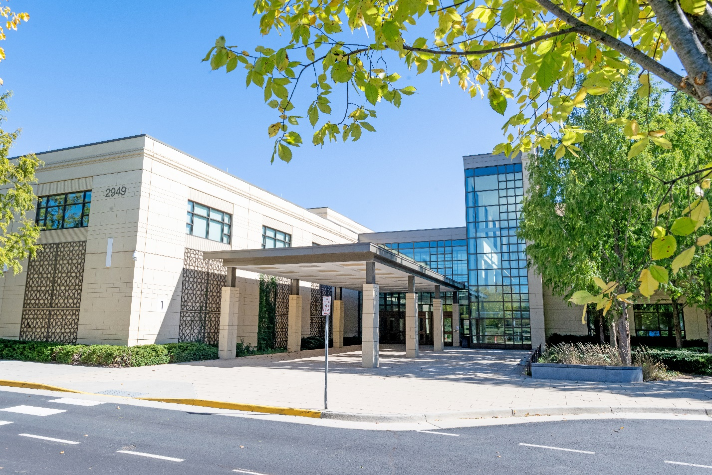
Exterior Views

Slide 6
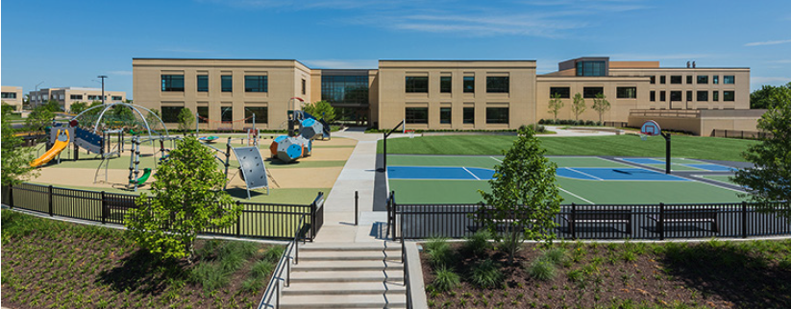
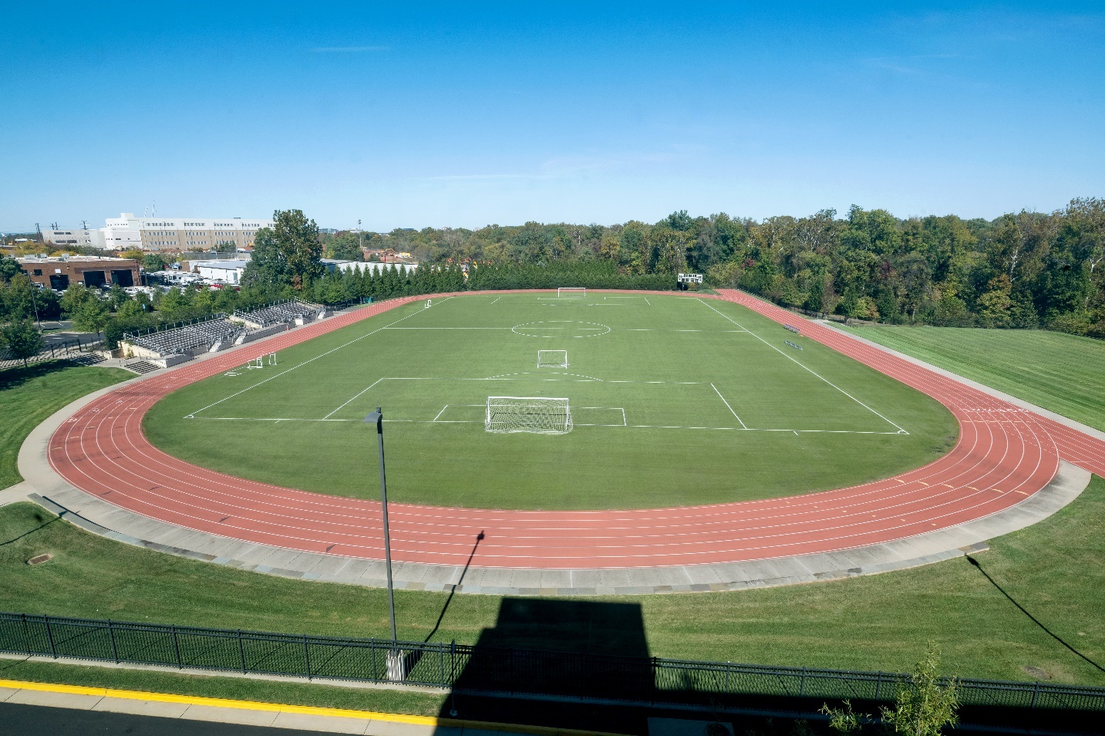
Exterior Views

Slide 7
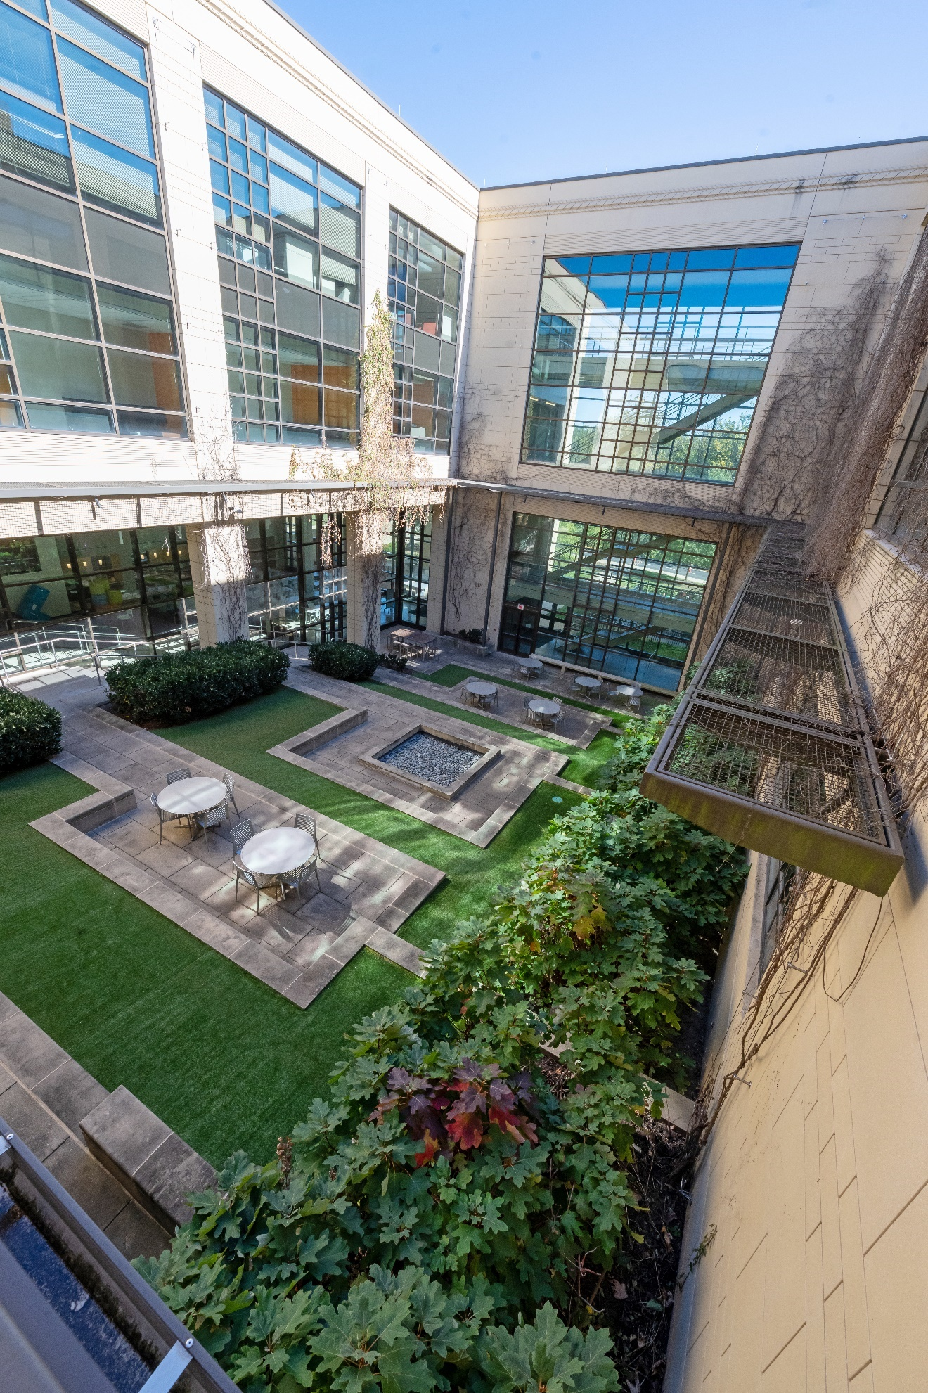
Exterior Views

Slide 8
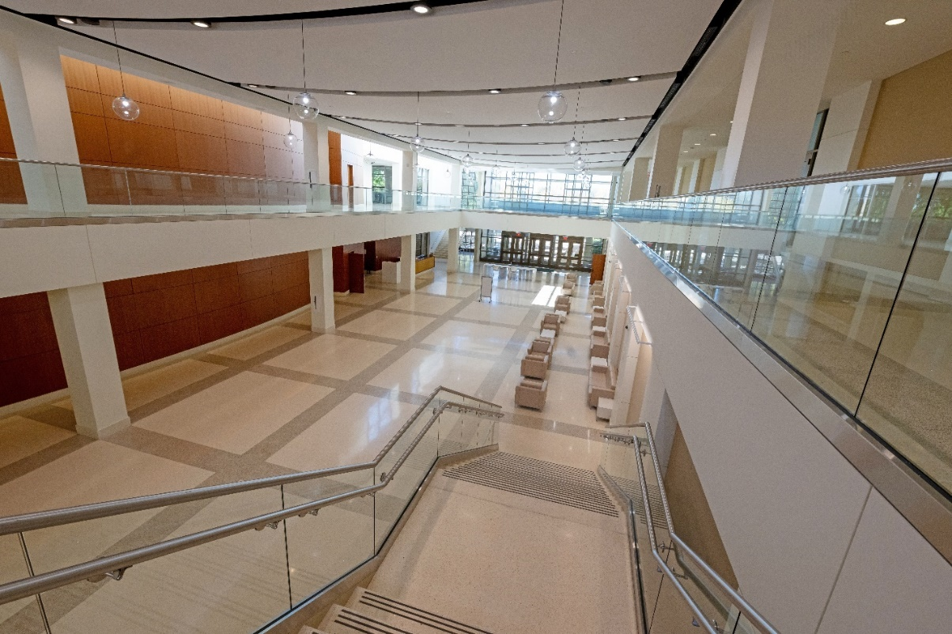
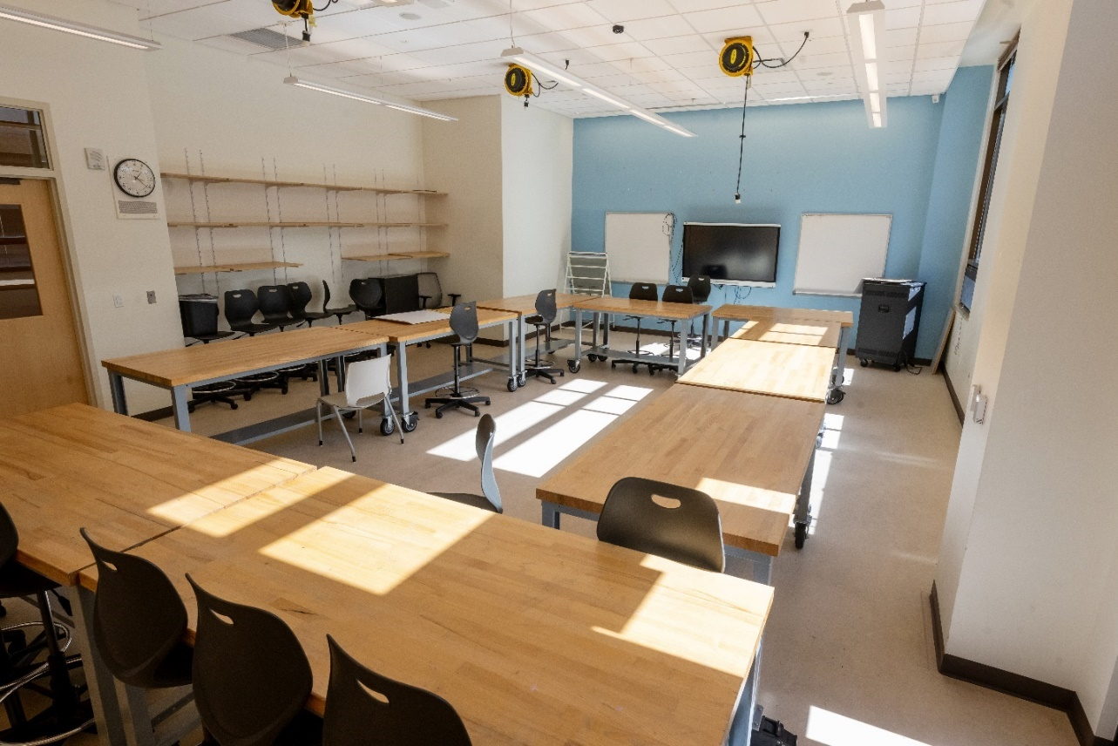
Interior Views

Slide 9
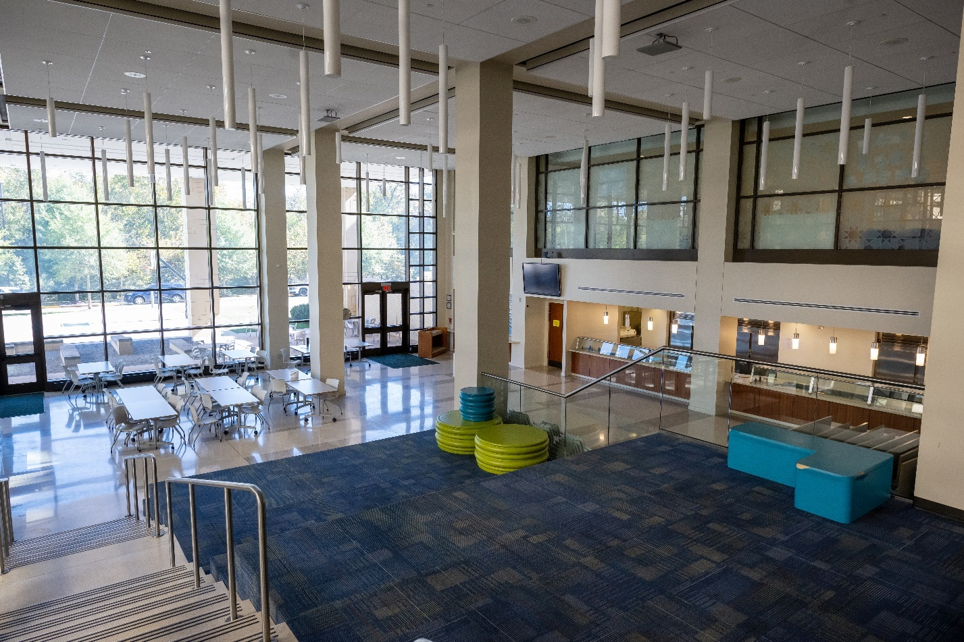
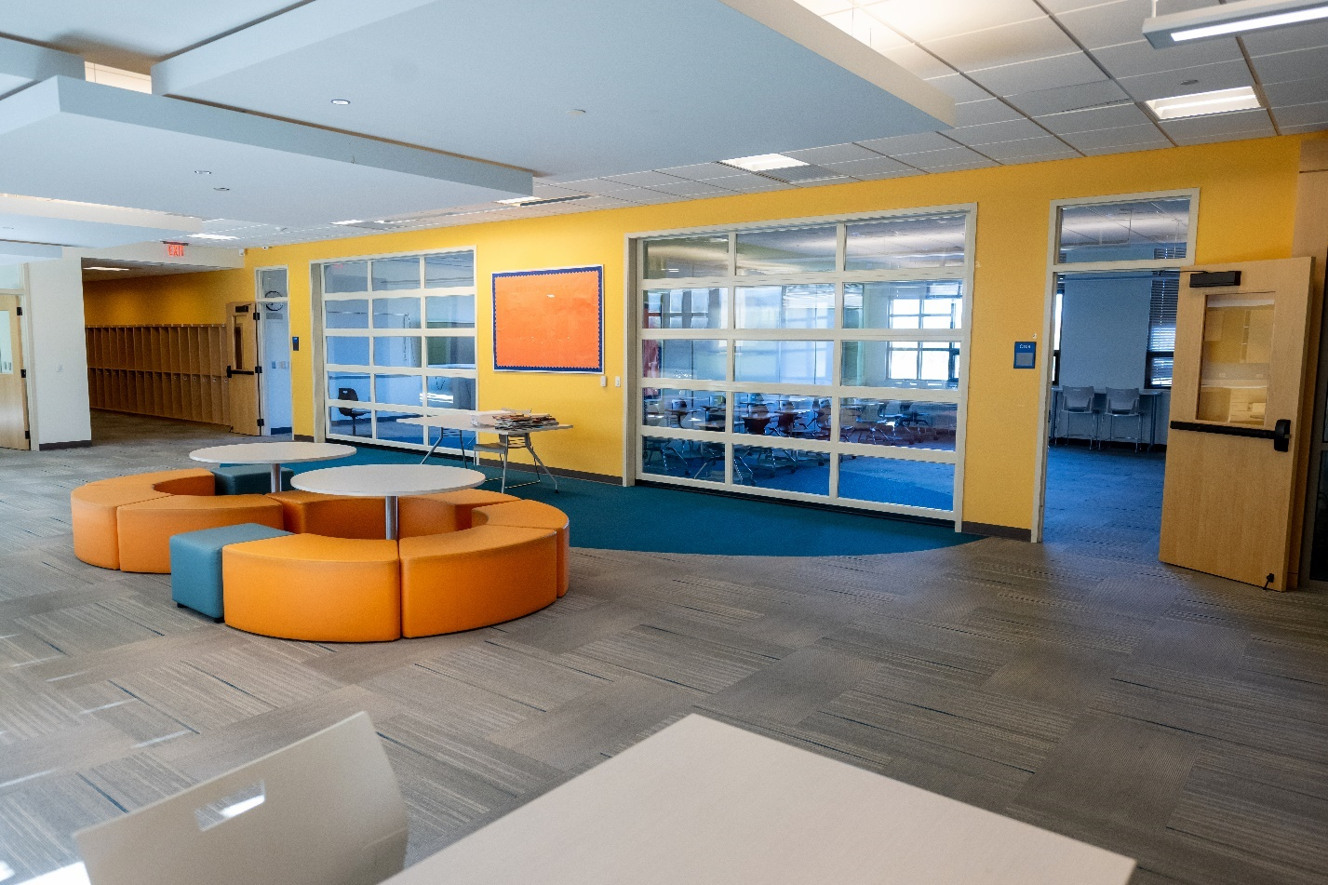
Interior Views

Slide 10
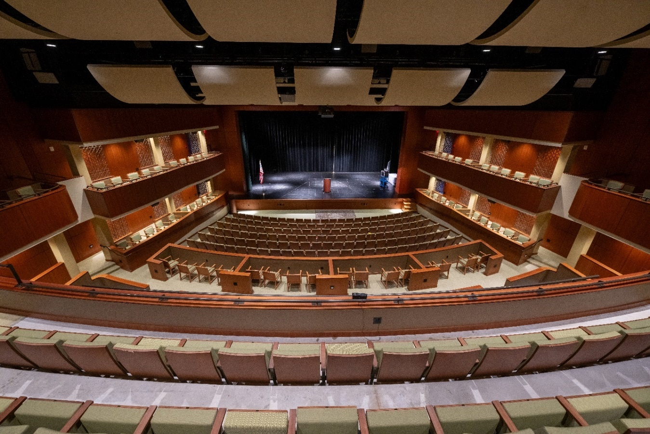
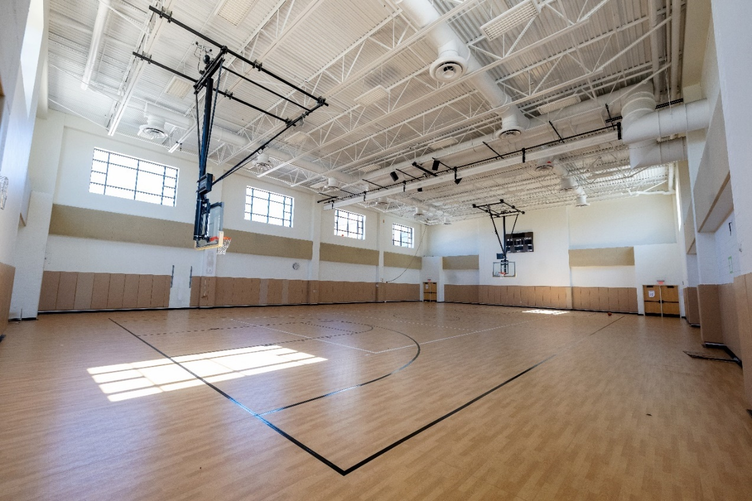
Interior Views

Slide 11
Benefits
Includes three gymnasiums, an indoor heated eight-lane swimming pool, two athletic fields, a turf field with a track, a weight room, a 650-seat auditorium, science laboratories, robotics and ceramics laboratories, multiple cafeteria and dining facilities, and a 4,500 square foot multi-purpose room
Best location for a new high school due to its location and substantial cost savings compared to purchasing land and building a new school
Availability of vacant land suitable for a high school in the western part of the County is sparse
Location of the high school is situated to alleviate over enrollment at high schools located in the western part of the County

