Slide 1

Skyview High School
2232-2025-SU-00010
Sully District Land Use and Transportation Committee
April 20, 2026

Slide 2
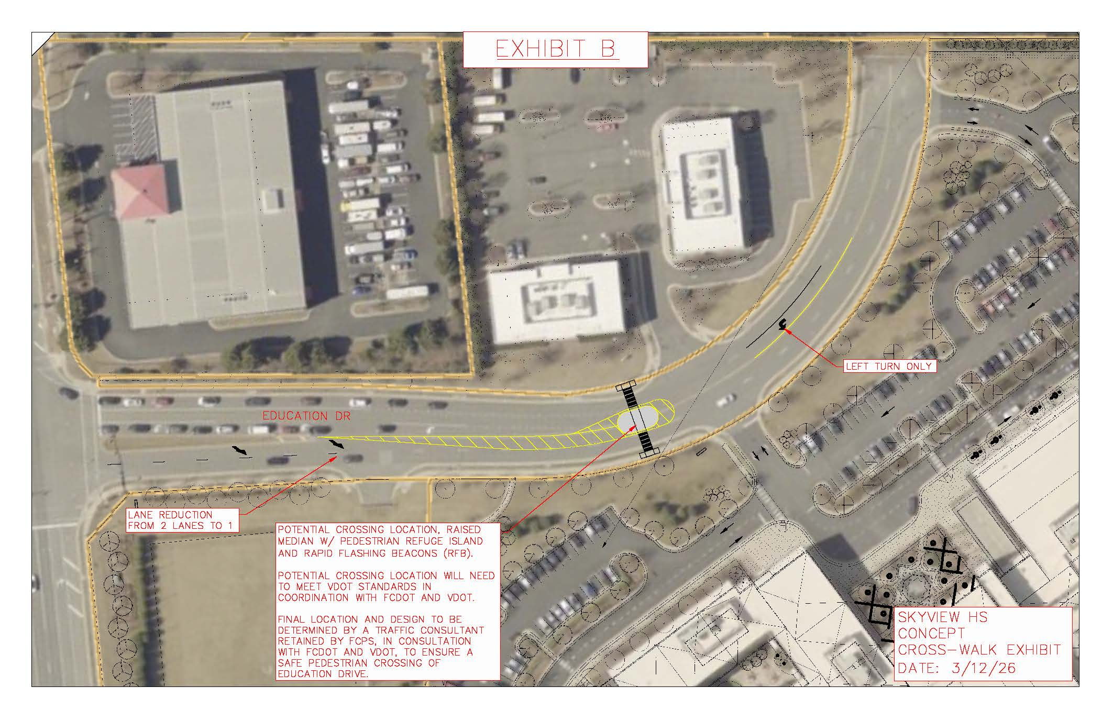
Crosswalk Design

Slide 3
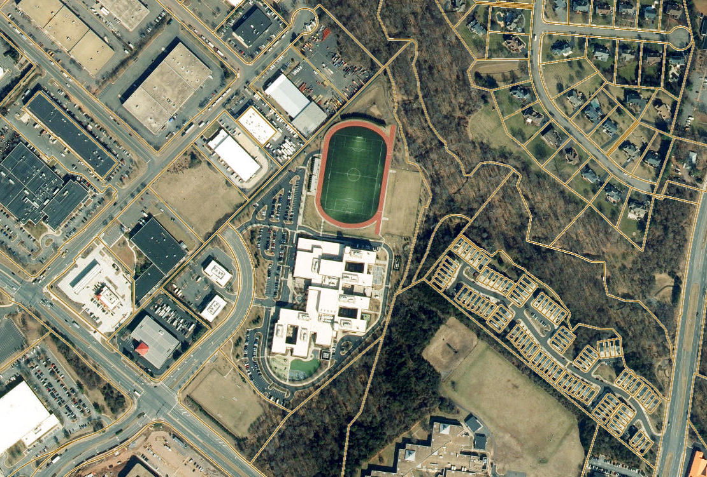

Road Connection

Slide 4
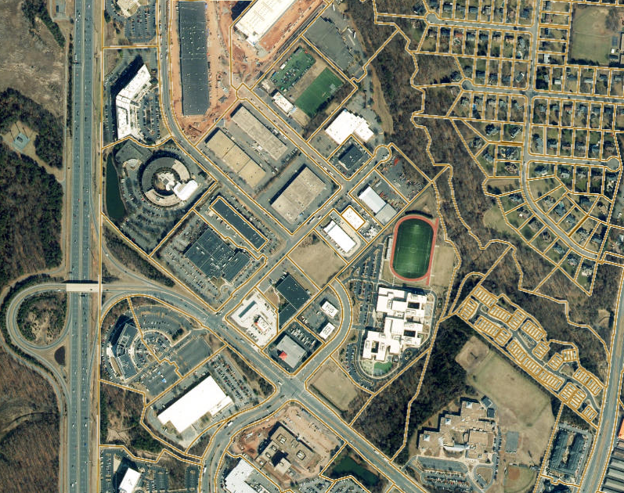
Current Use of Adjacent Parcels
2881 Towerview Road
  United Rentals
2869 Towerview Road
(Meridian Center)
  Gourmand (restaurant/eatery)
  Oceanflight Inc. (shipping/transportation broker)
  United States Police Canine Association
2875 Towerview Road
  Ace RV Service & Repair
  Ace RV Rentals
  RV Buddy Share
  Move & Shift LLC

