Slide 1
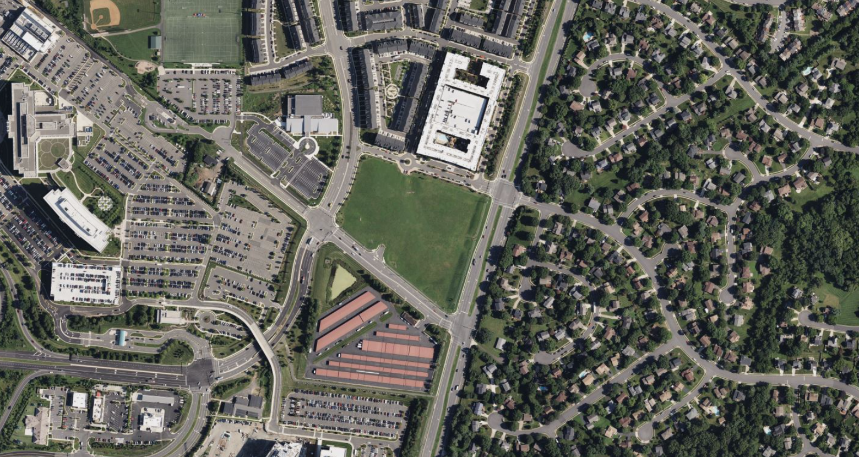
Discovery Square
Sully District Land Use and
Transportation Committee
July 20, 2026

Slide 2
Endeavour Drive
Yeager Drive
Atlantis Street
Site
Kinross Circle
Centreville Road
Wall Road
Air and Space Museum Parkway
Aerial View

Slide 3
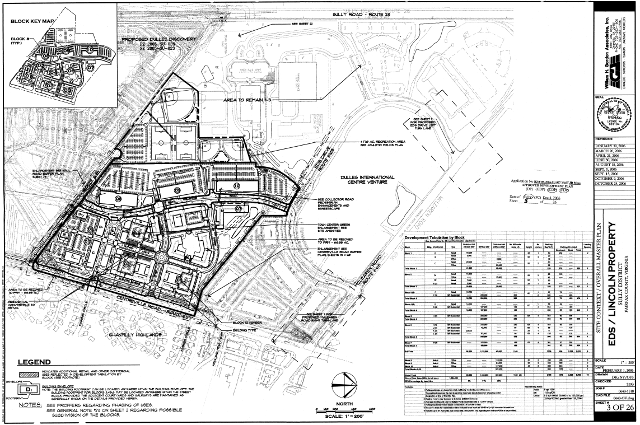
Site Area: 66.88 acres
Zoning District: PRM
Approved:
Residential: 1,159 MF
Office: 640,600 GFA
Retail: 107,350 GFA
RZ 2006-SU-007 Approval

Slide 4
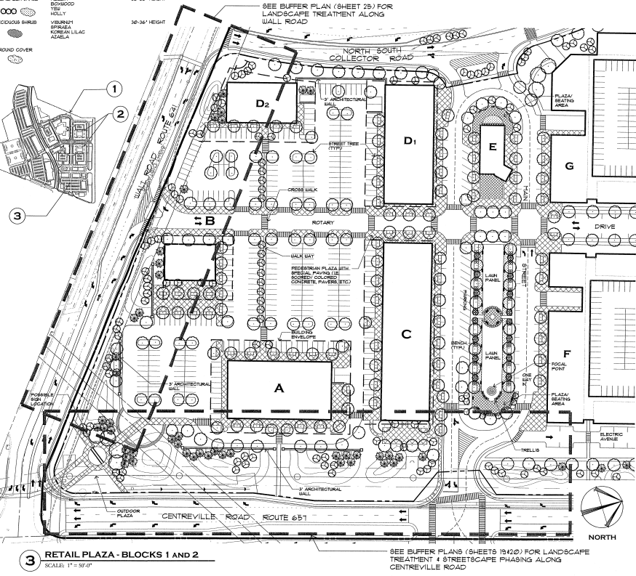
Site Area: ~8 acres
Zoning District: PRM
Approved:
Retail: 67,600 GFA
Office: 40,600 GFA
Total: 108,200 GFA
Surface Parking: 335
Block 1 & 2 Approval

Slide 5
On April 11, 2023, the Board of Supervisors authorized consideration of a Plan amendment for Tax Map Parcel 24-4 ((1)) 6C1 to allow 29,000 square feet of retail, 50 townhomes, and 4 live/work units.
On February 4, 2025, the Board of Supervisors updated the Plan Amendment authorization to evaluate multifamily housing and retail uses up to 0.8 FAR.
Staff comments issued in 2025:
  Retail uses should be integrated into the development proposal, fostering a well-connected community with services and amenities.
  Multifamily residential with structured parking will allow for additional open space.
  Align the park network with Atlantis Street.
  Pedestrian and bike facilities should be improved.
  Pedestrian crossings at intersections should be upgraded.
Comprehensive Plan Amendment

Slide 6
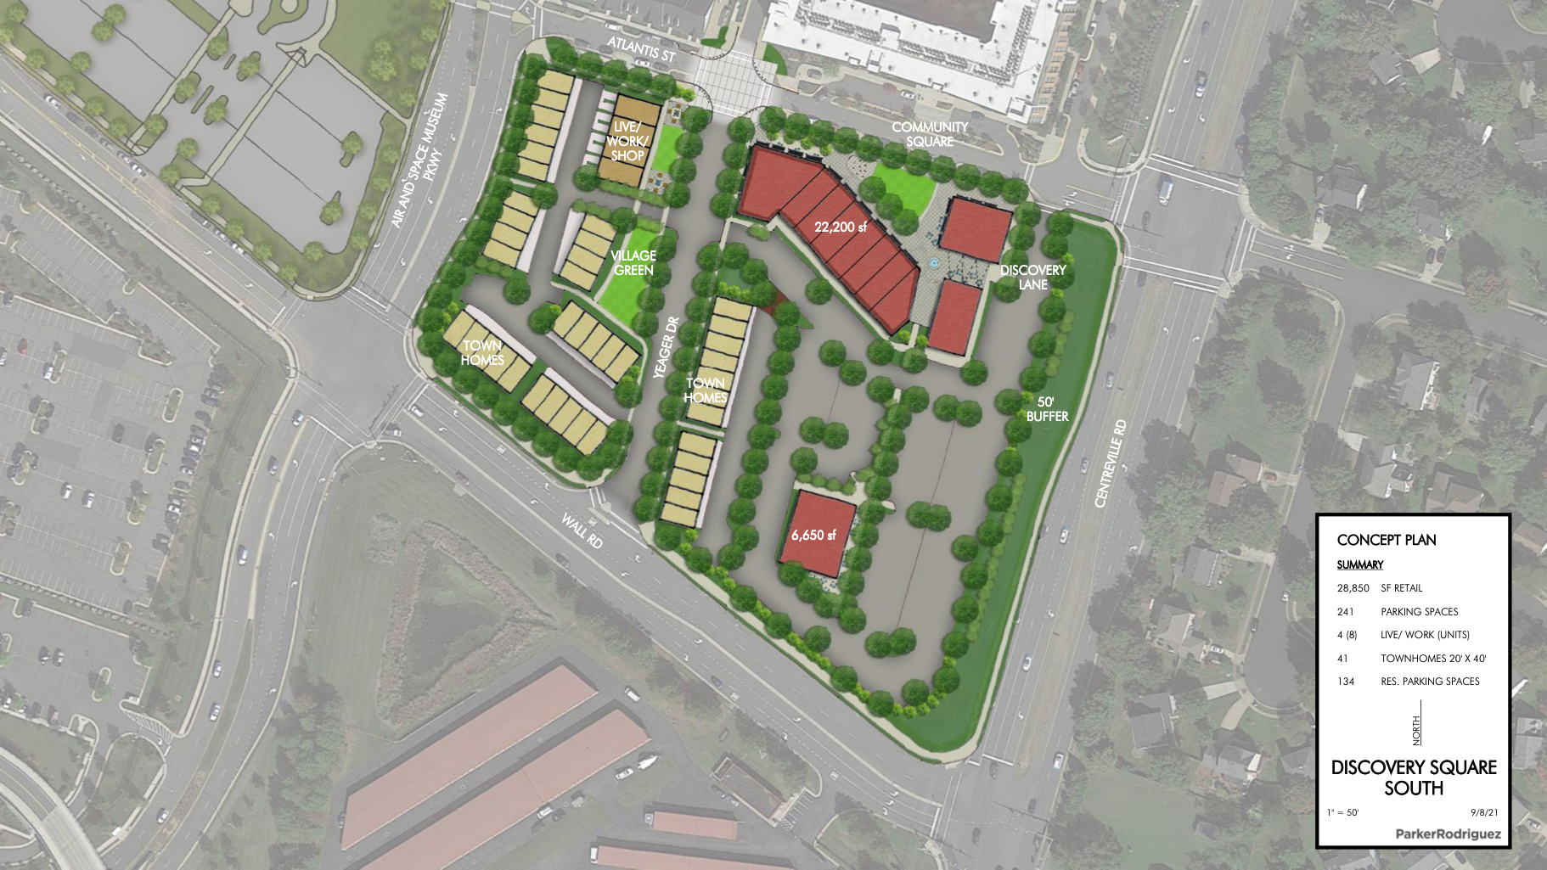
Initial Plan – 2021

Slide 7
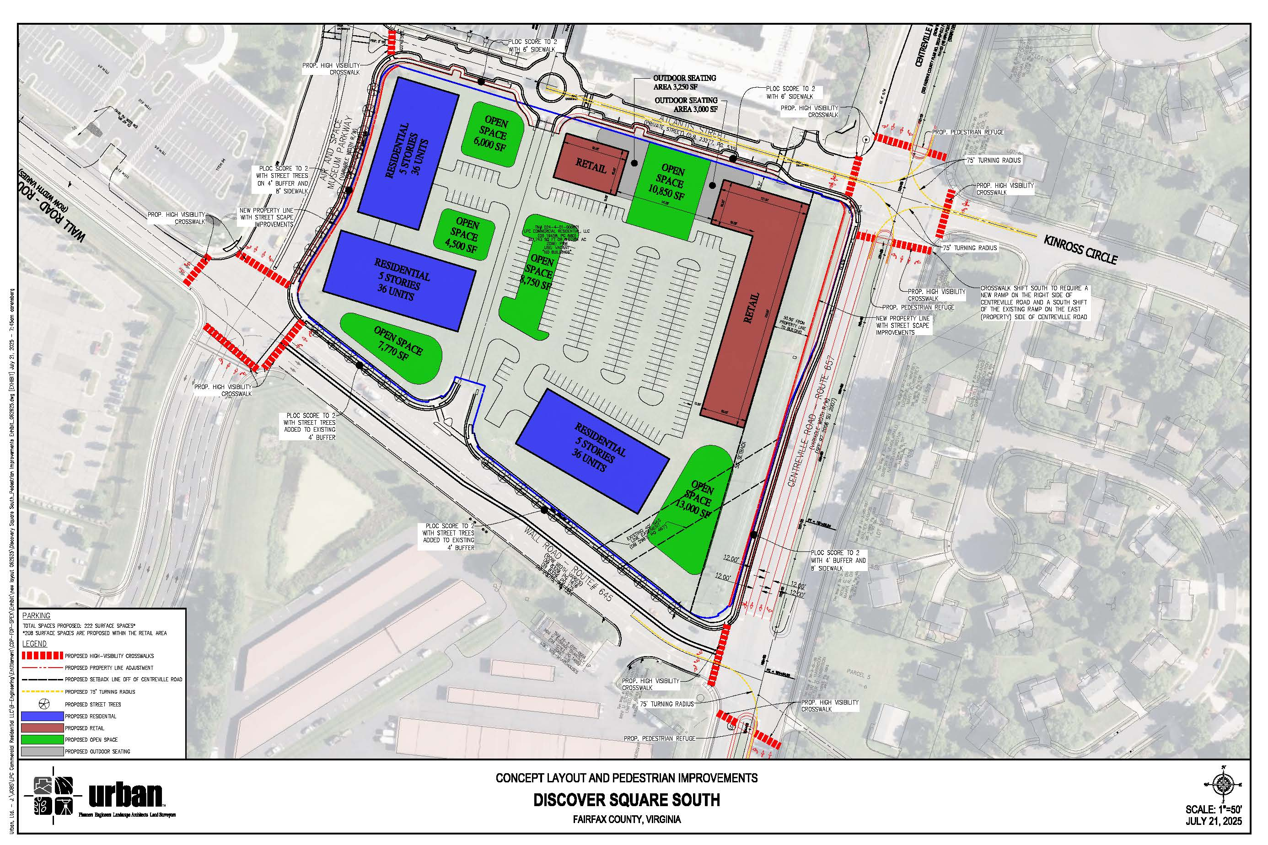
Previous Plan – 2025

Slide 8
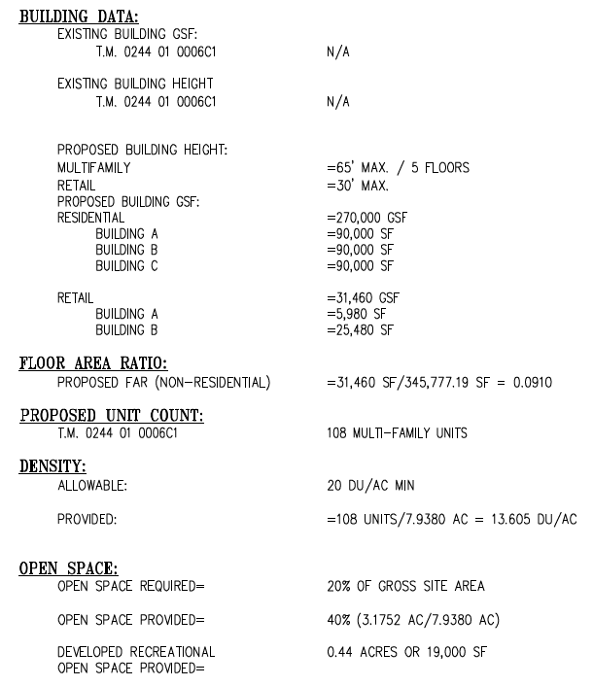
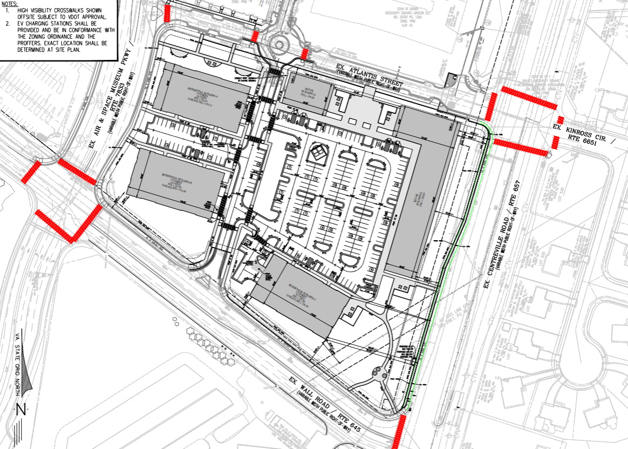
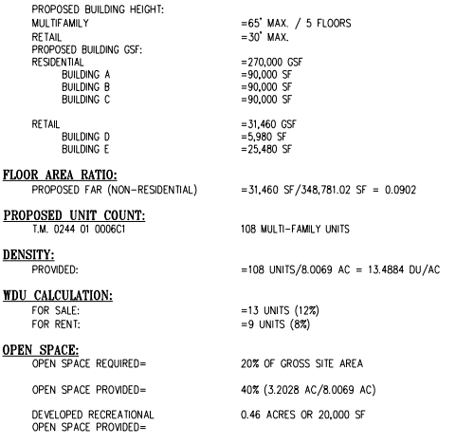
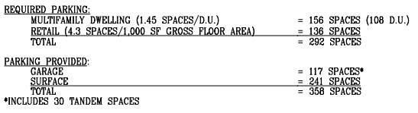
Building A
Building D
Building E
Building B
Building C
Development Proposal

Slide 9
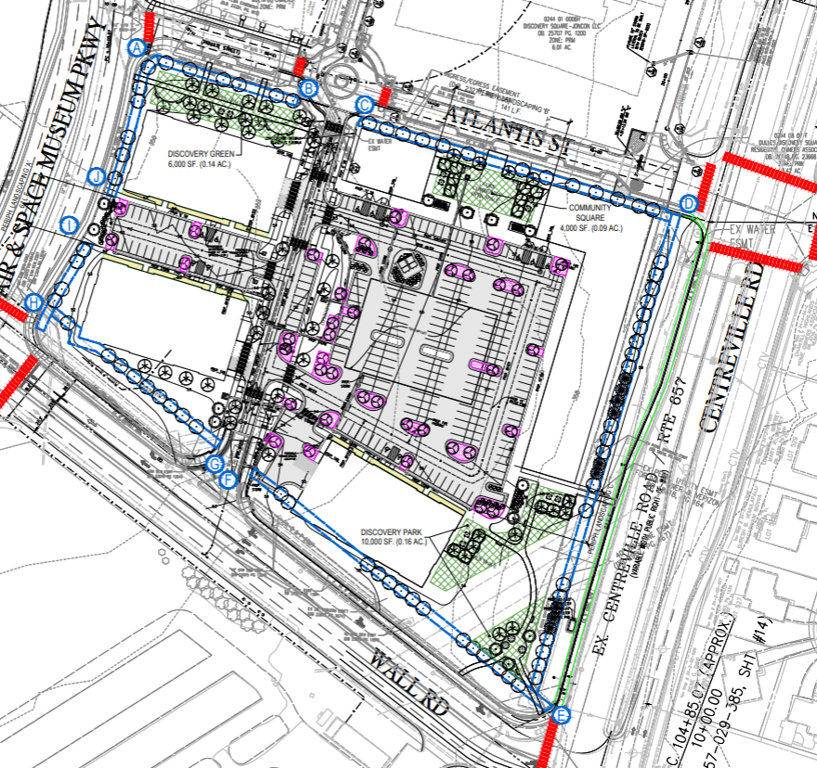

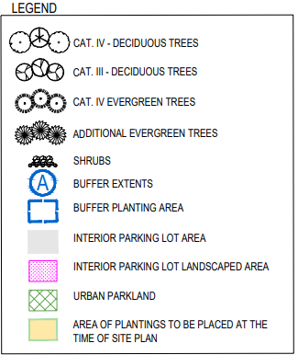
Building A
Building D
Building E
Building B
Building C
Open Space & Parks

Slide 10
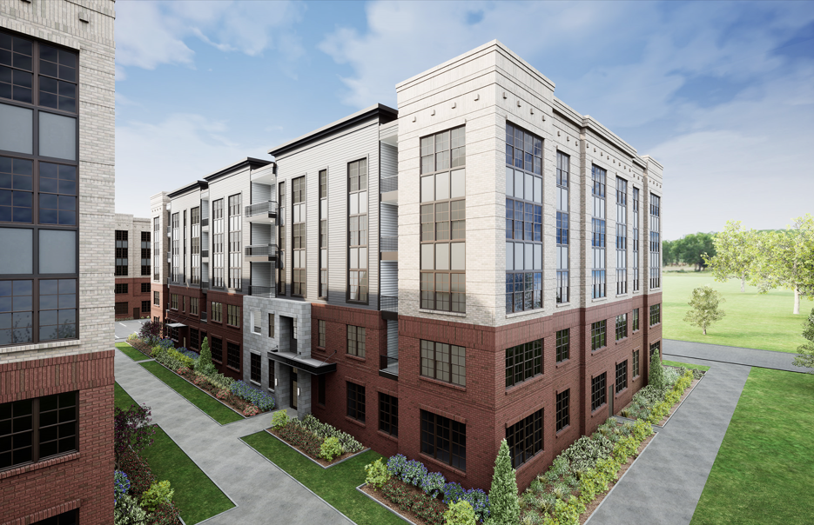
Residential – Illustrative

Slide 11
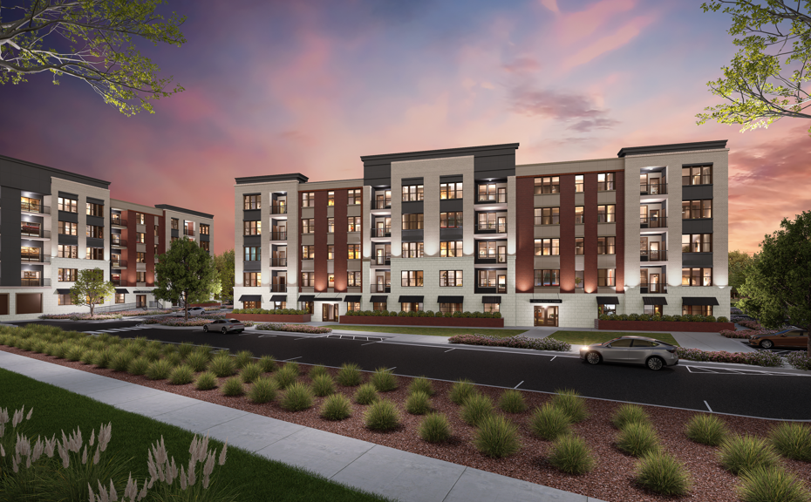
Residential – Illustrative

Slide 12
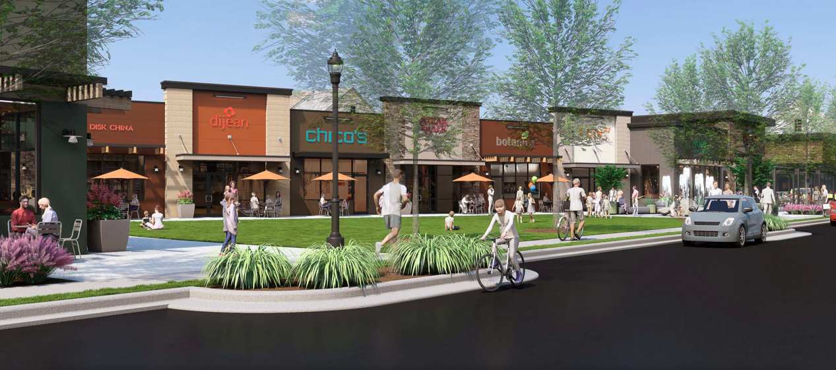
Retail – Illustrative

Slide 13
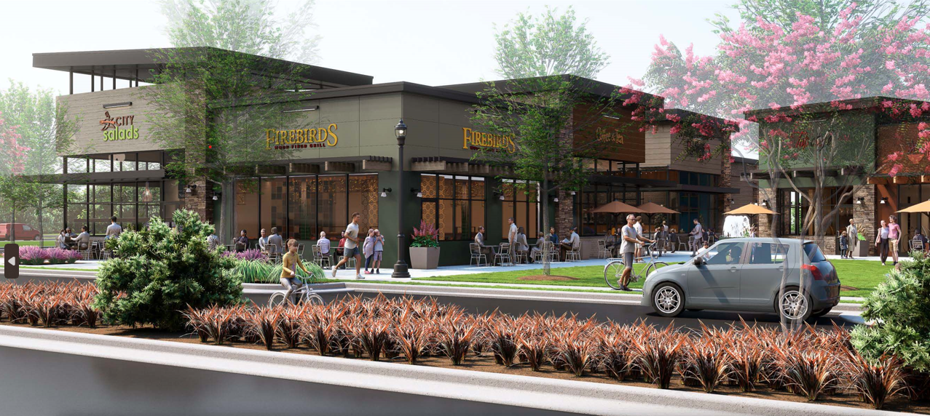
Retail – Illustrative

Slide 14
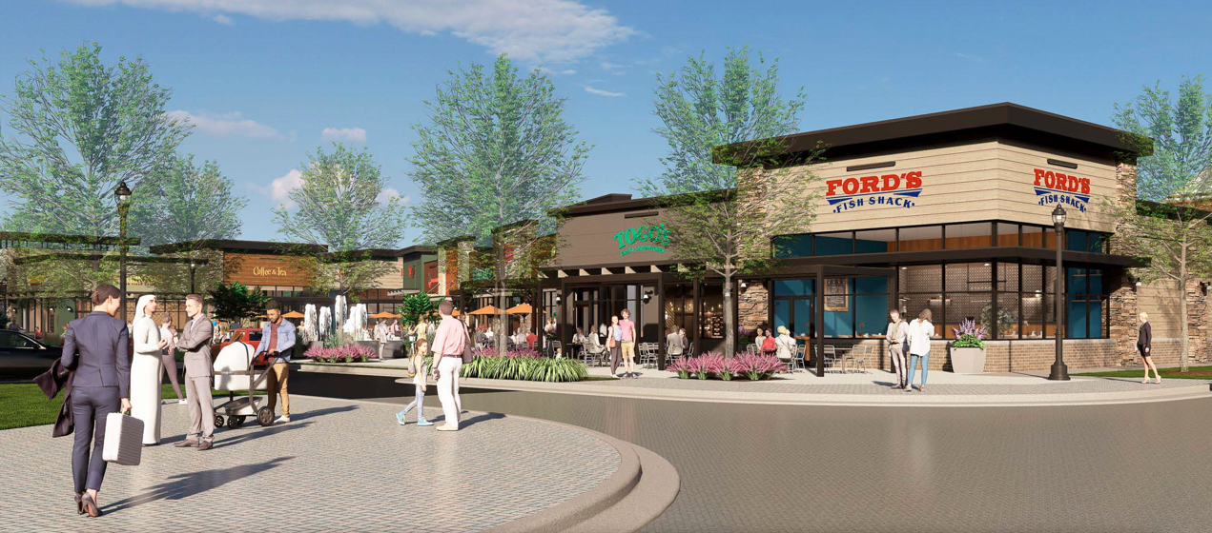
Retail – Illustrative

Slide 15
Plan Amendment SSPA 2023-III-4UP
Planning Commission: September 9, 2026
Board of Supervisors: October 13, 2026 at 4:00 PM
Staff Coordinator: Samantha Archibald
PCA 2006-SU-007-03, CDPA 2006-SU-007, and FDPA 2006-SU-007-05 (RZPA-2023-SU-00093)
Planning Commission: November 4, 2026
Board of Supervisors: December 8, 2026
Staff Coordinator: Ciarra Downing
Public Hearings

