Slide 1
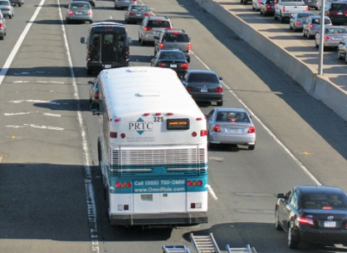
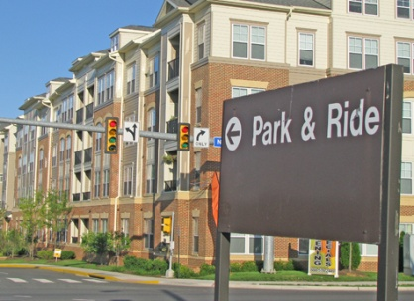
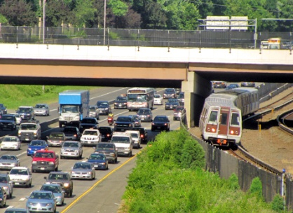
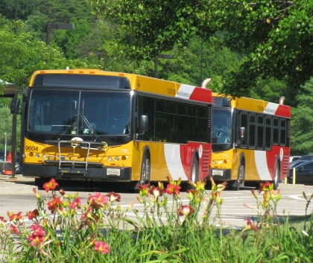
Countywide Transit Network Study objectives:
Establish a connected rapid transit system to meet demands through the year 2050
Define transit corridor functions, station locations, modes and rights-of-way to guide subsequent comprehensive plan amendments and development review processes that protect needed right-of-way for ultimate transit network
Coordinate with other regional, state, and local jurisdictional plans
Identify policies, programs, and actions to support phased implementation and expedite delivery of priority elements in the near term
1

Slide 2
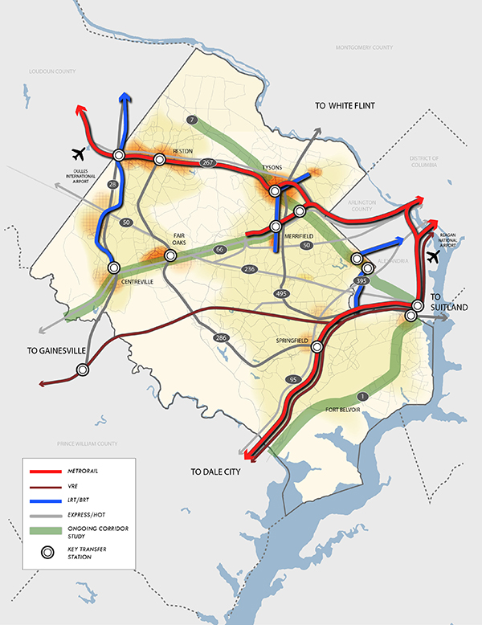
Proposed Transit Network Concept
The Proposed High Quality Transit
Network Concept builds upon the
existing and Constrained Long
Range Plan (CLRP) transit
investments to create an
interconnected network of
commuter and destination corridors,
supported by connecting express bus routes.
Quality Transit Network Concept
builds upon the existing and
Constrained Long Range Plan (CLRP)
transit investments to create an
Interconnected network of
commuter and destination corridors,
supported by connecting
express bus routes.

Slide 3
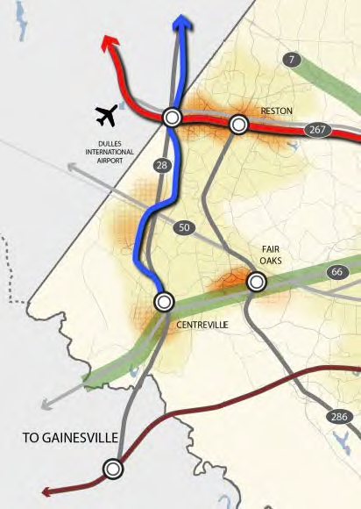
Route 28 Corridor

