Slide 1
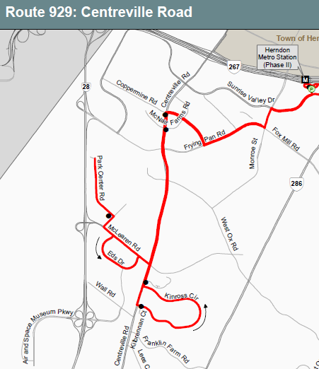
January 2015 Service Change Route 929 – Centreville Rd
Buses will serve Park Center Drive and Towerview Road via McLearen Road

Slide 2
Fairfax Connector
FY 2016 proposed service changes (subject to funding availability)
Implement new 624 (Fair Lakes) and 634 (Stringfellow – Vienna)
Implement off-peak and weekend service on existing 621, 630, 640, and 650

Slide 3
Fairfax Connector Route 624 – Fair Lakes

Slide 4
Fairfax Connector Route 634 – Vienna

Slide 5
Comprehensive Transit Plan
10-year bus plan
Will update the 2009 Transit Development Plan
Development of service planning recommendations is under way
Recommendations will be presented to public in spring 2015 (currently scheduled for April – May)

