Slide 1
Sully Station HOA Annual Meeting
February 11, 2015
Jim Neighbors
jimneighbors@verizon.net

Slide 2
Organizations and Meetings
Western Fairfax County Citizens Association (WFCCA)
Third Tuesday of the month
7:00 PM
Sully Government Center
Sully District Council (SDC)
http://www.sullydistrict.org
Fourth Wednesday of the month
7:00 PM
Sully Government Center
VDOT Projects (Northern Virginia)
http://www.virginiadot.org/projects/northern%20virginia/default.asp
Everyone is welcome

Slide 3
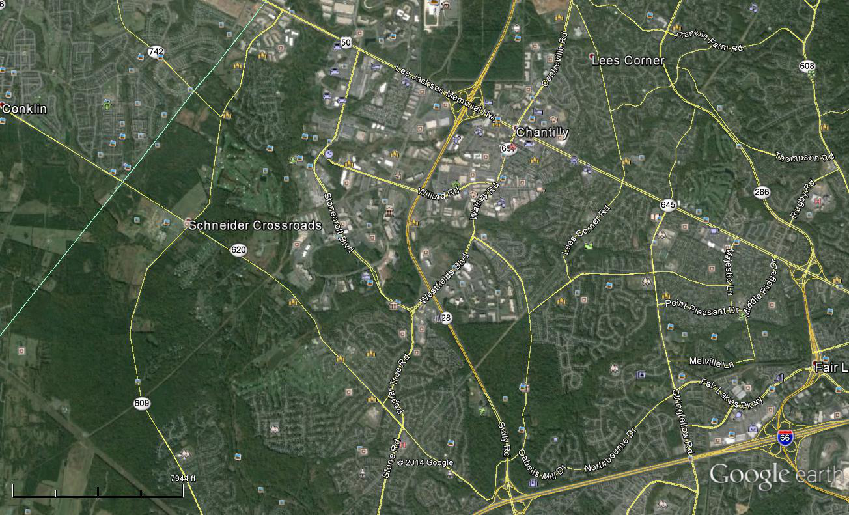
RT-50 Widening
6 Lanes/Bike Path:
Nov 2015 Completion
Transportation
Lee Road Bridge: Jun 2014 – May 15
Walney Road Bridge
4 Lanes/Bike Path:
Dec 14 – Sept 15
Pleasant Forest Project: Bike Path
July 2016
Street Repaving: Multiple Streets in Sully Station
I-66/Braddock Road/RT-28: Design is underway
PV Road/Braddock Road Roundabout:
Early 2015 – Spring 2016
I-66 ATM:
Early 2015

Slide 4
Land-Use
New Honda Dealership
New Office Building Construction
Proposed Wegmans (Unknown Date)
Aerospace Corp Phase I Completion; Phase II TBD
The Proposed Preserve of Westfields

Slide 5
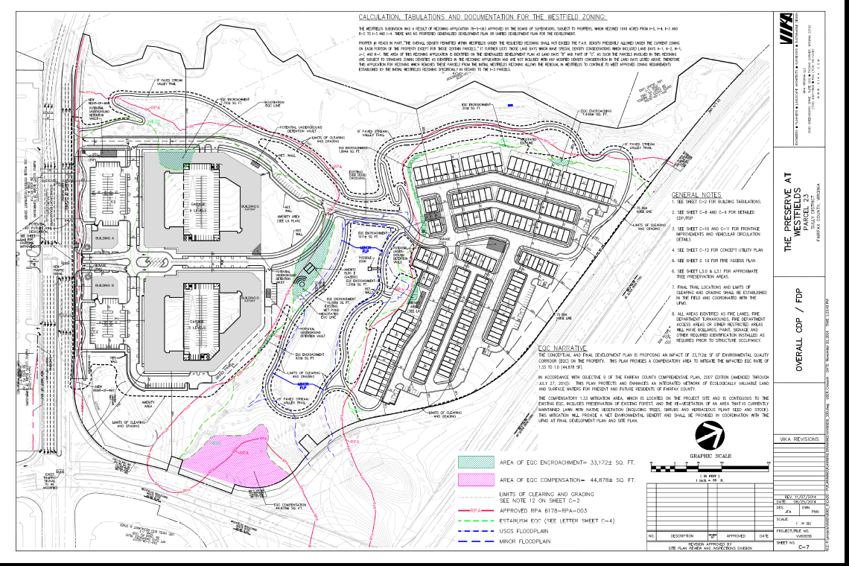

Slide 6
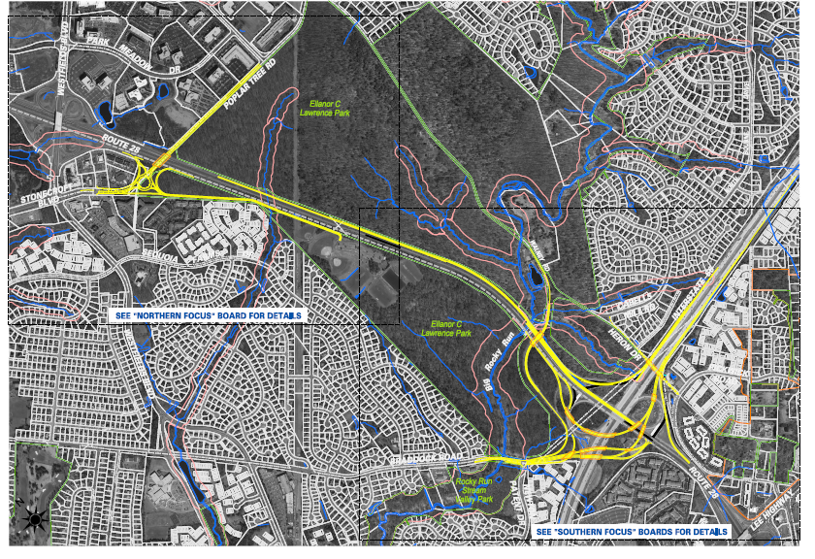
I-66/RT-28/Braddock Road
Concept Phase

