Slide 1
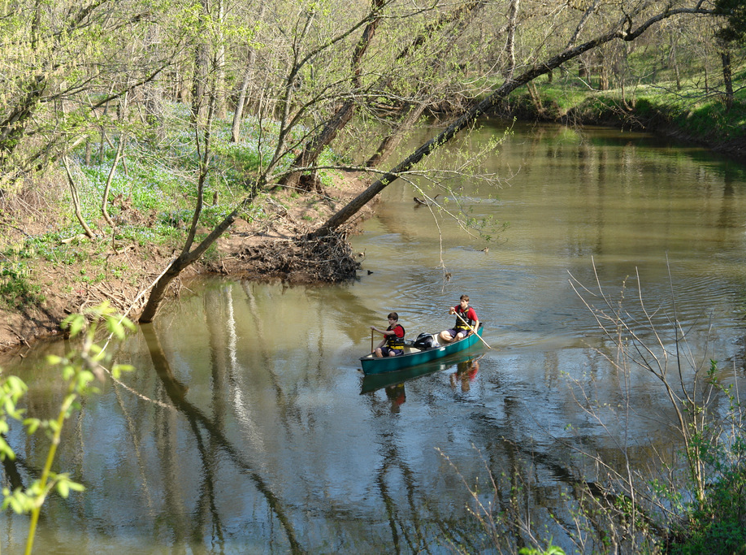
Agenda
Opening Remarks
FCPA
Sully District Parks
Recent improvements
Planned
Impacts
Poplar Ford Park

Slide 2
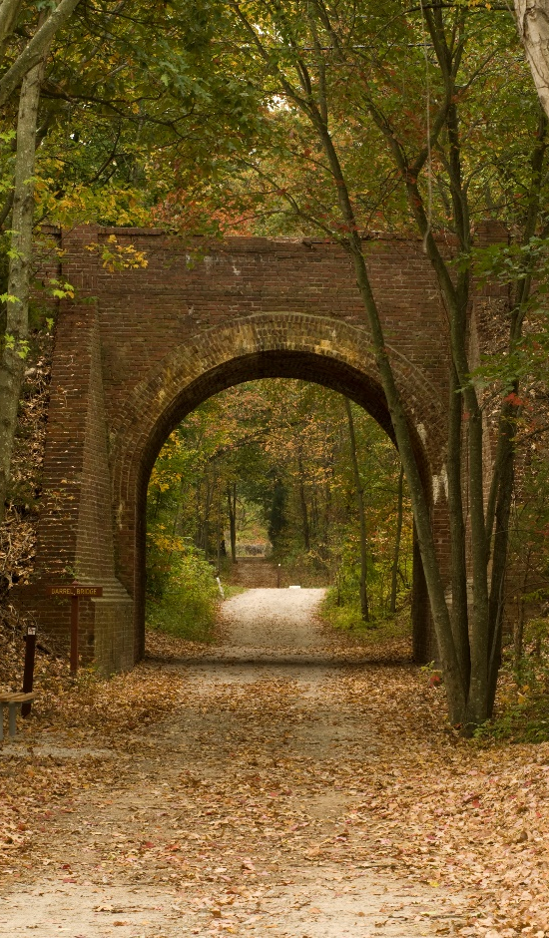
PARKS BY THE NUMBERS
425 Parks
23,310 Acres
374 structures with more than
1,383,992 million square feet of building space
$383,730,645
value of FCPA capital buildings and improvement assets
$385,931,602
value of FCPA land, easements and construction in progress

Slide 3
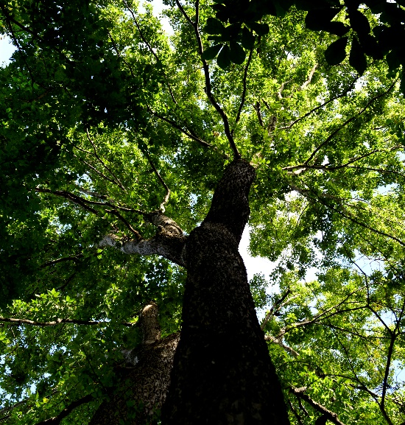
PARKS BY THE NUMBERS
80% of County residents use parks;
16.7 million Park visitors each year
Typical County households participate in an average of 5 park activities
Nearly 90% of all residents live within ½ mile of a park
Growing evidence of links between good health and active lifestyle
County tree canopy goals and environmental services are largely achieved on parkland

Slide 4
funding pie chart

Slide 5
General fund reductions since FY2008
26%

Slide 6
AGE OF PARK STRUCTURES
58% OF 374 PARK STRUCTURES ARE > 30 YEARS OLD
80% OF THOSE STRUCTURES ARE HISTORIC STRUCTURES
SULLY HISTORIC SITE STRUCTURES DATE BETWEEN 1794 - 1801
Notes:
As of FY 2014:
More than half of the 374 park structures are more than 40 years old
29% of FCPA structures are over 50 years old
20% of FCPA non historic structures over 50 year old
80% are Historic structures (over 50 years old with cultural significance)
25% of FCPA structures are at or less than 10 years old
21% of FCPA structures are over 30 years old
7% of FCPA structures are over 40 years old
7% of FCPA structures are over 10 years old
5% of FCPA structures are over 15 years old
6% of FCPA structures are over 20 years old

Slide 7
Allocation of park Bonds 2004-2012
2004 Park Bond $65.0 M
2006 Park Bond $25.0 M
2008 Park Bond & Premium $75.6 M
2012 Park Bond $63.0 M
2012 Park Bond
$63 Million
A broad range of park bond projects address a broad range of needs
Yet unable to meet need based on funding

Slide 8
deferred and planned lifecycle need by facility type
Facilities Beyond/At Life Expectancy Costs through FY 2020
Building Renovations | $27M
Playgrounds | $18M
Trails | $14M
Road & Parking Lots | $13M
Athletic Fields, Synthetic | $11M
Lighting & Irrigation Systems | $11M
Athletic Courts | $7M
Roofs | $4M
HVAC | $3M
Fire and Security | $1M
Golf Renovation | $1M
Total (excluding 8 RECenters) | $109M
Notes:
Needs are across the board

Slide 9
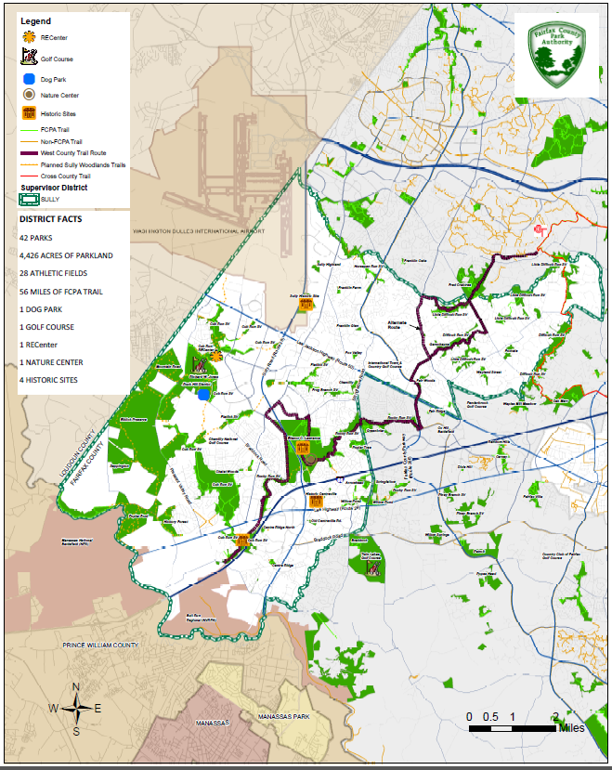
Sully District Parks and facilities
42 Parks
Over 5,000 Acres of Parkland
28 Athletic Fields
56 Miles of Multi-use Trails
1 Dog Park- Rock Hill
1 Golf Course- Pleasant Valley
1 RECenter- Cub Run
1 Nature Center- Walney at ECL
4 Historic Sites

Slide 10
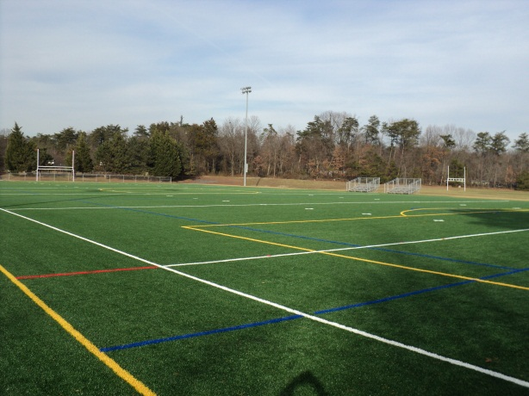
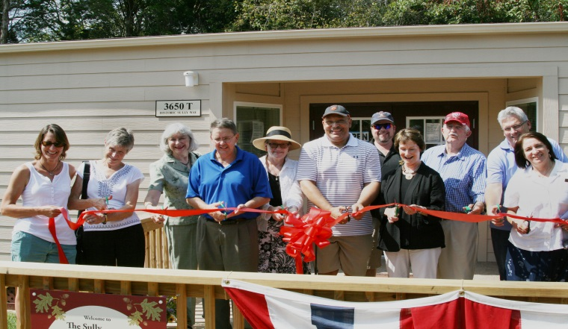
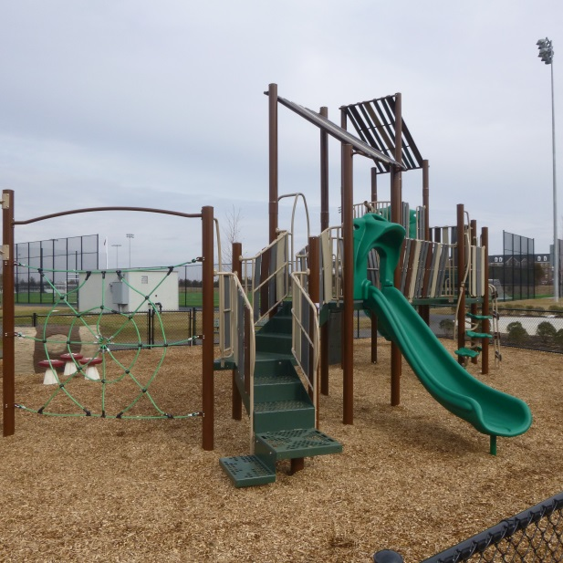
Recent sully park improvements

Slide 11
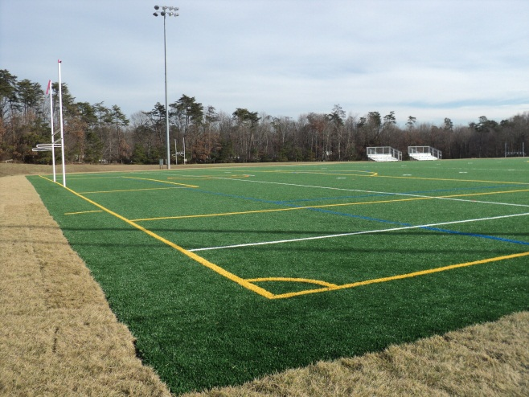
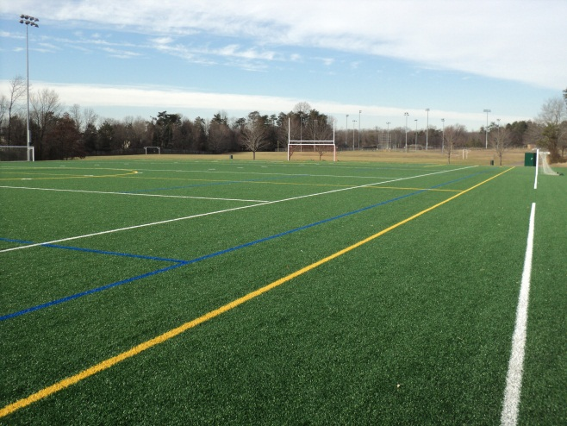
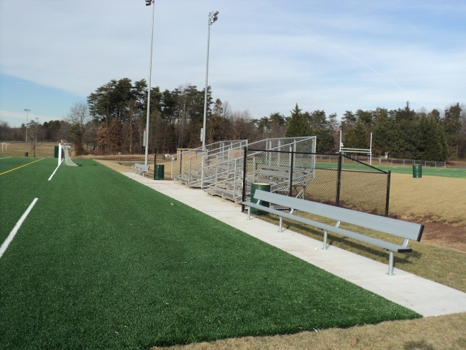
ELANOR C. LAWRENCE PARK – PROJECT COMPLETION REPORT
SYNTHETIC TURF FIELD 2 REPLACEMENT
The original synthetic turf was installed in 2004 with a warranted life expectancy of eight years. Due to the worn condition of the turf, maintenance of the field’s shock absorbency was not meeting required current standards. New synthetic turf and infill was installed over the existing gravel base and drainage system.
Scope Estimate Project Cost Scheduled Completion Actual Completion
$453,166 $453,166 December 2013 December 2013
Project Manager
Charles Mends-Cole
Designer Contractor
Burgess & Niple FieldTurf USA
Supervisory District: Sully Park Authority Board Member: Harold Strickland
Summary: General County turf replacement funding was used to complete this project
Planning & Development Division

Slide 12
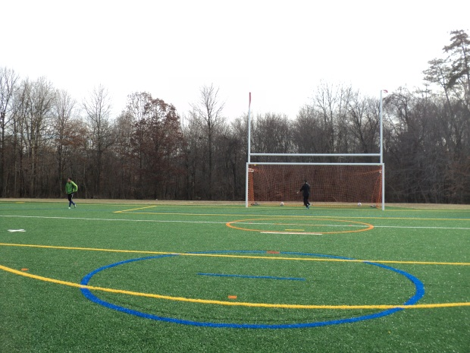
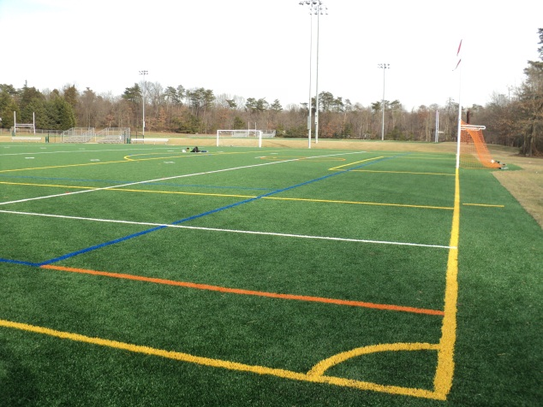
ELANOR C. LAWRENCE PARK – PROJECT COMPLETION REPORT
SYNTHETIC TURF FIELD 3 CONVERSION
Field #3 was converted from an existing natural surface field to a 210’ x 360’ synthetic turf field, meeting all general guidelines and standards established under the synthetic turf program.
Scope Estimate Project Cost Scheduled Completion Actual Completion
$825,000 $825,000 November 2013 November 2013
Project Manager
Charles Mends-Cole
Designer Contractor
Burgess & Niple FieldTurf USA
Supervisory District: Sully Park Authority Board Member: Harold Strickland
Summary: 2012 Park Bond funding was used to complete this project
Planning & Development Division

Slide 13
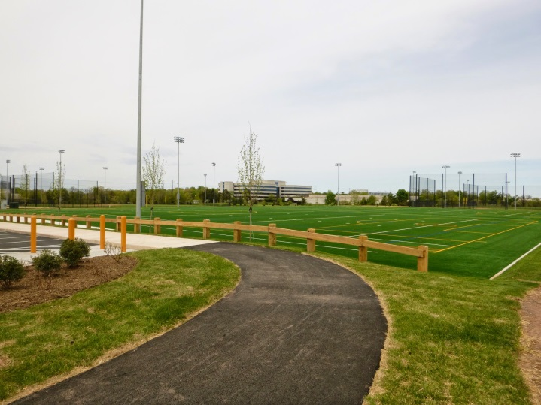
Sully Highlands PARK – PROJECT COMPLETION REPORT
ACQUISITION BY PROFFER – CREATION OF SULLY HIGHLANDS PARK
(Timber Ridge at Discovery Square, Inc.)
Sully Highlands Park is a 17 acre multi-field / multi-use park which was fully built and delivered to the Park Authority in May 2014 by the developer of Discovery Square which is an adjacent community now under construction. The park is the result of the developer executing the approved proffers pursuant to rezoning case RZ 2006-SU-007.
Purchase Price Acquisition Cost Project Initiation Date of Recordation
Proffer Donation $264.50 2006 Rezoning May 23, 2014
Project Manager
Brian Williams – John Zeigler
Supervisory District: Sully Park Authority Board Member: Harold Strickland
Summary: The park land and park construction was delivered turn-key and fully functional at no cost to the Park Authority
Planning & Development Division

Slide 14
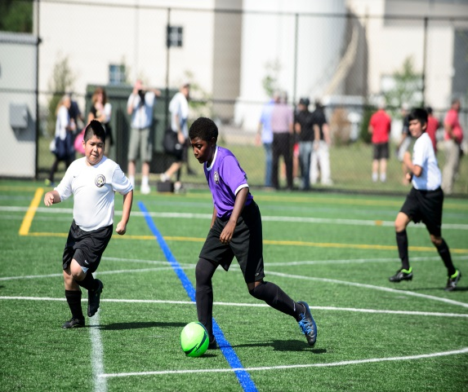
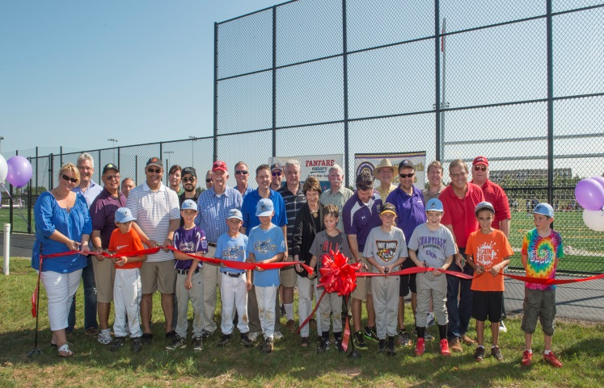
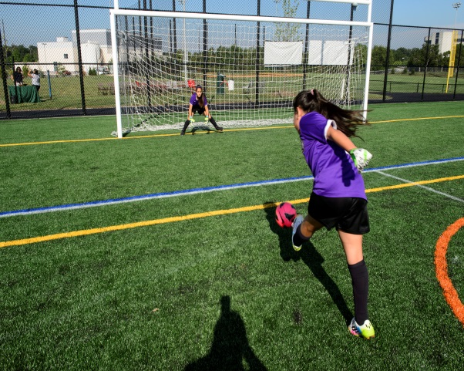
Sully Highlands PARK – PROJECT COMPLETION REPORT
Sully Highland Park - Athletic Fields
This project included the construction of two lighted full size rectangular synthetic turf fields constructed as a continuous sheet of synthetic turf to allow the field to accommodate a cricket pitch, two irrigated natural turf 60 ft diamond fields, and one irrigated natural turf 90 ft diamond field. The facility also includes a 270 space parking lot, and bioretention stormwater management facility. Future additions will include a playground, and restroom/shelter. A ribbon-cutting ceremony was held on September 6, 2014.
Project Cost Completion
Developer Proffer May 2014
Project Manager
Charles Mends-Cole
Designer Developer
William H. Gordon Associates, Inc. Timber Ridge at Discovery Square, Inc.
Supervisory District: Sully Park Authority Board Member: Harold Strickland
Summary: This project was designed and constructed using proffered Public Facilities Contribution by the Developer. Chantilly Youth Association donated approximately $120,000 to fund amenities.
Planning & Development Division

Slide 15
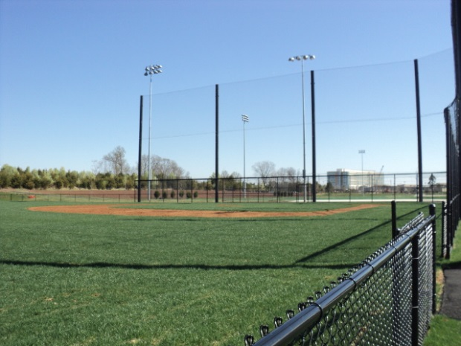
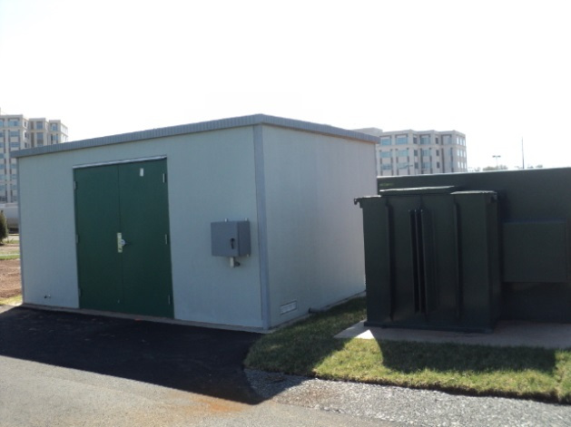
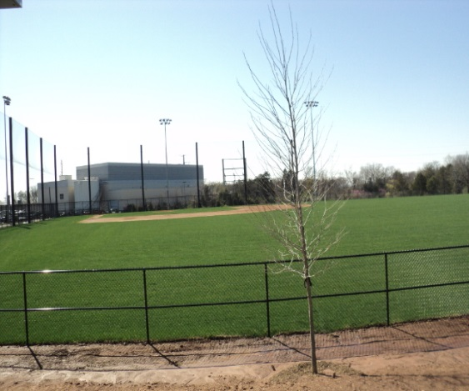
SULLY HIGHLANDS PARK – PROJECT COMPLETION REPORT
Athletic Field Lighting
Project consisted of the design and Installation of field lighting on two proffered 60' diamond fields and a 90' proffered diamond field at Sully Highlands Park.
Scope Estimate Project Cost Scheduled Completion Actual Completion
$370,000 $359,775 June 2014 February 2014
Project Manager
Wendy Li
Designer Contractor
Musco Sports Lighting R.E.Lee Electric Co.
Supervisory District: Sully Park Authority Board Member: Harold L. Stickland
Summary: This project was funded from the 2008 Park Bond.
Planning & Development Division

Slide 16
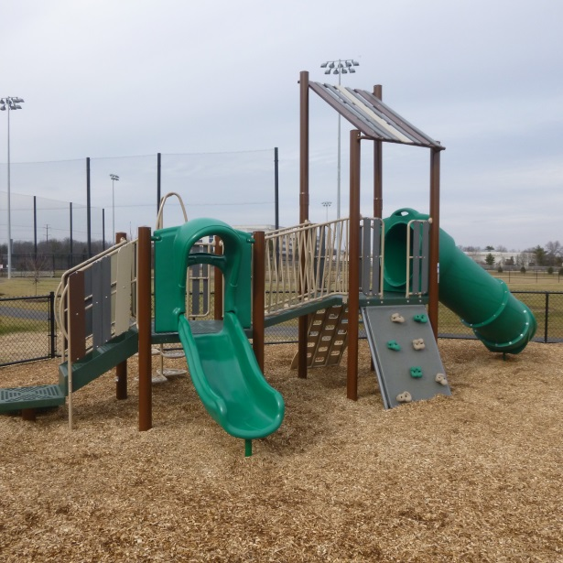
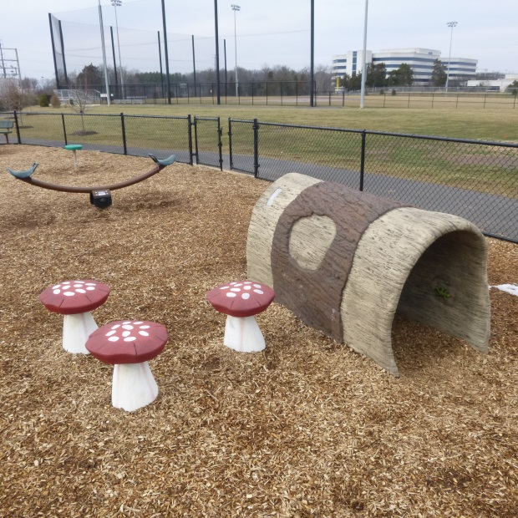
SULLY HIGHLANDS PARK PLAYGROUND – PROJECT COMPLETION REPORT
Proffered Park Development
The playground was installed to provide additional recreational opportunities that compliment the athletic fields developed as part a proffer that was completed in spring 2014.
Scope Estimate Project Cost Scheduled Completion Actual Completion
$120,000 $120,000 November 2014 November 2014
Project Manager
Charles Mends-Cole
Designer Contractor
FCPA Playcore (Gametime, Inc.)
Supervisory District: Sully Park Authority Board Member: Hal Strickland
Summary: This project was funded by a Chantilly Youth Association Contribution.
Planning & Development Division

Slide 17
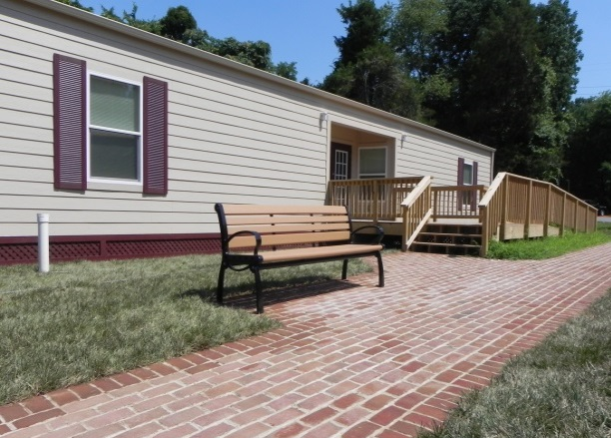
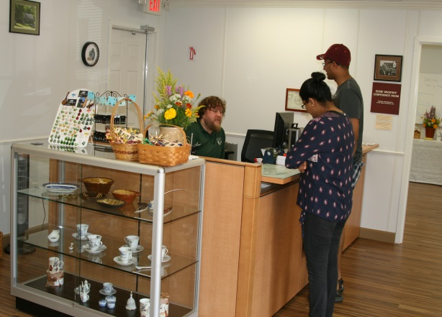
SULLY HISTORIC SITE – PROJECT COMPLETION REPORT
Sully Historic Site– Visitor Center Project
The project included the installation of a new modular visitor’s center and supporting infrastructure. The visitor center will welcome guests to the popular site as they arrive serving as a gathering place and accessible building allowing visitors to easily obtain information about the historic house and grounds while providing a point of orientation to the Sully historic core area. The visitor center includes a large space for museum gift shop merchandise, food and drink sales, restrooms, and a conference room for meetings.
Scope Estimate Project Cost Scheduled Completion Actual Completion
$713,360 $650,000 May 2014 May 2014
Project Manager
Kelly Davis
Designer Contractor
Bowman Consulting FCPA / Modular Building Systems / Southern Asphalt Co. Inc.
Supervisory District: Sully Park Authority Board Member: Hal Strickland
Summary: This project was constructed using funding from the Park Capital Improvement Fund, 2004 Bond Fund, Mastenbrook Grant funding, and a donation from the Sully Foundation.
Planning & Development Division

Slide 18
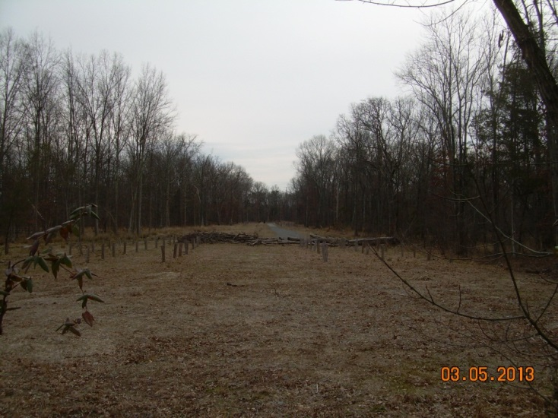
CUB RUN STREAM VALLEY PARK – PROJECT COMPLETION REPORT
Acquisition – Addition to Cub Run Stream Valley Park
(Henry Long Property)
Long property is a 5.5 acre parcel located in the Cub Run Stream Valley. The property has frontage on Old Lee Road and Cub Run traverses the property. The property is surrounded by parkland and the owner agreed to convey the property to the Park Authority in exchange for the payment of delinquent real estate taxes in the amount of $5,417.00.
Purchase Price Acquisition Cost Project Initiation Date of Recordation
$0 $10,000.00 March 2013 September 10, 2014
Project Manager
Brian Williams
Supervisory District: Sully Park Authority Board Member: Harold Strickland
Summary: 2008 Park Bond funding was used for the Park Authority’s acquisition costs and for staff costs related to the review of transfer documents and deeds.
Planning & Development Division

Slide 19
HORSEPEN RUN STREAM VALLEY PARK – PROJECT COMPLETION REPORT
Acquisition – McLearen Road Proffer
The McLearen Road Proffer property is approximately 4.5 acres and was transferred to the Park Authority as a condition of a 1982 rezoning. The property is fully wooded and a welcome addition to the Horsepen Stream Valley Park.
Purchase Price Acquisition Cost Project Initiation Date of Recordation
Proffer Fulfillment $0 1982 September 17, 2014
Project Manager
John Zeigler
Supervisory District: Sully Park Authority Board Member: Hal Strickland
Summary: The property was a proffer fulfillment from 1982 at no cost to the Park Authority.
Planning & Development Division

Slide 20
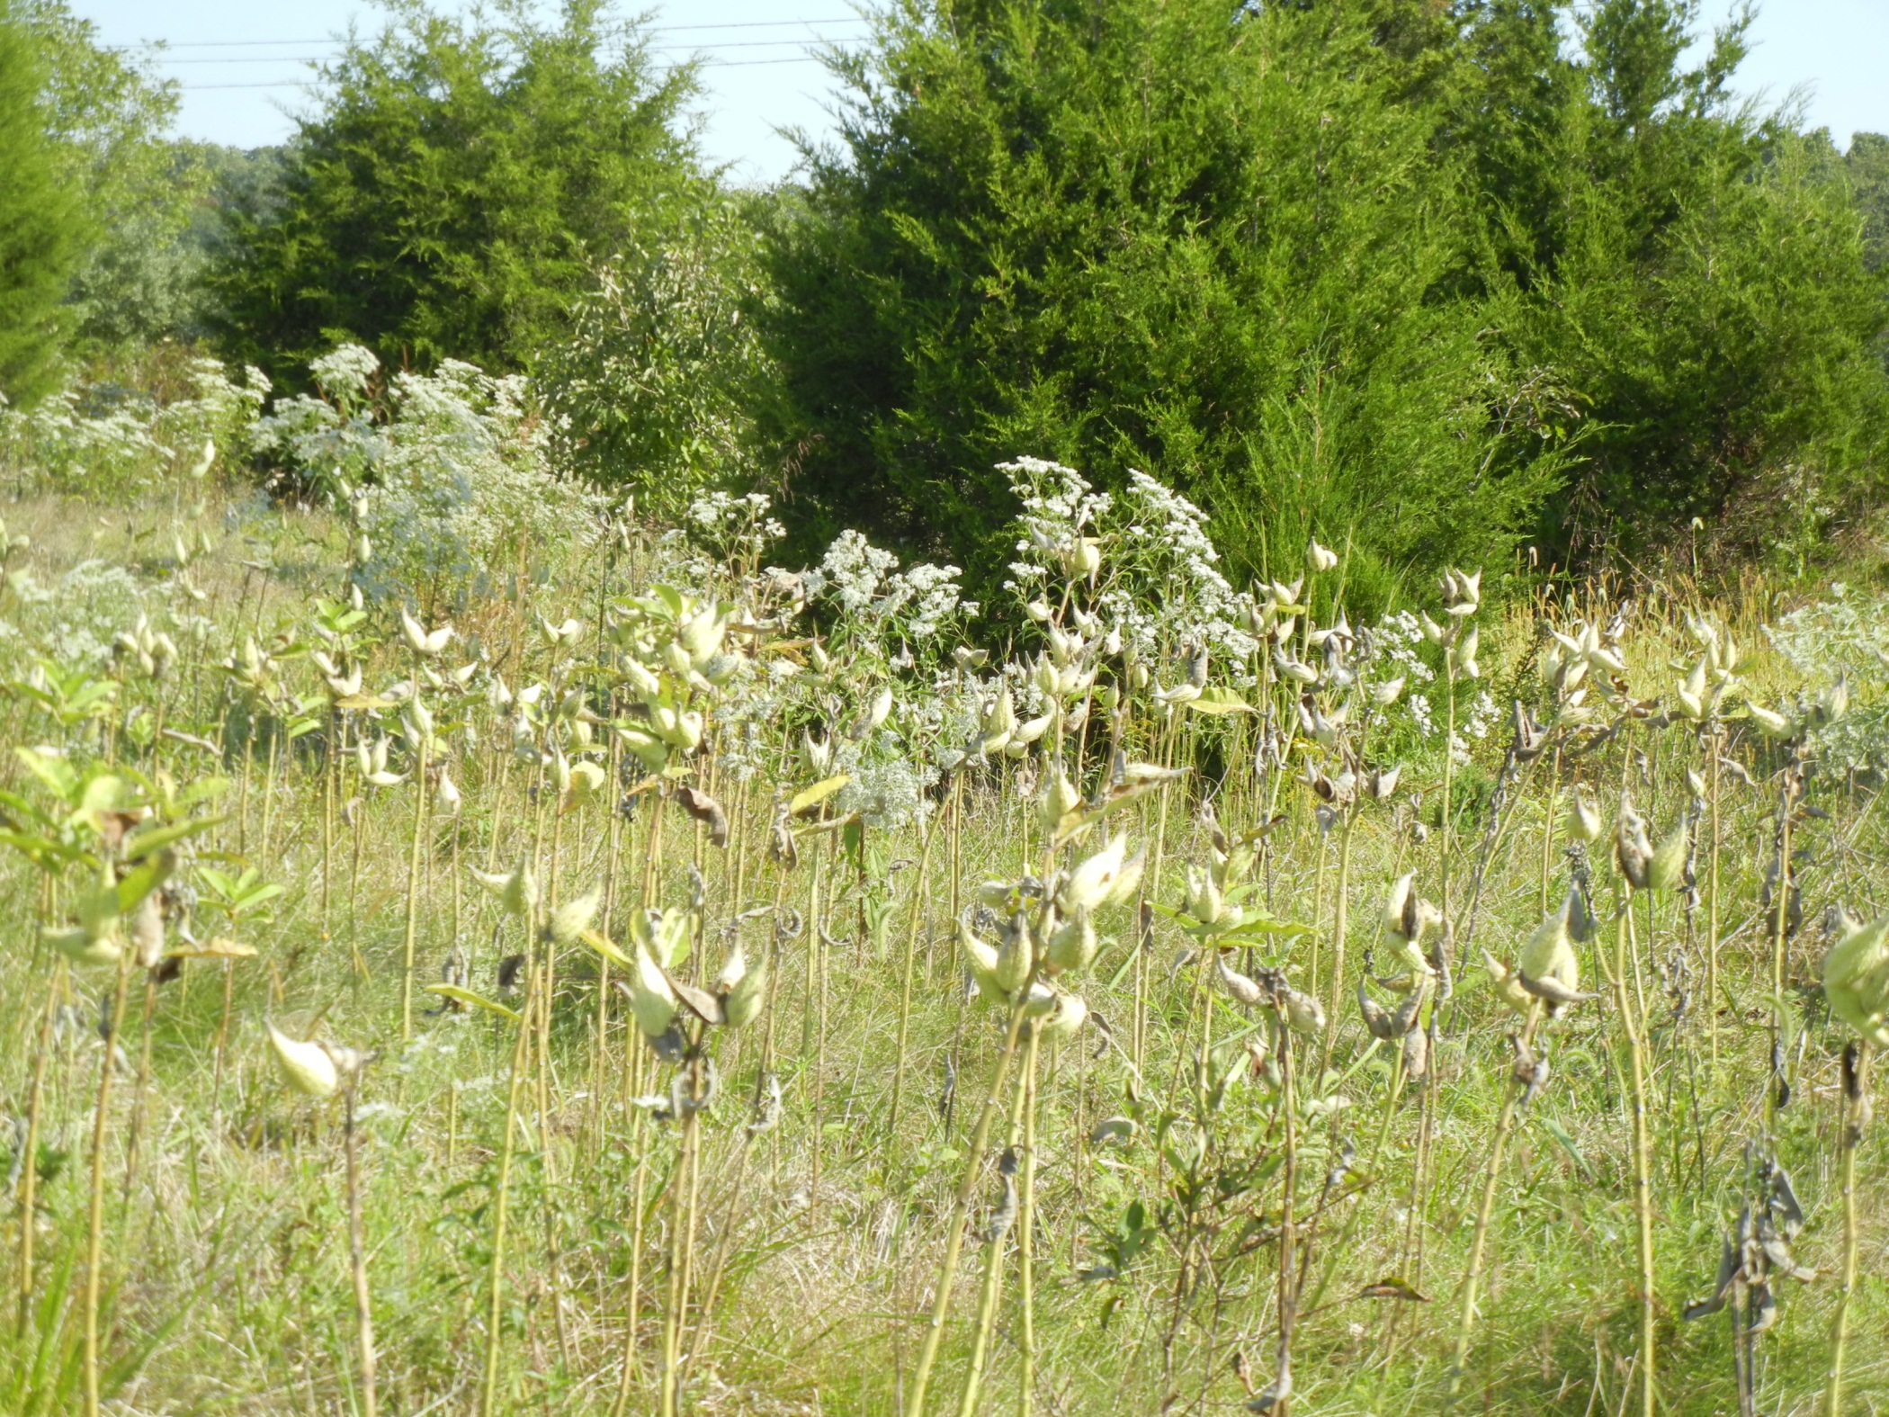
Planned Sully Improvements

Slide 21
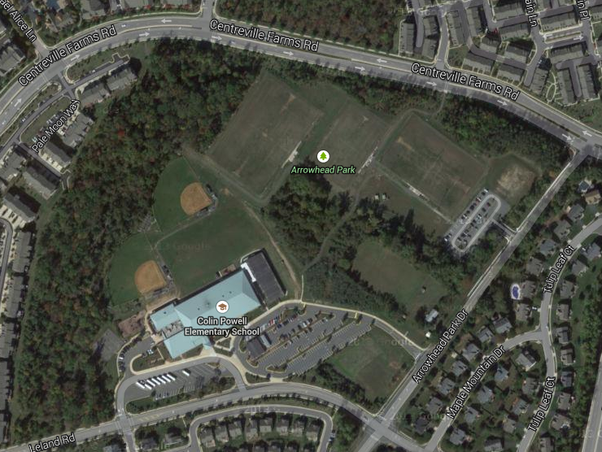
ARROWHEAD PARK – PROJECT SCOPE
Field 3
Field 1
Synthetic Turf Athletic Fields
This project includes the conversion of two existing natural turf fields to synthetic turf. Field 1 will be 330 ft. x 210 ft. and is striped for soccer, lacrosse, and field hockey. Field 3 will be 360 ft. x 210’ and be striped for soccer, football, lacrosse, and field hockey. Both fields are sized to allow for side play.
Scope Estimate Scheduled Completion Project Manager Designer
$1,647,500 August 2015 Charles Mends-Cole Burgess & Niple
Supervisory District: Sully Park Authority Board Member: Hal Strickland
Summary: This project is being developed using 2012 Bond Funds.
Planning & Development Division

Slide 22
Stewardship Education Center
The Stewardship Education Center is to be a
state of the art interpretive facility to:
Provide educational and visitor services to encourage natural and cultural stewardship and promote STEM learning.
Work with state staff in the management of the Sully Woodlands Natural Area Preserve.
Provide opportunities to work with staff from educational institutions, specialty organizations and others to become a regional research facility and outdoor lab.
Manage non-recreational parkland.
Contain cultural resource laboratory, storage and collections display spaces.
Conduct research and natural resource management activities.

Slide 23
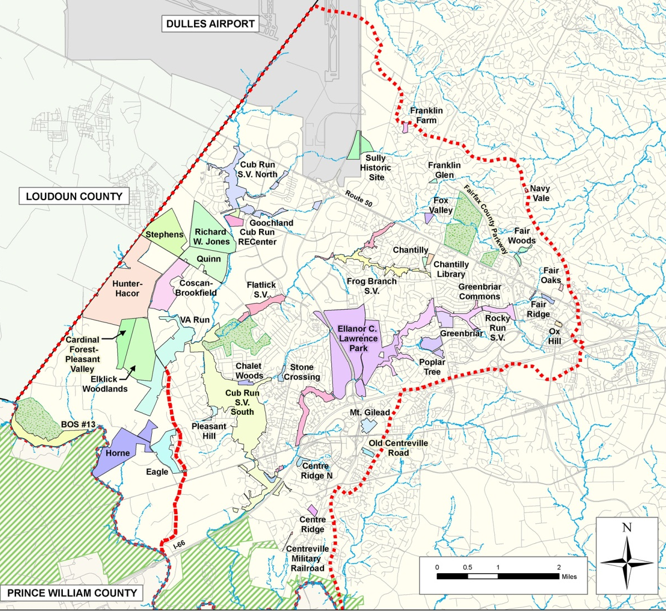
Sully Woodlands Regional Master Plan
PARK UNITS
Notes:
The regional plan covers 4,400 acres of parkland and 43 parks. The region aligns with the Bull Run and Cub Run Watersheds. A regional approach was used in this area due to the large assemblage of properties in the southwestern part that needed to be planned. Examining this assemblage of parkland and determining use and management zones in context with established parks in the two watersheds was a primary outcome of the regional plan.

Slide 24
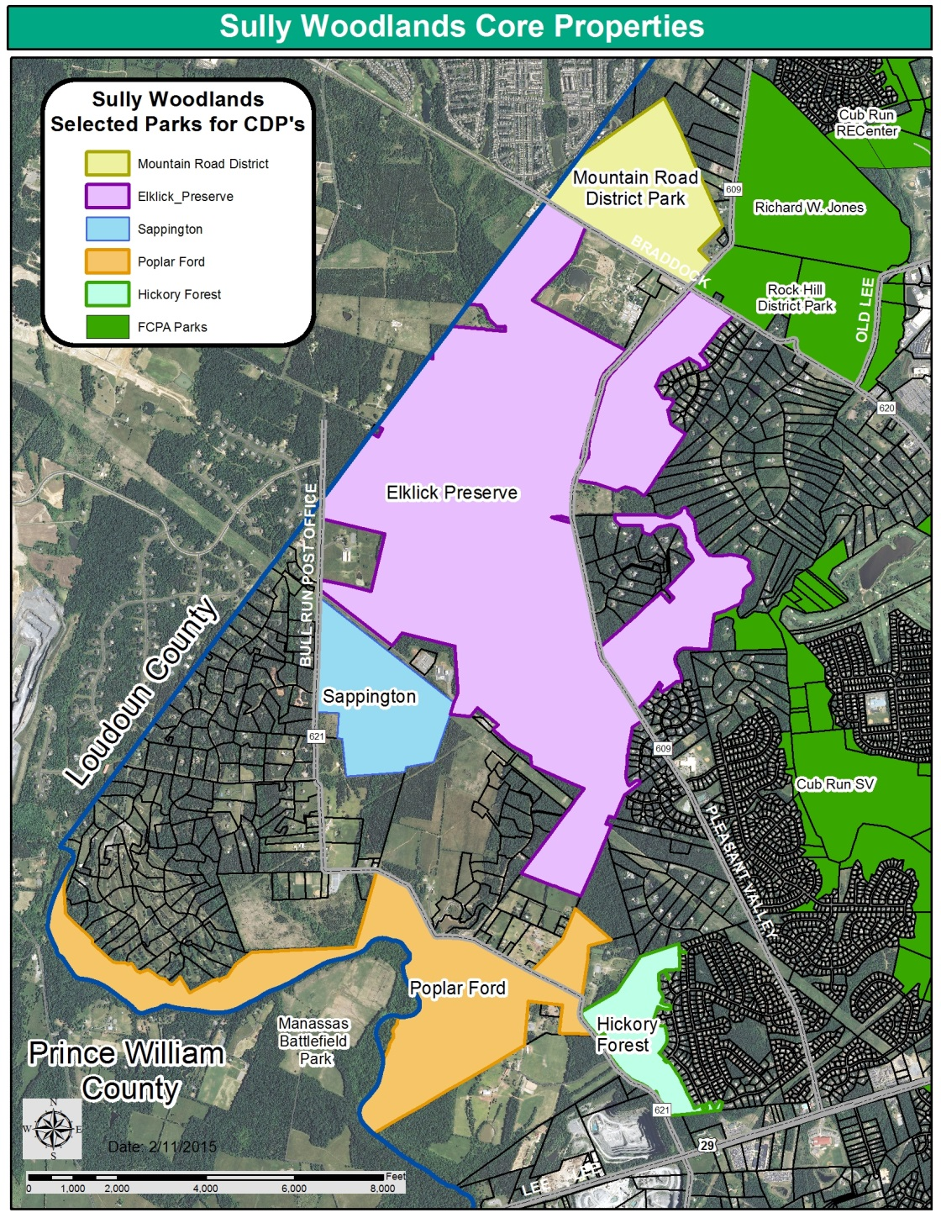
5 Large Parks in Planning Process
Hickory Forest
Mountain Road District
Poplar Ford
Elklick Preserve
Sappington
Conceptual Development Plans
Presented at multiple public meetings
Public comments considered
Final Plans to Park Authority Board for Approval in March

Slide 25
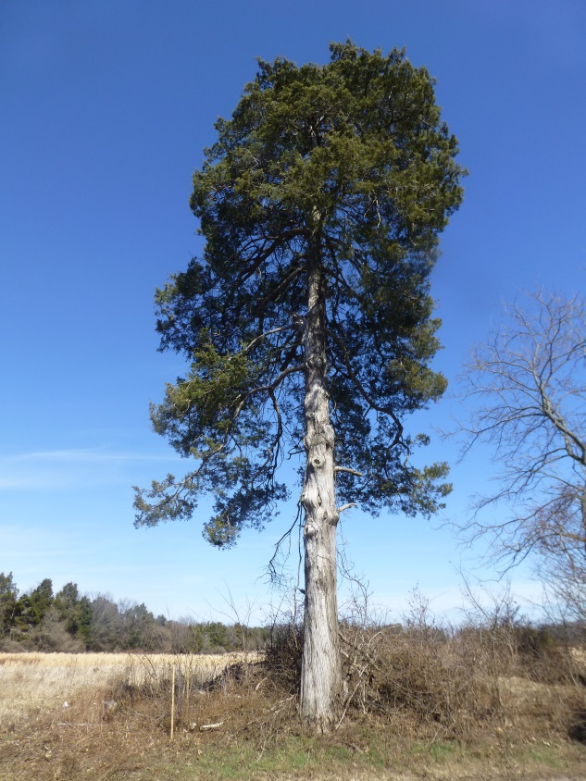
Core properties comprise 2,379 acres
175 acres
Reserved for active recreation
20 miles of new trails proposed
“In wilderness is the preservation of the world “
Henry David Thoreau
78% undisturbed
Notes:
Overall, the goal of this project is to propose park development that follows the recommendations of the regional master plan, that provides needed park facilities, both locally and regionally, and that allows the parks to develop in harmony with one another and the surrounding communities.
The benefits of these proposed park developments to the local community is tremendous. There will be 20 miles of trails, over 1,800 acres of protected natural landscapes and increased local athletic facilities to minimize driving trips for area residents.

Slide 26
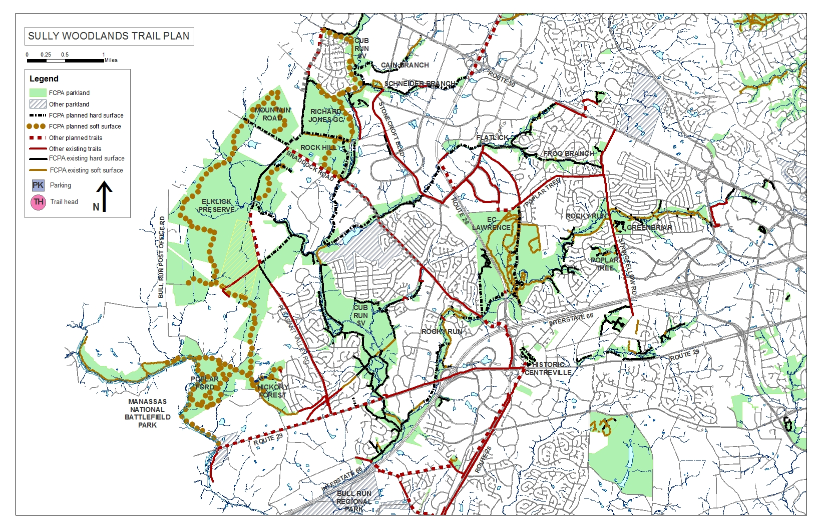

Slide 27
West County Trail – BOS MOTION
WEST COUNTY TRAIL (SULLY DISTRICT) - September 9, 2014
Supervisor Frey said that recently he met with Mr. Bill Niedringhaus, Ms. Karen Jones, and Park Authority and Transportation staff regarding the concept of a West County Trail that would provide a link to the Cross County Trail, better known as the Gerry Connolly Cross County Trail (GCCCT). The trail would be similar in scope to the GCCCT and provide further trail connectivity within the County for hikers and bikers, specifically connecting Reston to Bull Run Regional Park.
Therefore, Supervisor Frey asked unanimous consent that the Board direct the County Executive and appropriate staff to identify the ultimate route and add it to the County Trails Plan for the Board's approval. Without objection, it was so ordered.

Slide 28
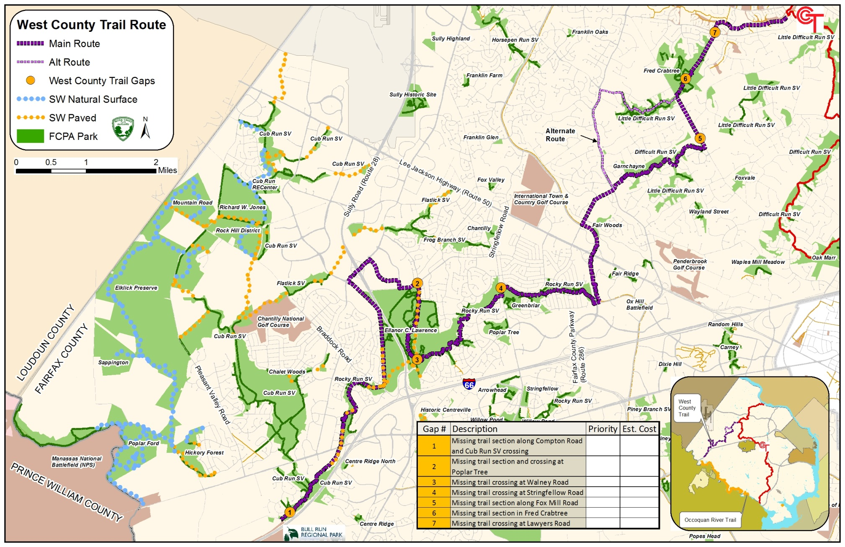
Proposed West County Trail Alignment
Notes:
BOS endorsed

Slide 29
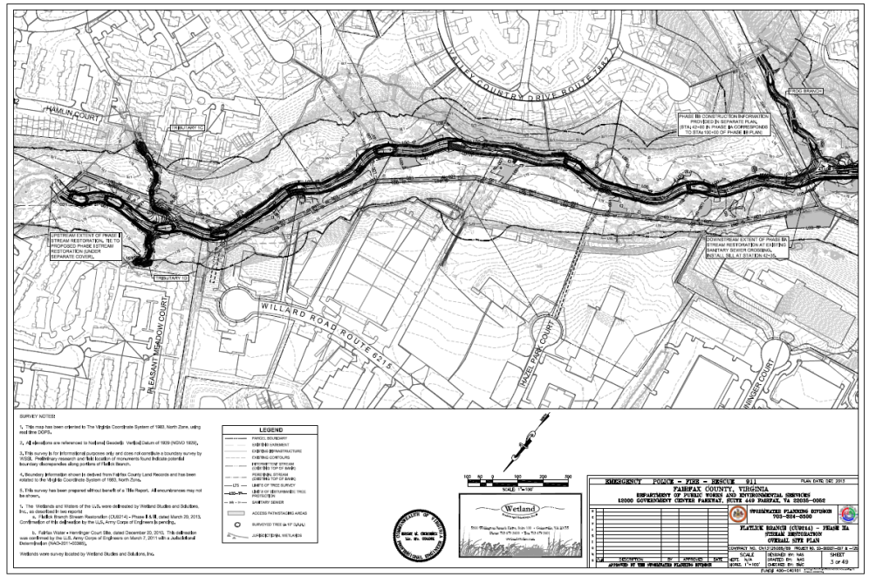
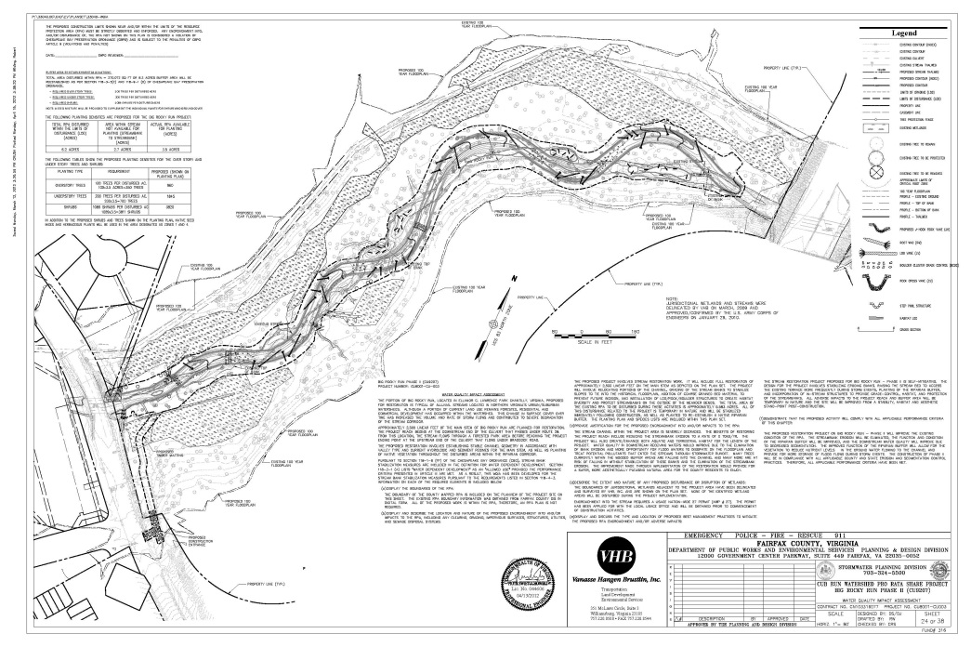
Bull Run and Cub Run Watershed Projects
Flatlick Branch Stream Restoration
Big Rocky Run Stream Restoration
Projects Identified in Watershed Plans
FCPA Partnership with DPWES Stormwater
Improves Water Quality and Stream Ecology
Chesapeake Bay Act Implementation

Slide 30
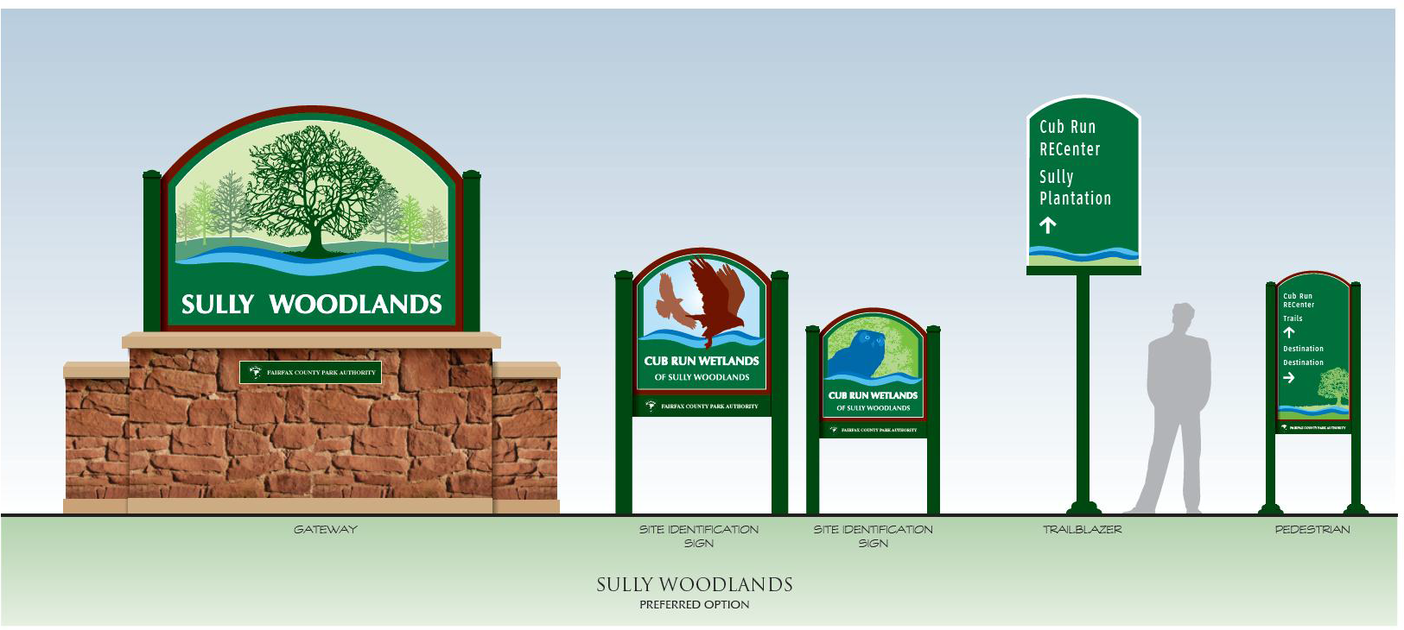
Sully woodlands identification/wayfinding

Slide 31
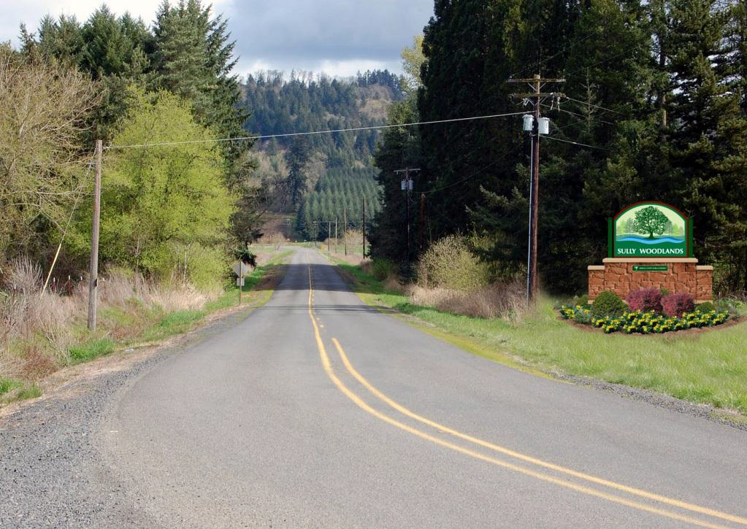
Sully woodlands Gateway identification

Slide 32
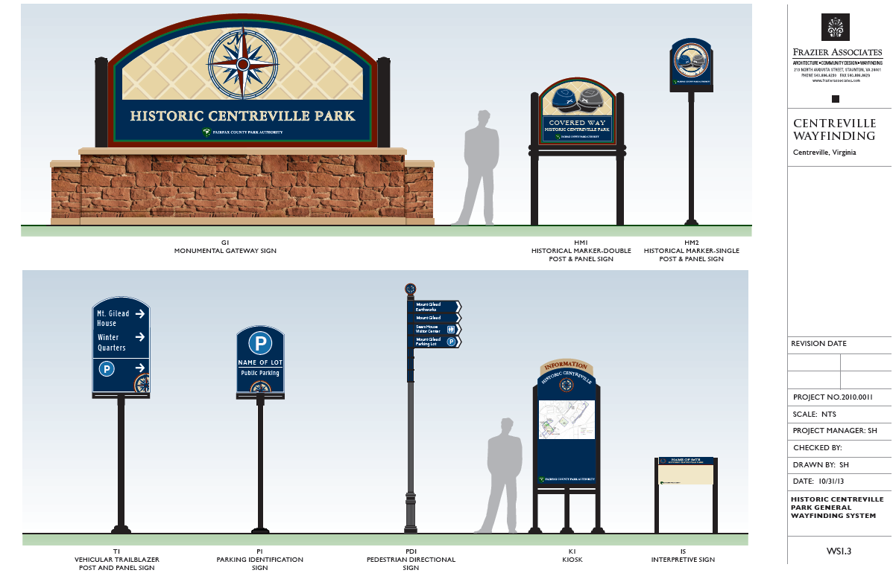
Historic centreville signage to be installed

Slide 33
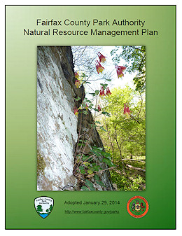
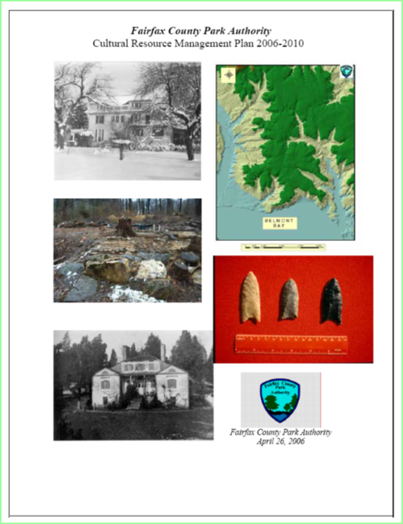
Stewardship of Our Resources

Slide 34
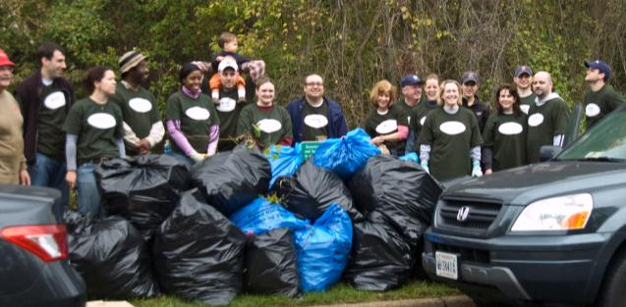
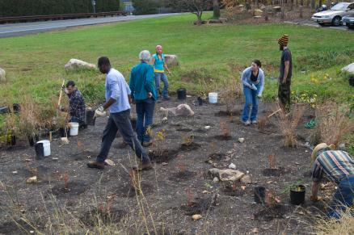
Community Engagement

Slide 35
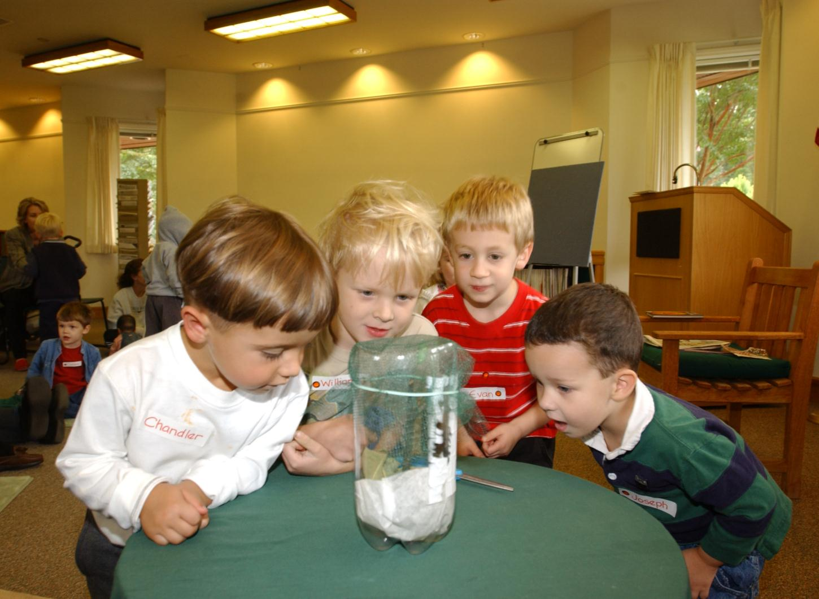
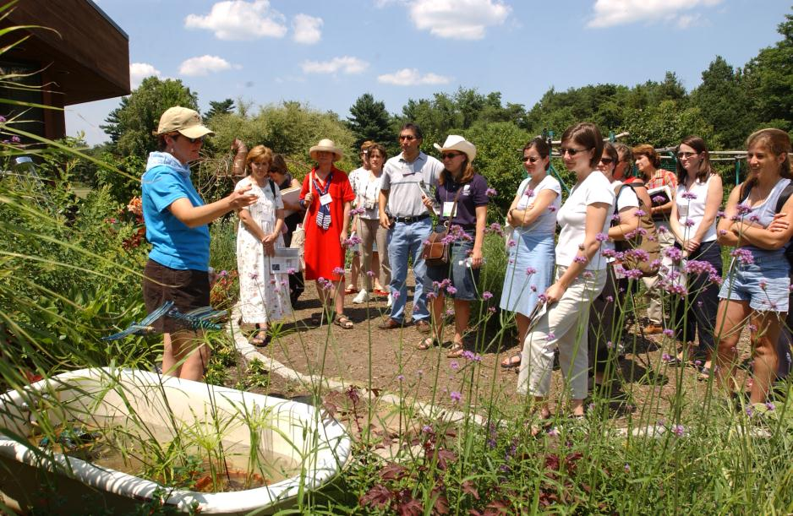
Stewardship Education

Slide 36
Investing in Our Natural Capital
Notes:
ECL Master Plan scheduled to be updated

Slide 37
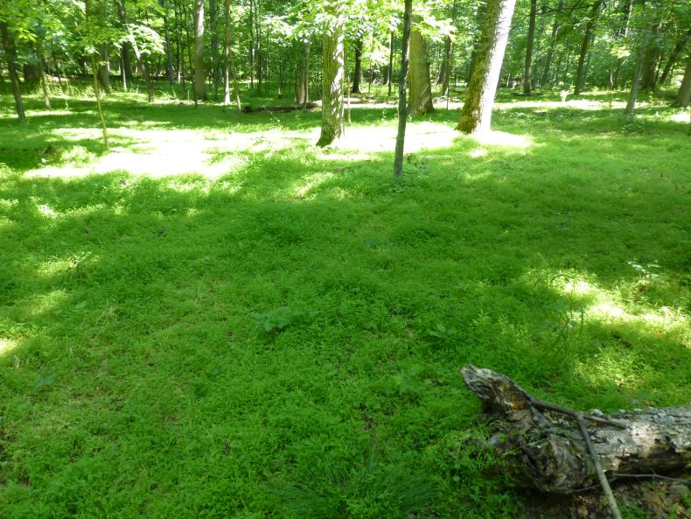
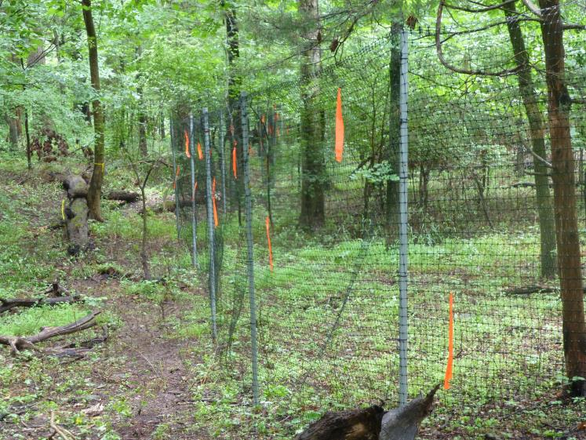
Deer Management
Unhealthy Forest Floor of Japanese Stiltgrass
Deer Exclosure Fences-Regeneration of Native Plants

Slide 38
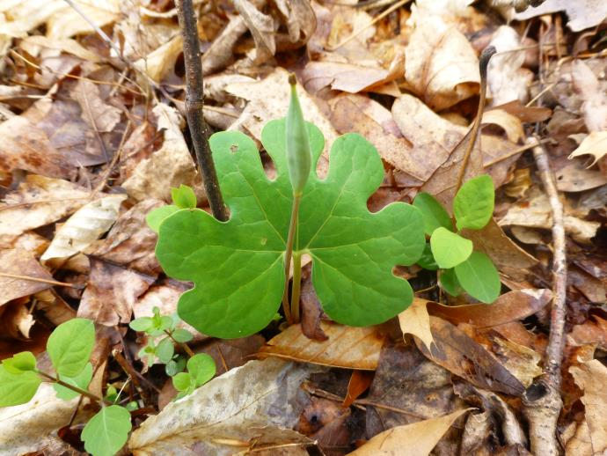
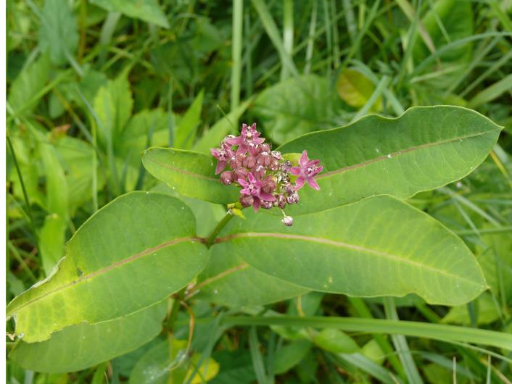
Deer Management Benefits
Diverse Forest Floor Plants Return
Purple Milkweed Appears – State Imperiled & Rare Fairfax Species

Slide 39
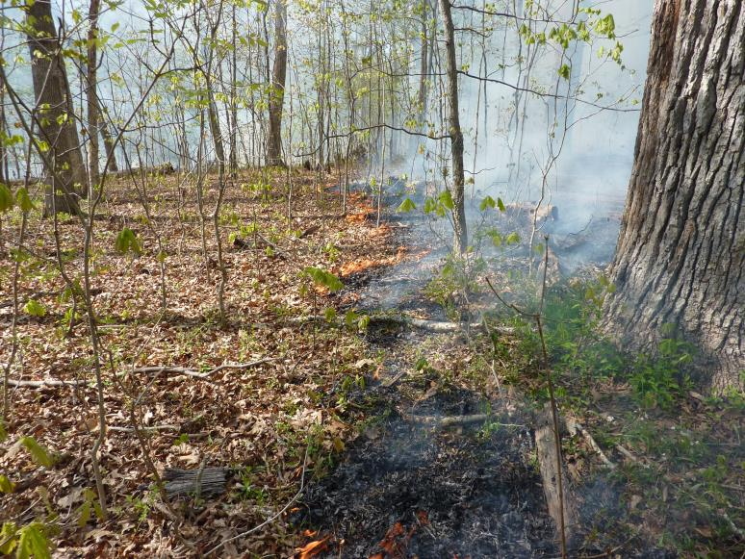
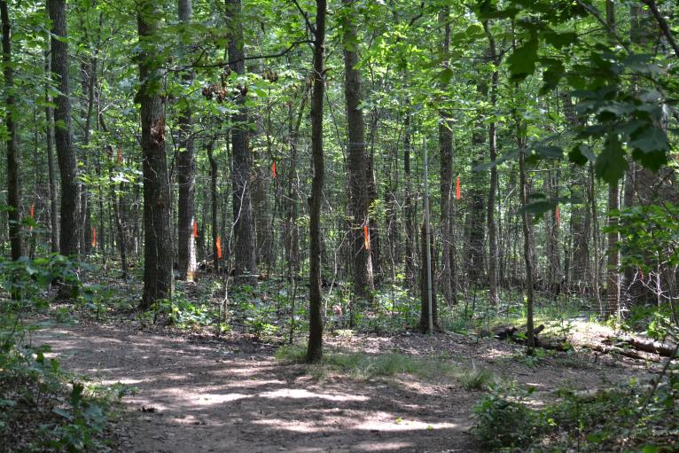
Fire As A Management Tool: Forests

Slide 40
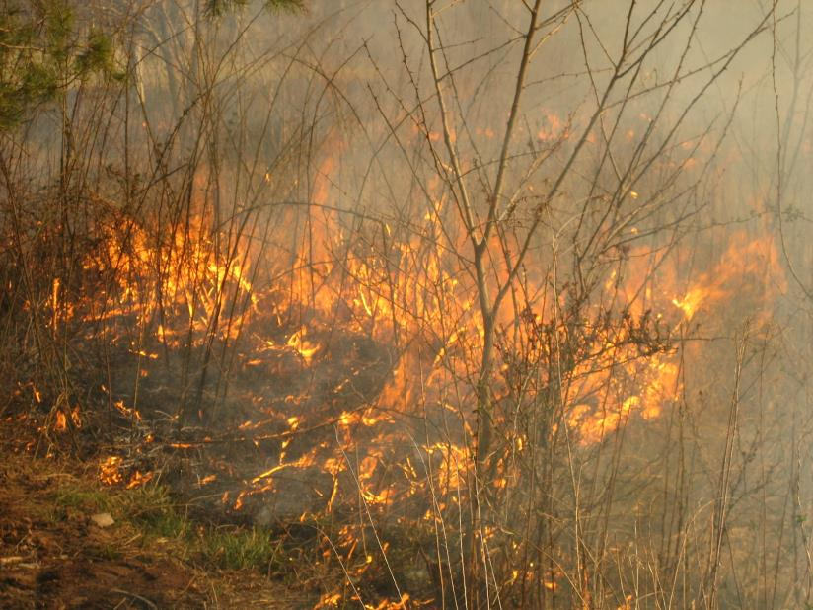
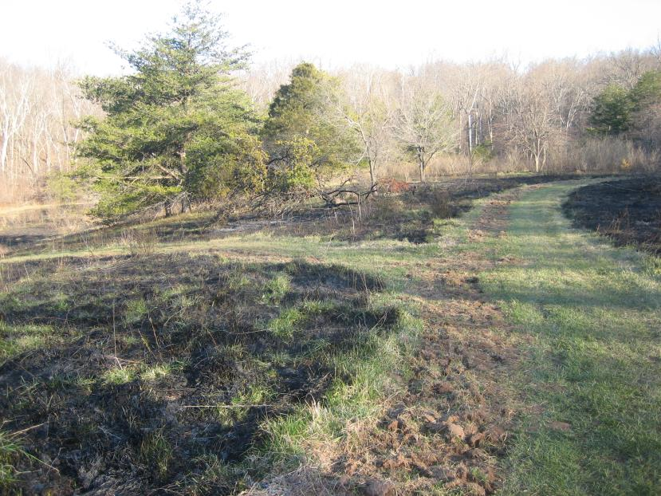
Established Meadows

Slide 41
Experiment for Best Practices
Partnering with multiple NGO’s, County Agencies, Schools/Universities, Governments, and Contractors.
Actions are multi-faceted to ensure repeatable results.
Lessons learned will be applied at other places to continue research and learning.
Further research and actions by partners will be fed back to the Park Authority to inform best practices by staff.

Slide 42
Growth and change in Sully district
Year | Sully District Population
 | Population | Households | Housing Units
2014 | 129,582 | 42,042 | 42,603
2020 | 130,820 | 42,493 | 43,067
2030 | 140,810 | 46,216 | 46,875
2040 | 150,058 | 49,665 | 50,403
Ages | % in 2013 | % in 2030
Under 5 | 6.7 | 6.0
5-9 | 6.5 | 6.5
10-14 | 6.7 | 7.2
15-20 | 6.4 | 6.1
20-24 | 5.5 | 5.5
25-34 | 14.7 | 13.5
35-44 | 14.0 | 14.6
45-54 | 15.6 | 14.3
55-64- | 12.4 | 11.0
65 and above | 10.7 | 15.2
Race or Ethnicity | % of Sully Population
White alone | 60.7
African American alone | 5.8
American Indian and Alaska Native alone | .4
Pacific Islander or Hawaiian native alone | .1
Asian alone | 23.1
Some other race alone | 6.0
2 or more races | 4
Hispanic or Latino | 15.5

Slide 43
Planned Transportation Improvements
Manassas Battlefield Bypass
Closes Rt. 29 through Park
To be federally funded
Requires mitigation

Slide 44
I-66 and rt. 28 improvements
Impacts ECL entrances on east and west sides of park
Still in design/study phase
VDOT is coordinating closely with FCPA

Slide 45
Eastern Loudoun county planned growth

Slide 46
Meet staff managers
Peter Furey, Manager of Golf Enterprises
Barbara Cosgrove, Twin Lakes Golf Course
Doreen Henry, Cub Run RECenter
John Shafer, Ellanor C. Lawrence/Historic Centreville
Carol McDonnell, Sully Historic Site
Kevin Williams, Former Area 5 Manager

Slide 47
Questions?????

