Slide 1
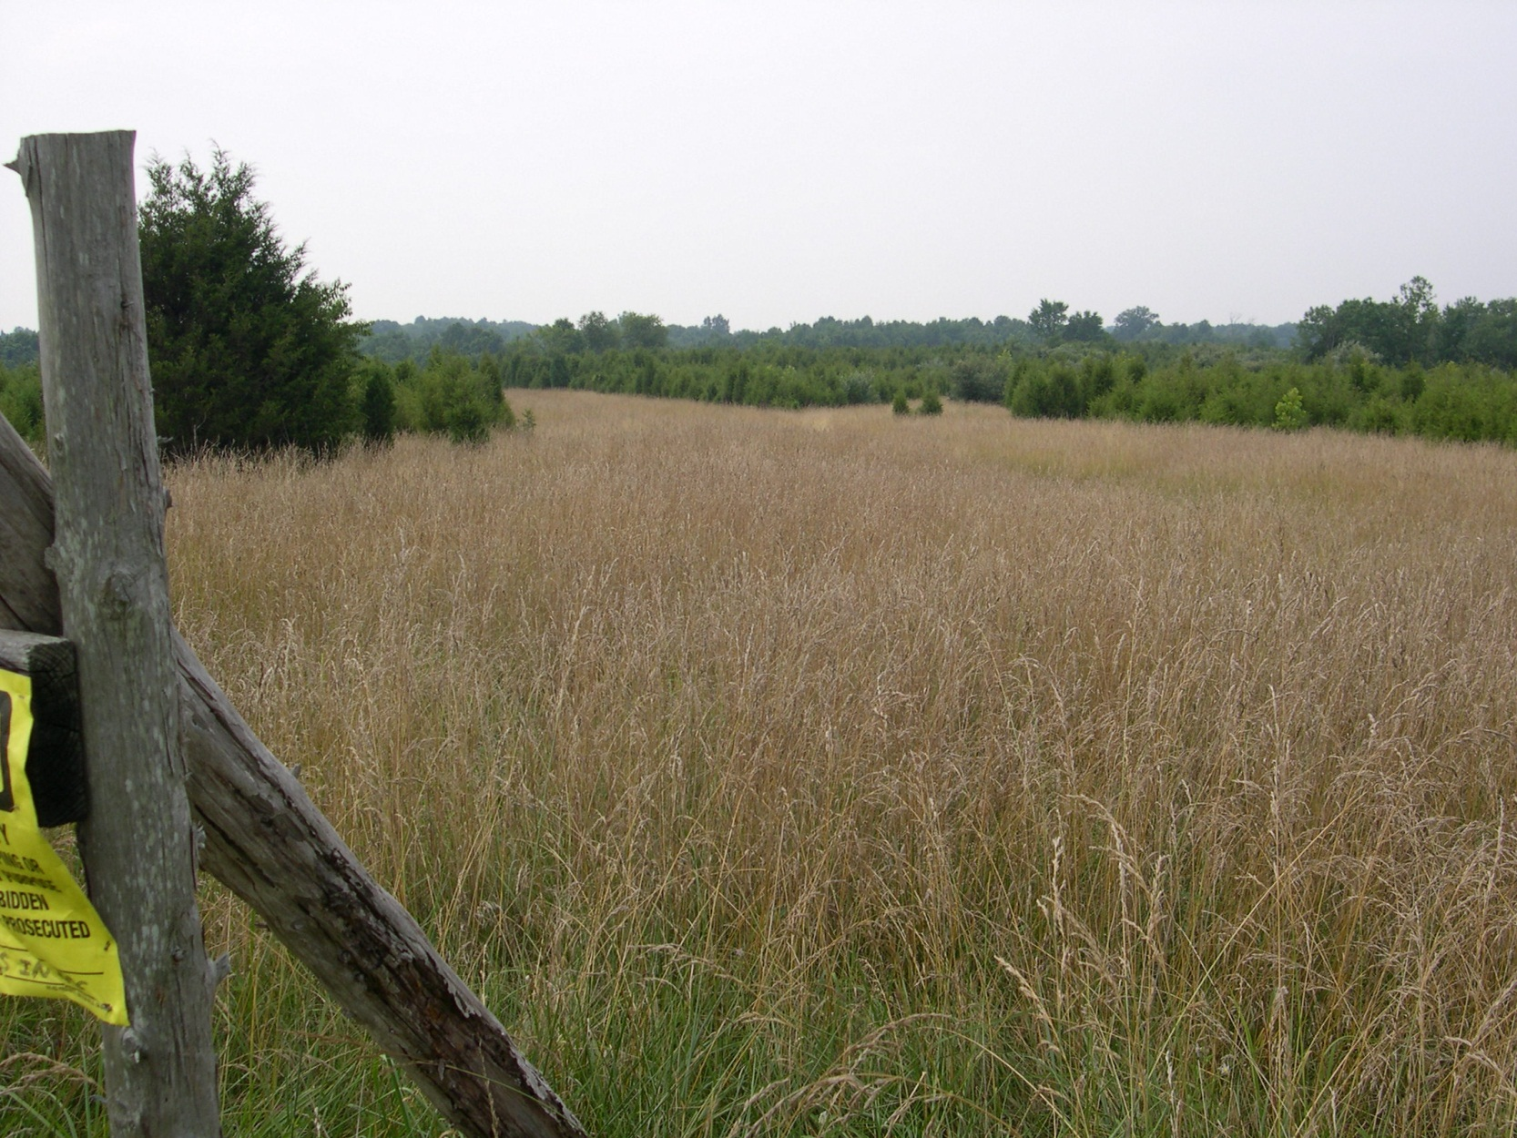
Sully Woodlands
Core property Conceptual Development Plans
Public Comment Meeting
October 1, 2014
Fairfax County Park Authority

Slide 2
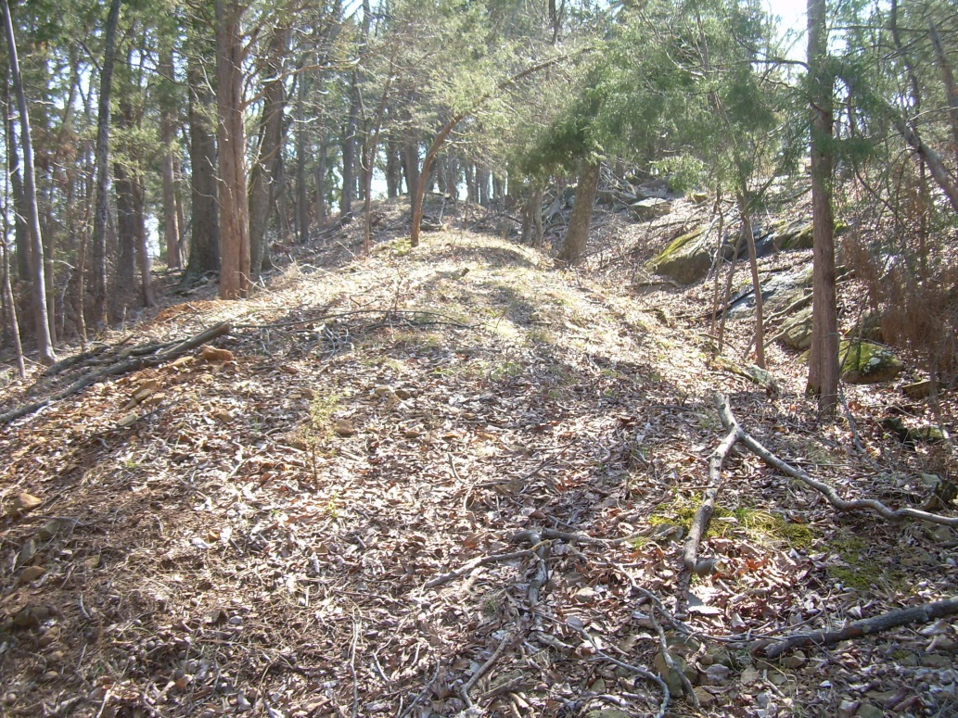
Tonight’s Agenda
Welcome/Introductions
Final CDP presentation
Hickory Forest Park
Poplar Ford Park
Elklick Preserve
Mountain Road District Park
Sappington site
Comment Period
Adjourn

Slide 3
Conceptual Development Plan Project Team
Pat Rosend, Project Manager, PDD
Justin Roberson, NRMP
John Rutherford, CRMP
Liz Cronauer, Trails Program Manager
Taylor Dixon , NCS
Kevin Williams, Area 5 Manager
Butch Loughry, Forestry Operations
Wang Bang, Community Connections Coordinator, PSD
Sousan Frankeberger, Program Services, PSD
Notes:
A staff team was formed to utilize the technical skills and expert knowledge of park authority staff for the project.
The team consisted of:
Pat Rosend, project manager, Planning and development Division
Justin Roberson, naturalist, Natural resource Management protection division
John Rutherford, Historian, Cultural Resource Management Protection division
Liz Cronauer, Trails program manager
Taylor Dixon, Parks/recreation specialist, Neighborhood and Community services
Kevin Williams, Area 5 Operations Manager
Butch Loughery, Manager , park authority forestry operations
Wang Bang, Community connections coordinator, Park Services Division
Sousan Frankenberger, Program services, park services division

Slide 4
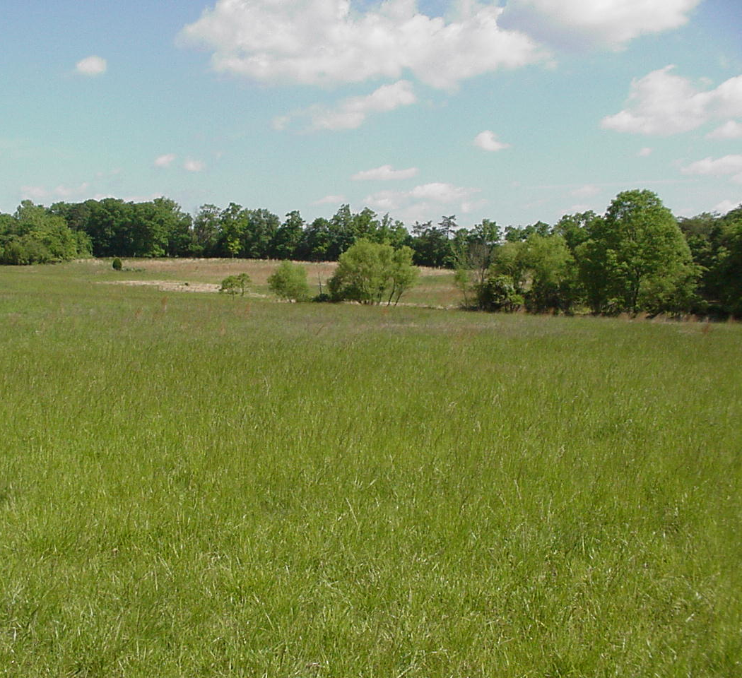
Park Authority Mission
Enhance Citizens Quality of Life Through:
Natural & Cultural Resource Stewardship
Quality Facilities & Services
Recreational Opportunities

Slide 5
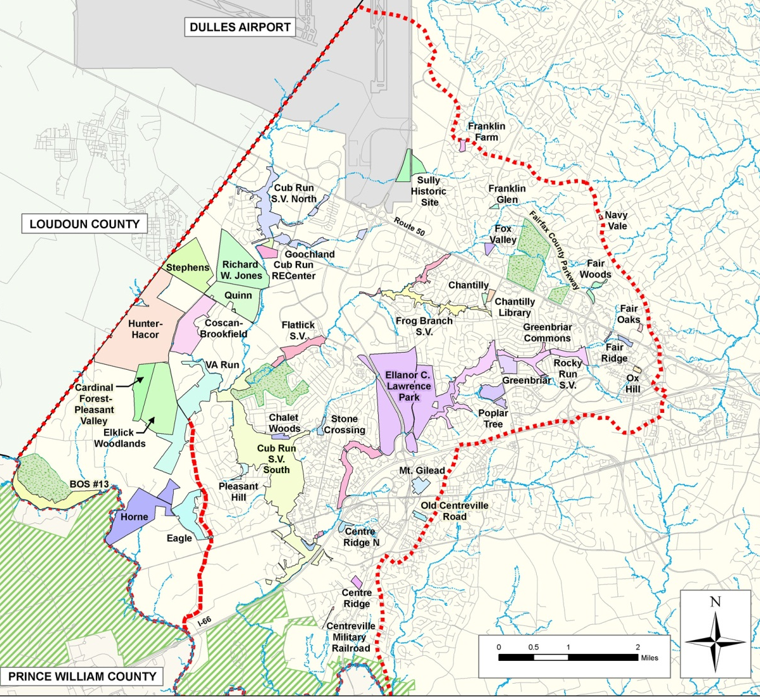
Sully Woodlands Regional Master Plan
PARK UNITS
Notes:
The regional plan covers 4,400 acres of parkland and 43 parks. The region aligns with the Bull Run and Cub Run Watersheds. A regional approach was used in this area due to the large assemblage of properties in the southwestern part that needed to be planned. Examining this assemblage of parkland and determining use and management zones in context with established parks in the two watersheds was a primary outcome of the regional plan.

Slide 6
Project Scope
Core Property CDP’s
Elklick Preserve
Mountain Road District
Poplar Ford
Hickory Forest
New Property integration
Sappington
Existing conditions
Identify land use
Append to Regional Master Plan
Notes:
The Sully Woodlands core properties conceptual development plan project was initiated in 2010.
Following the adoption of the Sully Woodlands Regional Master plan, the core properties were consolidated into 4 parks, Hickory Forest, Poplar Ford, Elklick Preserve and Mountain Road District Park. These 4 parks, plus some new properties acquired since 2006, comprise the properties that are involved in this Phase II implementation of the Sully Woodlands Regional Master Plan.
The conceptual development plans locate and formalize the land use recommendations of the regional master plan.

Slide 7
Scope of Conceptual Development Plan Process
Built on zones identified in Regional master plan and base studies (SWRMP pg 54)
Examined development options based on site opportunities and constraints
Established management zones for operations
Graphically shows general location of recommended facilities & use areas
Conceptual, not engineered site plan
Notes:
The conceptual development plan is a document that shows the general location of future park facilities and management areas. The process uses the exisitng site conditions to determine site opportunities and constraints and offers and blueprint for future development.
The plans are conceptual and not to be considered suitable for construction.

Slide 8
Sully Woodlands Trail Plan
Provides trail locations for more than 40 miles of trails in Sully Woodlands
Proposes more than 20 miles of new trails within the core properties
Offers opportunity to work with multiple government agencies to create a strong regional trail network
Notes:
The Park Authority has presented the Sully Woodlands Trail Plan for review and discussion during this project.
This plan establishes general locations for trail networks and connections in the entire Sully Woodlands Regional area. The recommendations include trails on parkland and on other publicly owned lands to create a comprehensive trail network.
The plan is available on –line at this project webpage. Trails have been modified to reflect any revisions or additions within the core properties.

Slide 9
Draft CDP Hickory Forest Park
97 acres
Natural Resources
Trails and Trails heads
Accessible trails
Small Local Park
Typical facilities may include:
Playground
Courts
Picnic Area
Notes:
This 97 acre park is currently undeveloped and is comprised of mature canopy forest with some existing natural surface trails.
The conceptual development plans recommends maintaining the existing forest and utilizing good forest management practices for forest health and habitat and increasing the existing trail network.
The first draft cdp recommended:
Adding additional trails
Updating some trails to accessible
Adding a local serving park

Slide 10
Revised Draft CDP Hickory Forest Park
97 acres
Natural resources
Modified trail locations and trail heads
Maintained accessible trails
No community park recommendation
Notes:
The revised Draft CDP proposes:
Consolidation of trails into a perimeter trail network thus protecting the forest center
Trailheads and entrances have been reduced to minimize neighborhood impacts
The local serving park recommendation has been removed due to the existing recreation and playground facilities meeting the needs of the community.

Slide 11
Draft CDP -Poplar Ford Park
439 acres
Resource Stewardship
Trails
Equestrian Access
Gateway
Special Use Zones
Notes:
Poplar Ford Park is proposed to be developed with an extension network of mixed use trails, a special use area for radio control aircraft and an improved entrance and parking area. The park will contain extensive natural resource management areas to be managed for animal habitat and natural resource protection.
The trail network will be mixed use natural surface trails. It will build on an existing trail network and will offer more than 6 miles of trails. Trail development will include signage and trail kiosks as appropriate. It is recommended to develop a portage trail to allow for carry in of small water craft, such as kayaks, on Bull Run. The historic fords across Bull Run to Manassas Battlefield Park will be maintained. No bridges or fair weather crossings are proposed.
The special use area will be maintained to allow for radio control model aircraft use with an approved permit. This permit is granted on a limited term basis and must be renewed every 3 to 5 years. The area consists of an open grass airfield, limited parking, a split rail fence to separate users from the airstrip and a small storage unit for use by the club only. It is recommended that a small shade or picnic shelter be allowed in the maintained area. Maintenance is provided by the permit holder under the park adoption guidelines.
The parking area shall be designed to include an entrance off Bull Run Post Office Road and parking suitable for horse trailer access. The entry shall be located per VDOT standards at such time that engineered plans are developed for the park development.
The regional master plan recommended design and construction of a gateway to Sully Woodlands. After evaluating the core properties, it is recommended to locate this gateway feature at Poplar Ford Park on along Bull Run Post Office Road. This gateway will be comprised of signage welcoming you to the Sully Woodlands area. It may include kioks or trail plaquards.

Slide 12
Revised Draft CDP-Poplar Ford Park
439 acres
Resource Stewardship
Trails
Equestrian Access
Gateway
Special Use Zones
Notes:
The Draft CDP has no revisions . Some plan changes were made to clarify existing conditions or development restrictions.

Slide 13
Draft CDP Elklick Preserve
1,423 acres
Resource Stewardship
Trails
Special Use areas
Managed Open Space
Stewardship Education Center
Notes:
The park today is comprised of large old growth diabase forest, meadow areas and two old homestead sites. The regional master plans recommendations call for preserving the majority of the park as natural resource protection areas with some areas reserved for low impact , non-athletic uses. The conceptual development plan recommends development of a north-south thru trail, and three special use areas comprising approximately 14% of the park area. The remaining 86% of the park will remain a nature resource protection area.

Slide 14
Revised Draft CDP Elklick Preserve
1,473 acres
Merge from Sappington
Deed restricted areas
Constructed Sustainable trails
Natural Area
Managed Open Space Area
Special use area- natural resource education
Notes:
The revised Draft CDP proposes:
Incorporating 50 acres from the adjacent Sappington parcel bringing the size of the preserve to 1,473 acres.
Almost 8 mile of trails
A natural use area on the western park boundary located on an old homestead site. This park area will allowed for permitted uses of a non-athletic nature such as scout activities, geocaching or camping. Access to this portion of the park is from Bull Run Post Office road in Loudoun County. This will be a limited access for maintenance vehicles and permit users only.
A managed open space area at the northern portion of the park along Braddock Road. This area will be maintained as generally open and would be available for small user group use with permits. Access would be coordinated from Loudoun County development on the western boundary. If a suitable access is developed, it would be appropriate to have some paved parking areas for permit users. Trail kiosks, signage, picnic areas and shelters would be appropriate in this area.
A special use area along Pleasant Valley road adjacent to the Cox Farms property. This area is the location of a former homestead. There remains an existing barn structure and some fencing and utility poles. The regional master plan recommends using this area for the development of a Sully Woodlands Stewardship Education Center or other similar education facility. The conceptual development plan maintains this recommendation.

Slide 15
Draft CDP- Mountain Road District park
200 acres
Lighted Athletic Fields
Extensive parking
Picnic areas
Flex space
Natural Resources
Trails
Notes:
Mountain Road District Park is a generally flat site that was used for light farming and turf farming prior to purchase by the Park Authority. Given the generally flat nature of the site and the disturbed nature of the site, the regional master plan looked to this site to help meet the needs for athletic and other park facilities for western Fairfax.
One third of the site will remain as managed forest. Two miles of accessible trails are proposed for the site connecting this park to the rest of Sully Woodlands and Western Fairfax.

Slide 16
Revised Draft CDP- Mountain Road District Park
200 acres
Lighted athletic fields
Extensive parking
Picnic areas
Flex space
Natural resources
Accessible trails
Notes:
The draft conceptual development plan recommends concentrating athletic facilities along the eastern third of the site. The center should be developed with picnic facilities, a flexible open space for permit users, facilities suitable for picnic users such as volley ball courts or playgrounds. Basketball courts or a basketball complex would be appropriate. A maintenance facility serving these core properties and other Sully Woodlands parks, should be located in this park away from general activities.

Slide 17
Sappington
220 acres
Existing conditions
Resource studies
Adjacent to Elklick Preserve
Not included in the Regional Plan
Notes:
The Sappington property was purchased in 2010. As such , this substantial land holding has no land use recommendations in the 2006 Sully Woodlands Regional Master Plan.
Because of it’s location in the center of the core properties, it was decided to include this site in the core properties project. The Park Authority is presenting the draft cdp tonight.

Slide 18
Draft CDP Sappington
170 acres
Region Wide Recreation Zone
Lighted facilities
Parking
Comfort facilities
Shelters and other typical park structures
Off-Road Bike Area
Managed and constructed by interest group
Support facilities such as packing and shelters
Access from Bull Run Post Office Road
Notes:
The Draft CDP proposes:
Transferring 50 acres from the area north of the power easement to Elklick Preserve
The remaining 170 acres would be available for park development as a stand alone park
Approximately 64 acres would be designated for use by off-road bike users. Construction and maintenance would be by bike groups or other partners.
Facilities such as shelters, parking lots, and other similar park elements would be suitable in this area.
Approximately 50 would be reserved for region wide activity use. This could include lighted athletic facilities, an event venue, or other county wide recreation facility. Structures such as shelters, restrooms, parking lots, playgrounds, and other similar facilities would be appropriate in this area.
An on-site trail network would be designed to connect to the Sully Woodland Trail network and to provide on-site usage as well.

Slide 19
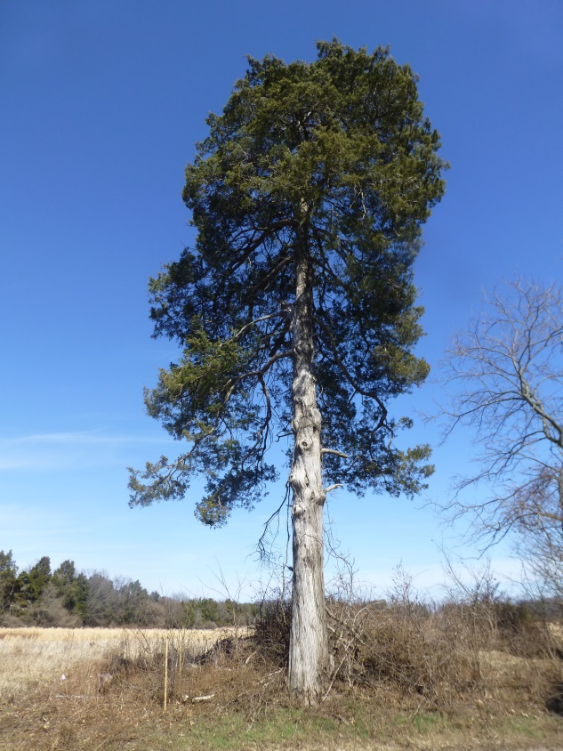
Core properties comprise 2,379 acres
175 acres
Reserved for active recreation
20 miles of new trails proposed
“In wilderness is the preservation of the world “
Henry David Thoreau
78% undisturbed
Notes:
Overall, the goal of this project is to propose park development that follows the recommendations of the regional master plan, that provides needed park facilities, both locally and regionally, and that allows the parks to develop in harmony with one another and the surrounding communities.
The benefits of these proposed park developments to the local community is tremendous. There will be 20 miles of trails, over 1,800 acres of protected natural landscapes and increased local athletic facilities to minimize driving trips for area residents.

Slide 20
Public Participation
Public comment and participation was an integral part of Sully Woodlands Regional Master Plan Development
Public and other stakeholders invited to comment on Core Property Draft CDP’s
Park Authority commitment to public input
Notes:
The Park Authority is committed to public involvement as part of the park design process. We look to the local community, user groups and other interested parties to guide our planning process.

Slide 21
Project Schedule
January - April
2014
Public Outreach
April 2104
Public Information and Input
April - June 2014
Revisions/develop draft plan for Sappington
4 draft plans
October 2014
October/November 2014
Winter 2015
Present draft Sappington plan and
60-day Public comment period
PA Board action on all properties
Present existing conditions for Sappington
60-day public comment for 4 draft plans
Final plans for Core Properties
Notes:
The next steps in the process include:
Collecting and compiling comments on these plan revisions
Revisions as may be needed
Presentation of final plans to the Park Authority Board for action.

Slide 22
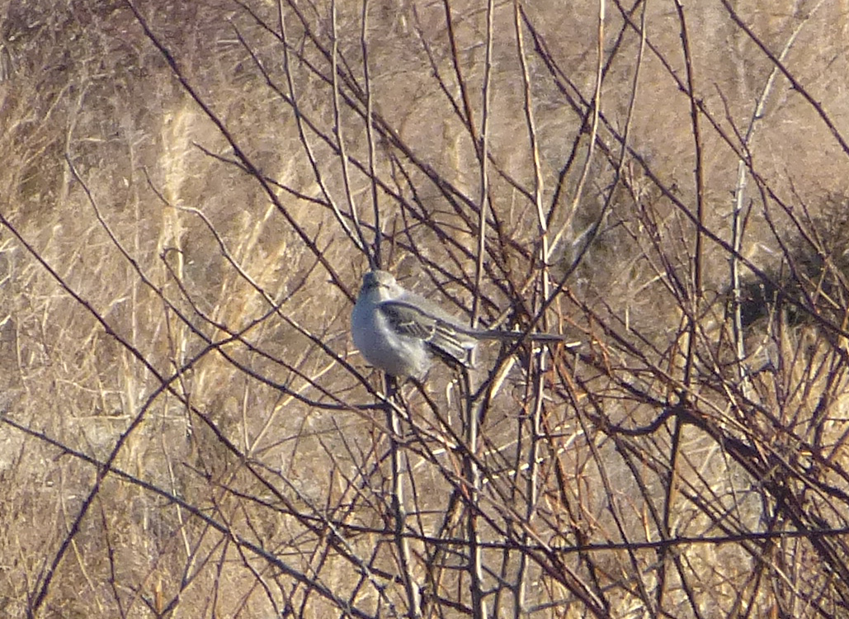
Comments and Feedback
Project website:
http://www.fairfaxcounty.gov/parks/plandev/sullywoodlands.htm
e-mail: parkmail@fairfaxcounty.gov
Send written comments to:
Pat Rosend, Project Manager
FCPA Planning &
Development Division
Suite 406
12055 Government Center Pkwy
Fairfax, Virginia 22035
Phone: 703-324-2387
Notes:
Thank you for you time on this project. The Park Authority appreciates your commitment to the park development process and looks forward to hearing your thoughts on these plans and projects.

