Slide 1
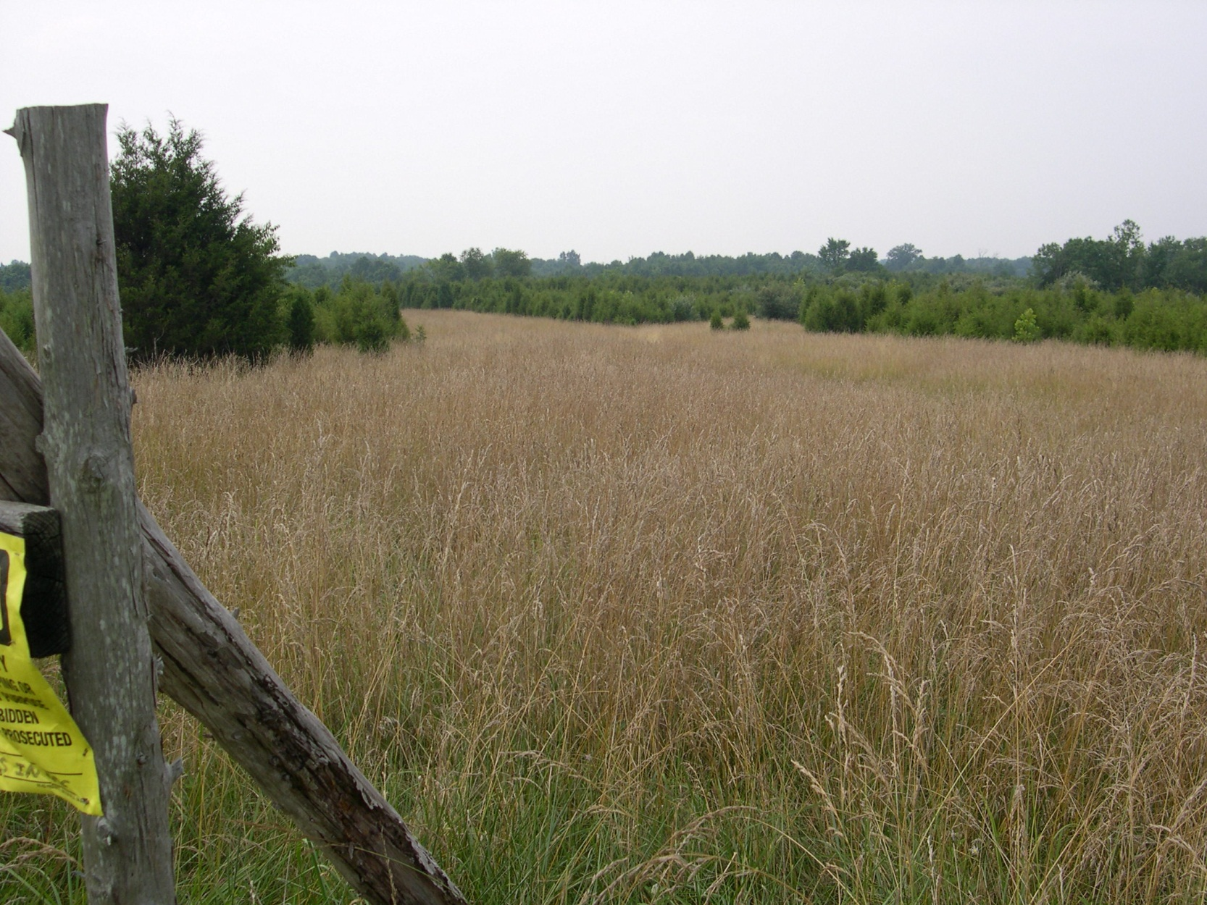
Elklick Preserve
Fairfax County Park Authority

Slide 2
Elklick Preserve
Fairfax County Park Authority

Slide 3
Elklick Preserve
Fairfax County Park Authority

Slide 4
Elklick Preserve
Fairfax County Park Authority

Slide 5
Elklick Preserve
Fairfax County Park Authority

Slide 6
Elklick Preserve
Fairfax County Park Authority

Slide 7
Elklick Preserve
Fairfax County Park Authority

Slide 8
Elklick Preserve
Fairfax County Park Authority

Slide 9
Elklick Preserve
Fairfax County Park Authority

Slide 10
Poplar Ford Park
Fairfax County Park Authority

Slide 11
Poplar Ford Park
Fairfax County Park Authority

Slide 12
Poplar Ford Park
Fairfax County Park Authority

Slide 13
Poplar Ford Park
Fairfax County Park Authority

Slide 14
Poplar Ford Park
Fairfax County Park Authority

Slide 15
Poplar Ford Park
Fairfax County Park Authority

Slide 16
Poplar Ford Park
Fairfax County Park Authority

Slide 17
Poplar Ford Park
Fairfax County Park Authority

Slide 18
Hickory Forest Park
Fairfax County Park Authority

Slide 19
Hickory Forest Park
Fairfax County Park Authority

Slide 20
Hickory Forest Park
Fairfax County Park Authority

Slide 21
Mountain Road District Park
Fairfax County Park Authority

Slide 22
Mountain Road District Park
Fairfax County Park Authority

Slide 23
Mountain Road District Park
Fairfax County Park Authority

Slide 24
Mountain Road District Park
Fairfax County Park Authority

Slide 25
Mountain Road District Park
Fairfax County Park Authority

Slide 26
Mountain Road District Park
Fairfax County Park Authority

Slide 27
Sappington Property
Fairfax County Park Authority

Slide 28
Sappington Property
Fairfax County Park Authority

Slide 29
Sappington Property
Fairfax County Park Authority

Slide 30
Sappington Property
Fairfax County Park Authority

Slide 31
Sappington Property
Fairfax County Park Authority

Slide 32
Sappington Property
Fairfax County Park Authority

