Slide 1
Stewardship Education
Educational Benefits
Centralized resources to service area students and teachers.
Extracurricular activities related to STEM and environmental sciences through after-school and summer camps.
Exhibits and programs aid in reaching the goals of the Virginia Standards of Learning.
A means for parents and caregivers to be more involved in educating their children.
Youth leadership programs to cultivate continued interest in STEM and environmental sciences.
A place that inspires youth to fill region’s significant technology workforce needs: 51% of net new jobs in No. Va. in next decade require significant science and math skills.
Community Benefits
A “town square” where citizens from across generations can engage and share their STEM talents and perspectives.
Meeting and event resources for the entire community.
A community connector, developing “Northern Virginia” identity.
Access for underserved children, enabling to be part of future technology workforce.
“Environmental education connects people and nature, prepares students for the future, empowers environmental stewards of all ages, builds community, and changes lives.”
North American Association for Environmental Education (NAAEE)

Slide 2
Stewardship Education Center Mission
Educate
STEM
Protect
Water
Preserve
History
Forest
SOL’s
MWEE
Nature
Habitat
Culture

Slide 3
Project Program
The Stewardship Education Center is to be a
state of the art interpretive facility to:
Provide educational and visitor services to encourage natural and cultural stewardship and promote STEM learning.
Work with state staff in the management of the Sully Woodlands Natural Area Preserve.
Provide opportunities to work with staff from educational institutions, specialty organizations and others to become a regional research facility and outdoor lab.
Manage non-recreational parkland.
Contain cultural resource laboratory, storage and collections display spaces.
Conduct research and natural resource management activities.

Slide 4
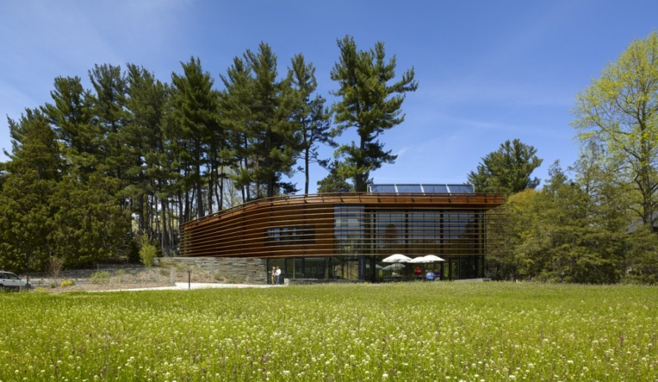
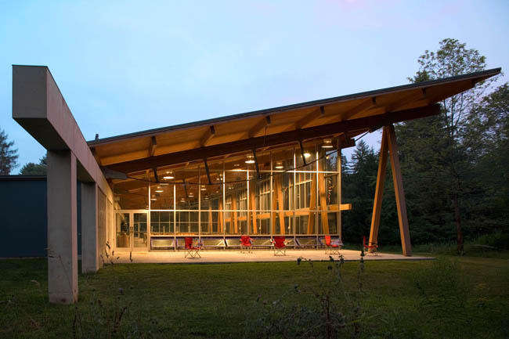
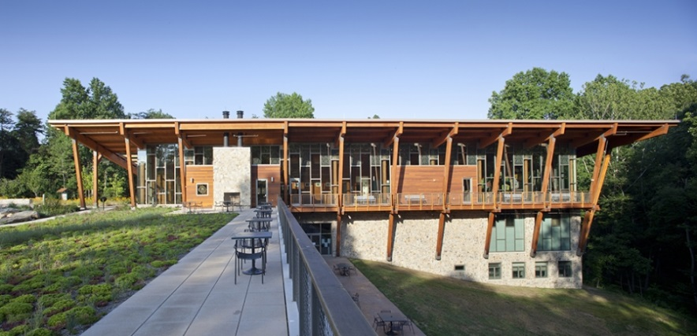
Nationally Recognized Facilities
Cornell Plantations Welcome Center, Ithaca, NY
Pocono Environmental Education Center,
Dingmans Ferry, PA
Robinson Nature Center, Columbia, MD
Chesapeake Bay Foundation
Philip Merrill Environmental Center, Annapolis, MD

Slide 5
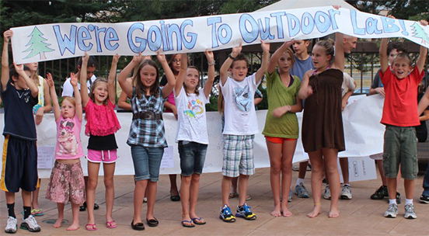
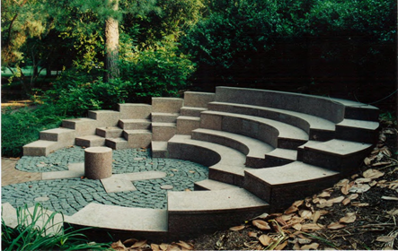
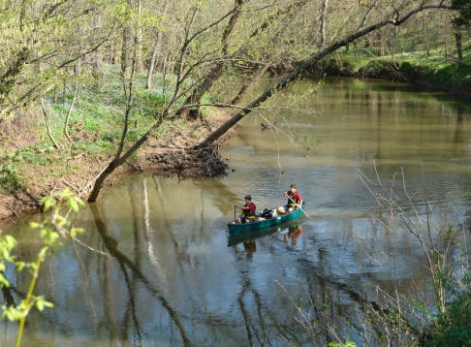
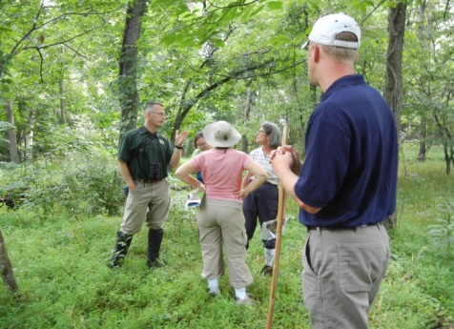
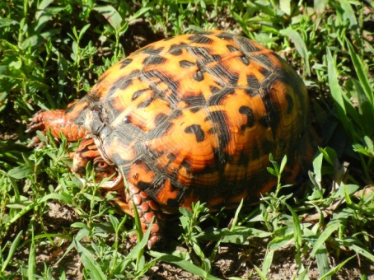
Stewardship Education Center in Sully Woodlands
Educate
Discover
Partner
Preserve
Manage
Research

Slide 6
SEC Conceptual Plan
Visitor Center
Indoor Classrooms
Collections storage and display
Staff Research
Partner space
Outdoor classrooms
Exhibit space

