Slide 1
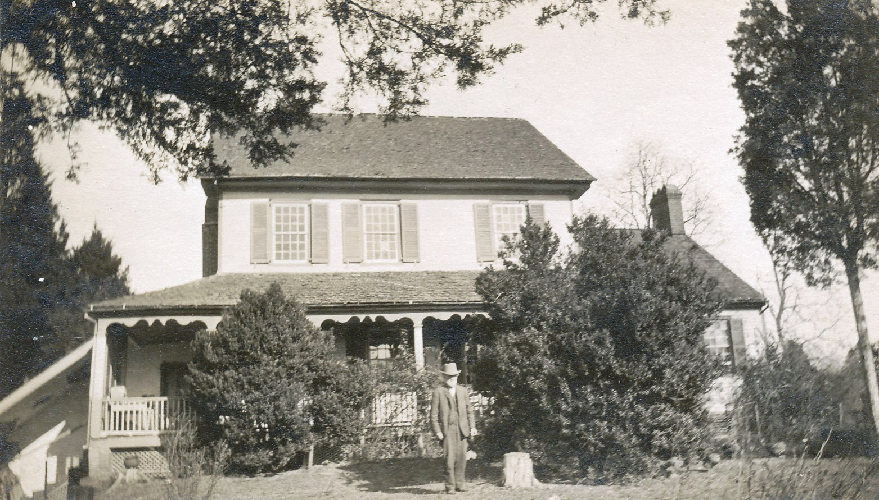
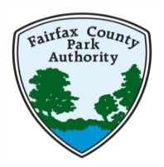
The Sully House
Early photo 1890’s
Sully Historic Site
3650 Historic Sully Way, Chantilly, Va.

Slide 2
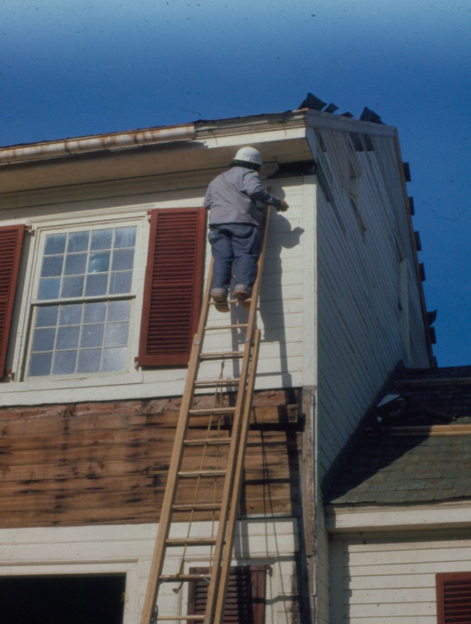
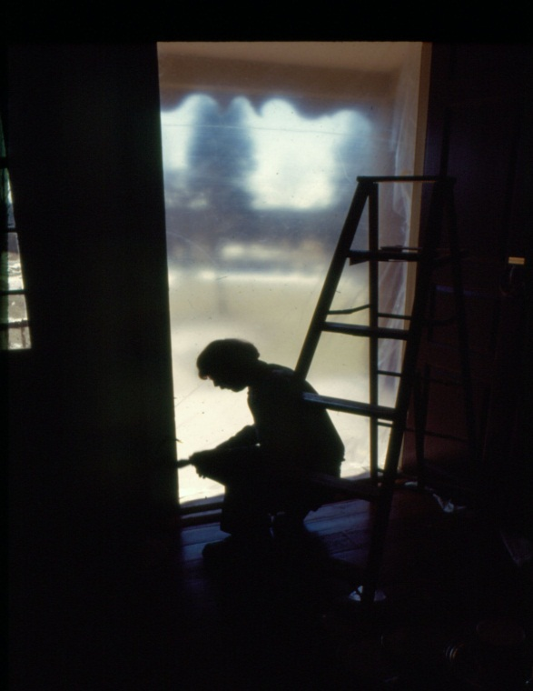
Built in 1794, built to last… Restored in 1974-1975

Slide 3
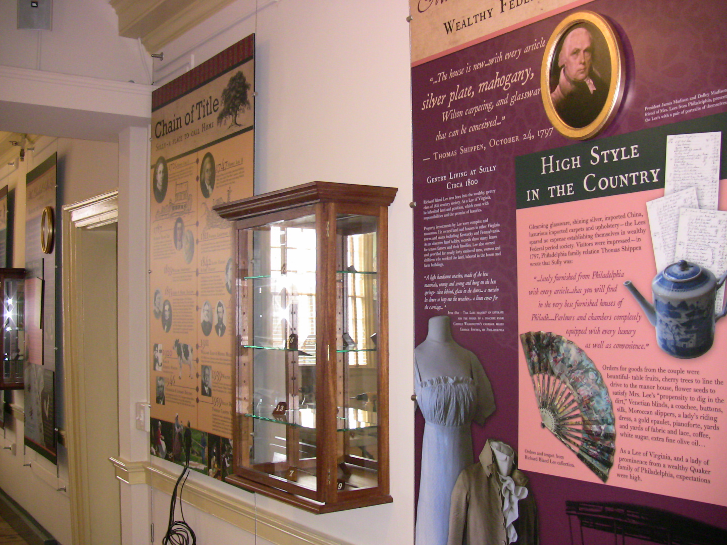
New Exhibit from Fairfax County bond funding 2011

Slide 4
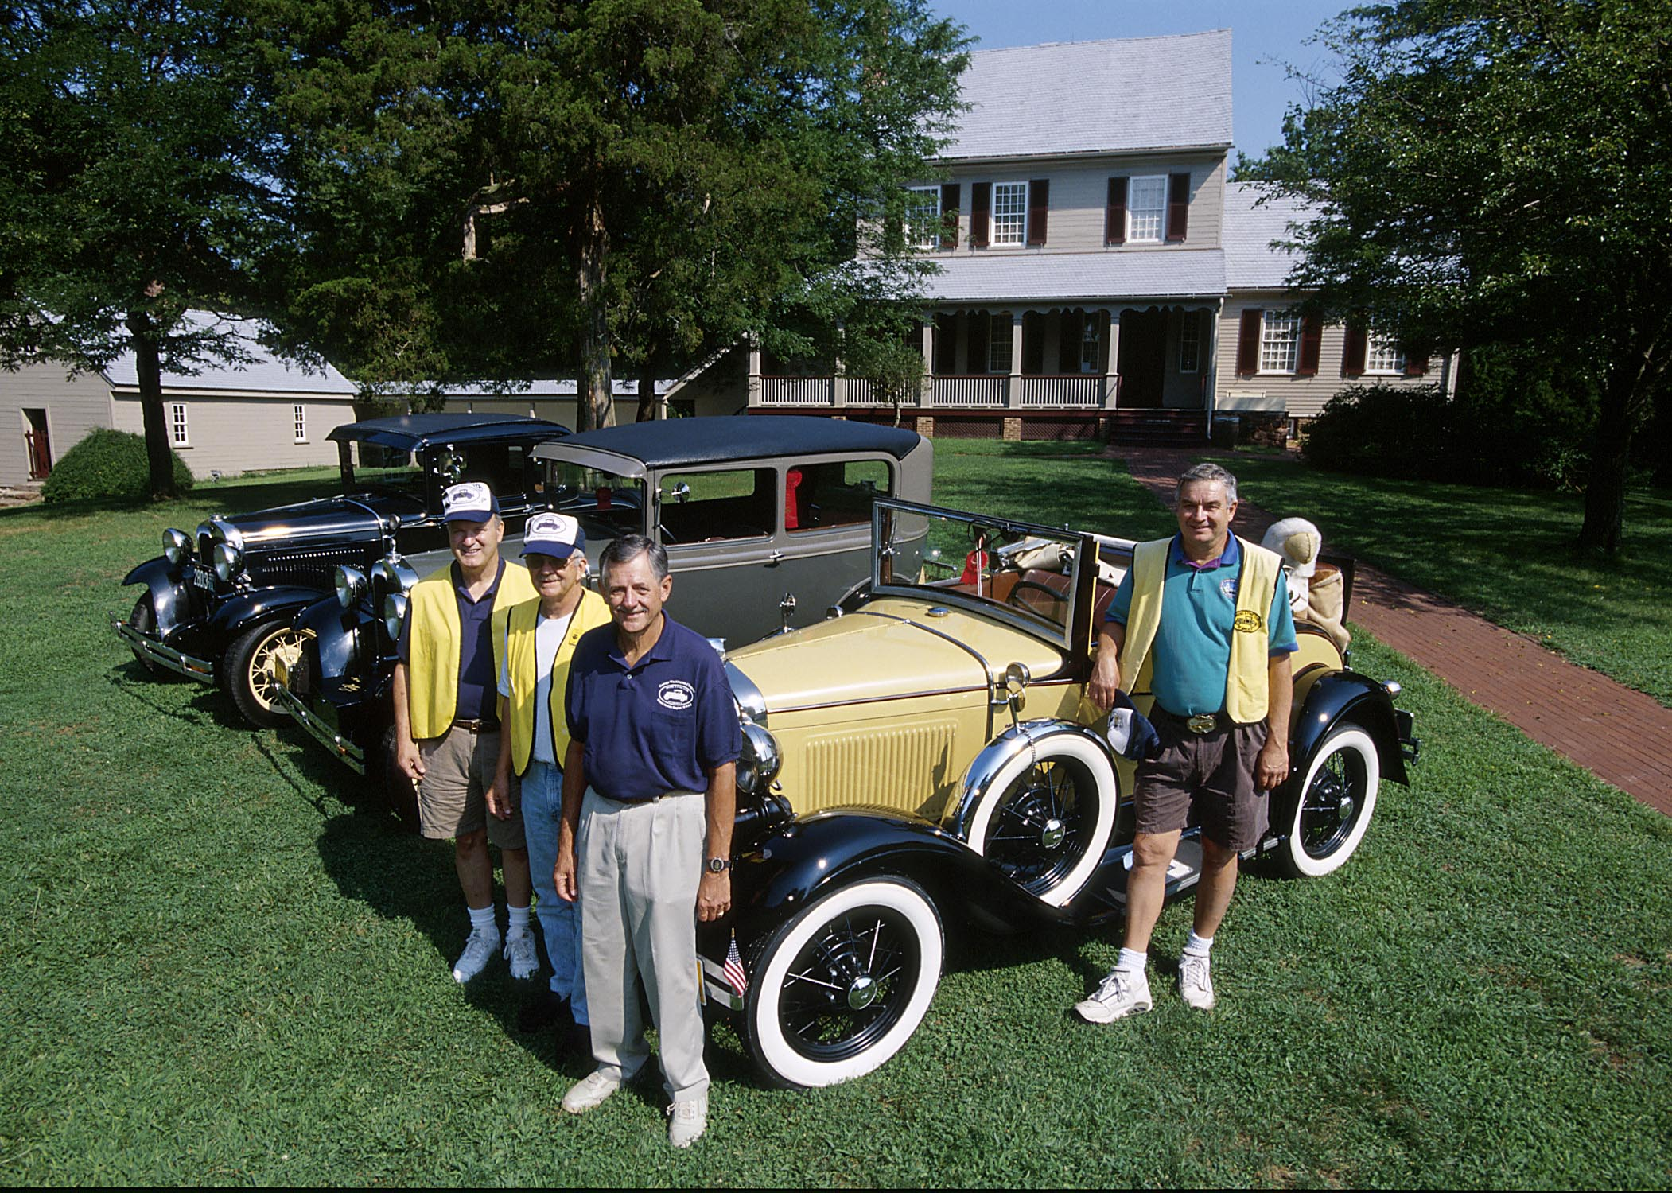
41 years of Sully Car Show success!

Slide 5
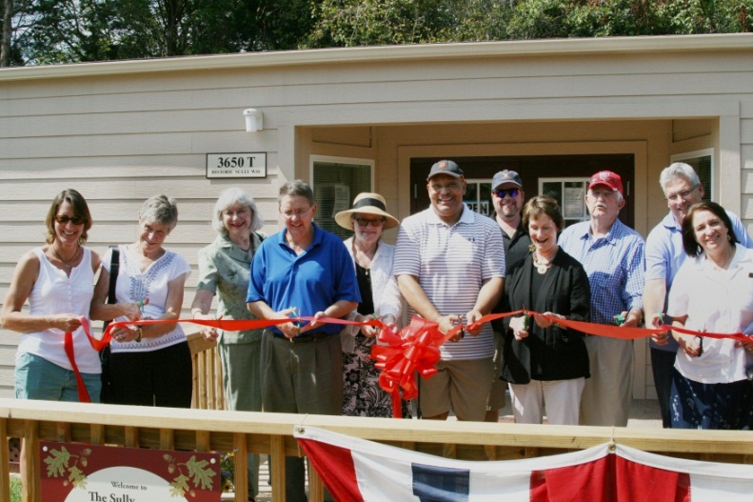
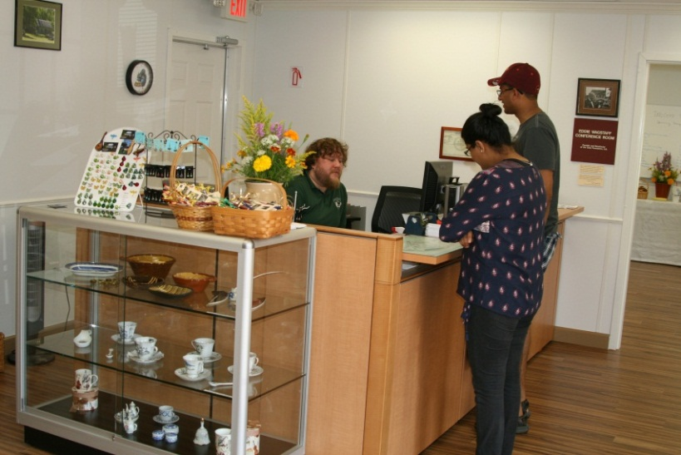
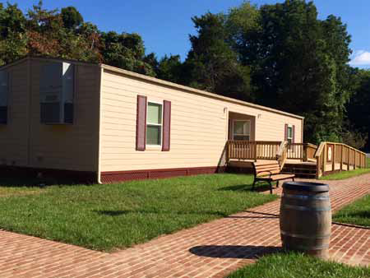
2014- New Sully Visitor Center open with small conference room space

Slide 6
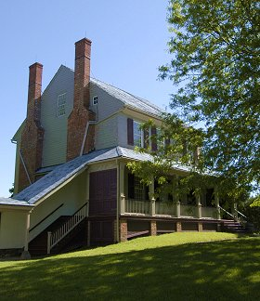
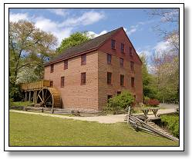
American Alliance of Museums Re-Accreditation program
Resource Management Division,
1979 - 2016

Slide 7
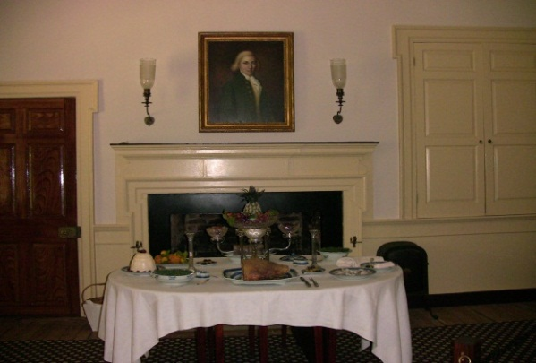
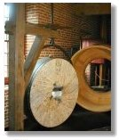
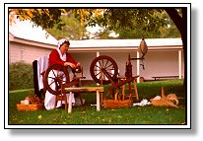
What is AAM Accreditation?
A nationally recognized seal of approval
The mark of excellence in museum operations
A rigorous process of self assessment and peer review
Serves as the museum field’s primary vehicle for quality assurance, self regulation, ethics and professionalism

Slide 8
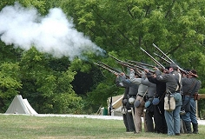
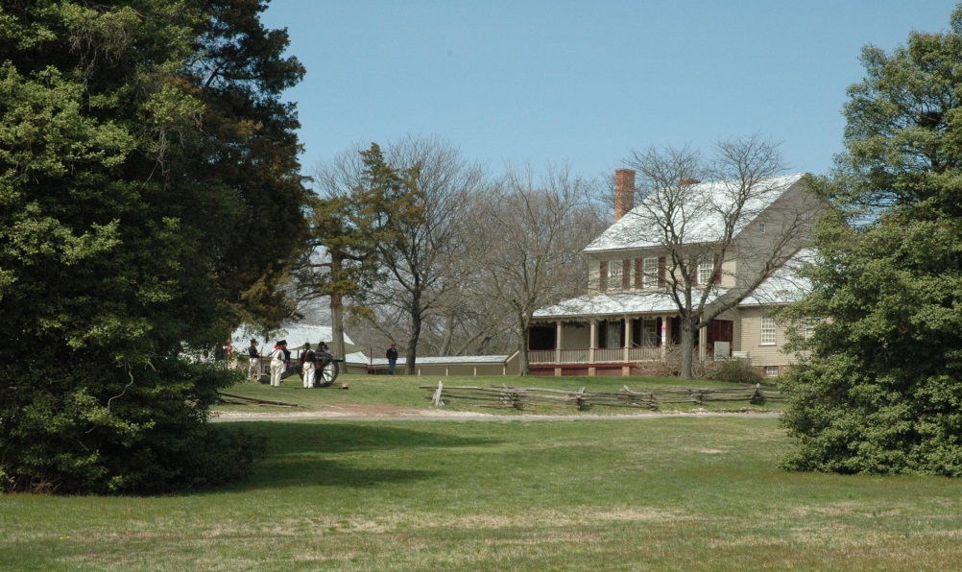
Accredited Status
Signifies our fulfillment of mission and obligation to the public
Recognizes our commitment to excellence, accountability and high professional standards of operations and continued institutional improvement
Certifies that the FCPA has met the accreditation standards, has undergone a rigorous process of self-assessment and peer review, and operates according to current best practices.

Slide 9
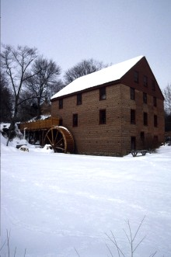
Benefits of Accreditation
Re-focused sense of purpose/mission
Clear understanding of our strengths, goals and priorities
Increased credibility with funding agencies, donors and partnerships
Stakeholders see that the agency’s obligation to the public trust is fulfilled

Slide 10
Ellanor C. Lawrence Park

Slide 11
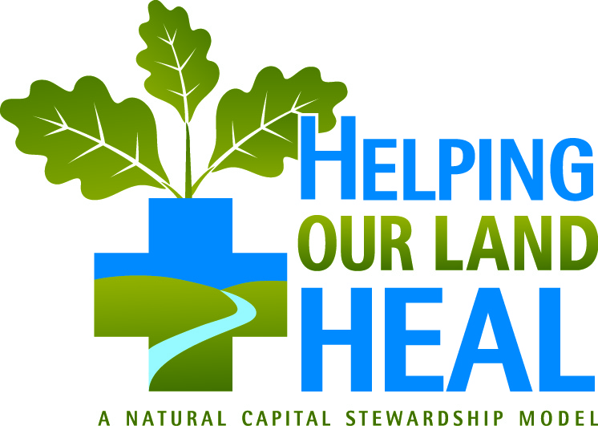
Current Management Actions in the Park Look Destructive, but are Beneficial!
To “Help Our Land Heal”, we are actively managing our forests and meadows with a number of actions to reduce the negative impacts of over-browsing deer, non-native and invasive plants, conflicting uses, and other threats.

Slide 12
All FCPS 1st Graders Will Use This Illustration This HOLH Illustration is On-line for All to Use

Slide 13
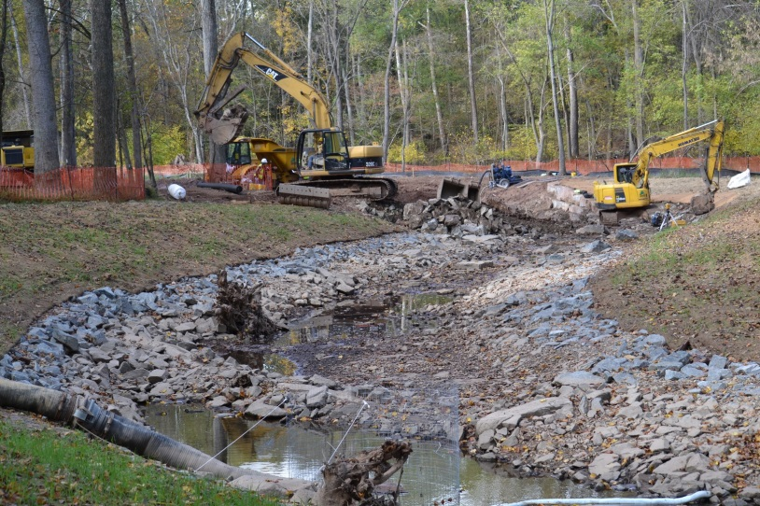
Big Rocky Run Stream Restoration Project – Completed Fall 2014

Slide 14
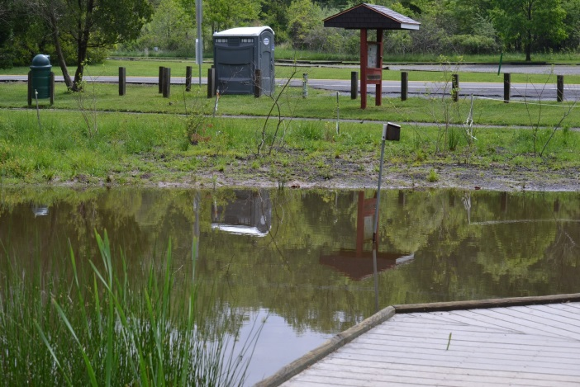
Walney Pond Projects - 2014
Underwater barriers to trap siltation in run-off
Channel to direct run-off into natural buffers

Slide 15
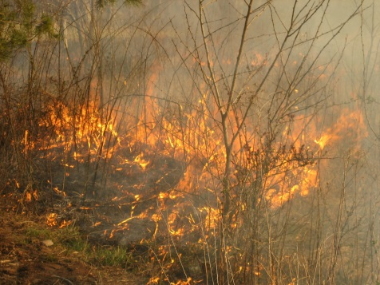
Meadow Management Actions
Mechanical Disking, Clearing, and Sawdust
Burning/Fire Breaks

Slide 16
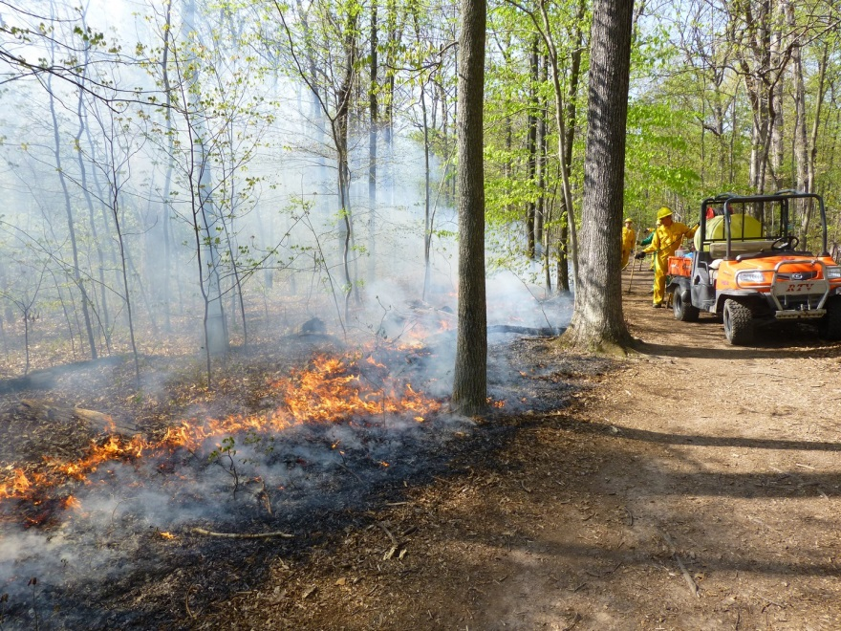
Forestry Management Actions

Slide 17
Equipment Use
Tracked Bobcat
Clearing Attachment

Slide 18
Forestry Management Actions
Forest Clearing
Before & After with Trail Between

Slide 19
Invasive Non-native Plants Removed by the Machine

Slide 20
A Number of Cultural History Sites are Being Actively Managed
Walney Icehouse – An Iron Structure is Being Built
Walney Dairy – Perimeter Excavation will Install Wall Protection
Walney Dairy – Building Berms to Divert Surface Run-off
Walney Dairy – Cleaning of Stone Surfaces
Walney Dairy – Construction of Additional Protective Landscape Walls

Slide 21
Walney Icehouse Stabilization Structure
Original Wall Needs Support
Steel for Constructing Structure to Stabilize, Secure, and Interpret the Feature

