Slide 1
Silver Line Update
November 18, 2015
Mark Canale
Fairfax County Department of Transportation

Slide 2
Project Status

Slide 3
Status
Phase 1
VDOT, WMATA, Fairfax Punchlist – Ongoing
Fairfax County – 38 open items
VDOT with majority of remaining punchlist items
Project Closeout anticipated at the end of 2015
Fairfax County completed clean up of kiss and ride lots and Route 7 median stormwater (MWAA to reimburse the County) – County to maintain Route 7 SWM
County Maintaining Mclean, Spring Hill K/R lots
Art in Transit Task Order issued
Phase 1 close out - $2.982B
Phase 2
Total Project Status (all bid packages)
Overall Project – 26%
Design – 94%
Construction – 10%
Highlights
Tower crane at Innovation Center Station
All Stations in Fairfax County have construction and/or utility work ongoing
Loudoun County Stations in design
Aerial Guideway at Dulles Airport under construction
Rail Yard at Dulles Airport in design
Centreville Road Girders Placement ongoing
Budget - $2.775B
Total Contingency - $551.4M (Remaining $500M)
Contract extension costs under negotiations between MWAA and CRC
County Activities – Past 60 Days
Girders at Centreville Road for rail track – Installation Completed
SE for Pavilion at Innovation Center Station (south) PC
Approved Oct 1
BOS approved Oct 20
Phase 2 Design Reviews
County Coordination
Project Partners (MWAA, VDOT, DRPT, WMATA, Loudoun County, Town of Herndon, Landowners)
Completed Phase 1 Kiss and Ride and RT 7 SWM Clean up
Herndon and Innovation Center Stations Garages – Ongoing design work
Herndon Station – Coordinated maintenance of traffic with MWAA, CRC, and Fairfax Connector for utility work

Slide 4
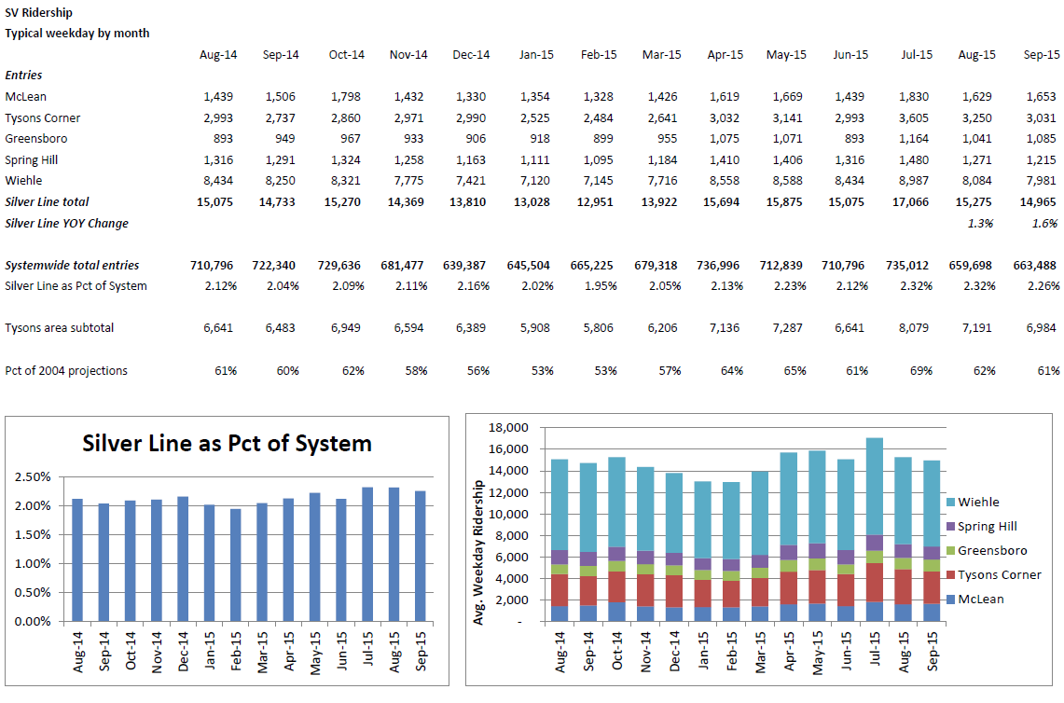

Slide 6
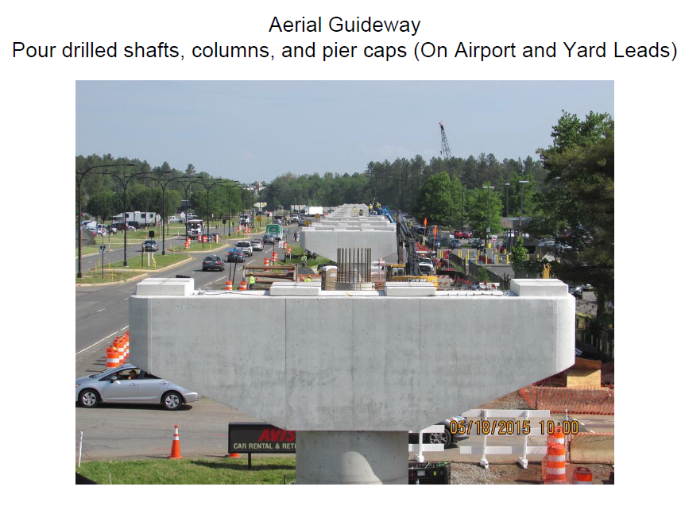

Slide 7
Project Overview

Slide 8
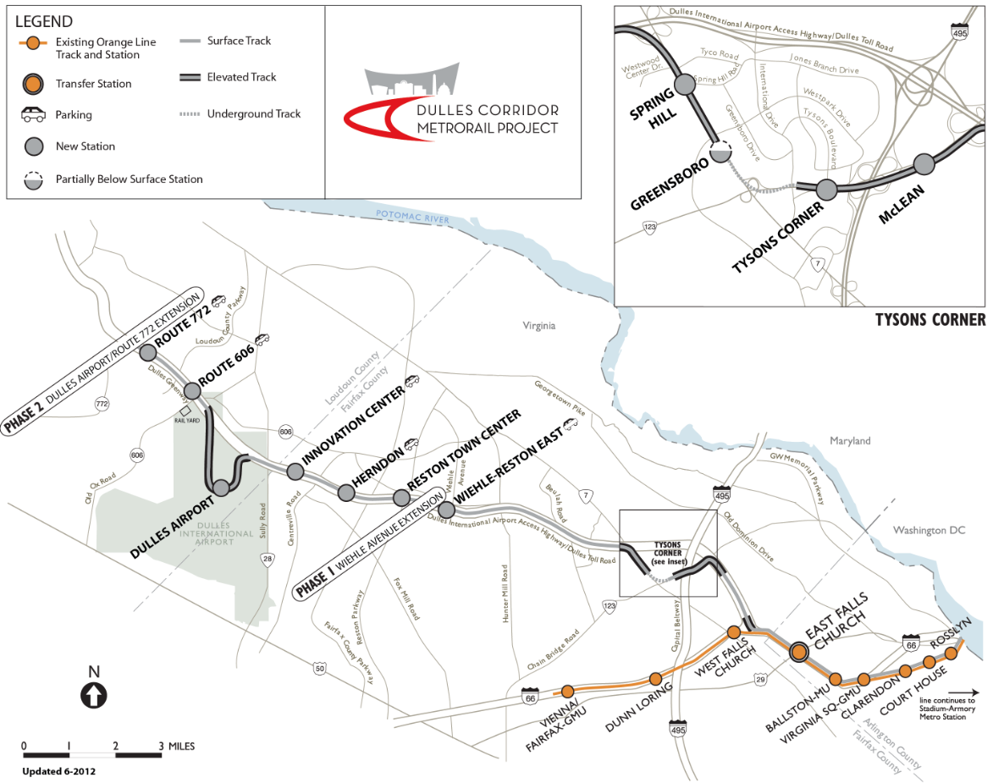
Route Map

Slide 9
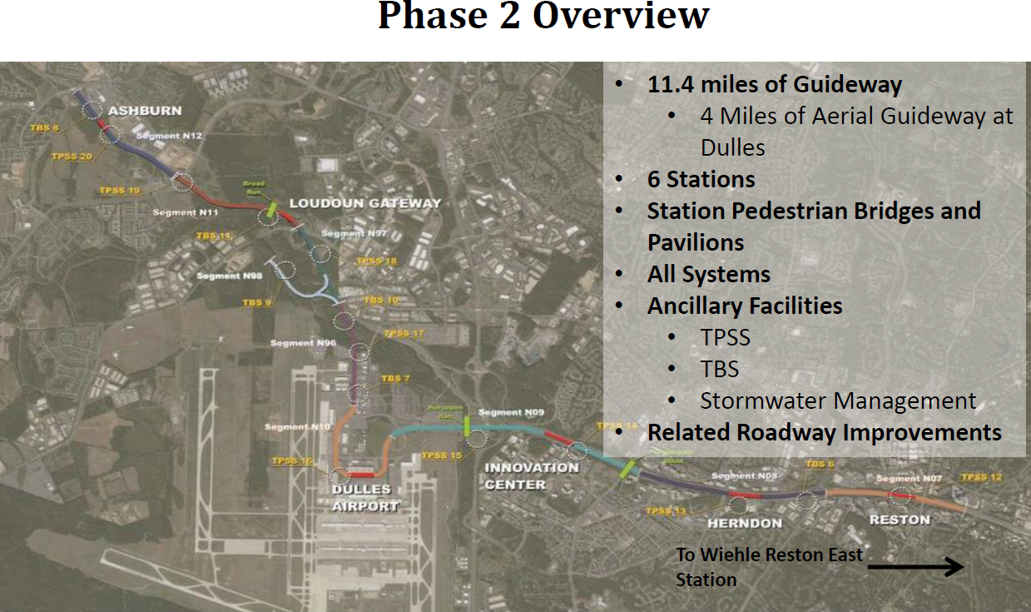

Slide 11
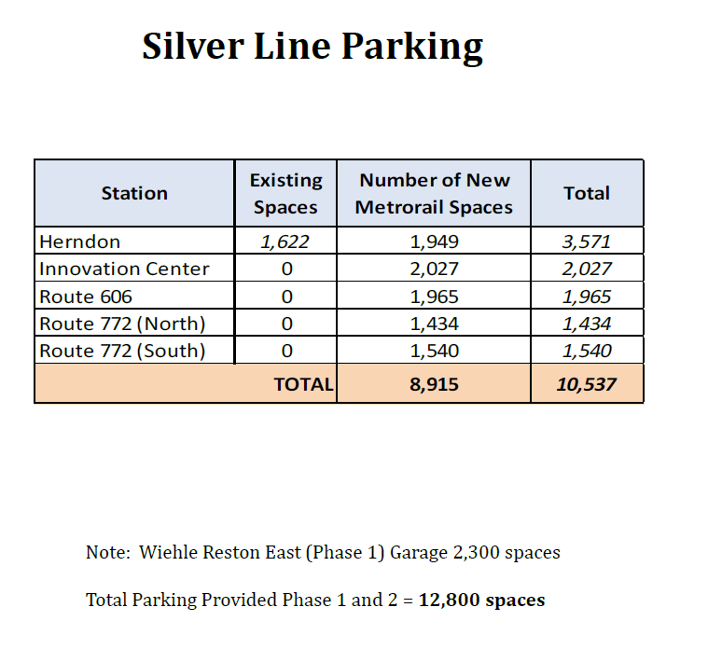

Slide 12
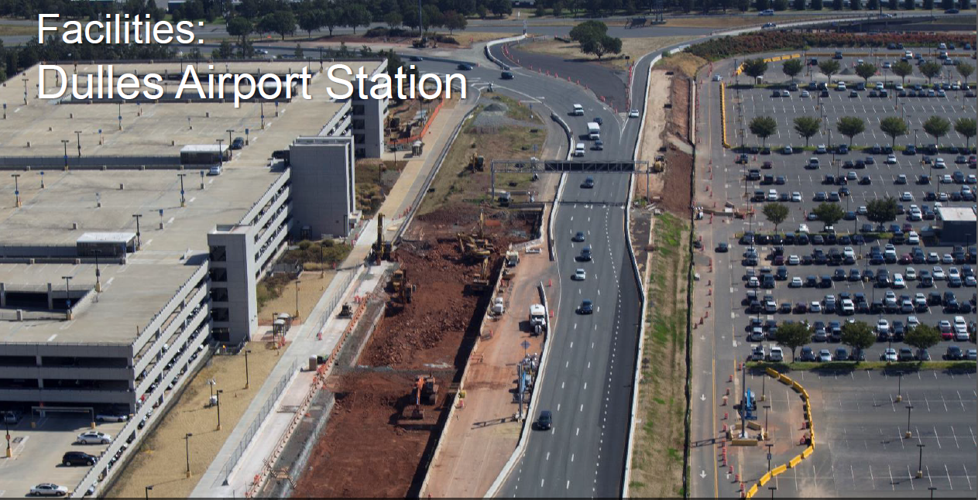

Slide 13
Fairfax County Stations without Garages

Slide 14
Innovation Center Station
Dulles Airport Station
Reston Town Center Station
Herndon Station
Phase 1 Last Station - Wiehle Reston East

Slide 15
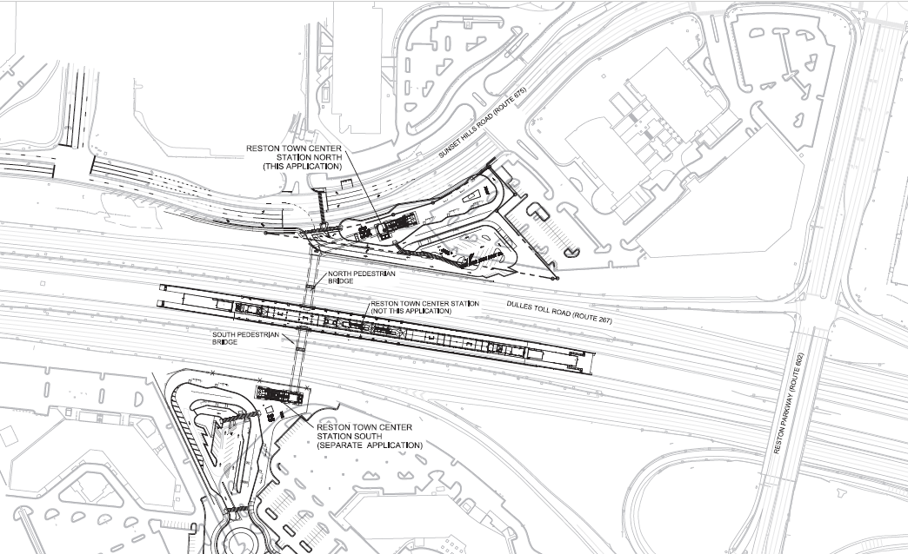
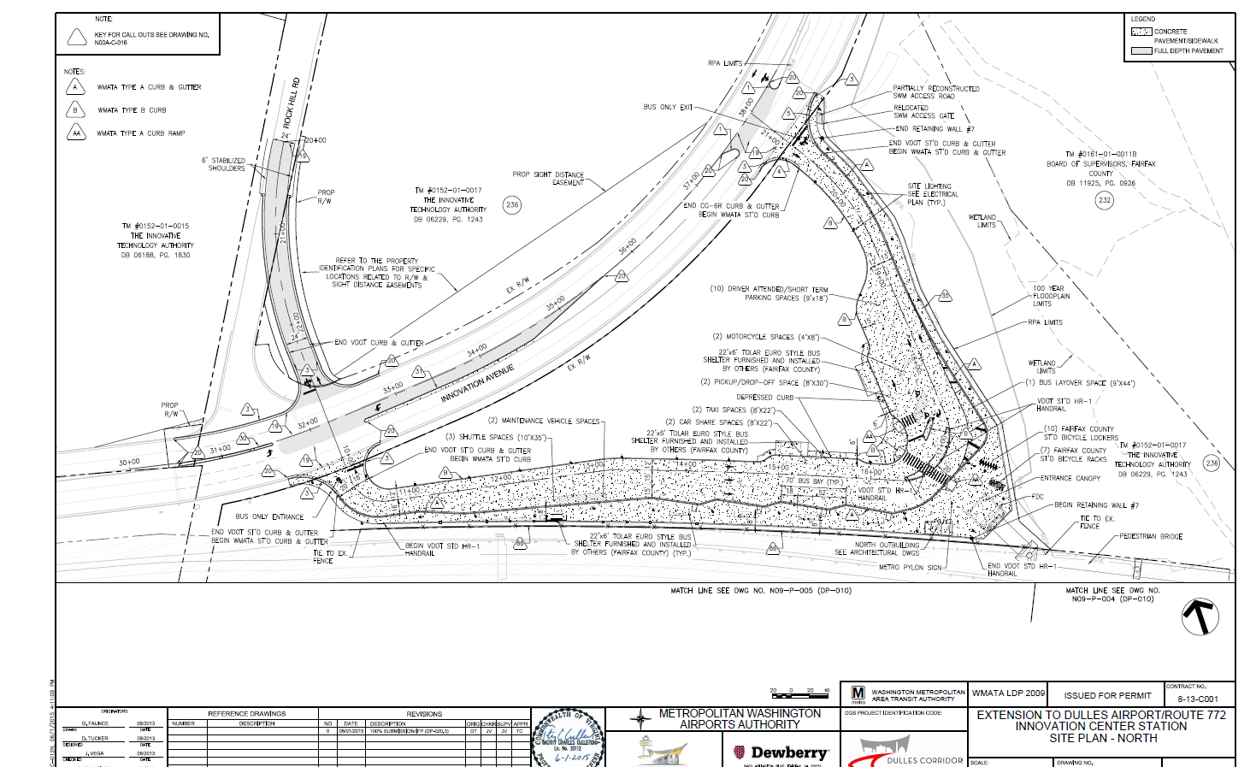
Reston Town Center Station

Slide 16
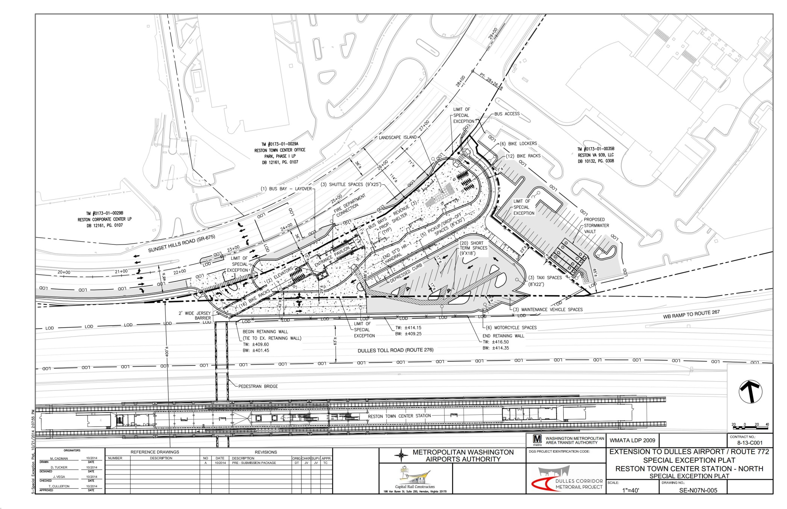
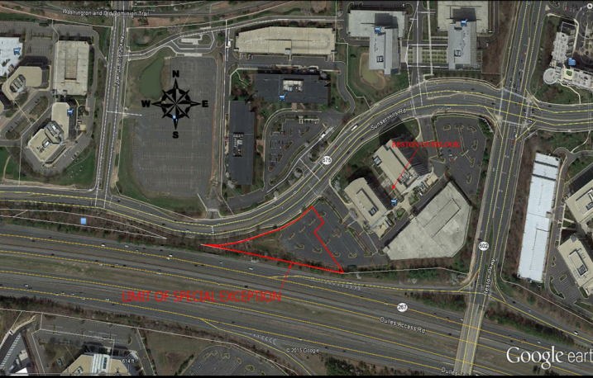
Reston Town Center Station - North Side

Slide 17
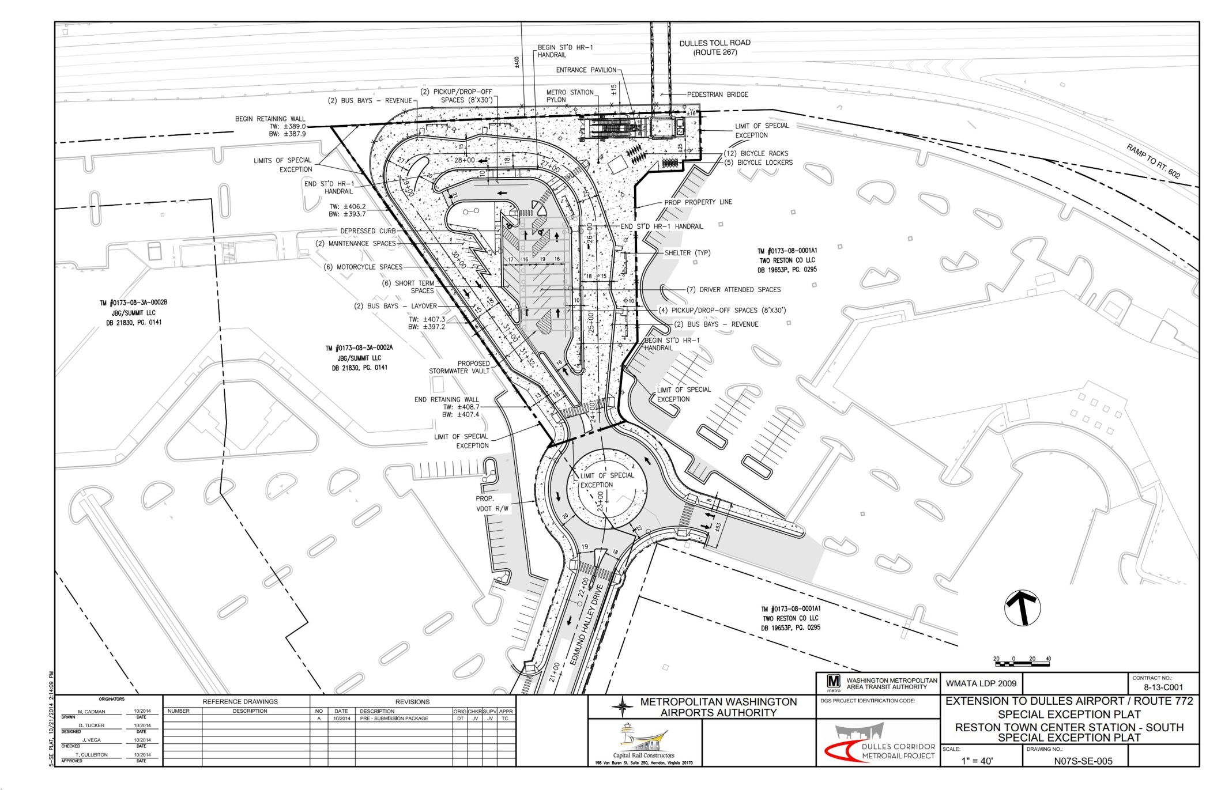
Reston Town Center Station - South Side

Slide 18
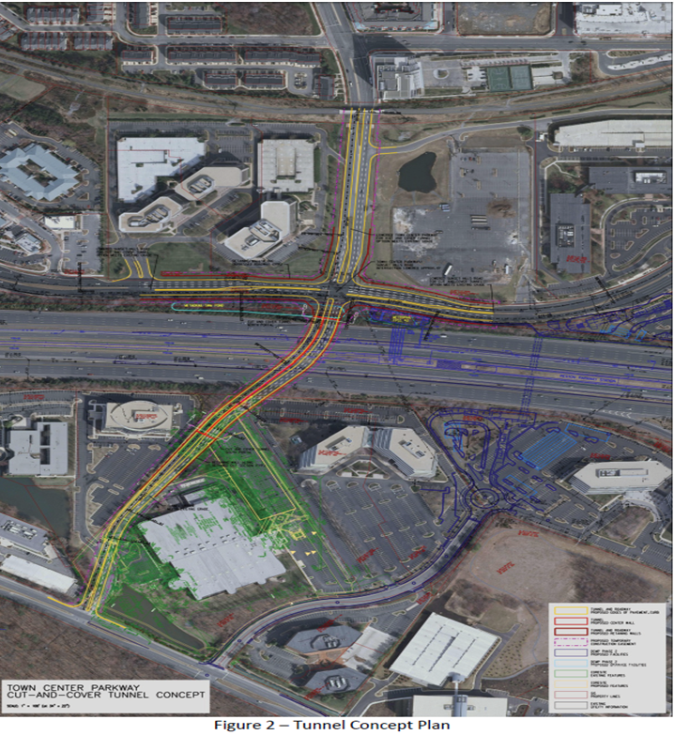

Slide 19
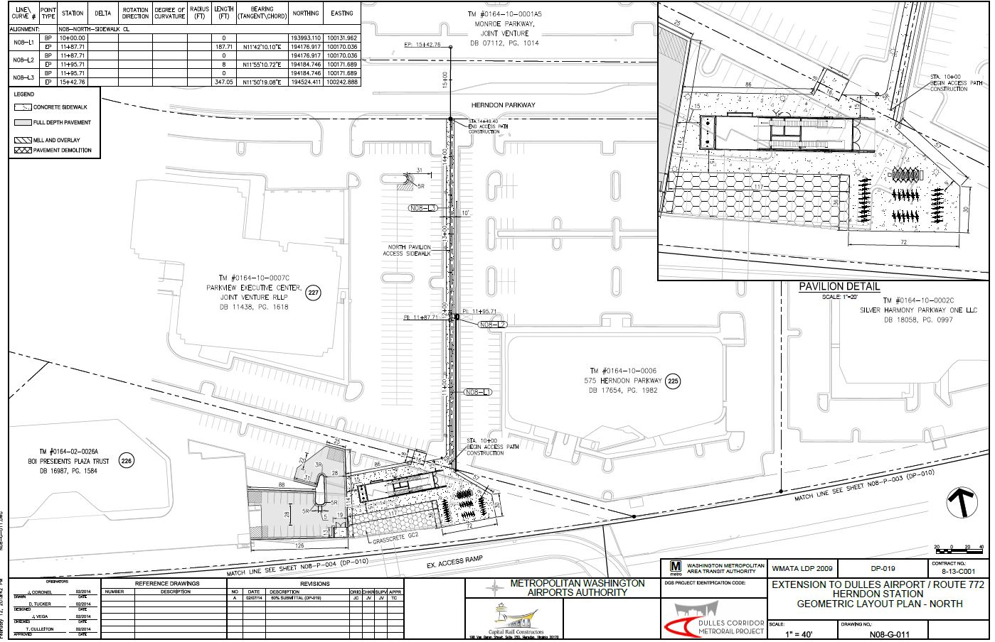
Herndon Station - North Side

Slide 20
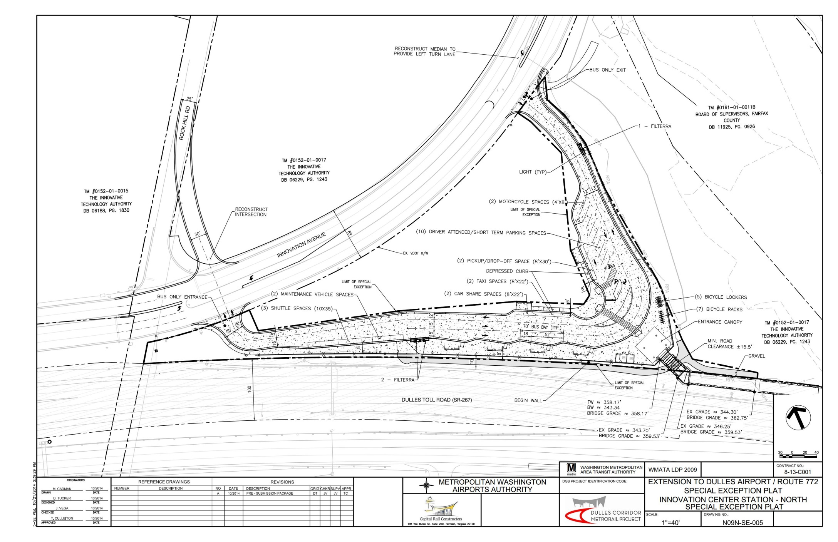
Innovation Center Station – North Side

Slide 21
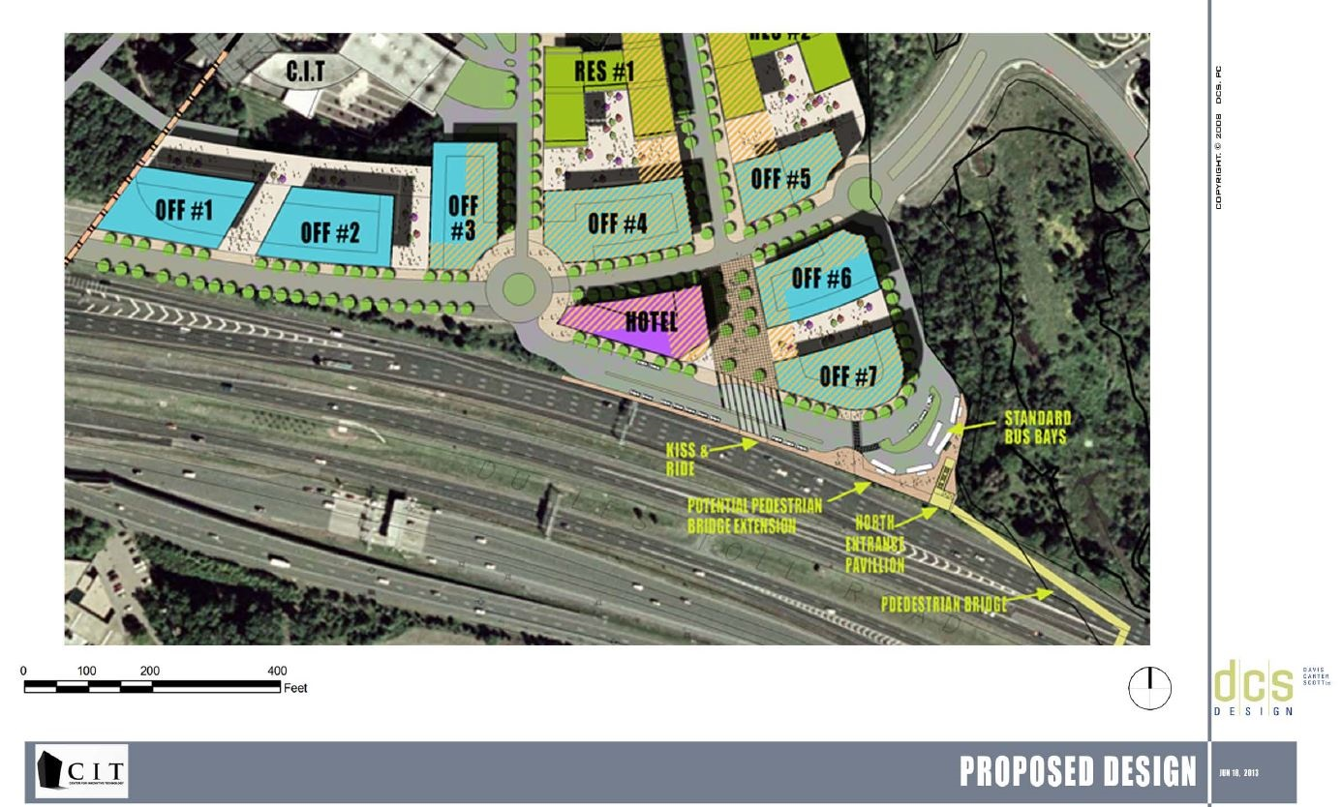

Slide 22
Fairfax County Stations with Garages

Slide 23
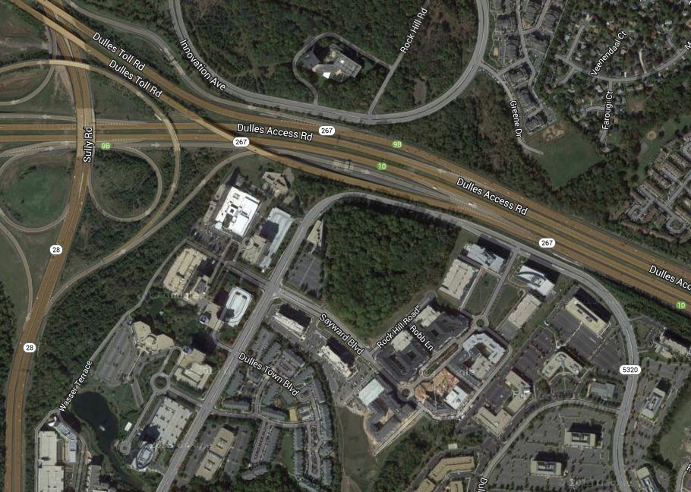
Innovation Center Station Garage
Location Map

Slide 24
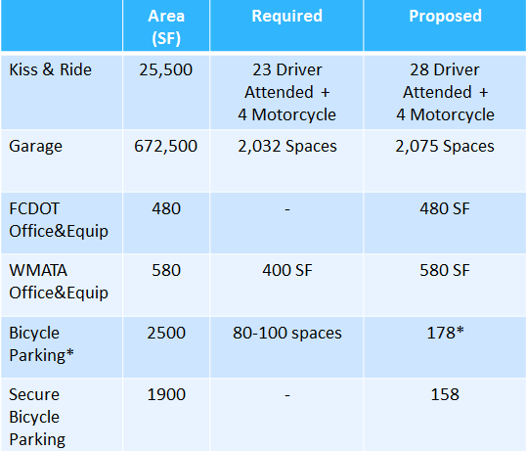
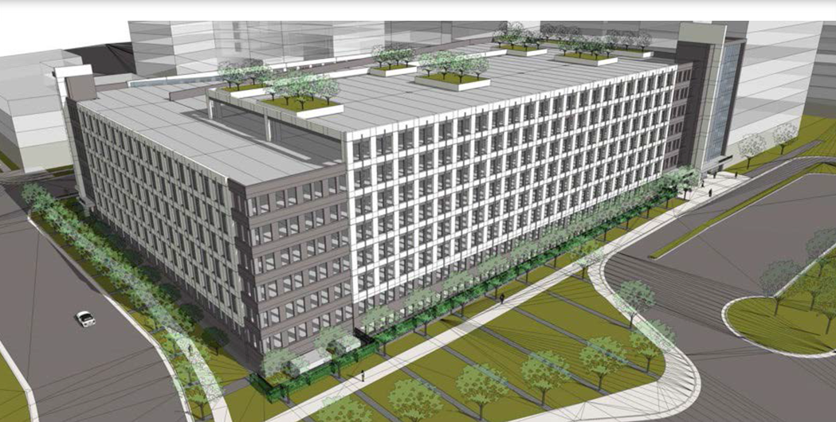
Innovation Center Station Garage

Slide 25
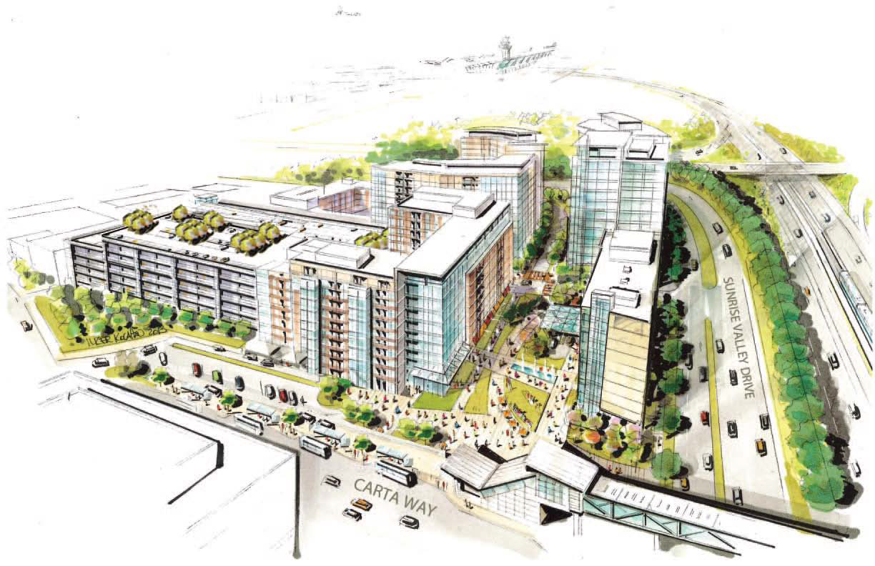
Innovation Center Station Garage
Campus

Slide 26
Innovation Center Station Garage
Campus

Slide 27
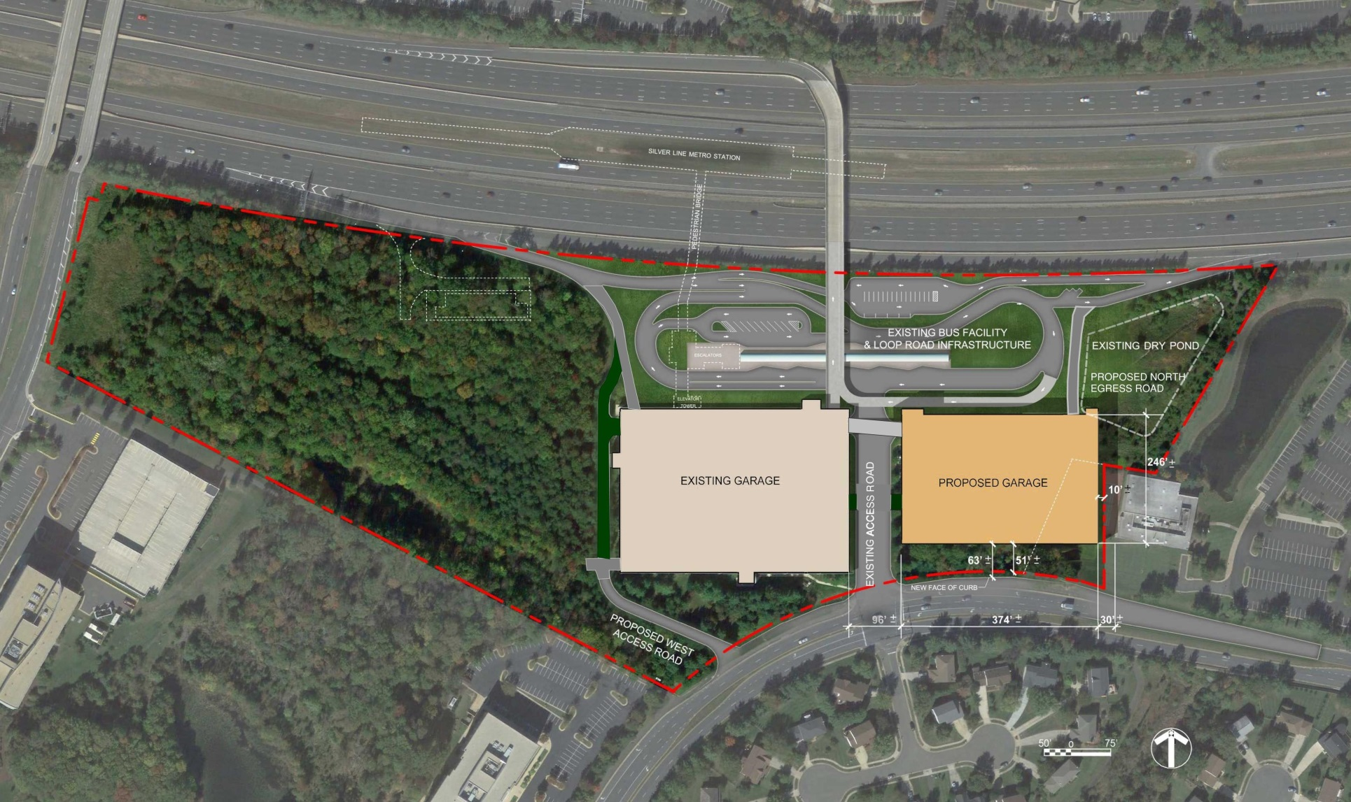
Herndon Station Garage
Building Design and Construction Division

Slide 28
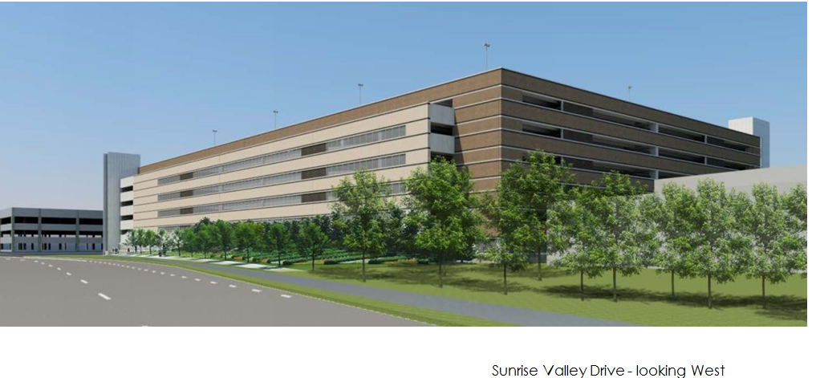
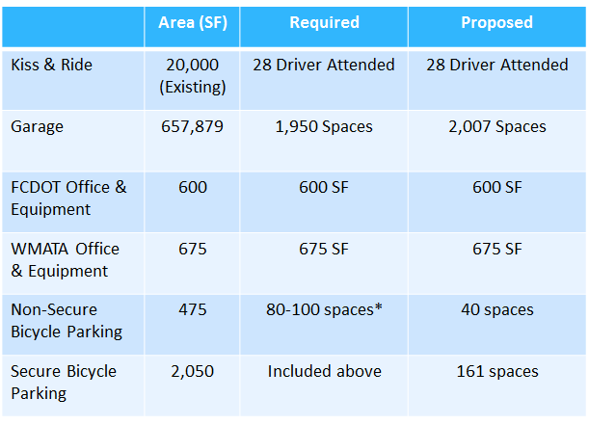
Herndon Station Garage

Slide 29
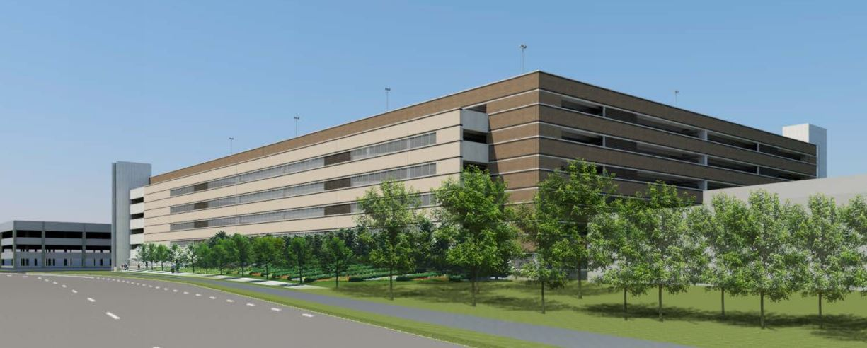
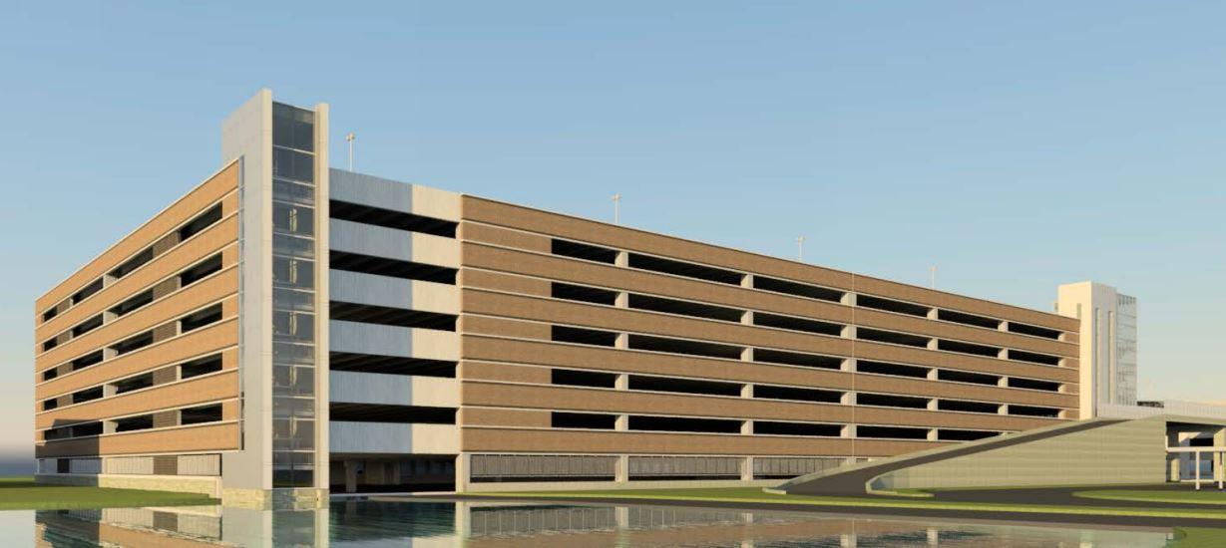
Garage Design - Elevations
Sunrise Valley Drive - looking West
Dulles Toll Road - looking South
Building Design and Construction Division

Slide 30
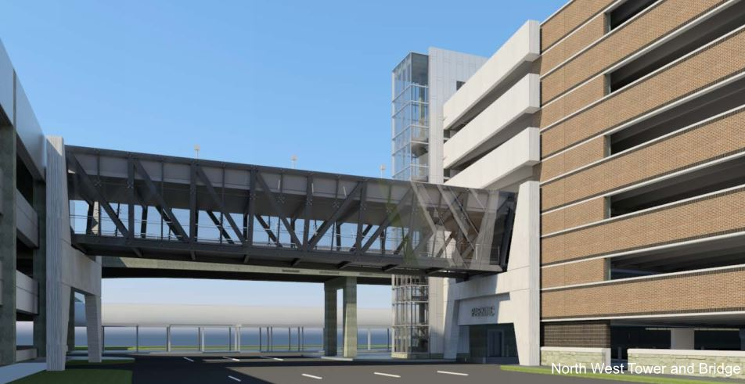
Garage Design - Bridge
Station Access Road - looking North
Building Design and Construction Division

Slide 31
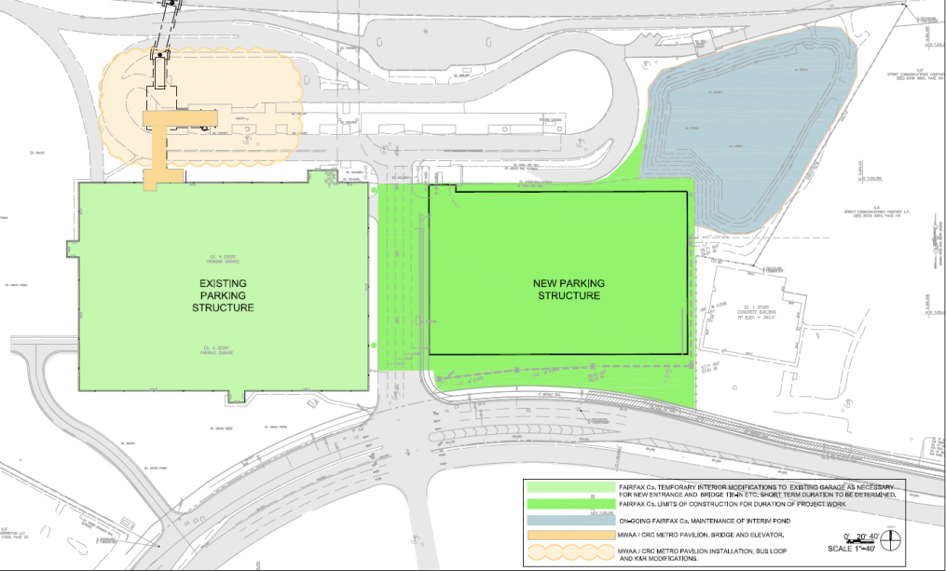
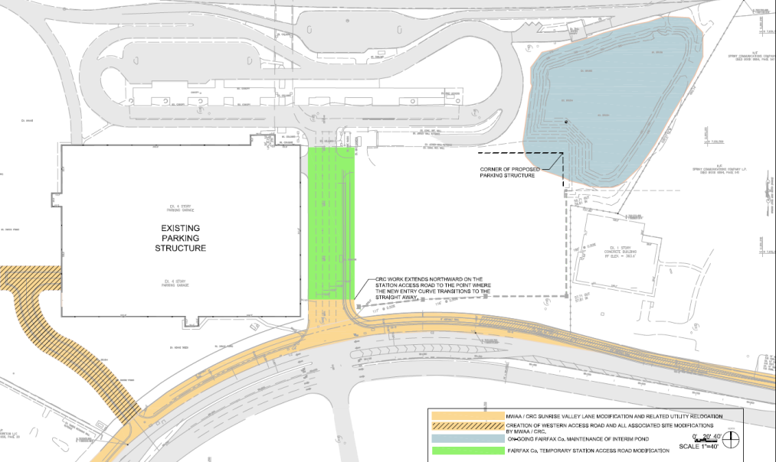
MWAA Coordination
Ongoing coordination with MWAA regarding interfacing with site and existing garage, utilities, stormwater management, Sunrise Valley Drive frontage improvements, utilities relocations, and onsite transportation improvements.
Metro South Pavilion (MWAA/CRC)
Stormwater Pond (FC)
Station Access Road (FC)
Existing Garage (FC)
New Garage (FC)
Sunrise Valley Drive (MWAA/CRC)
Western Access Road (MWAA/CRC)
Building Design and Construction Division

Slide 32
Questions?

