Slide 1
Fairfax County Fire and Rescue
Sully District Association Briefing

Slide 2
Fairfax County Fire & Rescue
Mission
Provide the highest quality services to protect the lives, property, and environment of our community
Vision
The Fairfax County Fire and Rescue Department is dedicated to being a premier community focused fire and rescue department ensuring a safe environment for everyone

Slide 3
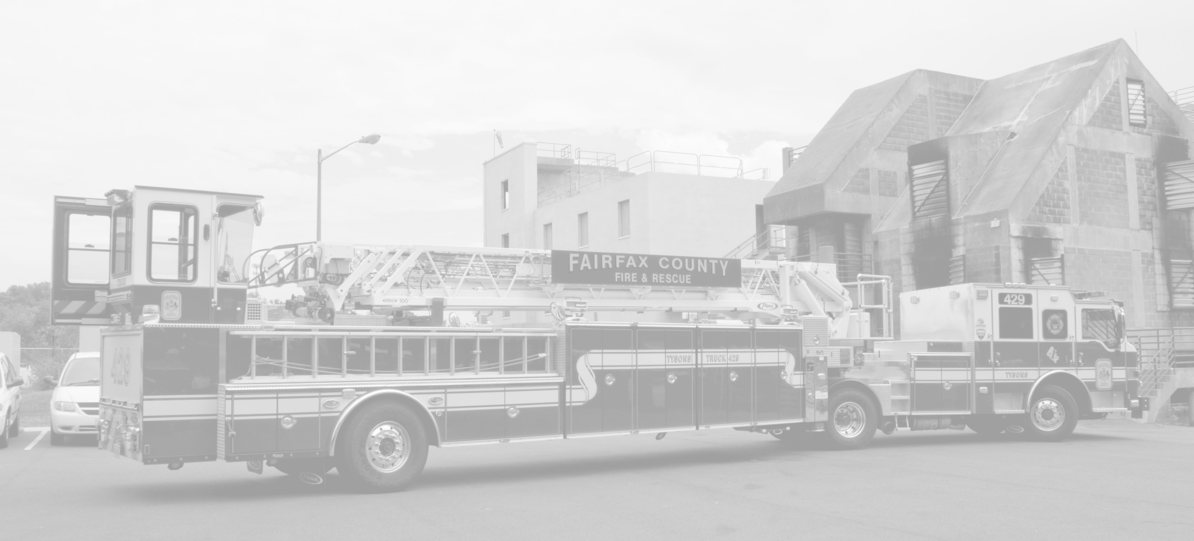
Fairfax County Fire & Rescue
FY2015 Annual Summary Figures
Population – 1,112,875
Roads – 4,800
Land Area – 395 sq. mi.
Acres – 260,368
Housing Units – 411,963
Households – 402,892

Slide 4
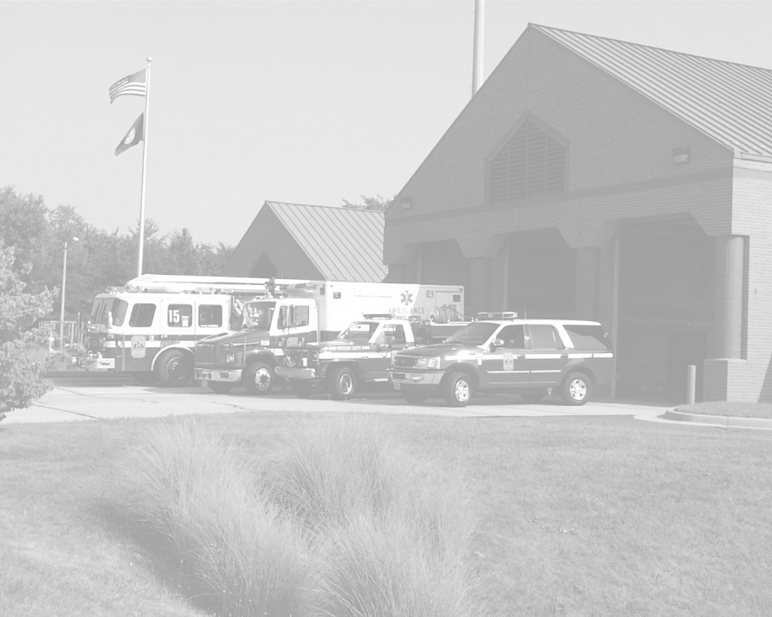
Fairfax County Fire & Rescue
Personnel
1366 Uniformed Personnel
184 Civilian Staff
382 Operational Volunteers
Units/Apparatus
38 ALS Engines
42 ALS Transport Units (Medics)
2 HAZMAT Units
14 Trucks
5 Tankers
8 Rescues (2 ALS)

Slide 5
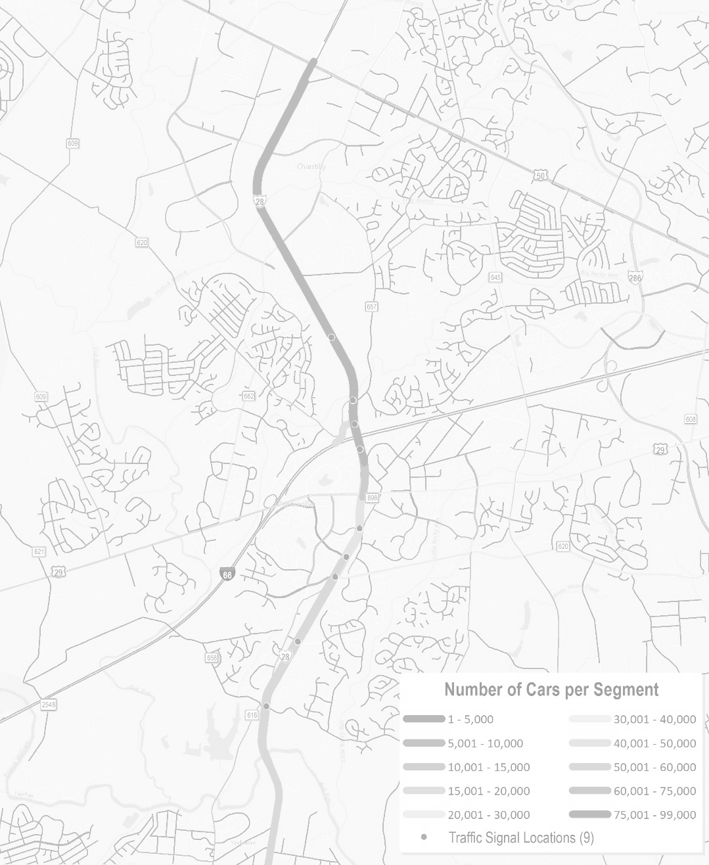
Key Challenge- Response Times
Population
Changing demographics
Daytime population
Urbanization
Density
Traffic congestion
Technology
Safety equipment – medical, personal protection
Communication – interoperability
Rescue – new construction, hybrid vehicles
Mandates/Standards
Safe Staffing
EMS
Natural Manmade Threats
Critical Infrastructure
Natural Disaster
Notes:
Added Cathi Schultz

Slide 6
FY 2017 County Budget Challenges
Revenue Estimate
Real estate base slow to recover
Major revenue categories projecting 2.3% growth
Disbursements
Disbursement growth anticipated to outpace revenue growth for next two fiscal years
Projected FY 2017 shortfall is $85 million
Taxes
Real estate taxes at current rate will not support disbursement level needed
Each penny of an increase would represent $23 million in revenue
Notes:
Added Cathi Schultz

Slide 7
FY 2017 Budget Challenges
Maintaining service levels with flat budget
Infrastructure
Aging facilities
Capital Equipment
Increasing Costs
Contractual Increases
Inflation
Raw Materials
Changing Safety/Technology Standards
Notes:
Added Cathi Schultz

Slide 8
System Response Statistics
 | FY11 | FY12 | FY13 | FY14 | FY15
Incidents | 89,412 | 91,228 | 90,205 | 91,308 | 95,364
Patients Transported | 47,840 | 48,990 | 49,739 | 48,966 | 51,425

Slide 9
System Performance Measures
AED Response rate within 5 minutes (National Standard 90%)
54.57% (FY15)
First ALS Provider within 5 minutes
58.26% (FY15)
ALS Transport Unit On Scene within 9 minutes (National Standard 90%)
89.95% (FY15)
Engine Company on a structure Fire within 5 minutes, 20 seconds (National Standard 90%)
51.9% (FY15)
15 Operational Personnel on a structure fire within 9 minutes, 20 seconds (National Standard 90%)*
83.18 % (FY15)
Total Fire Loss for commercial and residential structures (in millions)
15.9 (FY15)

Slide 10
Sully District
 | CY2010 | CY2011 | CY2012 | CY2013 | CY2014 | CY2015*
Incidents | 7,745 | 8,706 | 8,585 | 8,366 | 8,700 | 8,607
Average Incidents per Day | 21.2 | 23.9 | 23.5 | 22.9 | 23.8 | 25.8
* CY2015 includes all incidents through the end of November 2015

Slide 11
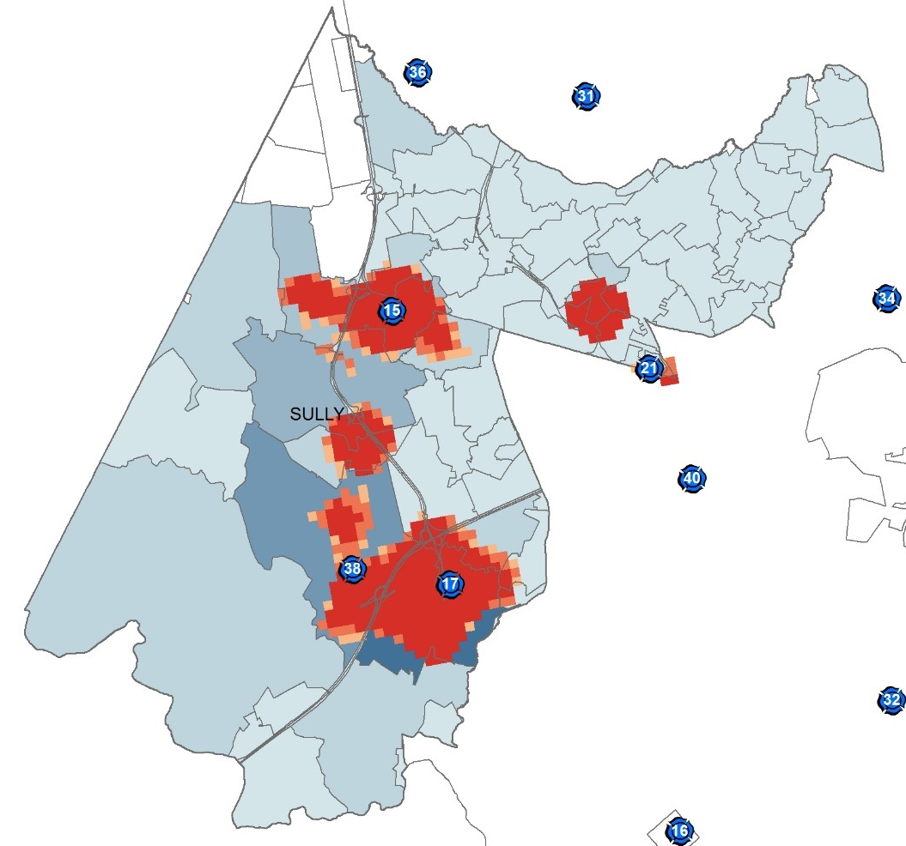
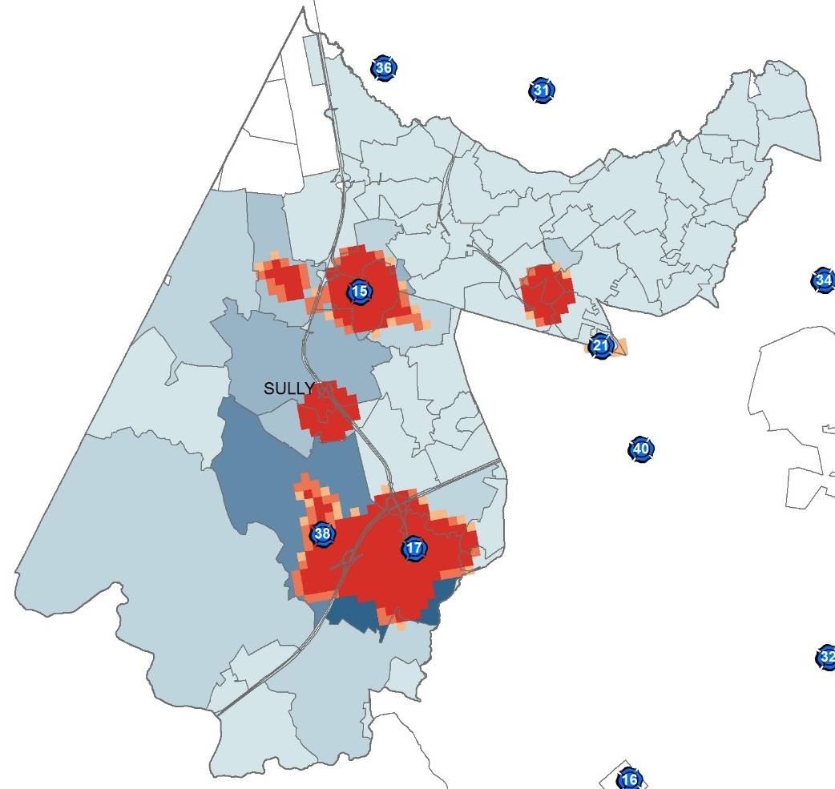
Sully District: Incident Hot Spots
Calendar Year 2010
Calendar Year 2015

Slide 12
Sully District: EMS Events
Average number of dispatched EMS Incidents since 2010 have increased from approximately 434 EMS incidents per month to 546 incidents per month
Event Type | 2010 | 2015* | Changes
ALS | 2,730 | 3,057 | ↑ 327
BLS | 1,343 | 1,494 | ↑ 151
Accidents (MVA) | 761 | 920 | ↑ 159
Overdoses | 149 | 234 | ↑ 85
CPR | 92 | 136 | ↑ 44
Medical Alert Alarm | 48 | 104 | ↑ 56
Interfacility Transport | 34 | 20 | ↓ 14
Suicide Attempt | 20 | 19 | ↓ 1
Stabbing, Shooting or Assault | 17 | 15 | ↓ 2
Carbon Monoxide Poisoning | 10 | 3 | ↓ 7
Drowning | 1 | 1 | ↔ 0
* CY2015 includes all incidents through the end of November 2015

Slide 13
Sully District: Fire Events
Average number of dispatched Fire Incidents since 2010 have increased from approximately 170 Fire incidents per month to 184 incidents per month.
Event Type | 2010 | 2015* | Changes
Fire Alarm | 1,298 | 1,287 | ↓
Fire | 376 | 291 | ↓
Investigation | 179 | 212 | ↑
Gas leaks | 124 | 135 | ↑
Odor of smoke | 41 | 49 | ↑
Wires down/Arcing | 35 | 28 | ↓
Other Events ** | 23 | 27 | ↑
* CY2015 includes all incidents through the end of November 2015

Slide 14
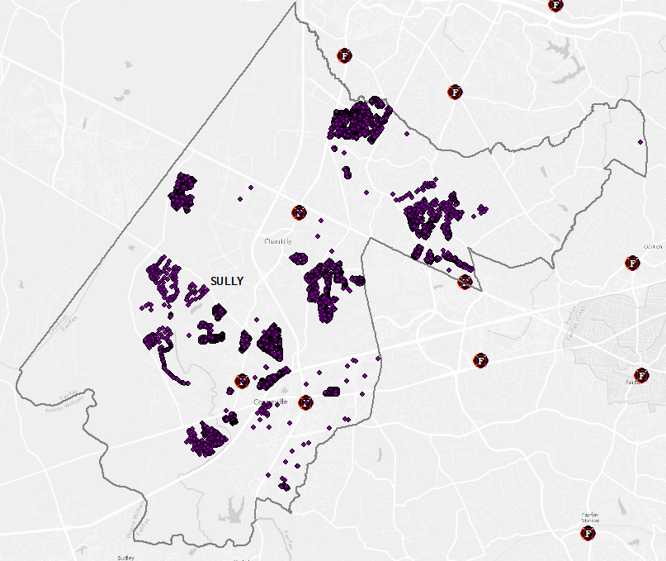
Sully District: SIOC
In 2015 the fire and rescue department started electronically and geospatially collecting data on which houses have been visited with the Safety in our community program.
4,990 homes were visited during the 2015 SIOC season in the Sully district
614 smoke alarms were installed in the Sully district
480 Files of Life were distributed in the Sully district
* CY2015 includes all incidents through the end of November 2015

Slide 15
Fairfax County Fire and Rescue
Questions?

